Slide 1
Outline
Introduction
Background
Distributed Database Design
  Fragmentation
  Data distribution
Database Integration
Semantic Data Control
Distributed Query Processing
Multidatabase Query Processing
Distributed Transaction Management
Data Replication
Parallel Database Systems
Distributed Object DBMS
Peer-to-Peer Data Management
Web Data Management
Current Issues

Slide 2
Design Problem
Design of Distributed Systems:
  Making decisions about the placement of data and programs across the sites of a computer network as well as possibly designing the network itself.
In Distributed DBMS, the placement of applications entails
  placement of the distributed DBMS software; and
  placement of the applications that run on the database

Slide 3
Dimensions of the Problem
- Framework of Distribution
Behavior of access patterns
partial
information
dynamic
static
complete
information
Data sharing
Level of knowledge about user access patterns
Data + program sharing
Level of sharing

Slide 4
Distribution Design
Top-down
  mostly in designing systems from scratch
  mostly in homogeneous systems
Bottom-up
  when the databases already exist at a number of sites

Slide 5
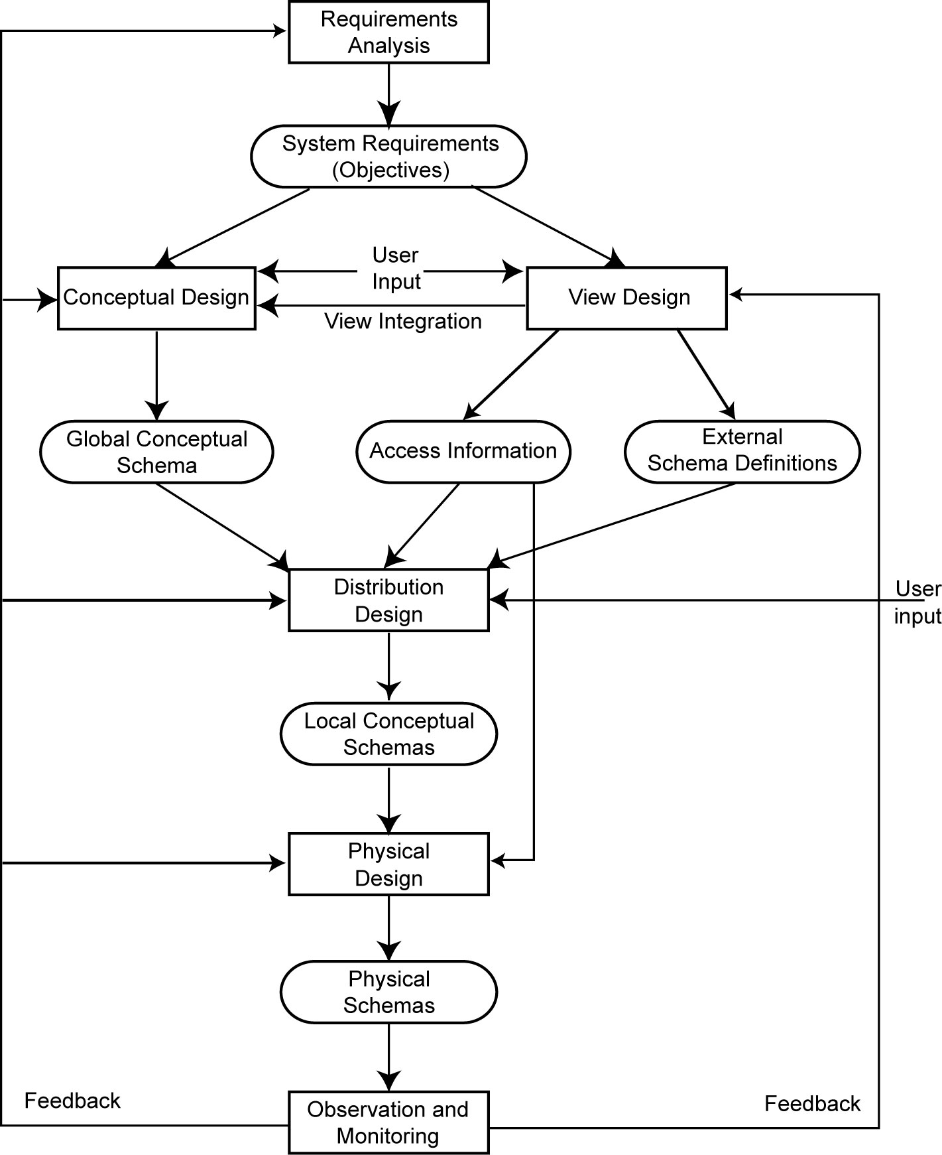
Top-Down Design process
Distribution Design:
To design the local conceptual
schemas (LCSs) by distributing the entities over the sites of the distributed system

Slide 6
Distribution Design Issues
Why fragment at all?
How to fragment?
How much to fragment?
How to test correctness?
How to allocate?
Information requirements (What information are needed for fragmentation and allocation?)

Slide 7
Fragmentation considerations
Can't we just distribute relations?
What is a reasonable unit of distribution?
  Relation? A relation is not the appropriate unit of distribution.
    Reason 1: User views are subsets of relations ➔locality (storing views locally, and not the entire relation)
    Reason 2: Replicated relations or not? ➔ extra communication vs difficulty of updates
      Reason 3: Decomposition of a relation into fragments, each being treated as a unit, permits a number of transactions to execute concurrently ➔ parallel query processing

Slide 8
Fragmentation
Fragmentation of relations into fragments (sub-relations)
  Fragmentation of relations typically results in the parallel execution of a single query by dividing it into a set of subqueries that operate on fragments (i.e., intraquery concurrency)
  Fragmentation typically increases the level of concurrency and therefore the system throughput.
  Pros vs Cons?
  + concurrent execution of a number of transactions that access different portions of a relation
  - views that cannot be defined on a single fragment will require extra processing
  - semantic data control (especially integrity enforcement) more difficult

Slide 9
Fragmentation Alternatives
– Horizontal
PROJ
PROJ₁ : projects with budgets less than $200,000
PROJ₂ : projects with budgets greater than or equal to $200,000
PNO
PNAME
BUDGET
LOC
P1
Instrumentation
150000
Montreal
P2
Database Develop.
135000
New York
P3
CAD/CAM
250000
New York
P4
Maintenance
310000
Paris
P5
CAD/CAM
500000
Boston
PROJ₁
PROJ₂
PNO
PNAME
BUDGET
LOC
PNO
PNAME
BUDGET
LOC
P1
Instrumentation
150000
Montreal
P3
CAD/CAM
250000
New York
P2
Database Develop.
135000
New York
P4
Maintenance
310000
Paris
P5
CAD/CAM
500000
Boston

Slide 10
Fragmentation Alternatives
– Vertical
PROJ
PROJ₁: information about project budgets
PROJ₂: information about project names and locations
PNO
PNAME
BUDGET
LOC
P1
Instrumentation
150000
Montreal
P2
Database Develop.
135000
New York
P3
CAD/CAM
250000
New York
P4
Maintenance
310000
Paris
P5
CAD/CAM
500000
Boston
PROJ₁
PROJ₂
PNO
BUDGET
PNO
PNAME
LOC
P1
150000
P1
Instrumentation
Montreal
P2
135000
P2
Database Develop.
New York
P3
250000
P3
CAD/CAM
New York
P4
310000
P4
Maintenance
Paris
P5
500000
P5
CAD/CAM
Boston

Slide 11
Degree of Fragmentation
finite number of alternatives
Individual tuples
or attributes
Subsets of tuples
or attributes
Whole
relations
Fragmentation affects the performance of query execution.
Finding the suitable level of partitioning within the range (with respect to the database applications)

Slide 12
Correctness of Fragmentation
- three rules concerning fragmentation
R1: Completeness
  Decomposition of relation R into fragments R₁, R₂, ..., R_{n} is complete
  if and only if each data item in R can also be found in some R_{i, 1 ≤ i ≤ n}
R2: Reconstruction (or Reconstructability)
  If relation R is decomposed into fragments R₁, R₂, ..., R_{n}, then there should exist some relational operator ∇ such that
        R = ∇_{1 ≤ i ≤ n} R_{i}
R3: Disjointness
  If relation R is horizontally decomposed into fragments R₁, R₂, ..., R_{n}, and data item d_{i} is in R_{j}, then d_{i} should not be in any other fragment R_{k} (k ≠ j ).

Slide 13
Allocation Alternatives
Non-replicated
  partitioned : each fragment resides at only one site
Replicated
  fully replicated : each fragment at each site
  partially replicated : each fragment at some of the sites
The decision regarding replication is a trade-off (depending on the ratio of the read-only queries to the update queries).
Q: Correct or not? →

Slide 14
Comparison of Replication Alternatives
Full-replication
Partial-replication
Partitioning
QUERY
PROCESSING
-
-
+
Easy
Same Difficulty
-
-
DIRECTORY
MANAGEMENT
+
Easy or
Non-existant
Same Difficulty
CONCURRENCY
CONTROL
+
Moderate
-
Difficult
+
Easy
RELIABILITY
+
Very high
+
High
-
Low
REALITY
Possible
application
Realistic
Possible
application

Slide 15
Information Requirements
When making decisions about distribution design, various factors ought to be considered in order to deliver “optimal” design.
  Database information
  Application information
  Communication network information
  Computer system information

Slide 16
Fragmentation
Horizontal Fragmentation (HF)
  Primary Horizontal Fragmentation (PHF)
    - the partitioning of a relation that results from predicates being defined on the relation itself
  Derived Horizontal Fragmentation (DHF)
    - the partitioning of a relation that results from predicates being defined on another relation (e.g., the parent relation)
Vertical Fragmentation (VF)
Hybrid Fragmentation (HF)

Slide 17
Information Requirements
Database Information
  Global conceptual schema
  Relationship
  owner/source/parent(L1) → SKILL
  member/target/child(L1) → EMP
Q: Where is the foreign key located?
the Referential Integrity constraint
  Cardinality of each relationship: card(R), the number of rows in R
  ≠ cardinality constraint of a relationship: one-to-many, many-to-many, one-to-one
SKILL
TITLE, SAL
L₁
EMP
PROJ
ENO, ENAME, TITLE
PNO, PNAME, BUDGET, LOC
ASG
ENO, PNO, RESP, DUR

Slide 18
Information Requirements
Application Information
  simple predicates : Given a relation R[A₁, A₂, …, A_{n}], a simple predicate p_{j} is
    p_{j} : A_{i} θ Value
  where θ ∈ {=,<,≤,>,≥,≠}, Value ∈ D_{i} and D_{i} is the domain of A_{i}.
  For relation R we define a set of predicates Pr = {p₁, p₂, …,p_{m}}
  Example :
      p₁: PNAME = "Maintenance"
      p₂ : BUDGET ≤ 200000

Slide 19
Information Requirements
Application Information
  minterm predicates (i.e., conjunction of simple predicates)
  Given a relation R and a set Pr = {p₁, p₂, …,p_{m}} of simple predicates,
  define the set of minterm predicates M = {m₁, m₂, …, m_{r}} as
  M = { m_{i} | m_{i} = ∧_{pj∈Pr} p_{j}* }, 1≤j≤m, 1≤i≤z
  where p_{j}* = p_{j} or p_{j}* = ¬(p_{j}).
  ‘Minterm’ means product (AND)
  e.g., Pr = {p1, p2}
  M = {p1 ^ p2, p1 ^ not p2, not p1 ^ p2, not p1 ^ not p2}
Notes:
From section 2.1:
First-order predicate calculus is based on a symbol alphabet that consists of
(1) variables, constants, functions, and predicate symbols; (2) parentheses; (3) the
logical connectors ^ (and), _ (or), ¬ (not), ->(implication), and <-> (equivalence);
and (4) quantifiers 8 (for all) and 9 (there exists). A term is either a constant or a
variable. Recursively, if f is an n-ary function and t1; : : : ; tn are terms, f (t1; : : : ; tn)
is also a term. An atomic formula is of the form P(t1; : : : ; tn), where P is an n-ary
predicate symbol and the ti’s are terms. A well-formed formula (wff ) can be defined
recursively as follows: If wi and wj are wffs, then (wi); :(wi); (wi)^(wj); (wi)_
(wj); (wi)!(wj), and (wi)$(wj) are all wffs. Variables in a wff may be free or
they may be bound by one of the two quantifiers.

Slide 20
Information Requirements
Example
  m₁: PNAME="Maintenance" ∧ BUDGET≤200000
  m₂: NOT(PNAME="Maintenance") ∧ BUDGET≤200000
  m₃: PNAME= "Maintenance" ∧ NOT(BUDGET≤200000)
  m₄: NOT(PNAME="Maintenance") ∧ NOT(BUDGET≤200000)

Slide 21
Information Requirements
Application Information - quantitative information
  minterm selectivities: sel(m_{i})
    The number of tuples of the relation that would be accessed by a user query which is specified according to a given minterm predicate m_{i}.
    Q: sel(m₁)? sel(m₂)?
  access frequencies: acc(q_{i})
    The frequency with which a user application qi accesses data.
    Access frequency for a minterm predicate can also be defined.

Slide 22
Primary Horizontal Fragmentation (PHF)
Definition :
      R_{j} = σ_{Fj}(R), 1 ≤ j ≤ w
  where F_{j} is a selection formula, which is (preferably) a minterm predicate.
Therefore,
  A horizontal fragment R_{i} of relation R consists of all the tuples of R which satisfy a minterm predicate m_{i}.
⬇
  Given a set of minterm predicates M, there are as many horizontal fragments of relation R as there are minterm predicates.
  Set of horizontal fragments also referred to as minterm fragments.

Slide 23
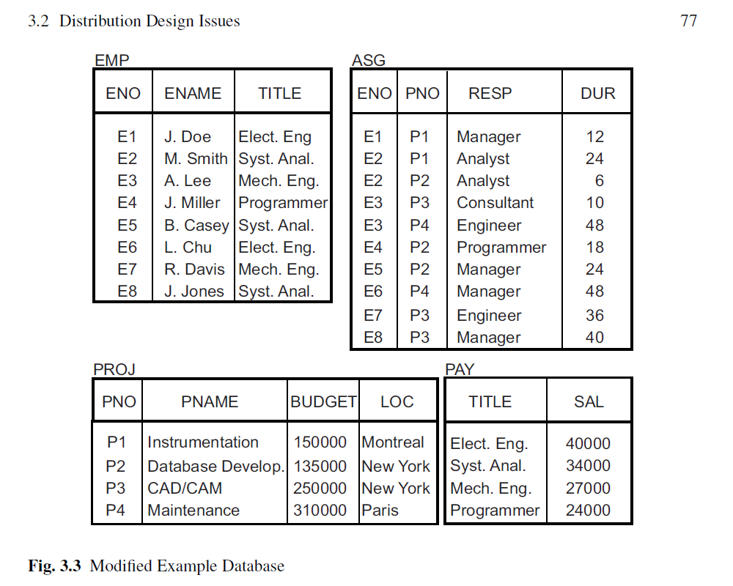
Modified Example Database

Slide 24
PHF – Algorithm
Given: A relation R, the set of simple predicates Pr
Output: The set of fragments of R = {R₁, R₂,…,R_{w}} which obey the fragmentation rules.
Preliminaries :
  Pr should be complete
  Pr should be minimal

Slide 25
Completeness of Simple Predicates
A set of simple predicates Pr is said to be complete if and only if the accesses to the tuples of the minterm fragments defined on Pr requires that two tuples of the same minterm fragment have the same probability of being accessed by any application.
Example :
  Assume PROJ[PNO,PNAME,BUDGET,LOC] has two applications defined on it.
    Find the budgets of projects at each location. (app 1)
    Find projects with budgets less than $200000. (app 2)

Slide 26
Completeness of Simple Predicates
According to (1),
  Pr={LOC=“Montreal”, LOC=“New York”, LOC=“Paris”}
which is not complete with respect to (2).
Check the resulted fragments next:

Slide 27
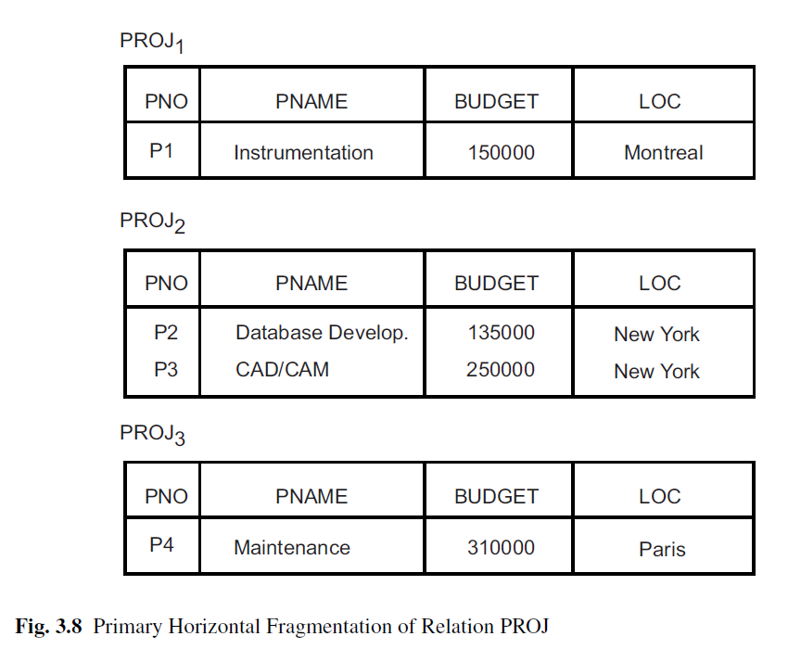

Slide 28
Completeness of Simple Predicates
Modify
  Pr ={LOC=“Montreal”, LOC=“New York”, LOC=“Paris”, BUDGET≤200000, BUDGET>200000}
which is complete.
EX: Show the resulting fragments of PROJ that will be produced out of this modified Pr.

Slide 29
Minimality of Simple Predicates
Minimality: If a predicate influences how fragmentation is performed, (i.e., causes a fragment f to be further fragmented into, say, f_{i} and f_{j}) then there should be at least one application that accesses f_{i} and f_{j} differently.
In other words, the simple predicate should be relevant in determining a fragmentation.
If all the predicates of a set Pr are relevant, then Pr is minimal.
Note: correct the error of the formula on p.88

Slide 30
Minimality of Simple Predicates
Example :
  Pr ={LOC=“Montreal”, LOC=“New York”, LOC=“Paris”,
    BUDGET≤200000, BUDGET>200000}
is minimal (in addition to being complete). However, if we add
  PNAME = “Instrumentation”
then Pr is not minimal.

Slide 31
COM_MIN Algorithm
Given: a relation R and a set of simple predicates Pr
Output: a complete and minimal set of simple predicates Pr' for Pr
Rule 1: a relation or fragment is partitioned into at least two parts which are accessed differently by at least one application.

Slide 32
COM_MIN Algorithm
Initialization :
  find a p_{i} ∈ Pr such that p_{i} partitions R according to Rule 1
  set Pr' = p_{i} ; Pr ←Pr – {p_{i}} ; F ← {f_{i}}
Iteratively add predicates to Pr' until it is complete
  find a p_{j} ∈ Pr such that p_{j} partitions some f_{k} defined according to minterm predicate over Pr' according to Rule 1
  set Pr' = Pr' ∪ {p_{i}}; Pr ←Pr – {p_{i}}; F ← F ∪ {f_{i}}
  if ∃p_{k} ∈ Pr' which is nonrelevant then
      Pr' ← Pr – {p_{i}}
      F ← F – {f_{i}}

Slide 33
PHORIZONTAL Algorithm
Makes use of COM_MIN to perform fragmentation.
Input: a relation R and a set of simple predicates Pr
Output: a set of minterm predicates M according to which relation R is to be fragmented
Pr' ← COM_MIN (R,Pr)
determine the set M of minterm predicates
determine the set I of implications among p_{i} ∈ Pr
eliminate the contradictory minterms from M

Slide 34
PHF – Example
Two candidate relations : PAY and PROJ.
Fragmentation of relation PAY
  Application: Check the salary info and determine raise.
  Employee records kept at two sites ⇒ application run at two sites
  Simple predicates
    p₁ : SAL ≤ 30000
    p₂ : SAL > 30000
    Pr = {p₁,p₂} which is complete and minimal Pr'=Pr
  Minterm predicates
    m₁ : (SAL ≤ 30000)
    m₂ : NOT(SAL ≤ 30000) = (SAL > 30000)

Slide 35
PHF – Example
PAY₁
PAY₂
TITLE
SAL
TITLE
SAL
Mech. Eng.
27000
Elect. Eng.
40000
Programmer
24000
Syst. Anal.
34000

Slide 36
PHF – Example
Fragmentation of relation PROJ
  Applications:
    Find the name and budget of projects given their no.
      Issued at three sites
    Access project information according to budget
      one site accesses ≤200000; the other accesses >200000
  Simple predicates
  For application (1)
    p₁ : LOC = “Montreal”
    p₂ : LOC = “New York”
    p₃ : LOC = “Paris”
  For application (2)
    p₄ : BUDGET ≤ 200000
    p₅ : BUDGET > 200000
  Pr = Pr' = {p₁,p₂,p₃,p₄,p₅}

Slide 37
PHF – Example
Fragmentation of relation PROJ continued
  Minterm fragments left after elimination
    m₁ : (LOC = “Montreal”) ∧ (BUDGET ≤ 200000)
    m₂ : (LOC = “Montreal”) ∧ (BUDGET > 200000)
    m₃ : (LOC = “New York”) ∧ (BUDGET ≤ 200000)
    m₄ : (LOC = “New York”) ∧ (BUDGET > 200000)
    m₅ : (LOC = “Paris”) ∧ (BUDGET ≤ 200000)
    m₆ : (LOC = “Paris”) ∧ (BUDGET > 200000)

Slide 38
PHF – Example
PROJ₁
PROJ₂
PNO
PNAME
BUDGET
LOC
PNO
PNAME
BUDGET
LOC
P1
Instrumentation
150000
Montreal
P2
Database
Develop.
135000
New York
PROJ₄
PROJ₆
PNO
PNAME
BUDGET
LOC
PNO
PNAME
BUDGET
LOC
P3
CAD/CAM
250000
New York
P4
Maintenance
310000
Paris

Slide 39
PHF – Correctness
Completeness
  Since Pr' is complete and minimal, the selection predicates are complete
Reconstruction
  If relation R is fragmented into F_{R} = {R₁,R₂,…,R_{r}}
        R = ∪_{∀Ri ∈FR} R_{i}
Disjointness
  Minterm predicates that form the basis of fragmentation should be mutually exclusive.

Slide 40
Derived Horizontal Fragmentation (DHF)
Defined on a member relation of a link according to a selection operation specified on its owner.
  Each link is an equijoin.
  Equijoin can be implemented by means of semijoins.
SKILL
TITLE,
SAL
L₁
EMP
PROJ
ENO, ENAME, TITLE
PNO, PNAME, BUDGET, LOC
L₂
L₃
ASG
ENO, PNO,
RESP, DUR

Slide 41
DHF – Definition
Given a link L where owner(L)=S and member(L)=R, the derived horizontal fragments of R are defined as
  R_{i} = R ⋉_{F} S_{i}, 1≤i≤w
where w is the maximum number of fragments that will be defined on R and
    S_{i} = σ_{Fi} (S)
where F_{i} is the formula according to which the primary horizontal fragment S_{i} is defined.

Slide 42
DHF – Example
Given link L₁ where owner(L₁)=SKILL and member(L₁)=EMP
    EMP₁ = EMP ⋉ SKILL₁
    EMP₂ = EMP ⋉ SKILL₂
where
    SKILL₁ = σ_{SAL≤30000}(SKILL)
    SKILL₂ = σ_{SAL>30000}(SKILL)
EMP₂
EMP₁
ENO
ENAME
TITLE
ENO
ENAME
TITLE
E1
J. Doe
Elect. Eng.
E2
M. Smith
Syst. Anal.
E3
A. Lee
Mech. Eng.
E5
B. Casey
Syst. Anal.
E4
J. Miller
Programmer
E6
L. Chu
Elect. Eng.
E7
R. Davis
Mech. Eng.
E8
J. Jones
Syst. Anal.

Slide 43
DHF – Correctness
Completeness
  Referential integrity
  Let R be the member relation of a link whose owner is relation S which is fragmented as F_{S} = {S₁, S₂, ..., S_{n}}. Furthermore, let A be the join attribute between R and S. Then, for each tuple t of R, there should be a tuple t' of S such that
      t[A] = t' [A]
Reconstruction
  Same as primary horizontal fragmentation.
Disjointness
  Simple join graphs between the owner and the member fragments.

Slide 44
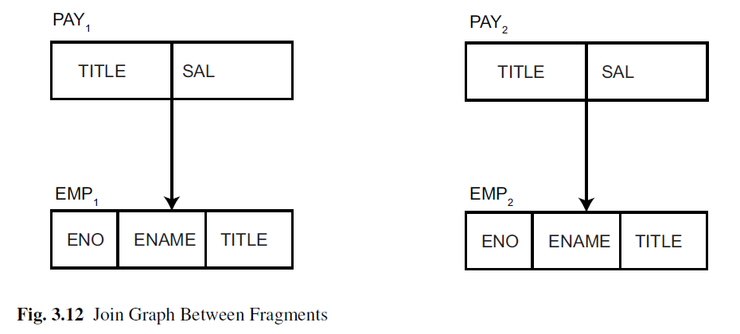
Simple Join Graphs
In a simple graph, there exists only one link coming in or going out of a fragment.
PAY₁
PAY₂
TITLE
SAL
TITLE
SAL
Mech. Eng.
27000
Elect. Eng.
40000
Programmer
24000
Syst. Anal.
34000
EMP₂
EMP₁
ENO
ENAME
TITLE
ENO
ENAME
TITLE
E1
J. Doe
Elect. Eng.
E3
A. Lee
Mech. Eng.
E2
M. Smith
Syst. Anal.
E4
J. Miller
Programmer
E5
B. Casey
Syst. Anal.
E7
R. Davis
Mech. Eng.
E6
L. Chu
Elect. Eng.
E8
J. Jones
Syst. Anal.

Slide 45
Lessons learned about DHF
Derived fragmentation may follow a chain where one relation is fragmented as a result of another one’s design and it, in turn, causes the fragmentation of another relation (e.g., the chain PAY → EMP → ASG).
Typically, there will be more than one candidate fragmentation for a relation (e.g., relation ASG). The final choice of the fragmentation scheme may be a decision problem addressed during allocation.

Slide 46
Vertical Fragmentation
Has been studied within the centralized context
  design methodology
  physical clustering
More difficult than horizontal, because more alternatives exist.
Two approaches :
  grouping
    attributes to fragments
  splitting
    relation to fragments

Slide 47
Vertical Fragmentation
Overlapping fragments
  grouping
Non-overlapping fragments
  splitting
We do not consider the replicated key attributes to be overlapping.
Advantage:
  Easier to enforce functional dependencies
  (for integrity checking etc.)

Slide 48
VF – Information Requirements
Application Information
  Attribute affinities
    a measure that indicates how closely related the attributes are
    This is obtained from more primitive usage data
  Attribute usage values
    Given a set of queries Q = {q₁, q₂,…, q_{q}} that will run on the relation R[A₁, A₂,…, A_{n}],
    use(q_{i},•) can be defined accordingly
⎧
1 if attribute A_{j} is referenced by query q_{i}
use(q_{i},A_{j}) =
⎨
⎩
0 otherwise

Slide 49
VF – Definition of use(q_{i},A_{j})
Consider the following 4 queries for relation PROJ
q₁: SELECT BUDGET q₂: SELECT PNAME,BUDGET
FROM PROJ FROM PROJ
WHERE PNO=Value
q₃: SELECT PNAME q₄: SELECT SUM(BUDGET)
FROM PROJ FROM PROJ
WHERE LOC=Value WHERE LOC=Value
Let A₁= PNO, A₂= PNAME, A₃= BUDGET, A₄= LOC
A₁
A₂
A₃
A₄
q₁
1
0
1
0
q₂
0
1
1
0
q₃
0
1
0
1
q₄
0
0
1
1

Slide 50
VF – Affinity Measure aff(A_{i},A_{j})
The attribute affinity measure between two attributes A_{i} and A_{j} of a relation R[A₁, A₂, …, A_{n}] with respect to the set of applications Q = (q₁, q₂, …, q_{q}) is defined as follows :
∑
aff (A_{i}, A_{j}) =
(query access)
all queries that access A_{i} and A_{j}
∑
access
query access =
access frequency of a query ∗
execution
all sites

Slide 51
VF – Calculation of aff(A_{i}, A_{j})
S
S
S
1
2
3
Assume each query in the previous example accesses the attributes once during each execution.
Also assume the access frequencies
Then
  aff(A₁, A₃) = 15*1 + 20*1+10*1
  = 45
and the attribute affinity matrix AA is
q
15
20
10
1
q
5
0
0
2
q
25
25
25
3
q
3
0
0
4
A
A
A
A
1
2
3
4
A
45
0
45
0
1
A
0
80
5
75
2
A
45
5
53
3
3
A
0
75
3
78
4

Slide 52
VF – Clustering Algorithm
Take the attribute affinity matrix AA and reorganize the attribute orders to form clusters where the attributes in each cluster demonstrate high affinity to one another.
Bond Energy Algorithm (BEA) has been used for clustering of entities. BEA finds an ordering of entities (in our case attributes) such that the global affinity measure is maximized.
AM =
∑
∑
(affinity of A_{i} and A_{j} with their neighbors)
i
j

Slide 53
Bond Energy Algorithm
Input: The AA matrix
Output: The clustered affinity matrix CA which is a perturbation of AA
Initialization: Place and fix one of the columns of AA in CA.
Iteration: Place the remaining n-i columns in the remaining i+1 positions in the CA matrix. For each column, choose the placement that makes the most contribution to the global affinity measure.
Row order: Order the rows according to the column ordering.

Slide 54
Bond Energy Algorithm
“Best” placement? Define contribution of a placement:
  cont(A_{i}, A_{k}, A_{j}) = 2bond(A_{i}, A_{k})+2bond(A_{k}, A_{l}) –2bond(A_{i}, A_{j})
where
n
∑
aff(A_{z},A_{x})aff(A_{z},A_{y})
bond(A_{x},A_{y}) =
z =1

Slide 55
BEA – Example
Consider the following AA matrix and the corresponding CA matrix where A₁ and A₂ have been placed. Place A₃:
Ordering (0-3-1) :
  cont(A₀,A₃,A₁) = 2bond(A₀ , A₃)+2bond(A₃ , A₁)–2bond(A₀ , A₁)
  = 2* 0 + 2* 4410 – 2*0 = 8820
Ordering (1-3-2) :
  cont(A₁,A₃,A₂) = 2bond(A₁ , A₃)+2bond(A₃ , A₂)–2bond(A₁,A₂)
  = 2* 4410 + 2* 890 – 2*225 = 10150
Ordering (2-3-4) :
  cont (A₂,A₃,A₄) = 1780

Slide 56
BEA – Example
Therefore, the CA matrix has the form
When A₄ is placed, the final form of the CA matrix (after row organization) is
A₁
A₃
A₂
45
45
0
0
5
80
45
53
5
0
3
75
A₁
A₃
A₂
A₄
A₁
45
45
0
0
A₃
45
53
5
3
A₂
0
5
80
75
A₄
0
3
75
78

Slide 57
VF – Algorithm
How can you divide a set of clustered attributes {A₁, A₂, …, A_{n}} into two (or more) sets {A₁, A₂, …, A_{i}} and {A_{i}, …, A_{n}} such that there are no (or minimal) applications that access both (or more than one) of the sets.
A₁
A₂
A₃
…
A_{i}
A_{i+1}
. . .
A_{m}
A₁
A₂
. . .
TA
A_{i}
A_{i+1}
. . .
BA
A_{m}

Slide 58
VF – ALgorithm
Define
  TQ = set of applications that access only TA
  BQ = set of applications that access only BA
  OQ = set of applications that access both TA and BA
and
  CTQ = total number of accesses to attributes by applications that access only TA
  CBQ = total number of accesses to attributes by applications that access only BA
  COQ = total number of accesses to attributes by applications that access both TA and BA
Then find the point along the diagonal that maximizes
CTQ∗CBQ−COQ²

Slide 59
VF – Algorithm
Two problems :
Cluster forming in the middle of the CA matrix
  Shift a row up and a column left and apply the algorithm to find the “best” partitioning point
  Do this for all possible shifts
  Cost O(m²)
More than two clusters
  m-way partitioning
  try 1, 2, …, m–1 split points along diagonal and try to find the best point for each of these
  Cost O(2^{m})

Slide 60
VF – Correctness
A relation R, defined over attribute set A and key K, generates the vertical partitioning F_{R} = {R₁, R₂, …, R_{r}}.
Completeness
  The following should be true for A:
        A = ∪ A_{Ri}
Reconstruction
  Reconstruction can be achieved by
        R = ⋈_{K} R_{i}, ∀R_{i} ∈ F_{R}
Disjointness
  TID's are not considered to be overlapping since they are maintained by the system
  Duplicated keys are not considered to be overlapping

Slide 61
Hybrid Fragmentation
R
HF
HF
R₁
R₂
VF
VF
VF
VF
VF
R₁₁
R₁₂
R₂₁
R₂₂
R₂₃

Slide 62
Fragment Allocation
Problem Statement
  Given
      F = {F₁, F₂, …, F_{n}} fragments
      S ={S₁, S₂, …, S_{m}} network sites
      Q = {q₁, q₂,…, q_{q}} applications
  Find the "optimal" distribution of F to S.
Optimality
  Minimal cost
    Communication + storage + processing (read & update)
    Cost in terms of time (usually)
  Performance
    Response time and/or throughput
  Constraints
    Per site constraints (storage & processing)

Slide 63
Information Requirements
Database information
  selectivity of fragments
  size of a fragment
Application information
  access types and numbers
  access localities
Communication network information
  unit cost of storing data at a site
  unit cost of processing at a site
Computer system information
  bandwidth
  latency
  communication overhead

Slide 64
Allocation
File Allocation (FAP) vs Database Allocation (DAP):
  Fragments are not individual files
    relationships have to be maintained
  Access to databases is more complicated
    remote file access model not applicable
    relationship between allocation and query processing
  Cost of integrity enforcement should be considered
  Cost of concurrency control should be considered

Slide 65
Allocation – Information Requirements
Database Information
  selectivity of fragments
  size of a fragment
Application Information
  number of read accesses of a query to a fragment
  number of update accesses of query to a fragment
  A matrix indicating which queries updates which fragments
  A similar matrix for retrievals
  originating site of each query
Site Information
  unit cost of storing data at a site
  unit cost of processing at a site
Network Information
  communication cost/frame between two sites
  frame size

Slide 66
Allocation Model
General Form
min(Total Cost)
subject to
response time constraint
storage constraint
processing constraint
Decision Variable
1 if fragment F_{i} is stored at site S_{j}
x_{ij} =
0 otherwise

Slide 67
Allocation Model
∑
Total Cost
Storage Cost (of fragment F_{j} at S_{k})
Query Processing Cost (for one query)
  processing component + transmission component
query processing cost +
all queries
∑
∑
cost of storing a fragment at a site
all sites
all fragments
(unit storage cost at S_{k}) ∗ (size of F_{j}) ∗ x_{jk}

Slide 68
Allocation Model
Query Processing Cost
  Processing component
    access cost + integrity enforcement cost + concurrency control cost
  Access cost
  Integrity enforcement and concurrency control costs
    Can be similarly calculated
∑
∑
(no. of update accesses+ no. of read accesses) ∗
all sites
all fragments
x_{ij} ∗ local processing cost at a site

Slide 69
Allocation Model
Query Processing Cost
  Transmission component
    cost of processing updates + cost of processing retrievals
  Cost of updates
  Retrieval Cost
∑
∑
update message cost +
all sites
all fragments
∑
∑
acknowledgment cost
all sites
all fragments
∑
min
(cost of retrieval command +
all sites
all fragments
cost of sending back the result)

Slide 70
Allocation Model
Constraints
  Response Time
    execution time of query ≤ max. allowable response time for that query
  Storage Constraint (for a site)
  Processing constraint (for a site)
∑
storage requirement of a fragment at that site ≤
all fragments
storage capacity at that site
∑
processing load of a query at that site ≤
all queries
processing capacity of that site

Slide 71
Allocation Model
Solution Methods
  FAP is NP-complete
  DAP also NP-complete
Heuristics based on
  single commodity warehouse location (for FAP)
  knapsack problem
  branch and bound techniques
  network flow

Slide 72
Allocation Model
Attempts to reduce the solution space
  assume all candidate partitionings known; select the “best” partitioning
  ignore replication at first
  sliding window on fragments

