Slide 1
Outline
Introduction
Background
  Relational database systems
  Computer networks
Distributed Database Design
Database Integration
Semantic Data Control
Distributed Query Processing
Multidatabase Query Processing
Distributed Transaction Management
Data Replication
Parallel Database Systems
Distributed Object DBMS
Peer-to-Peer Data Management
Web Data Management
Current Issues

Slide 2
Relational Model
Relation
  A relation R with attributes A = {A₁, A₂, …, A_{n}} defined over n domains D = {D₁, D₂, ..., D_{n}} (not necessarily distinct) with values {Dom₁, Dom₂, ..., Dom_{n}} is a finite, time varying set of n-tuples ⟨d₁, d₂, ..., d_{n}⟩ such that d₁ ∈Dom₁, d₂ ∈ Dom₂, ..., d_{n} ∈ Dom_{n}, and A₁ ⊆ D₁, A₂ ⊆ D₂, ..., A_{n} ⊆ D_{n}.
    _{NOTE: Each} Di is a domain name (such as EmployeeID), while each Dom_{i is a set of values for} Di (for example, the set {00000, 00001, …, 99999} )
  Notation: R(A₁, A₂, …, A_{n}) or R(A₁: D₁, A₂: D₂, …, A_{n}: D_{n})
  Alternatively, given R as defined above, an instance of it at a given time is a set of n-tuples (aka tuples):
  {⟨A₁: d₁, A₂: d₂, …, A_{n}: d_{n}⟩ | d₁ ∈ Dom₁, d₂ ∈ Dom₂, ..., d_{n} ∈ Dom_{n}}
Tabular structure of data where
  R is the table heading
  Attributes are table columns
  Each tuple is a row

Slide 3
Relation Schemes and Instances
Relation scheme
  A relation scheme is the definition of a relation
    - i.e., a set of attributes
  A relational database scheme is a set of relation schemes:
    i.e., a set of sets of attributes
Relation instance (simply relation)
  A relation is an instance of a relation scheme
  a relation r over a relation scheme R = {A₁, ..., A_{n}} is a subset of the Cartesian product of the domains of all attributes, i.e.,
    r ⊆ Dom₁ × Dom₂ × … × Dom_{n}

Slide 4
Domains
A domain is a type in the programming language sense
  Name: String
  Salary: Real
Domain values is a set of acceptable values for a variable of a given type.
  Name: CdnNames = {…},
  Salary: ProfSalary = {45,000 - 150,000}
  Simple/Composite domains
    Address = Street name + street number + city + province + postal code
Domain compatibility
  Binary operations (e.g., comparison to one another, addition, etc.) can be performed on compatible domains.

Slide 5
Relation Schemes
EMP
ENO
ENAME
TITLE
SAL
PNO
RESP
DUR
PROJ
PNO
PNAME
BUDGET
EMP(ENO, ENAME, TITLE, SAL, PNO, RESP, DUR)
PROJ (PNO, PNAME, BUDGET)
Underlined attributes are relation keys (tuple identifiers).
Tabular form

Slide 6
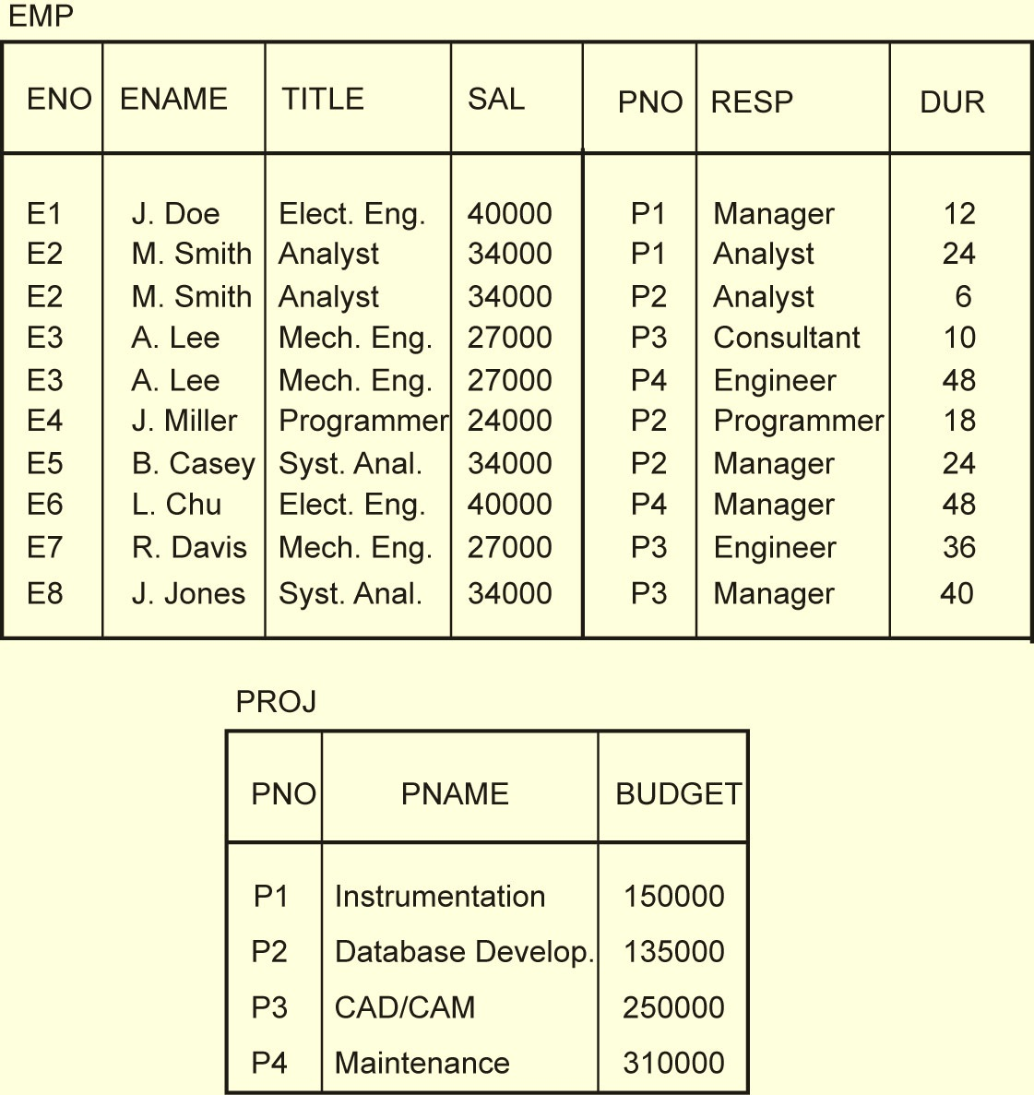
Example Relation Instances

Slide 7
Repetition Anomaly
The NAME, TITLE, SAL attribute values are repeated for each project that the employee is involved in.
Issues?
  Waste of space
  Complicates updates
EMP
ENO
ENAME
TITLE
SAL
PNO
RESP
DUR
E1
J. Doe
Elect. Eng.
40000
P1
Manager
12
E2
M. Smith
Analyst
34000
P1
Analyst
24
E2
M. Smith
Analyst
34000
P2
Analyst
6
E3
A. Lee
Mech. Eng.
27000
P3
Consultant
10
E3
A. Lee
Mech. Eng.
27000
P4
Engineer
48
E4
J. Miller
Programmer
24000
P2
Programmer
18
E5
B. Casey
Syst. Anal.
34000
P2
Manager
24
E6
L. Chu
Elect. Eng.
40000
P4
Manager
48
E7
R. Davis
Mech. Eng.
27000
P3
Engineer
36
E8
J. Jones
Syst. Anal.
34000
P3
Manager
40

Slide 8
Update Anomaly
If any attribute of project (say SAL of an employee) is updated, multiple tuples have to be updated to reflect the change.
EMP
ENO
ENAME
TITLE
SAL
PNO
RESP
DUR
E1
J. Doe
Elect. Eng.
40000
P1
Manager
12
E2
M. Smith
Analyst
34000
P1
Analyst
24
E2
M. Smith
Analyst
34000
P2
Analyst
6
E3
A. Lee
Mech. Eng.
27000
P3
Consultant
10
E3
A. Lee
Mech. Eng.
27000
P4
Engineer
48
E4
J. Miller
Programmer
24000
P2
Programmer
18
E5
B. Casey
Syst. Anal.
34000
P2
Manager
24
E6
L. Chu
Elect. Eng.
40000
P4
Manager
48
E7
R. Davis
Mech. Eng.
27000
P3
Engineer
36
E8
J. Jones
Syst. Anal.
34000
P3
Manager
40

Slide 9
Insertion Anomaly
A new employee cannot be inserted until he/she is assigned to at least one project.
A new project cannot be inserted until at least one employee is assigned to that new project.
EMP
ENO
ENAME
TITLE
SAL
PNO
RESP
DUR
E1
J. Doe
Elect. Eng.
40000
P1
Manager
12
E2
M. Smith
Analyst
34000
P1
Analyst
24
E2
M. Smith
Analyst
34000
P2
Analyst
6
E3
A. Lee
Mech. Eng.
27000
P3
Consultant
10
E3
A. Lee
Mech. Eng.
27000
P4
Engineer
48
E4
J. Miller
Programmer
24000
P2
Programmer
18
E5
B. Casey
Syst. Anal.
34000
P2
Manager
24
E6
L. Chu
Elect. Eng.
40000
P4
Manager
48
E7
R. Davis
Mech. Eng.
27000
P3
Engineer
36
E8
J. Jones
Syst. Anal.
34000
P3
Manager
40

Slide 10
Deletion Anomaly
If an engineer, who is the only employee on a project, leaves the company, his personal information cannot be deleted, or the information about that project is lost.
May have to delete many tuples in order to delete one employee or one project.
EMP
ENO
ENAME
TITLE
SAL
PNO
RESP
DUR
E1
J. Doe
Elect. Eng.
40000
P1
Manager
12
E2
M. Smith
Analyst
34000
P1
Analyst
24
E2
M. Smith
Analyst
34000
P2
Analyst
6
E3
A. Lee
Mech. Eng.
27000
P3
Consultant
10
E3
A. Lee
Mech. Eng.
27000
P4
Engineer
48
E4
J. Miller
Programmer
24000
P2
Programmer
18
E5
B. Casey
Syst. Anal.
34000
P2
Manager
24
E6
L. Chu
Elect. Eng.
40000
P4
Manager
48
E7
R. Davis
Mech. Eng.
27000
P3
Engineer
36
E8
J. Jones
Syst. Anal.
34000
P3
Manager
40

Slide 11
What to do?
Take each relation individually and “improve” it in terms of the desired characteristics.
  Normal forms
    A relation is in a certain normal form when it satisfies the condition associated with that normal form.
    Atomic values (1NF), i.e., no sets as values
    Can be defined according to keys and dependencies.
    Functional Dependencies ( 2NF, 3NF, BCNF)
    Multi-valued dependencies (4NF)
  Normalization
    a process of concept separation which applies a top-down methodology for producing a schema by subsequent refinements and decompositions.
    Do not combine unrelated sets of facts in one table; each relation should contain an independent set of facts.
    Universal relation assumption
    1NF to 3NF; 1NF to BCNF

Slide 12
Normalization Issues
How do we decompose a schema into a desirable normal form?
What criteria should the decomposed schemas follow in order to preserve the semantics of the original schema?
  Reconstructability: recover the original relation ⇒ no spurious joins
  Lossless decomposition: no information loss
  Dependency preservation: the constraints (i.e., dependencies) that hold on the original relation should be enforceable by means of the constraints (i.e., dependencies) defined on the decomposed relations.
What happens to queries?
  Processing time may increase due to joins
  Denormalization

Slide 13
Functional Dependence
Given relation R defined over U = {A₁, A₂, ..., A_{n}} where X ⊆ U, Y ⊆ U. If, for all pairs of tuples t₁ and t₂ in any legal instance of relation scheme R,
    t₁[X] = t₂[X] ⇒ t₁[Y] = t₂[Y],
then the functional dependency X → Y holds in R.
Example
  In relation EMP
    (ENO, PNO) → (ENAME, TITLE, SAL, DUR, RESP)
  In relation PROJ
    PNO → (PNAME, BUDGET)

Slide 14
2NF
A 1NF relation is in 2NF form if and only if
all of its non-prime attributes are functionally dependent on the whole of every candidate key.
That is, the relation does not have any non-prime attribute that is functionally dependent on any proper subset of any candidate key of the relation.
Q: Is Emp 2NF?
EMP
ENO
ENAME
TITLE
SAL
PNO
RESP
DUR
E1
J. Doe
Elect. Eng.
40000
P1
Manager
12
E2
M. Smith
Analyst
34000
P1
Analyst
24
E2
M. Smith
Analyst
34000
P2
Analyst
6
E3
A. Lee
Mech. Eng.
27000
P3
Consultant
10
E3
A. Lee
Mech. Eng.
27000
P4
Engineer
48
E4
J. Miller
Programmer
24000
P2
Programmer
18
E5
B. Casey
Syst. Anal.
34000
P2
Manager
24
E6
L. Chu
Elect. Eng.
40000
P4
Manager
48
E7
R. Davis
Mech. Eng.
27000
P3
Engineer
36
E8
J. Jones
Syst. Anal.
34000
P3
Manager
40

Slide 15
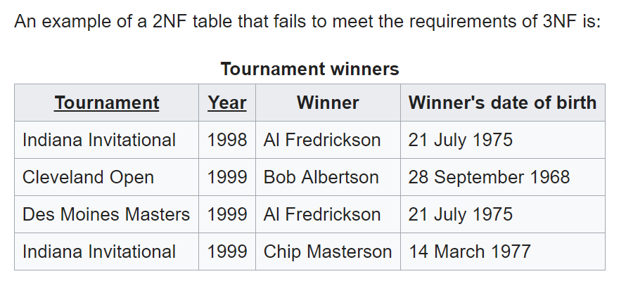
3NF
A relation R is in 3NF iff
  R is in 2NF, and
  No non-prime attributes is transitively dependent on any key. (That is, no non-prime attribute depends on other non-prime attributes. All the non-prime attributes must depend only on the keys.)

Slide 16
BCNF (or 3.5NF)
A relation R is in BCNF iff
  R is in 3NF, and
  for every one of its dependencies X → Y, at least one of the following conditions hold:
    X → Y is a trivial functional dependency (Y ⊆ X),
    X is a superkey for R.

Slide 17
Normal Forms Based on FDs
First Normal Form (1NF)
eliminate the partial functional dependencies of non-prime attributes to key attributes
Second Normal Form (2NF)
eliminate the transitive functional dependencies of non-prime attributes to key attributes
Third Normal Form (3NF)
eliminate the partial and transitive functional dependencies of prime (key) attributes to key.
Boyce-Codd Normal Form (BCNF)
Notes:
Animated slide

Slide 18
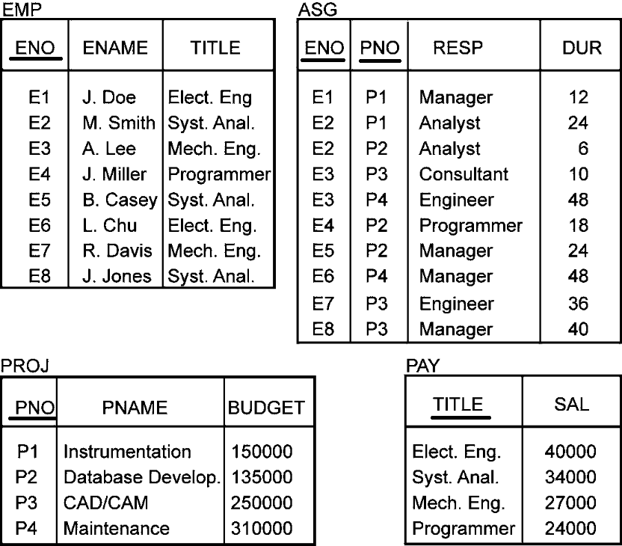
Normalized Relations – Example

Slide 19
Relational Algebra
Specify how to obtain the result using a set of operators
Form:
⟨Operator⟩_{⟨parameters⟩} ⟨Operands⟩ → ⟨Result⟩
↓ ↓
Relation (s) Relation

Slide 20
Relational Algebra Operators
Fundamental
  Selection
  Projection
  Union
  Set difference
  Cartesian product
Additional
  Intersection
  θ-join
  Natural join
  Semijoin
  Division
Union compatibility
  Same degree
  Corresponding attributes defined over the same domain

Slide 21
Selection
Produces a horizontal subset of the operand relation
General form
σ_{F}(R)={t |t∈R and F(t) is true}
where
  R is a relation, t is a tuple variable
  F is a formula consisting of
    operands that are constants or attributes
    arithmetic comparison operators
    <, >, =, ≠, ≤, ≥
    logical operators
    ∧, ∨, ¬

Slide 22
Selection Example
EMP
ENO
ENAME
TITLE
E1
J. Doe
Elect. Eng.
E2
M. Smith
Syst. Anal.
σ_{TITLE='Elect. Eng.'}(EMP)
E3
A. Lee
Mech. Eng.
ENO
ENAME
TITLE
E4
J. Miller
Programmer
E5
B. Casey
Syst. Anal.
E1
J. Doe
Elect. Eng
E6
L. Chu
Elect. Eng.
E6
L. Chu
Elect. Eng.
E7
R. Davis
Mech. Eng.
E8
J. Jones
Syst. Anal.

Slide 23
Projection
Produces a vertical slice of a relation
General form
Π_{A1,…,An}(R)={t[A₁,…, A_{n}] | t∈R}
where
  R is a relation, t is a tuple variable
  {A₁,…, A_{n}} is a subset of the attributes of R over which the projection will be performed
Note: projection can generate duplicate tuples. Commercial systems (and SQL) allow this and provide
  Projection with duplicate elimination
  Projection without duplicate elimination

Slide 24
Projection Example
PROJ
Π_{PNO,BUDGET}(PROJ)
PNO
PNAME
BUDGET
PNO
BUDGET
P1
Instrumentation
150000
P1
150000
P2
Database Develop.
135000
P2
135000
P3
CAD/CAM
250000
P3
250000
P4
Maintenance
310000
P4
310000

Slide 25
Union
Similar to set union
General form
R ∪ S={t | t ∈ R or t ∈ S}
where R, S are relations, t is a tuple variable
  Result contains tuples that are in R or in S, or in both (duplicates removed)
  R, S should be union-compatible

Slide 26
Set Difference
General Form
R – S = {t |t ∈ R and t ∉ S}
where R and S are relations, t is a tuple variable
  Result contains all tuples that are in R, but not in S.
  R – S ≠ S – R
  R, S union-compatible

Slide 27
Cartesian (Cross) Product
Given relations
  R of degree k_{1 ,} cardinality n₁
  S of degree k_{2 ,} cardinality n₂
Cartesian (cross) product:
R × S = {t [A₁,…,A_{k1}, A_{k1+1},…,A_{k1+k2}] | t[A₁,…,A_{k1}] ∈ R and t[A_{k1+1},…,A_{k1+k2}] ∈ S}
The result of R ⋅ S is a relation of degree (k₁+ k₂) and consists of all (n₁* n₂)-tuples where each tuple is a concatenation of one tuple of R with one tuple of S.

Slide 28
Cartesian Product Example
EMP
EMP × PAY
ENO
ENAME
TITLE
ENO
ENAME
EMP.TITLE
PAY.TITLE
SALARY
E1
J. Doe
Elect. Eng
E1
J. Doe
Elect. Eng.
Elect. Eng.
55000
E2
M. Smith
Syst. Anal.
E1
J. Doe
Elect. Eng.
Syst. Anal.
70000
E3
A. Lee
Mech. Eng.
E1
J. Doe
Elect. Eng.
Mech. Eng.
45000
E4
J. Miller
Programmer
E1
J. Doe
Elect. Eng.
Programmer
60000
E5
B. Casey
Syst. Anal.
E2
M. Smith
Syst. Anal.
Elect. Eng.
55000
E6
L. Chu
Elect. Eng.
E2
M. Smith
Syst. Anal.
Syst. Anal.
70000
E7
R. Davis
Mech. Eng.
E2
M. Smith
Syst. Anal.
Mech. Eng.
45000
E8
J. Jones
Syst. Anal.
E2
M. Smith
Syst. Anal.
Programmer
60000
E3
A. Lee
Mech. Eng.
Elect. Eng.
55000
PAY
E3
A. Lee
Mech. Eng.
Syst. Anal.
70000
E3
A. Lee
Mech. Eng.
Mech. Eng.
45000
TITLE
SALARY
E3
A. Lee
Mech. Eng.
Programmer
60000
Elect. Eng.
55000
E8
J. Jones
Syst. Anal.
Elect. Eng.
55000
Syst. Anal.
70000
E8
J. Jones
Syst. Anal.
Syst. Anal.
70000
Mech. Eng.
45000
E8
J. Jones
Syst. Anal.
Mech. Eng.
45000
Programmer
60000
E8
J. Jones
Syst. Anal.
Programmer
60000

Slide 29
Intersection
Typical set intersection
R ∩ S = {t | t ∈ R and t ∈ S}
= R – (R – S)
R, S union-compatible

Slide 30
θ−Join
General form:
R ⋈_{F(R.Ai, S.Bj)} S={t[A₁,…,A_{n},B₁,…,B_{m}] |
t[A₁,…,A_{n}] ∈ R and t[B₁,…,B_{m}] ∈ S
and F(R.A_{i}, S.B_{j}) is true}
where
  R, S are relations, t is a tuple variable
  F (R.A_{i}, S.B_{j})is a formula defined as that of selection.
A derivative of Cartesian product
  R ⋈_{F} S = σ_{F}(R × S)

Slide 31
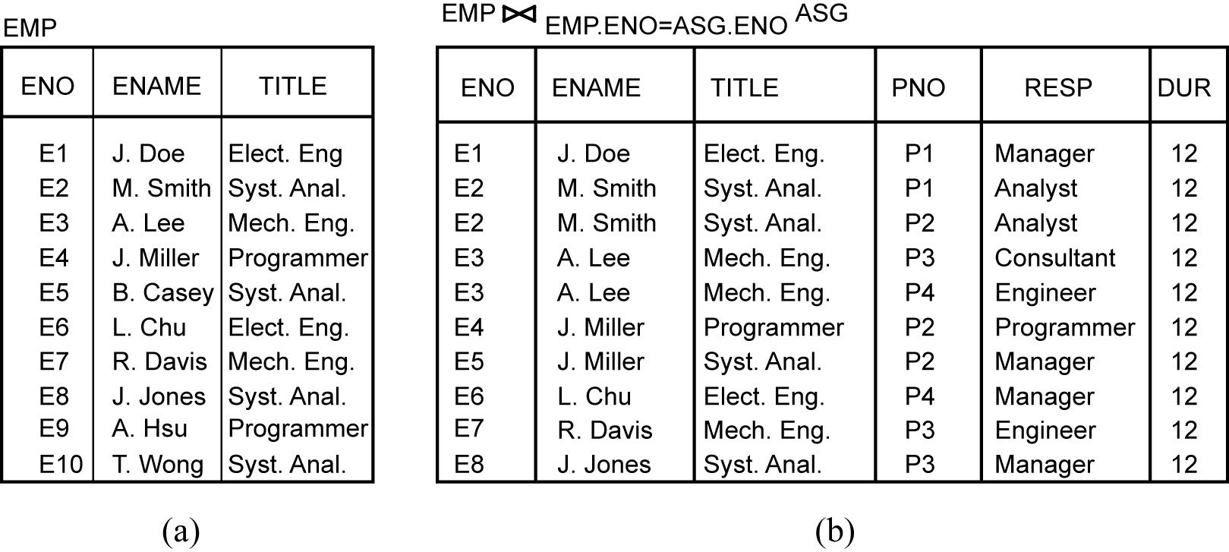
Join Example

Slide 32
Types of Join
Equi-join
  The formula F only contains equality
  R ⋈_{R.A=S.B} S
Natural join
  A special case of Equi-join
  Equi-join of two relations R and S over an attribute (or attributes) common to both R and S and projecting out one copy of those attributes
  R ⋈_{A} S = Π_{R∪S}σ_{F}(R × S), where F is R._{A} = S._{A}

Slide 33
Natural Join Example
EMP
EMP ⋈ PAY
ENO
ENAME
TITLE
ENO
ENAME
TITLE
SALARY
E1
J. Doe
Elect. Eng
E2
M. Smith
Syst. Anal.
E1
J. Doe
Elect. Eng.
55000
E3
A. Lee
Mech. Eng.
E2
M. Smith
Analyst
70000
E4
J. Miller
Programmer
E3
A. Lee
Mech. Eng.
45000
E5
B. Casey
Syst. Anal.
E6
L. Chu
Elect. Eng.
E4
J. Miller
Programmer
60000
E7
R. Davis
Mech. Eng.
E5
B. Casey
Syst. Anal.
70000
E8
J. Jones
Syst. Anal.
E6
L. Chu
Elect. Eng.
55000
PAY
E7
R. Davis
Mech. Eng.
45000
E8
J. Jones
Syst. Anal.
70000
TITLE
SALARY
Elect. Eng.
55000
Join is over the common attribute TITLE.
Syst. Anal.
70000
Mech. Eng.
45000
Programmer
60000

Slide 34
Types of Join
Outer-Join
  Ensures that tuples from one or both relations that do not satisfy the join condition still appear in the final result with other relation’s attribute values set to NULL
    Left outer join
    Right outer join
    Full outer join

Slide 35
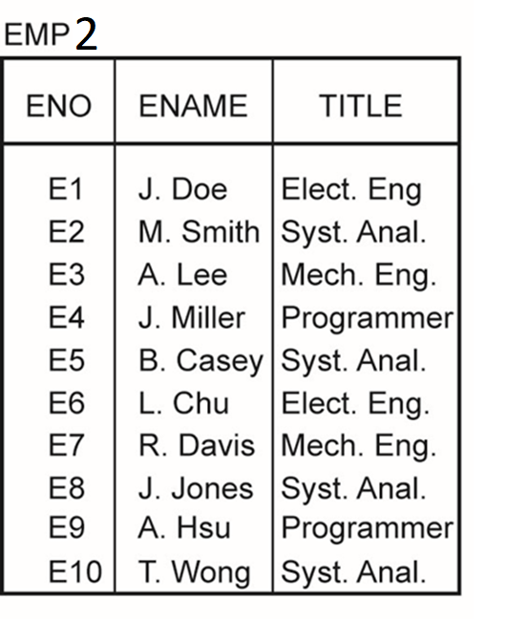
Outer Join Example
Left outer join:
Using EMP2
-- with two additional tuples added to the Emp

Slide 36
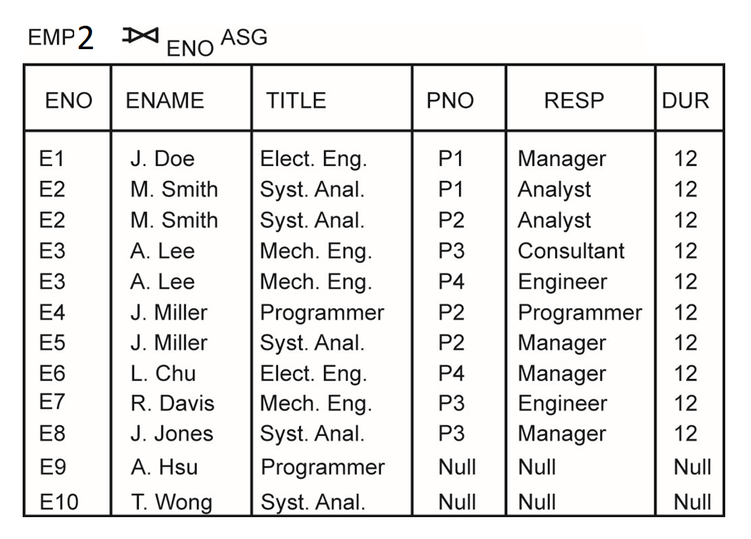
Outer Join Example
Left outer join result

Slide 37
Semijoin
Derivation
R ⋉_{F} S = Π_{A}(R ⋈_{F} S)
= Π_{A}(R) ⋈ Π_{A∩B}(S)
= R ⋈_{F} Π_{A∩B}(S)
where
  R, S are relations
  A is a set of attributes over which R is defined
i.e., After the semijoin, only attributes from R are included in the result.

Slide 38
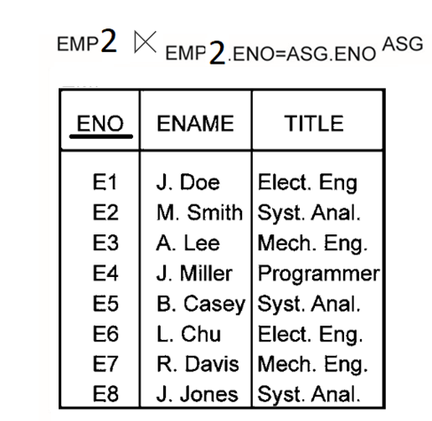
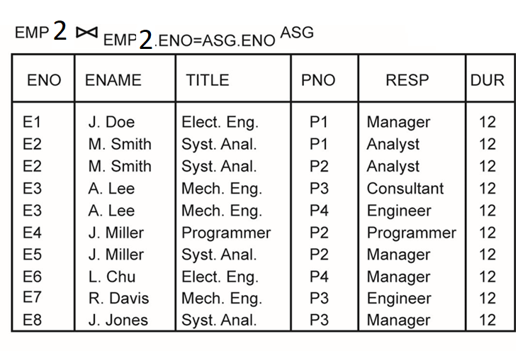
Semijoin vs Join Examples

Slide 39
Division (Quotient)
Given relations
  R of degree k₁ (R = {A₁,…,A_{k1}})
  S of degree k₂ (S = {B₁,…,B_{k2}})
  Let A = {A₁,…,A_{k1}} [i.e., R(A)] and B = {B₁,…,B_{k2}} [i.e., S(B)] and B ⊆ A.
  Then, T = R ÷ S gives T of degree k₁-k₂ [i.e., T(Y) where Y = A-B] such that for a tuple t to appear in T, the values in t must appear in R in combination with every tuple in S.
Derivation
  R ÷ S = Π_{Y}(R) – Π_{Y}((Π_{Y}(R) × S) – R)
  Where _{Y = A - B}

Slide 40
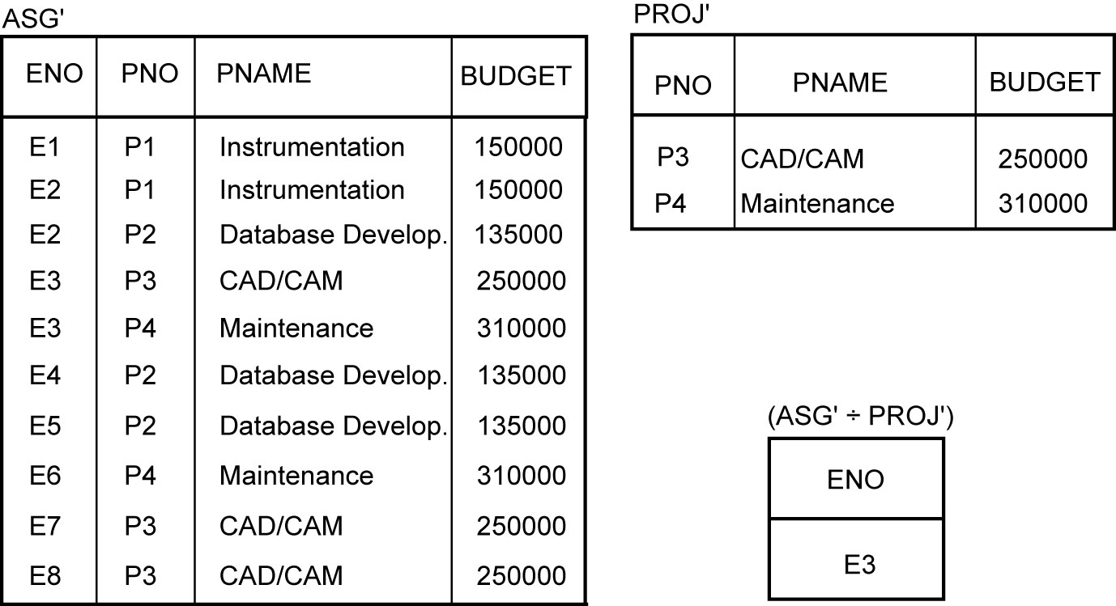
Division Example
The query: Find the employee numbers of those employees who are assigned to all the projects that have a budget greater than $200,000

Slide 41
Relational Calculus
Specify the properties that the result should hold
Declarative/what (as in Relational Calculus) vs procedural/how (as in Relational Algebra)
Two categories:
  Tuple relational calculus
  Domain relational calculus

Slide 42
Tuple Relational Calculus
Query of the form {t|F{t}} where
  t is a tuple variable
  F is a well-formed formula
Atomic formula
  Tuple-variable membership expressions
    R.t or R(t) : tuple t belongs to relation R
  Conditions
    s[A] θ t[B]; s and t are tuple variables, A and B are components of s and t, respectively, θ ∈ {<,>, =,≠, ≤, ≥}; e.g., s[SAL] > t[SAL]
    s[A] θ c; s, A, and θ as defined above, c is a constant; e.g., s[ENAME] = ‘Smith’
SQL is an example of tuple relational calculus (at least in its simple form)

Slide 43
SQL Examples
Query: “Find the names of employees working on the CAD/CAM project”
can be expressed as follows:
  SELECT EMP.ENAME
  FROM EMP,ASG,PROJ
  WHERE EMP.ENO = ASG.ENO
  AND ASG.PNO = PROJ.PNO
  AND PROJ.PNAME = "CAD/CAM"

Slide 44
SQL Examples
An Update Query: “Replace the salary of programmers by $25,000”
can be expressed as follows:
  UPDATE PAY
  SET SAL = 25000
  WHERE PAY.TITLE = "Programmer"

Slide 45
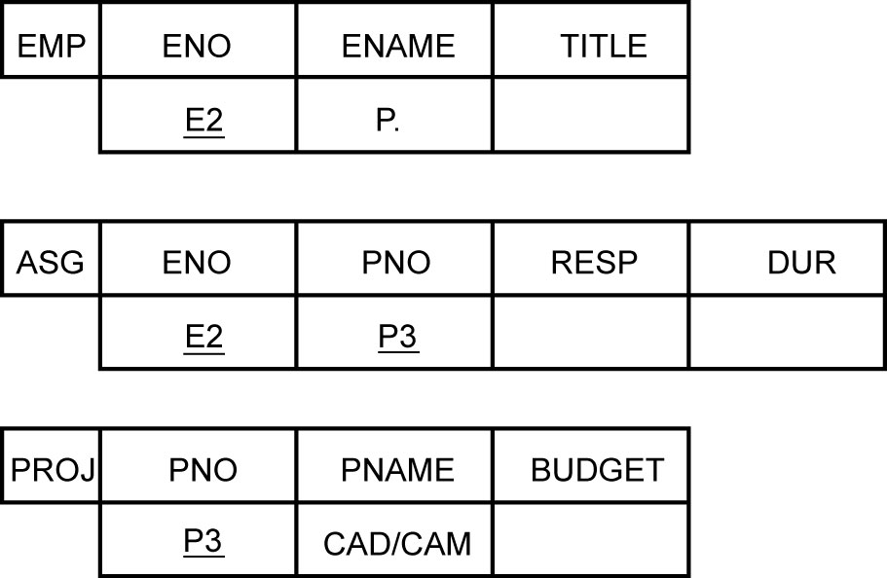
Domain Relational Calculus
Query of the form x₁, x₂, …, x_{n}|F(x₁, x₂, …, x_{n}) where
  F is a well-formed formula in which x₁, x₂, …, x_{n} are the free variables
QBE is an example

Slide 46
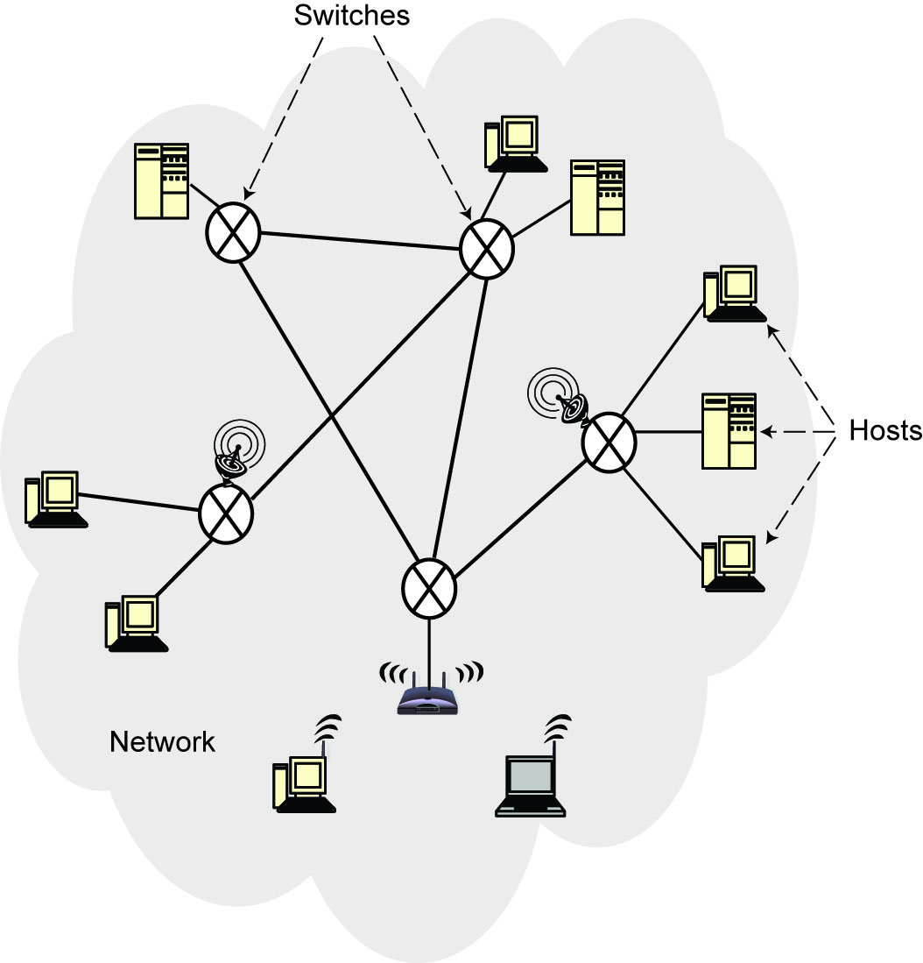
Computer Network
An interconnected collection of autonomous computers that are capable of exchanging information among themselves.
Components
  Hosts (nodes, end systems)
  Switches
  Communication link

Slide 47
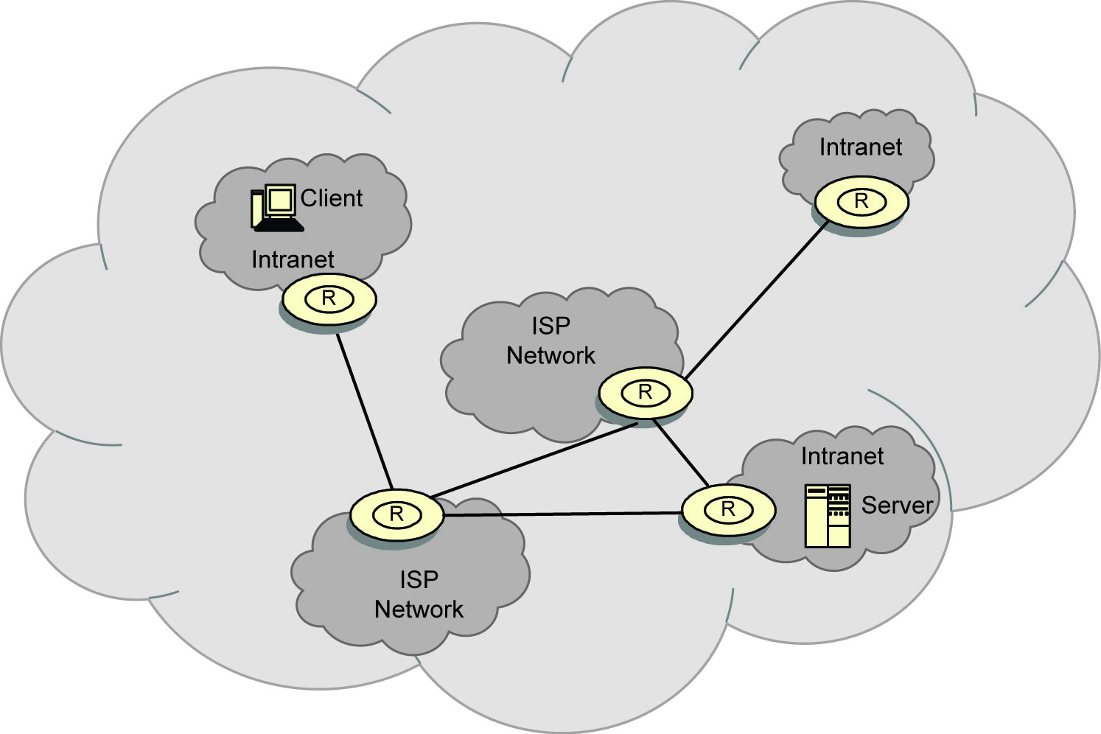
Internet
Network of networks

Slide 48
Types of Networks
According to scale (geographic distribution)
  Wide are network (WAN)
    Distance between any two nodes > 20km and can go as high as thousands of kms
    Long delays due to distance traveled
    Heterogeneity of transmission media
    Speeds of 150Mbps to 10Gbps (OC192 on the backbone)
  Local area network (LAN)
    Limited in geographic scope (usually < 2km)
    Speeds 10-1000 Mbps
    Short delays and low noise
  Metropolitan area network (MAN)
    In between LAN and WAN

Slide 49
Types of Networks (cont’d)
Topology
  Irregular: No regularity in the interconnection – e.g., Internet
  Bus:
    All workstations are connected in succession (a "bus" arrangement) on a single cable.
    All transmissions go to all the connected workstations.
    Each workstation then selects the transmissions it should receive based on the address information contained in the transmission.
    e.g., 10BASE5 (Standard Ethernet) and 10BASE2 (Thin Ethernet)
  Star:
    All attached workstations are wired directly to a central hub that establishes, maintains, and breaks connections between them (in the event of an error).
  e.g., 10BASE-T (Twisted-Pair Ethernet)

Slide 50
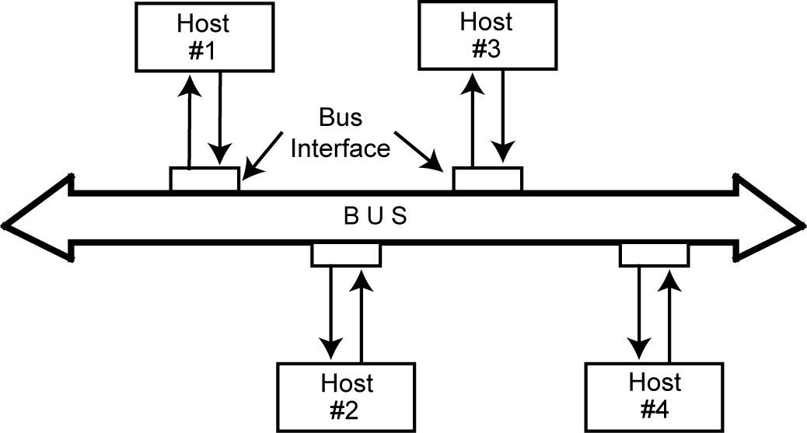
Bus network

Slide 51
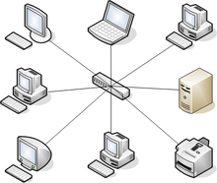
Star topology

Slide 52
Communication Schemes
Point-to-point (unicast)
  One or more (direct or indirect) links between each pair of nodes
  Communication always between two nodes
  Receiver and sender are identified by their addresses included in the message header
  Message may follow one of many links between the sender and receiver using switching or routing
Broadcast (multi-point)
  Messages are transmitted over a shared channel and received by all the nodes
  Each node checks the address and if it is not the intended recipient, ignores
  Multi-cast: special case
    Message is sent to a subset of the nodes

Slide 53
Communication Alternatives
Twisted pair
Coaxial
Fiber optic cable
Satellite
Microwave
Wireless

Slide 54
Data Communication
Hosts are connected by links, each of which can carry one or more channels
Link: physical entity; channel: logical entity
Digital signal versus analog signal
Capacity – bandwidth
  The amount of information that can be transmitted over the channel in a given time unit
Alternative messaging schemes
  Packet switching
    Messages are divided into fixed size packets, each of which is routed from the source to the destination
  Circuit switching
    A dedicated channel is established between the sender and receiver for the duration of the session

Slide 55
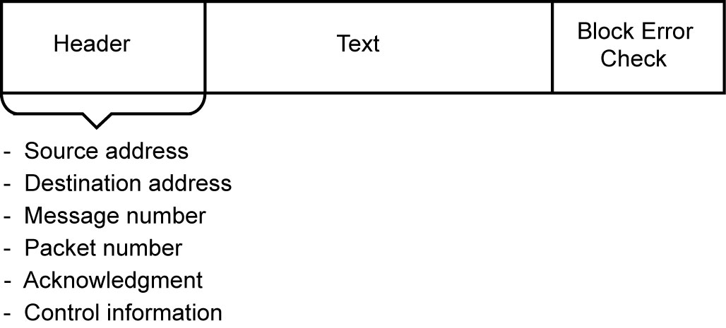
Packet Format

Slide 56
Communication Protocols
Software that ensures error-free, reliable and efficient communication between hosts
Layered architecture – hence protocol stack or protocol suite
TCP/IP is the best-known one
  Used in the Internet

Slide 57
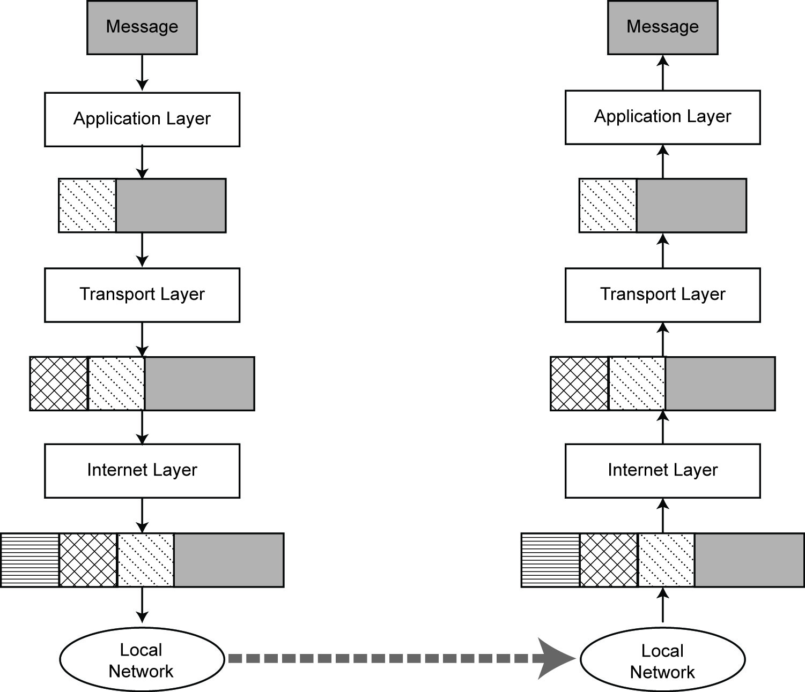
Message Transmission using TCP/IP

Slide 58
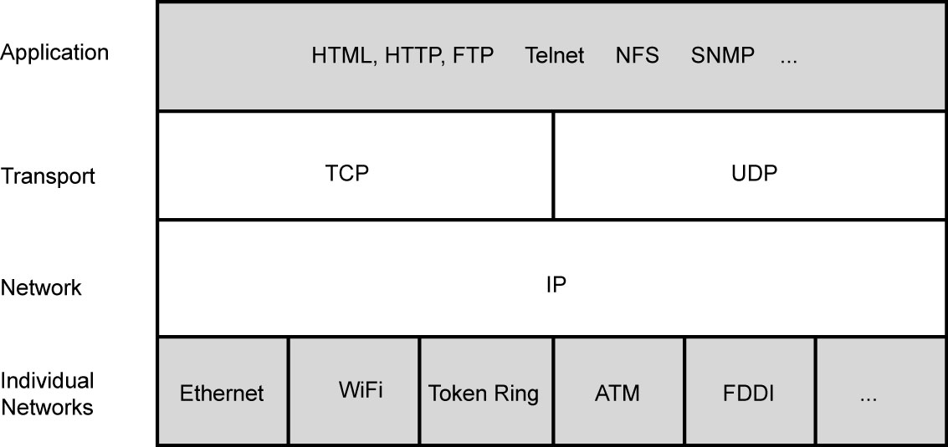
TCP/IP Protocol

