Slide 1
Outline
Introduction
Background
Distributed Database Design
Database Integration
Semantic Data and Control
  View Management
  Data Security
  Semantic Integrity Control
Distributed Query Processing
Multidatabase Query Processing
Distributed Transaction Management
Data Replication
Parallel Database Systems
Distributed Object DBMS
Peer-to-Peer Data Management
Web Data Management
Current Issues

Slide 2
Semantic Data Control
Data and access control using high-level semantics
  View management
  Security control
  Integrity control
Objective:
  To ensure that authorized users perform correct operations on the database, contributing to the maintenance of the database integrity.

Slide 3
View Management
EMP
View – virtual relation
  generated from base relation(s) by a query
  not stored as base relations
Example :
  CREATE VIEW SYSAN(ENO,ENAME)
  AS SELECT ENO,ENAME
  FROM EMP
  WHERE TITLE= "Syst. Anal."
ENO
ENAME
TITLE
E1
J. Doe
Elect. Eng
E2
M. Smith
Syst. Anal.
E3
A. Lee
Mech. Eng.
E4
J. Miller
Programmer
E5
B. Casey
Syst. Anal.
E6
L. Chu
Elect. Eng.
E7
R. Davis
Mech. Eng.
E8
J. Jones
Syst. Anal.
SYSAN
ENO
ENAME
E2
M.Smith
E5
B.Casey
E8
J.Jones

Slide 4
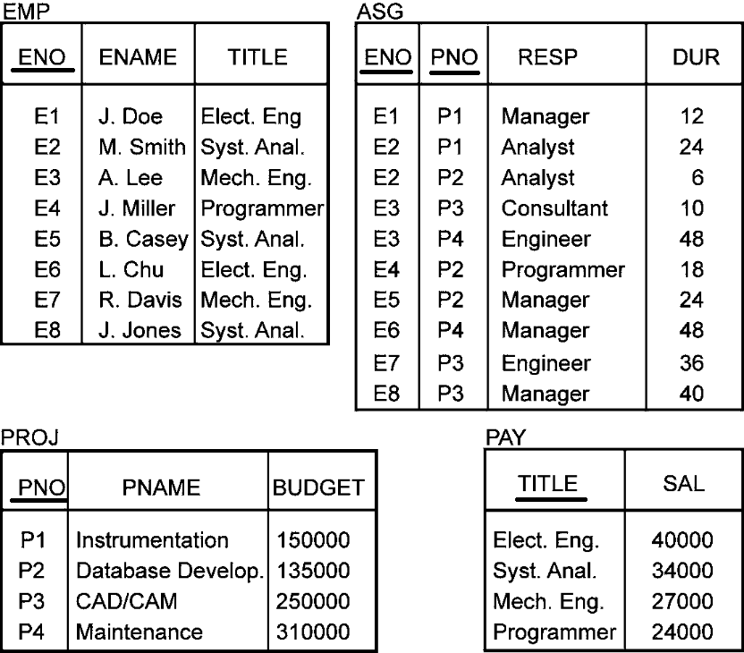
Example relations

Slide 5
View Management
Views can be manipulated as base relations
Example :
SELECT ENAME, PNO, RESP
FROM SYSAN, ASG
WHERE SYSAN.ENO = ASG.ENO

Slide 6
Query Modification
  Queries expressed on views
  SELECT ENAME, PNO, RESP
    FROM SYSAN, ASG
    WHERE SYSAN.ENO = ASG.ENO
Queries expressed on base relations
    SELECT ENAME,PNO,RESP
    FROM EMP, ASG
    WHERE EMP.ENO = ASG.ENO
    AND TITLE = "Syst. Anal."
ENAME
PNO
RESP
M.Smith
P1
Analyst
M.Smith
P2
Analyst
B.Casey
P32
Manager
J.Jones
P43
Manager

Slide 7
View Management
To restrict access
  Example restriction: A user can only access employees that have the same title as the user him/herself.
  CREATE VIEW ESAME
  AS SELECT *
  FROM EMP E1, EMP E2
  WHERE E1.TITLE = E2.TITLE
  AND E1.ENO = USER
Sample Query (issued by J. Doe)
  SELECT *
  FROM ESAME
Q: Is the result of the query correct (per the defined view)?
ENO
ENAME
TITLE
E1
J. Doe
Elect. Eng
E2
L. Chu
Elect. Eng

Slide 8
View Updates
Updatable vs Non-updatable views
Updatable
  CREATE VIEW SYSAN(ENO,ENAME)
  AS SELECT ENO,ENAME
  FROM EMP
  WHERE TITLE="Syst. Anal.“
  Updates through views can be handled automatically only if they can be propagated correctly to the base relations.
  Sample update queries: insert <E9, “J. Fox”> into SYSAN

Slide 9
View Updates
Non-updatable
  CREATE VIEW EG(ENAME,RESP)
  AS SELECT DISTINCT ENAME,RESP
  FROM EMP, ASG
  WHERE EMP.ENO=ASG.ENO
  A view is not updatable when an update through the view cannot be propagated correctly to the base relations (e.g., because ambiguities).
  Sample update queries: delete <“J. Fox”, “Analyst”> from EG
Current practice: DBMS are very restrictive about supporting updates through views. Views can be updated only if they are derived from a single relation by selection and projection.
NOTE: Views derived by join are updatable if they include the keys of the base relations.

Slide 10
View Management in DDBMS
Views might be derived from fragments.
View definition storage should be treated as database storage
Query modification results in a distributed query
View evaluations might be costly if base relations are distributed
  Use materialized views

Slide 11
Materialized View
Origin: snapshot in the 1980’s
  Static copy of the view, avoid view derivation for each query
  But periodic recomputing of the view may be expensive
Actual version of a view
  Stored as a database relation, possibly with indices
Used much in practice
  DDBMS: No need to access remote, base relations
  Data warehouse: to speed up OLAP
    Use aggregate (SUM, COUNT, etc.) and GROUP BY

Slide 12
Materialized View Maintenance
Updating (refreshing) the view to reflect changes to base data
  Resembles data replication but there are differences
    View expressions typically more complex
    Replication configurations more general
View maintenance policy to specify:
  When to refresh
  How to refresh

Slide 13
When to Refresh a View
Immediate mode
  As part of the updating transaction, e.g. through 2PC
  View always consistent with base data and fast queries
  But increased transaction time to update base data
Deferred mode (preferred in practice)
  Through separate refresh transactions
    No penalty on the updating transactions
  Triggered at different times with different trade-offs
    Lazily: just before evaluating a query on the view
    Periodically: every hour, every day, etc.
    Forcedly: after a number of predefined updates

Slide 14
How to Refresh a View
Full computing from base data
  Efficient if there has been many changes
Incremental computing by applying only the changes to the view
  Better if a small subset has been changed
  Uses differential relations which reflect updated data only

Slide 15
Differential Relations
Given relation R and update u
R⁺ contains tuples inserted by u
R⁻ contains tuples deleted by u
Type of u:
insert R⁻ empty
delete R⁺ empty
modify R⁺ ∪ (R – R⁻ )
Refreshing a view V is then done by computing V⁺ ∪ (V – V⁻ )
Computing V⁺ and V⁻ may require accessing base data

Slide 16
Example
  EG = SELECT DISTINCT ENAME, RESP
  FROM EMP, ASG
  WHERE EMP.ENO=ASG.ENO
  EG⁺ = (SELECT DISTINCT ENAME, RESP
  FROM EMP, ASG⁺
  WHERE EMP.ENO=ASG⁺.ENO) UNION
  (SELECT DISTINCT ENAME, RESP
  FROM EMP⁺, ASG
  WHERE EMP⁺.ENO=ASG.ENO) UNION
  (SELECT DISTINCT ENAME, RESP
  FROM EMP⁺, ASG⁺
  WHERE EMP⁺.ENO=ASG⁺.ENO)

Slide 17
Techniques for Incremental View Maintenance
Different techniques depending on:
  View expressiveness
    Non recursive views: SPJ wit duplicate elimination, union and aggregation
    Views with outerjoin
    Recursive views
Most frequent case is non recursive views
  Problem: an individual tuple in the view may be derived from several base tuples
    Example: tuple ⟨M. Smith, Analyst⟩ in EG corresponding to
      ⟨E2, M. Smith, … ⟩ in EMP
      ⟨E2,P1,Analyst,24 ⟩ and ⟨E2,P2,Analyst,6⟩ in ASG
    Makes deletion difficult
  Solution: Counting

Slide 18
Counting Algorithm
Basic idea
  Maintain a count of the number of derivations for each tuple in the view
  Increment (resp. decrement) tuple counts based on insertions (resp. deletions)
  A tuple in the view whose count is zero can be deleted
Algorithm
  Compute V⁺ and V⁻ using V, base relations and diff. relations
  Compute positive in V⁺ and negative counts in V⁻
  Compute V⁺ ∪ (V – V⁻ ), deleting each tuple in V with count=0
Optimal: computes exactly the view tuples that are inserted or deleted

Slide 19
View Self-maintainability
A view is self-maintainable if the base relations need not be accessed.
  Not the case for the Counting algorithm
Self-maintainability depends on views’ expressiveness
  Most SPJ views are often self-maintainable wrt. deletion and modification, but not wrt. Insertion
  Example: a view V is self-maintainable wrt to deletion in R if the key of R is included in V

Slide 20
Database security?
The multi-perspectives of security:
    Security = confidentiality + integrity + origin integrity (aka authentication) + availability + non-repudiability + …
  Confidentiality: Only the authorized can access the data.
  Integrity: The data is correct.
  Origin integrity: The origin information of the data is correct.
  Availability: The data (and answer to the queries) must be available to the authorized.
  Non-repudiability (NR): creator NR, retriever NR, operator NR, …

Slide 21
Common security mechanisms
Security services/components/goals/features | Security mechanisms/methods/implementations
the WHAT | the HOW
Confidentiality: The data d is only available to those that are authorized. | Authentication (login, etc.) Authorization (file permissions) Encryption/decryption
Integrity: The user of data d trust that d is correct. | Message Digest, checksums Message Authentication Codes (MAC) Digital Signatures
Origin Integrity: The user of data d trust that the origin data of d is correct. | Message Authentication Codes (MAC) Digital Signatures
Availability: The service s is available to all that are authorized to use s. | Replicated services Access Control …
Non-Repudiability: The actor of an action (A) cannot deny that he/she was the actor of that action. If the actor tries to deny that action, there exists an infallible mechanism to prove that he or she is lying. | Digital Signatures

Slide 22
Threats against database security?
-- Exercises (2 slides)
Security services | Threats?
Confidentiality
Integrity
Origin integrity
Availability
Non-repudiability
 | Any other threats against databases?

Slide 23
Threats against database security?
Q1: What is a SQL Inject attack?
Q2: How does SQL inject attack work?
Q3: What security services are impacted by a SQL Inject?

Slide 24
Data Security
Data protection
  Prevents the physical content of data to be understood by unauthorized users
  Uses encryption/decryption techniques (Public key)
Access control
  Only authorized users perform operations they are allowed to on database objects
  Discretionary access control (DAC)
    Long been provided by DBMS with authorization rules
  Multilevel access control (MAC)
    Increases security with security levels
  Another MAC: Mandatory access control
  AAA: Authentication, Authorization, and Accounting

Slide 25
Discretionary Access Control
Main actors
  Subjects (users, groups of users) who execute operations
  Operations (in queries or application programs)
  Objects, on which operations are performed
Checking whether a subject may perform an op. on an object
  Authorization= (subject, op. type, object def.)
  Defined using GRANT OR REVOKE
  Centralized: one single user class (admin.) may grant or revoke
  Decentralized, with op. type GRANT
    More flexible but recursive revoking process which needs the hierarchy of grants

Slide 26
Problem with DAC
A malicious user can access unauthorized data through an authorized user
Example
  User A has authorized access to R and S
  User B has authorized access to S only
  B somehow manages to modify an application program used by A so it writes R data in S
  Then B can read unauthorized data (in S) without violating authorization rules
Solution: multilevel security based on the famous Bell and Lapuda model for OS security

Slide 27
Multilevel Access Control
Different security levels (clearances)
  Top Secret (TS) > Secret (S) > Confidential (C) > Unclassified (U)
Access controlled by 2 rules:
  R1: No read up
    subject S is allowed to read an object of level L only if level(S) ≥ L
    Protect data from unauthorized disclosure, e.g. a subject with secret clearance cannot read top secret data
  R2: No write down
    subject S is allowed to write an object of level L only if level(S) ≤ L
    Protect data from unauthorized change, e.g. a subject with top secret clearance can only write top secret data but not secret data (which could then contain top secret data)

Slide 28
MAC in Relational DB
A relation can be classified at different levels:
  Relation level: All tuples in R have the same clearance
  Tuple level: Every tuple has a clearance
  Attribute level: Every attribute has a clearance
A classified relation is thus multilevel
  Appears differently (with different data) to subjects with different clearances

Slide 29
Example
PROJ*: classified at attribute level
PNO | SL1 | PNAME | SL2 | BUDGET | SL3 | LOC | SL4
P1 P2 P3 | C C S | Instrumentation DB Develop. CAD/CAM | C C S | 150000 135000 250000 | C S S | Montreal New York New York | C S S
PROJ* as seen by a subject with confidential clearance
PNO | SL1 | PNAME | SL2 | BUDGET | SL3 | LOC | SL4
P1 P2 | C C | Instrumentation DB Develop. | C C | 150000 Null | C C | Montreal Null | C C

Slide 30
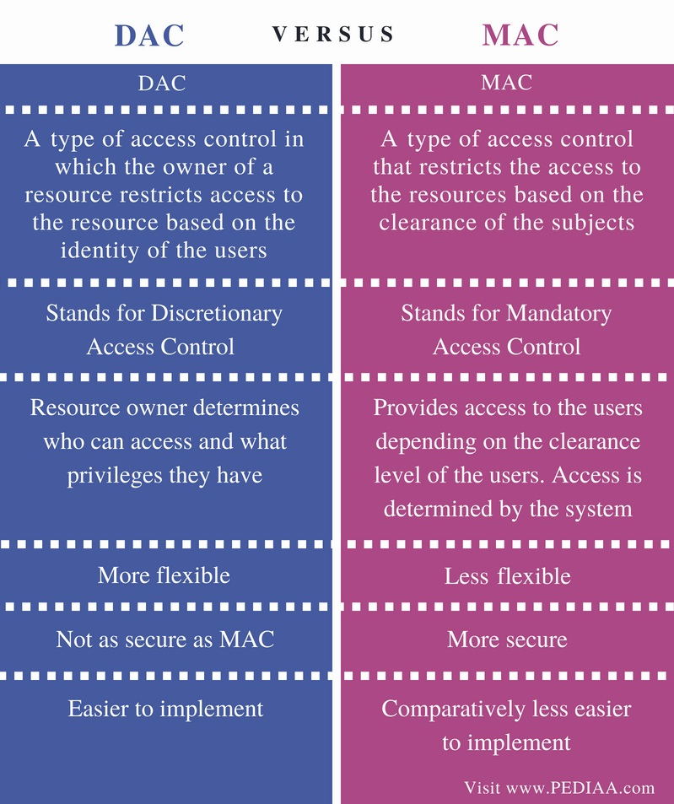
Source: https://pediaa.com/difference-between-dac-and-mac/

Slide 31
Distributed Access Control
Additional problems in a distributed environment
  Remote user authentication
    Typically using a directory service
      Should be replicated at some sites for availability
  Management of DAC rules
    Problem if users’ group can span multiple sites
      Rules stored at some directory based on user groups location
      Accessing rules may incur remote queries
  Covert channels in MAC

Slide 32
Covert Channels
“a type of attack that creates a capability to transfer information objects between processes that are not supposed to be allowed to communicate by the computer security policy” (Wikipedia)
The attacker uses indirect means to access unauthorized data.
Example
  Consider a simple DDB with 2 sites: C (confidential) and S (secret)
  Following the “no write down” rule, an update from a subject with secret clearance can only be sent to S
  Following the “no read up” rule, a read query from the same subject can be sent to both C and S
  Issue: The query may contain secret information (e.g., in a select predicate), so is a potential covert channel
Solution: replicate part of the DB
  So that a site at security level L contains all data that a subject at level L can access (e.g., S above would replicate the confidential data so it can entirely process secret queries)

Slide 33
Semantic Integrity Control
Maintain database consistency by enforcing a set of constraints defined on the database.
Structural constraints
  basic semantic properties inherent to a data model
    e.g., unique key constraint in relational model
Behavioral constraints
  regulate application behavior
    e.g., dependencies in the relational model
Two components
  Integrity constraint specification
  Integrity constraint enforcement

Slide 34
Semantic Integrity Control
Procedural control
    control embedded in each application program
Declarative control
    assertions in predicate calculus
  + easy to define constraints
  + definition of database consistency clear
  - inefficient to check assertions for each update
    limit the search space
    decrease the number of data accesses/assertion
    preventive strategies
    checking at compile time

Slide 35
Constraint Specification Language
Predefined constraints
  specify the more common constraints of the relational model
  Not-null attribute
    ENO NOT NULL IN EMP
  Unique key
    (ENO, PNO) UNIQUE IN ASG
  Foreign key
    A key in a relation R is a foreign key if it is a primary key of another relation S and the existence of any of its values in R is dependent upon the existence of the same value in S
    PNO IN ASG REFERENCES PNO IN PROJ
  Functional dependency
    ENO IN EMP DETERMINES ENAME

Slide 36
Constraint Specification Language
Precompiled constraints
  Express preconditions that must be satisfied by all tuples in a relation for a given update type
  (INSERT, DELETE, MODIFY)
  NEW - ranges over new tuples to be inserted
  OLD - ranges over old tuples to be deleted
  General Form
    CHECK ON <relation> [WHEN <update type>] <qualification>

Slide 37
Constraint Specification Language
Precompiled constraints
  Domain constraint
    CHECK ON PROJ (BUDGET≥500000 AND BUDGET≤1000000)
  Domain constraint on deletion
    CHECK ON PROJ WHEN DELETE (BUDGET = 0)
  Transition constraint
    CHECK ON PROJ (NEW.BUDGET > OLD.BUDGET AND NEW.PNO = OLD.PNO)

Slide 38
Constraint Specification Language
General constraints
  Constraints that must always be true. Formulae of tuple relational calculus where all variables are quantified.
  General Form
    CHECK ON <variable>:<relation>,(<qualification>)
  Functional dependency
    CHECK ON e1:EMP, e2:EMP
    (e1.ENAME = e2.ENAME IF e1.ENO = e2.ENO)
  Constraint with aggregate function
    CHECK ON g:ASG, j:PROJ
    (SUM(g.DUR WHERE g.PNO = j.PNO) < 100 IF
    j.PNAME = “CAD/CAM”)

Slide 39
Integrity Enforcement
Two methods
Detection
  Execute update u: D → D_{u}
  If D_{u} is inconsistent then
  if possible: compensate D_{u} → D_{u}’
  else
  undo D_{u} → D
Preventive
  Execute u: D → D_{u} only if D_{u} will be consistent
  Determine valid programs
  Determine valid states

Slide 40
Query Modification
Preventive
Add the assertion qualification to the update query
Only applicable to tuple calculus formulae with universally quantified variables
    UPDATE PROJ
    SET BUDGET = BUDGET*1.1
    WHERE PNAME = "CAD/CAM"
    UPDATE PROJ
    SET BUDGET = BUDGET*1.1
    WHERE PNAME = "CAD/CAM"
    AND NEW.BUDGET ≥ 500000
    AND NEW.BUDGET ≤ 1000000

Slide 41
Compiled Assertions
Triple (R,T,C) where
R relation
T update type (insert, delete, modify)
C assertion on differential relations
Example: Foreign key assertion
  ∀g ∈ ASG, ∃j ∈ PROJ : g.PNO = j.PNO
  Compiled assertions:
    (ASG, INSERT, C1), (PROJ, DELETE, C2), (PROJ, MODIFY, C3)
  where
    C1:∀NEW ∈ ASG+ ∃j ∈ PROJ: NEW.PNO = j.PNO
    C2:∀g ∈ ASG, ∀OLD ∈ PROJ⁻ : g.PNO ≠ OLD.PNO
    C3:∀g ∈ ASG, ∀OLD ∈ PROJ⁻ ∃NEW ∈ PROJ⁺:
    g.PNO ≠OLD.PNO OR OLD.PNO = NEW.PNO

Slide 42
Differential Relations
Given relation R and update u
R⁺ contains tuples inserted by u
R⁻ contains tuples deleted by u
Type of u
insert R⁻ empty
delete R⁺ empty
modify R⁺ ∪ (R – R⁻)

Slide 43
Differential Relations
Algorithm:
Input: Relation R, update u, compiled assertion C_{i}
Step 1: Generate differential relations R⁺ and R–
Step 2: Retrieve the tuples of R⁺ and R– which do not satisfy C_{i}
Step 3: If retrieval is not successful, then the assertion is valid.
Example :
  u is delete on J. Enforcing (EMP, DELETE, C2) :
    retrieve all tuples of EMP⁻
    into RESULT
    where not(C2)
  If RESULT = {}, the assertion is verified

Slide 44
Distributed Integrity Control
Problems:
  Definition of constraints
    consideration for fragments
  Where to store
    replication
    non-replicated : fragments
  Enforcement
    minimize costs

Slide 45
Types of Distributed Assertions
Individual assertions
  single relation, single variable
  domain constraint
Set oriented assertions
  single relation, multi-variable
    functional dependency
  multi-relation, multi-variable
    foreign key
Assertions involving aggregates

Slide 46
Distributed Integrity Control
Assertion Definition
  similar to the centralized techniques
  transform the assertions to compiled assertions
Assertion Storage
  Individual assertions
    one relation, only fragments
    at each fragment site, check for compatibility
    if compatible, store; otherwise reject
    if all the sites reject, globally reject
  Set-oriented assertions
    involves joins (between fragments or relations)
    maybe necessary to perform joins to check for compatibility
    store if compatible

Slide 47
Distributed Integrity Control
Assertion Enforcement
  Where to enforce each assertion depends on
    type of assertion
    type of update and where update is issued
  Individual Assertions
    update = insert
      enforce at the site where the update is issued
    update = qualified
      send the assertions to all the sites involved
      execute the qualification to obtain R⁺ and R⁻
      each site enforce its own assertion
  Set-oriented Assertions
    single relation
      similar to individual assertions with qualified updates
    multi-relation
      move data between sites to perform joins; then send the result to the query master site

