Slide 1

Slides for Chapter 3:
Networking and Internetworking
From Coulouris, Dollimore, Kindberg and Blair
Distributed Systems:
Concepts and Design
Edition 5, © Addison-Wesley 2012
Most Content Added by: Ahmed Abukmail

Slide 2
Introduction
Networks are built from a variety of transmission media (wires, cables, fibre, wireless, …), devices (routers, switches, bridges, hubs, repeaters, …), and software components (protocol stacks, communication handlers, drivers, …).
User applications depend on the support provided by the underlying operating systems to communicate with remote applications.

Slide 3
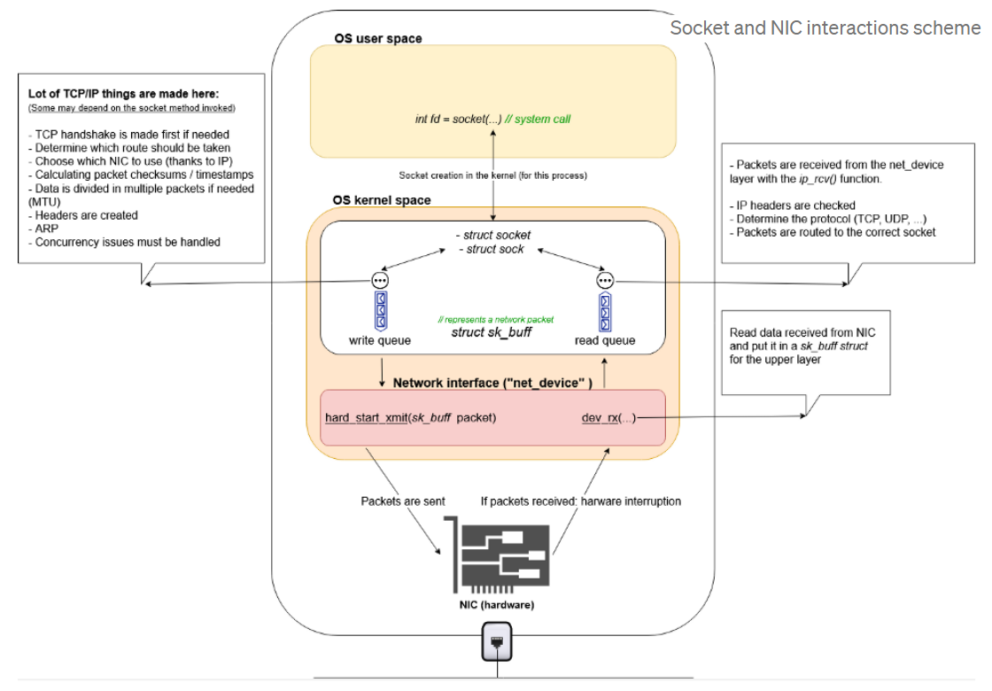
Source: https://medium.com/swlh/from-sockets-to-nic-a-big-picture-7494356cfcd4
Notes:
The Communications Device Handler Interface services provide a standard interface between network interface drivers and communications device handlers. (source: https://www.ibm.com/docs/en/aix/7.2?topic=services-communications-device-handler-interface-kernel)

Slide 4
Introduction
A communication subsystem in a distributed system
  The collection of hardware and software components that provide the communication facilities for a distributed system
Recall: In a distributed system, the middleware often provides communication services to enable communications between the distributed applications running on various platforms.
Notes:
The Communications Device Handler Interface services provide a standard interface between network interface drivers and communications device handlers. (source: https://www.ibm.com/docs/en/aix/7.2?topic=services-communications-device-handler-interface-kernel)

Slide 5
Outline
An introductory overview of computer networking and its impact on the communication subsystem
  Networking issues for distributed systems
  Types of network
  Network principles
  Internet protocols
  Case studies: Ethernet, WiFi and Bluetooth
Ch 7: Operating system support for networking and related issues

Slide 6
Networking Issues in DS
Performance parameters affect the speed with which individual messages are transferred in DS.
  Latency – the delay that occurs after send is executed and before data starts to arrive
    Can be considered as the time required to transfer an empty message
    Software overheads, routing delays, congestion, …
  Data Transfer Rate (bits per second) – speed at which data can be transferred between two computers in the network once transmission has begun
  Message transmission time = latency + length / data transfer rate
  Total System Bandwidth – total volume of traffic transferred across the network at a given time
    a measure of the throughput
The performance of networks deteriorates in conditions of overload – when there are too many messages in the network at the same time.

Slide 7
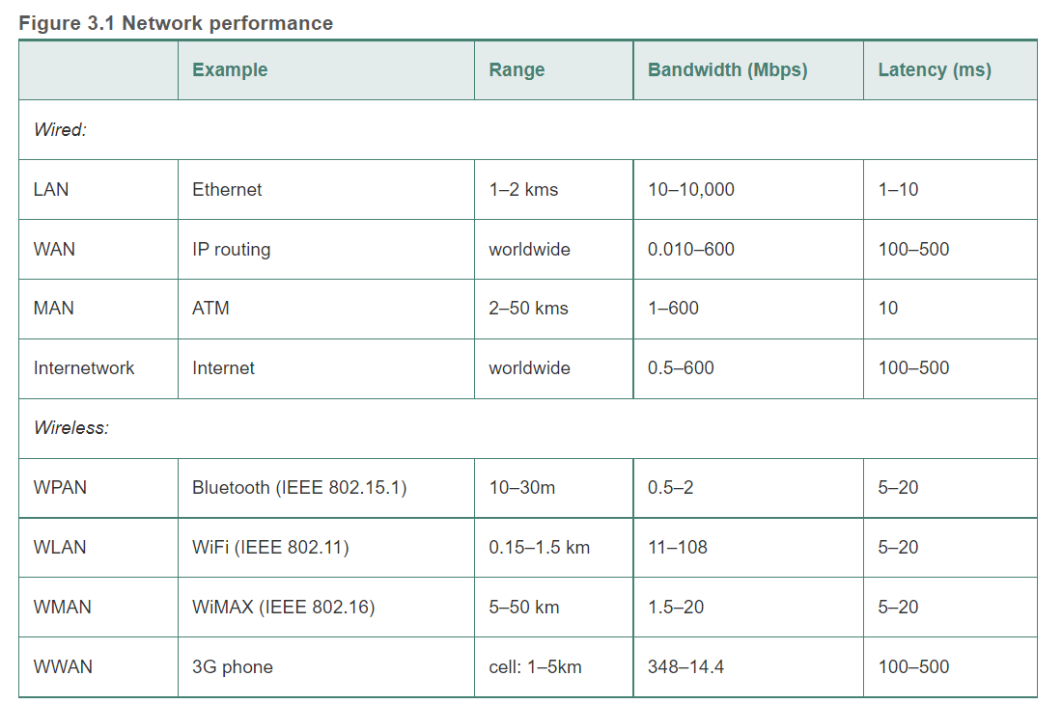
Figure 3.1 Network performance
km
c.f.,
CPU operations: in nanoseconds (ns)
Memory accesses: in microseconds (µs)
Disk accesses: milliseconds (ms)
Network accesses: ms

Slide 8
Networking Issues in DS (Cont’d)
Scalability
  Size increases
  Communication load increases
Reliability
  impact of communication errors
  The end-to-end argument: The communication subsystem need not provide totally error-free communication; the detection of communication errors and their correction is often best performed by application-level software.
Security
  Firewalls impose restrictions on traffic flow between networks.
  Protection of routers and other network devices/appliances
  Application and Data security: End-to-end authentication, privacy, confidentiality, message integrity, traffic analysis, anti-replay, … (more in Ch. 11)

Slide 9
Networking Issues in DS (Cont’d)
Mobility
  Mobile devices move and may require re-connection.
  Wireless connectivity
QoS (Quality of Service)
  the ability to meet deadlines when transmitting and processing streams of real-time multimedia data
  Guaranteed bandwidth, bounded latencies
  a minimum acceptable QoS vs a desired optimum
Multicasting communication
  One-to-Many communication
  simultaneous transmission of messages to several recipients

Slide 10
Types of Networks
Personal Area Networks (PANs) and Wireless PANs (WPANs)
Local Area Networks (LANs)
Wide Area Networks (WANs)
Metropolitan Area Networks (MANs)
WLANs
WMANs
WWANs – Global System for Mobile Communication (GSM)
Internetworks
Failure processing: Network errors can occur in any network.
Network Transparency

Slide 11
Networking Principles
Packet Transmission
  Message is a sequence of data items of arbitrary length.
  Messages are subdivided into “packets”.
    addressing info + sequence of binary data of a restricted length
      So computers can allocate sufficient buffer size to hold data.
      To avoid delays that occur when a message is long
Data streaming
  Audio/Video transmission and display is known as “streaming”.
    Video stream requires 1.5 Mbps if compressed, otherwise it requires 120 Mbps.
  Timely delivery depends on the availability of connections with adequate quality of service.

Slide 12
Networking Principles (cont’d)
Switching Schemes
  Broadcast: no switching, everything transmitted to every node.
    Ethernet is based on broadcasting.
    Wireless networking is based on broadcasting, but if a fixed circuit is not available, broadcasts are arranged to reach nodes grouped in cells.
  Circuit Switching
    Plain Old Telephone System (POTS)
    Pairing of wires from caller to callee via automatic switch between the two exchanges.

Slide 13
Networking Principles (cont’d)
Switching Schemes (cont’d)
  Packet Switching
    store-and-forward network – forward packets from source to destination
      Each packet arriving to a node is stored, processed, and then forwarded.
  Frame Relay
    Store-and-forwards takes between a few tens of microseconds to a few milliseconds.
      dependent on packet size, hardware speed and quantity of other traffic
      Too much delay for real-time applications
    Frame relay brings advantages of circuit switching to packet switching.
      Switch small packets (frames) on the fly
      Examine first few bits to route, frames pass through (not stored at) nodes as a short stream of bits.
      e.g. ATM networks

Slide 14
Networking Principles (cont’d)
Protocols
  A well-known set of rules and formats to be used for communication
    A specification of the sequence of messages that must be exchanged
    A specification of the format of the data
  Concept of Protocol Layers (layering)
  Encapsulation

Slide 15
Figure 3.2
Conceptual layering of protocol software
Message sent
Message received
Layer n
Layer 2
Layer 1
Sender
Communication
Recipient
medium

Slide 16
Figure 3.3
Encapsulation as it is applied in layered protocols

Slide 17
Networking Principles (cont’d)
Protocols (cont’d)
  Protocol Suites – a complete set of protocol layers (aka a protocol stack)
    ISO OSI Model is an example.
    TCP/IP suites
  Packet Assembly
    Dividing messages into packets before transmission and reassembling after receiving them
    Packets consist of header and data/payload fields.
      Data field has a max length based on MTU.
      If size exceeds MTU, then divide into smaller chunks.

Slide 18
Figure 3.4
Protocol layers in the ISO Open Systems Interconnection (OSI) model

Slide 19
Figure 3.5
OSI protocol summary
Layer
Description
Examples
Application
Protocols that are designed to meet the communication requirements of
HTTP,
FTP
,
SMTP,
specific applications, often defining the interface to a service.
CORBA IIOP
Presentation
Protocols at this level transmit data in a network representation that is
Secure Sockets
independent of the representations used in individual computers, which may
(
SSL),CORBA Data
differ. Encryption is also performed in this layer, if required.
Rep.
Session
At this level reliability and adaptation are performed, such as detection of
failures and automatic recovery.
Transport
This is the lowest level at which messages (rather than packets) are handled.
TCP,
UDP
Messages are addressed to communication ports attached to processes,
Protocols in this layer may be connection-oriented or connectionless.
Network
Transfers data packets between computers in a specific network. In a WAN
IP,
ATM virtual
or an internetwork this involves the generation of a route passing through
circuits
routers. In a single LAN no routing is required.
Data link
Responsible for transmission of packets between nodes that are directly
Ethernet MAC,
connected by a physical link. In a WAN transmission is between pairs of
ATM cell transfer,
routers or between routers and hosts. In a LAN it is between any pair of hosts.
PPP
Physical
The circuits and hardware that drive the network. It transmits sequences of
Ethernet base- band
binary data by analogue signalling, using amplitude or frequency modulation
signalling,
ISDN
of electrical signals (on cable circuits), light signals (on fibre optic circuits)
or other electromagnetic signals (on radio and microwave circuits).

Slide 20
Figure 3.6 Internetwork layers (layer 3 and above) vs Network interface (layer 2)
Internetwork layer (end-to-end): IP, TCP, HTTP
Data Link layer (link layer): Ethernet, Wifi, Bluetooth, …
  A → A’s router/gateway → next router/hop → … → B’s router/gateway → B

Slide 21
Networking Principles (cont’d)
Protocols (cont’d)
  Ports – software-defined destination points at a host computer.
    Well-known-port < 1023, registered ports are between 1024 and 49151, anything else is available for private purpose.
    Port# + IP address specifies a particular process running on a given computer.
  Addressing
    Transport layer needs a network address and a port number.
    Networking layer needs only a network address.
  Packet delivery
    Datagram packet delivery – no setup, one-shot delivery
      Packets can follow different routes.
      Only need source and destination addresses.
    Virtual Circuit Packet Delivery
      Implement network-level services like telephone lines.
      VC number is used instead of the address.
      Circuits are represented by table entries at every node.

Slide 22
Networking Principles (cont’d)
Routing
  Find a path (realistically, the next hop) to deliver a message
    Adaptive routing
      keep adjusting the path by re-evaluating the network periodically
  A routing algorithm consists of two parts:
    Routing: (Conceptually) Making a decision to determine route taken by each packet as it travels through the network
      NOTE: (Realistically) Each router, having received a packet, makes its routing decision to determine the next hop to forward the given packet.
    Router-to-router communication: Dynamically update the knowledge of the network based on traffic monitoring and configuration changes or failure

Slide 23
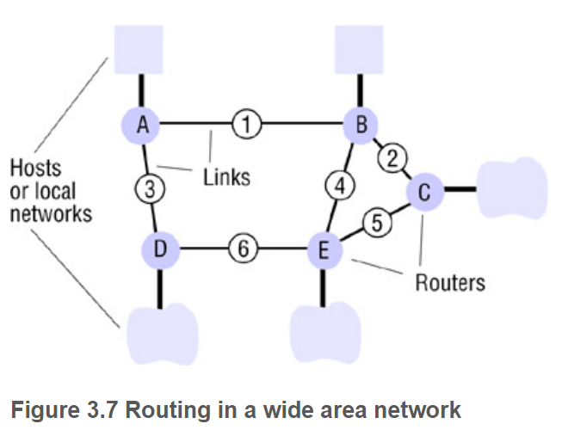
Figure 3.7 Routing in a wide area network

Slide 24
Figure 3.8
Routing tables for the network in Figure 3.7
Routings from A
Routings from B
Routings from C
To
Link
Cost
To
Link
Cost
To
Link
Cost
A
local
0
A
1
1
A
2
2
B
1
1
B
local
0
B
2
1
C
1
2
C
2
1
C
local
0
D
3
1
D
1
2
D
5
2
E
1
2
E
4
1
E
5
1
Routings from D
Routings from E
To
Link
Cost
To
Link
Cost
A
3
1
A
4
2
B
3
2
B
4
1
C
6
2
C
5
1
D
local
0
D
6
1
E
6
1
E
local
0

Slide 25
Figure 3.9
Pseudo-code for RIP routing algorithm
RIP (Routing Information Protocol)
  a dynamic routing protocol that uses hop count as a routing metric to find the best path between the source and the destination network
Send: Each t seconds or when Tl changes, send Tl on each non-faulty outgoing link.
Receive: Whenever a routing table Tr is received on link n:
for all rows Rr in Tr {
if (Rr.link ≠ n) {
Rr.cost = Rr.cost + 1;
Rr.link = n;
if (Rr.destination is not in Tl)
// add new destination to Tl
add Rr to Tl;
else
for all rows Rl in Tl {
if (Rr.destination = Rl.destination and
(Rr.cost < Rl.cost or Rl.link = n)) Rl = Rr;
// Rr.cost < Rl.cost : remote node has better route
// Rl.link = n : remote node is more authoritative
}
}
}

Slide 26
Networking Principles (cont’d)
Congestion Control
  When a load on a link approaches capacity, queues will build up.
    If load continues to build up, buffer capacity limit will be reached.
    If this happens, nodes will start to drop packets.
      Retransmission will be required.
    Security implications? DoS attacks
  Generally at > 80% capacity the total throughput tends to drop.
  Solution:
    Hold packets at earlier nodes before they reach congested nodes. It will cause delays, but no significant impact on the throughput.
    This is known as Congestion Control.

Slide 27
Congestion Control (Cont’d)
  General congestion control is achieved by informing nodes along a route that congestion has occurred and that their rate of transmission should be reduced.
    Buffering will occur.
  “Choke Packets” can be sent to request the reduction of transmission rate.

Slide 28
Networking Principles (cont’d)
Internetworking
  To build an internetwork from subnetworks, we must have:
    A unified addressing scheme. ex. IP Address
    A protocol to define the format of packets. ex. IP protocol
    Interconnecting components. ex. Internet routers.
  Routers, Bridges, Hubs, Switches, Tunnelling

Slide 29
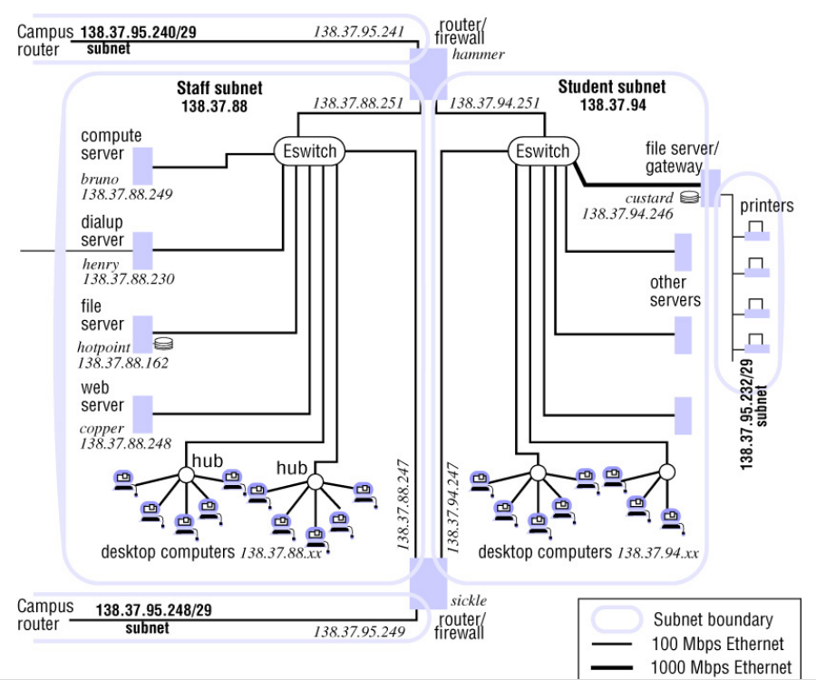
Figure 3.10 Simplified view of part of a university campus network

Slide 30
Figure 3.11
Tunnelling for IPv6 migration
IPv6 encapsulated in IPv4 packets
IPv4 network
IPv6
IPv6
A
B
Encapsulators
A protocol tunnel is a software layer that transmits packets through an alien network environment.
Tunneling vs Encapsulation?
Given a packet at layer n
  Encapsulation: The packet becomes the payload of another packet at layer n-1 or lower.
  Tunneling: The packet becomes the payload of another packet at layer n or above.

Slide 31
Internet Protocols
The TCP/IP protocol stack.
Encapsulation
Addressing (IPv4) and (IPv6)
  Classful and Classless
IP Protocol
  ARP
Mobile IP

Slide 32
Figure 3.12 TCP/IP layers
Message
Layers
Application
Messages (UDP) or Streams (TCP)
Transport
UDP or TCP packets
Internet
IP datagrams
Network interface
Network-specific frames
Underlying network

Slide 33
Figure 3.13
Encapsulation in a message transmitted via TCP over an Ethernet
Application message
TCP header
port
IP header
TCP
Ethernet header
IP
Ethernet frame

Slide 34
Figure 3.14
The programmer's conceptual view of a TCP/IP Internet

Slide 35
Figure 3.15
Internet address structure, showing field sizes in bits
28

Slide 36
Figure 3.16
Decimal representation of Internet addresses
octet 1
octet 2
octet 3
Range of addresses
Network ID
Host ID
Class A:
1 to 127
0 to 255
0 to 255
0 to 255
1.0.0.0 to
127.255.255.255
Network ID
Host ID
Class B:
128 to 191
0 to 255
0 to 255
0 to 255
128.0.0.0 to
191.255.255.255
Network ID
Host ID
Class C:
192 to 223
0 to 255
0 to 255
1 to 254
192.0.0.0 to
223.255.255.255
Multicast address
Class D (multicast):
224 to 239
0 to 255
0 to 255
1 to 254
224.0.0.0 to
239.255.255.255
Class E (reserved):
240 to 255
0 to 255
0 to 255
1 to 254
240.0.0.0 to
255.255.255.255

Slide 37
Figure 3.17 IP packet layout

