Slide 1
IPSEc VPN
Xiaodong Liang (Rommel)
CSCI 5235 - Network Security
07-17-2012

Slide 2
Outline
IPSec Two Modes
Two Security Protocols
Services Provided by IPSec
Two important aspects of IPSec
Internet Key Exchange (IKE)v1, v2
Virtual Private Network (VPN)
IPSec VPN
DEMO
Setting up VPN in CISCO ASA 5505

Slide 3
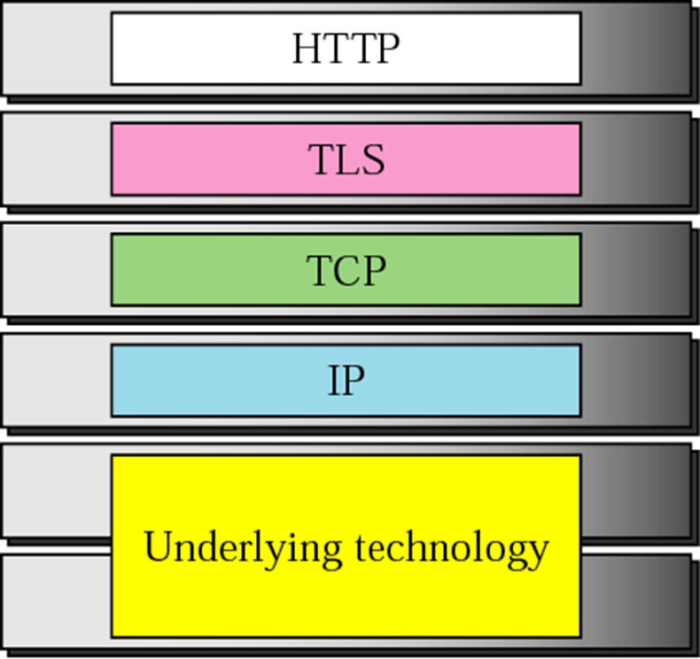
IPSec - Location
Application Layer
(SSH)
Transport Layer
(SSL&TLS)
Network Layer
(IPSec)
Data Link Layer
(Layer2 security)

Slide 4

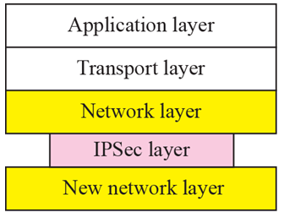
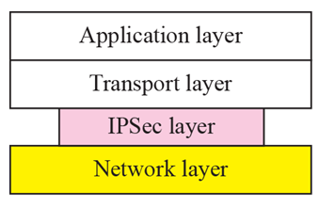
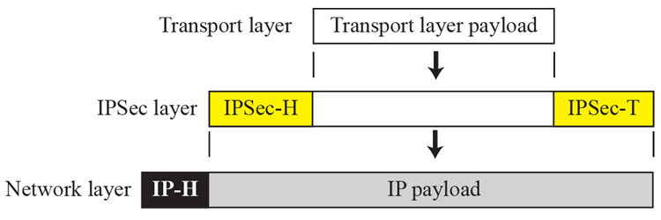
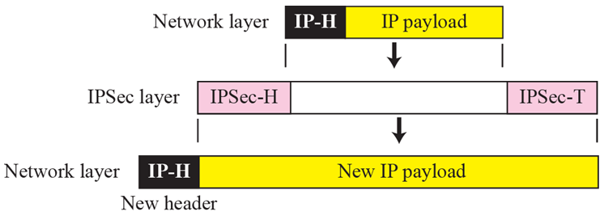
IPSec – two modes
Transport Mode: Tunnel Mode:
( ←→ ) ( ←→ ←→ ←→ )

Slide 5
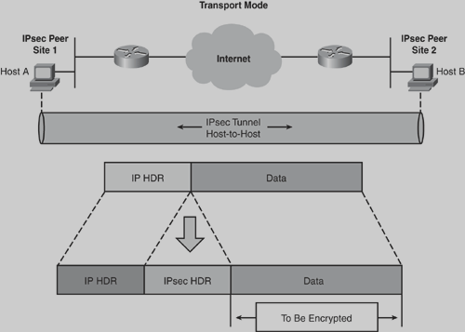
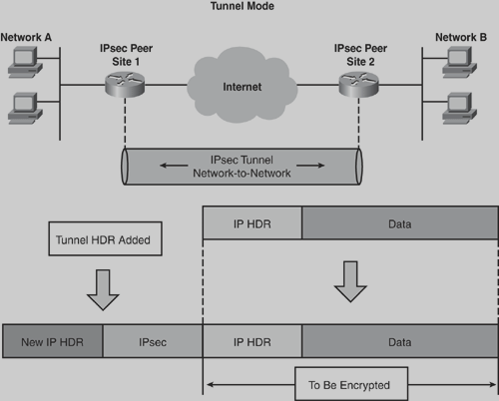
IPSec – two modes

Slide 6
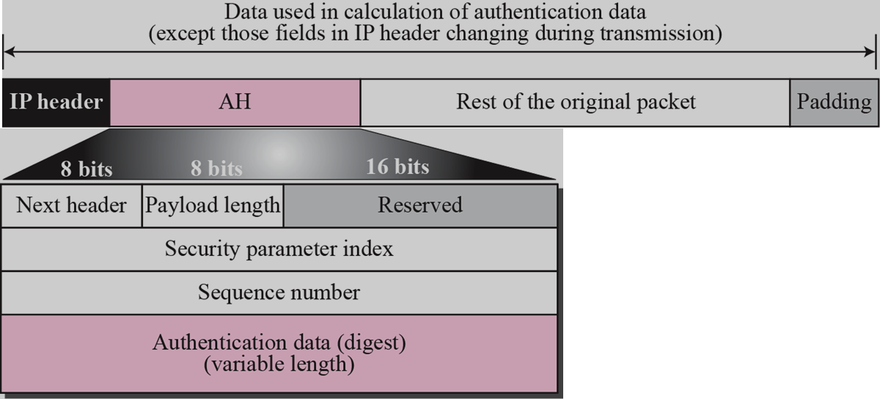
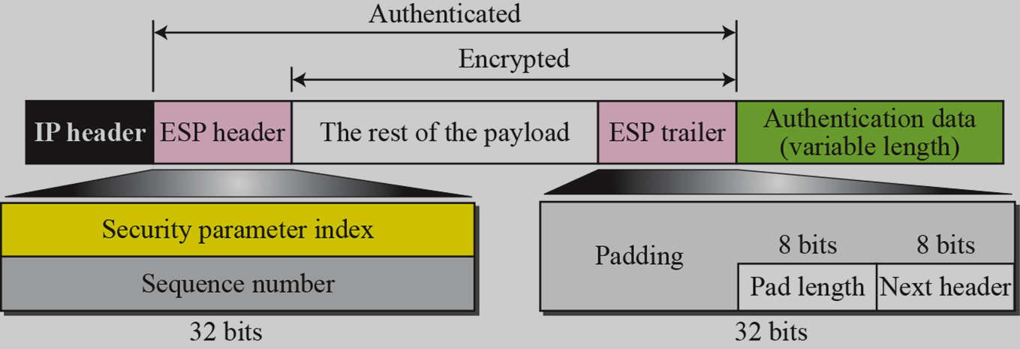
IPSec – two protocols
Authentication Header Protocol (AH)
Encapsulating Security Payload Protocol (ESP)

Slide 7
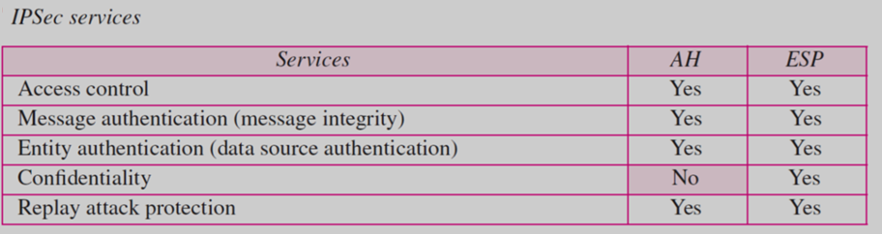
IPSec – Services

Slide 8
IPSec – important aspects
Security Association (SA)
IPSec requires a logical relationship between two hosts, that relationship called SA.
  Security Association Database (SAD)
  one for Outbound SA, one for Inbound SA
Security Policy (SP)
Defines the type of security applied to a packet .
  Security Policy Database (SPD)
  one for Outbound SP, one for Inbound SP

Slide 9
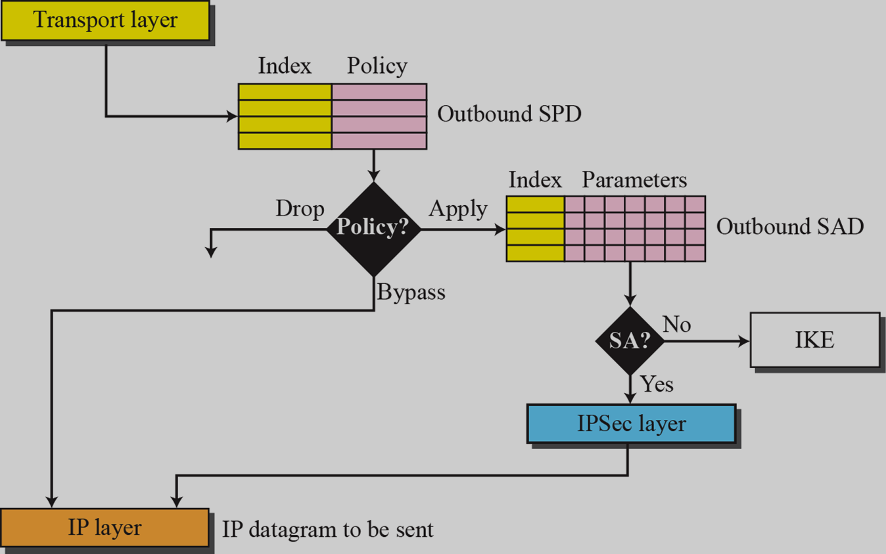
IPSec – important aspects
Outbound processing

Slide 10
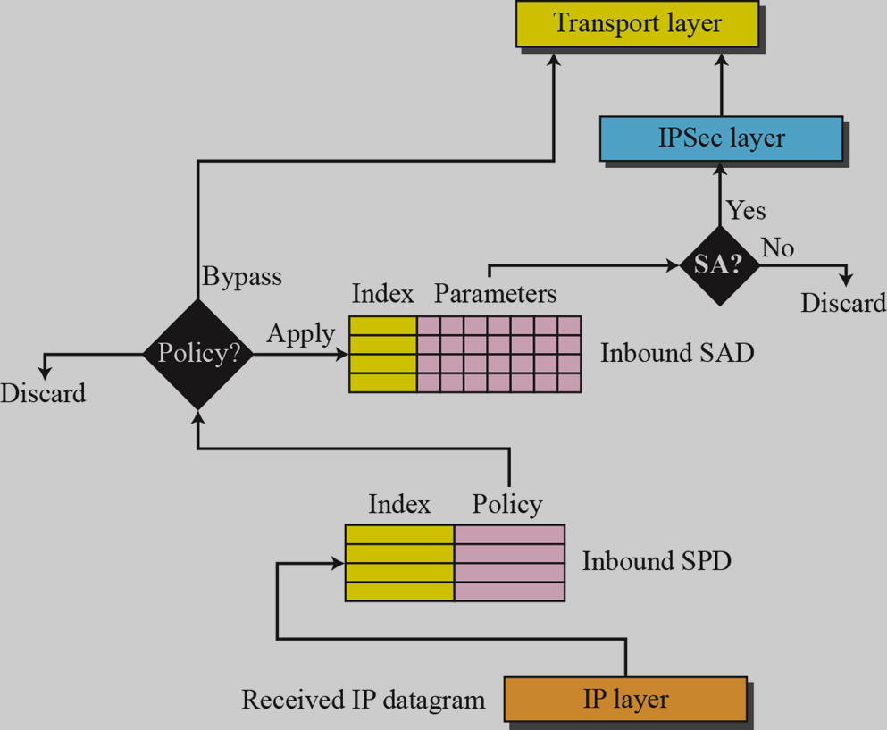
IPSec – important aspects
Inbound processing

Slide 11
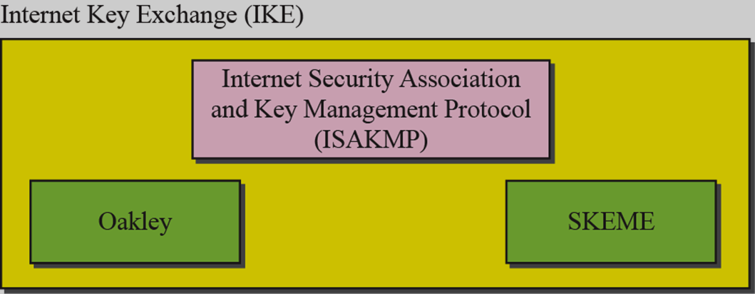
IPSec - IKE
Internet Key Exchange (IKE)
IKE creates Sas for IPSec
Oakley: key creation protocol
SKEME: key exchange protocol
ISAKMP: key management

Slide 12
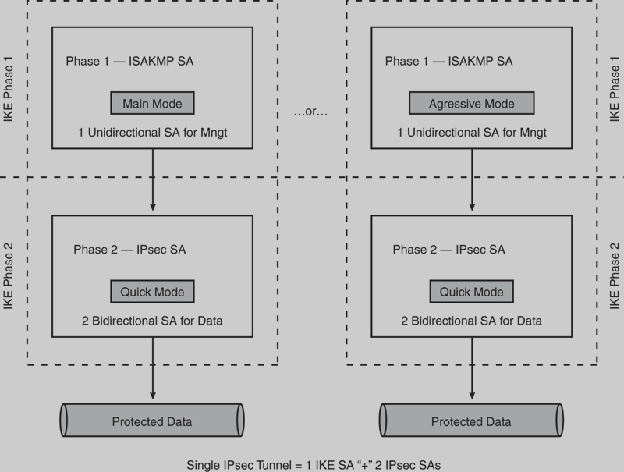
IPSec – IKE v1

Slide 13
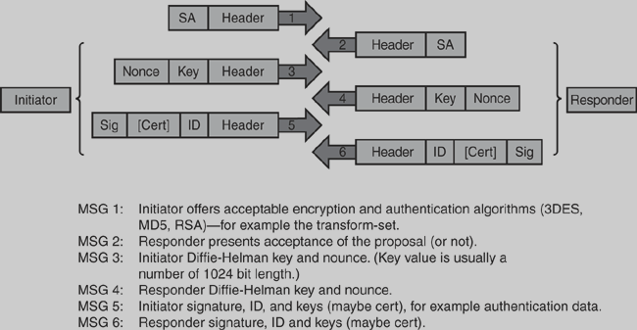
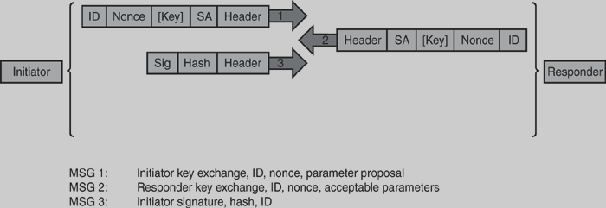
IPSec – IKE v1
IKE Phase 1
—Main Mode
IKE Phase 1
—Aggressive Mode

Slide 14
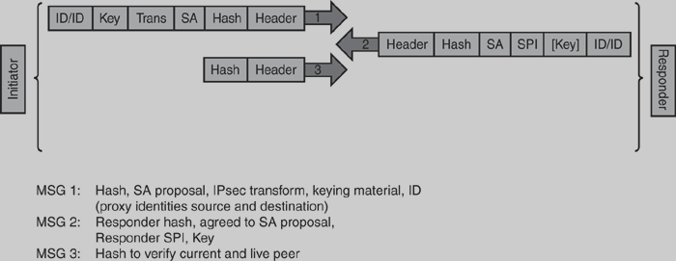
IPSec – IKE v1
IKE Phase 2
—Quick Mode

Slide 15
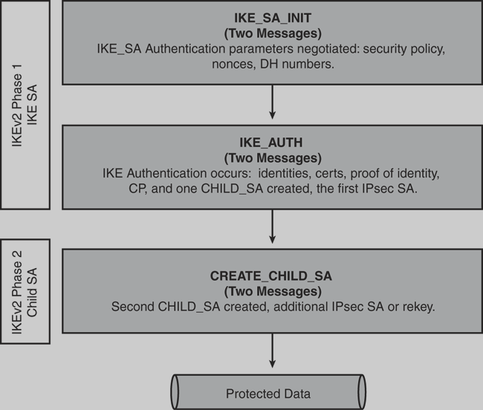
IPSec – IKE v2

Slide 16
IPSec – IKE v1 v.s. v2
 | IKEv1 | IKEv2
UDP port | 500 | 500, 4500
Phases | Phase 1 (6/3 messages) Phase 2 (3 messages) | Phase 1 (4 messages) Phase 2 (2 messages)
Keepalives | No | Yes
Identity Hiding | Yes in main mode, No in aggressive mode | Yes
UDP/NAT | No | Yes
SA Negotiation | Responder selects initiator's proposal | Same as IKEV1, proposal structure simplified
Number of Msgs | 6–9 | 4–8
EAP/CP | No | Yes

Slide 17
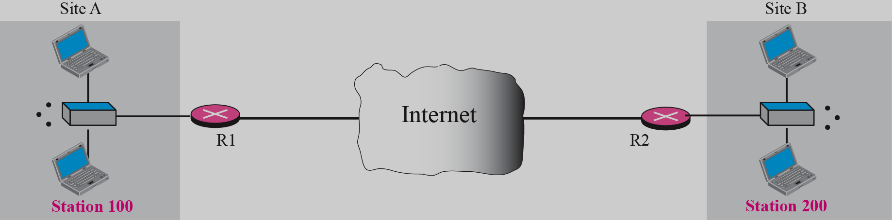
VPN
Virtual Private Network
VPN is a network that is private but virtual.

Slide 18
VPN - types
Secure VPN (also known as Cryptographic VPN)
Traffic is secured using encryption technology in a secure tunnel between the communicating peers. (IPSec VPN)
Trusted VPN (known as non-Cryptographic VPN)
When traffic traverses these dedicated point-to-point circuits, you have what is called a Trusted VPN.
Hybrid VPN
Run a secure VPN tunnel as part of a trusted VPN—that is, a tunnel within a tunnel.

Slide 19
IPSec VPN
Offers the following security services:
  Peer Authentication
  Data confidentiality
  Data integrity
  Data origin Authentication
  Replay detection
  Access control
  Traffic flow confidentiality

Slide 20
IPSec VPN
Type:
Site-to-site (aka LAN-to-LAN) IPsec VPN
    Full Mesh
    Hub-and-Spoke
    DMVPN
    Static VTI
    GET VPN
Remote-access client IPsec VPN
    Easy VPN
    Dynamic VTI

Slide 21
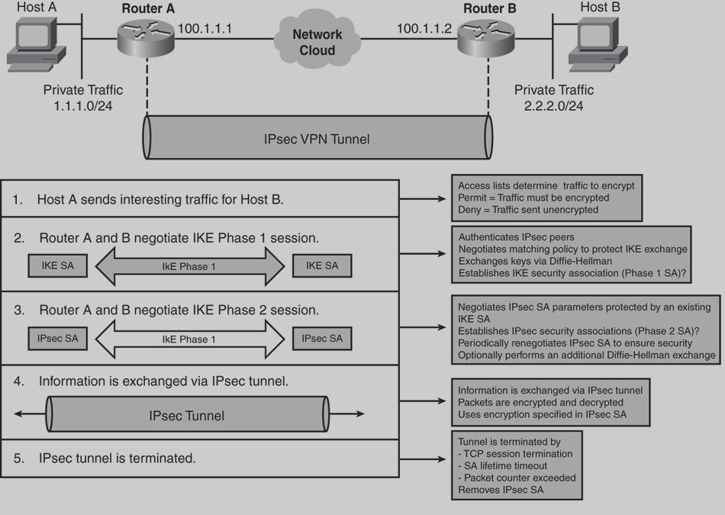
IPSec VPN
Site-to-Site IPsec Tunnel (Five-Steps Model)

Slide 22
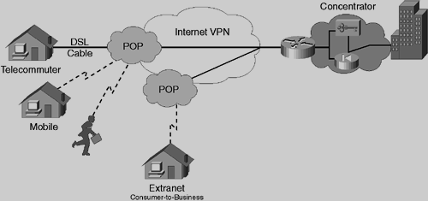
IPSec VPN
Remote-Access Client Ipsec Unique challenges:
    IPsec clients use unknown-to-gateway IP addresses to connect to the gateway
    Client’s IP address assigned by the ISP is not compatible with the private network’s addressing.
    The clients must use the DNS server, DHCP server, and other such servers on the private network.
    PAT can no longer function as normal (because ESP encrypts all the port info in the TCP or UDP header).

Slide 23
Summary
What is IPSec?
Why we need IPSec?
When is IPSec implemented?
Where is IPSec implemented?
Who carry the duty to do this?
How is IPSec worked?

Slide 24
Resources
Behrouz A. Forouzan, TCP/IP Protocol Suite (4th 2010)
TCP IP Illustrated, Vol 1 The Protocols (2nd 2012)
Yusuf Bhaiji, Cisco Press Network Security Technologies and Solutions (2008)
William Stallings, Network Security Essentials (2nd 2003)
IBM iSeries Information Center, (Version 5 Release 3) http://publib.boulder.ibm.com/infocenter/iseries/v5r3/index.jsp?topic=%2Frzaja%2Frzajaahheader.htm

Slide 25
Thank you !
Questions?

Slide 26
DEMO
Device: (CISCO Firewall ASA 5505)
http://www.newegg.com/Product/ProductList.aspx?Submit=ENE&N=-1&IsNodeId=1&Description=asa%205505&bop=And&Order=PRICE&PageSize=20
Protocol:
http://www.databasemart.com/HowTo/Cisco_VPN_Remote_Access_Setup_ASA5500.aspx

