Slide 1
Network Intrusion Prevention
CSCI 5235.01 Network Security
Amruta Gurav

Slide 2
Outline
Intrusion System Terminologies
Network Intrusion Prevention Overview
Cisco IOS IPS
Cisco IPS Sensor Software
IPS High Availability

Slide 3
Need for intrusion prevention system
Today, viruses, worms, and several other invading malicious codes and programs proliferate widely on the Internet. With the environment becoming increasingly hostile, networks are easy targets because the infection can spread across the network rapidly.
Networks need to be designed and equipped with sophisticated intelligence to diagnose and mitigate threats in real-time.
Notes:
Networks are easy targets for any type of attack like viruses, worms, any kind of malicious program, etc. This is because the infection can spread easily across the network with high speed. Therefore, to prevent this, networks need to be designed and equipped with sophisticated intelligence to diagnose and mitigate threats in real-time. Network Intrusion Prevention provides self-defending solutions that offer network wide protection and mitigation techniques. It has the intelligence to accurately detect, analyze, classify, and mitigate malicious traffic in real-time, offering comprehensive protection for a wide range of network intrusions and attacks.

Slide 4
Intrusion System Terminologies
IDS (Intrusion Detection System): The term IDS is typically limited to sensors that employ promiscuous-only monitoring based on an out-of-packet stream.
IPS (Intrusion Prevention System): The term IPS is most commonly applied to sensors that reside inline within the packet stream and that can drop malicious packets, flows, or attackers.
IPS Feature versus IDS Feature: The IPS feature is specifically the inline monitoring with inline response action deny-packet capability, whereas the IDS feature is promiscuous-only monitoring with post attack response actions such as TCP reset or block/shun on an external device.

Slide 5
Network Intrusion Prevention Overview
Networks today have grown both in size and complexity while the environment has remained highly exposed and vulnerable.
Because of the evolving network landscape, networks require a security solution that works throughout the network in collaboration with all the network devices, servers, and endpoints within the network.
Notes:
Today, network size has increased enormously, and the surrounding environment has become highly vulnerable. Because of this, network requires a security measure that can span the whole network, and can act in collaboration with other network devices.

Slide 6
Challenges for networks in providing in-depth defense
Security incidents and evolving threats are on the rise and are increasing exponentially.
The complexity and sophistication of malicious codes and network exploits continues to rise.
The potential impact resulting from these attacks is significant.
Multiple technologies are working together, in contrast to the point products deployed independently in the past.

Slide 7
Cisco Network Intrusion Prevention solution
It is an integral part of the Cisco Self-Defending Network strategy that provides network intelligence to identify and prevent malicious traffic including network viruses, worms, spyware, adware, and application abuse.
The solution offers comprehensive threat prevention and protection for a wide range of network intrusions and attacks.

Slide 8
Cisco IOS IPS
The Cisco IOS Intrusion Prevention System (IPS) feature set provides an integrated inline deep-packet inspection solution within the router software architecture.
IOS IPS enables the network to be able to defend itself with the intelligence to monitor, detect, identify, classify, and mitigate malicious traffic in real-time and stop malicious traffic close to its entry point.
Notes:
Cisco IOS IPS when deployed in inline mode, enables you to stop the attack at the point of origin. The IOS IPS solution can be deployed at various network points within the network and can be ideally situated at the network edge to protect the network from malicious traffic entering into the network. The IOS IPS provides a single point of protection at the network perimeter.
IOS IPS offers unparalleled intrusion security, reliability, scalability, and multilevel performance.

Slide 9
Key features in IOS IPS
Protects against network viruses, worms, and a large variety of network threats and exploits.
Eliminates the need for a standalone IPS device.
Provides integrated inline deep-packet inspection.
Supports about 2,000 attack signatures similar to those available on a regular Cisco IPS sensor appliance.
Uses Cisco IOS routing capabilities to deliver integrated functionality.
Enables distributed network wide threat mitigation.
Sends a syslog message or an alarm in Secure Device Event Exchange (SDEE) format upon detecting an attack signature.
Complements Cisco IOS Firewall and VPN solutions for superior threat protection at all entry points into the network.

Slide 10
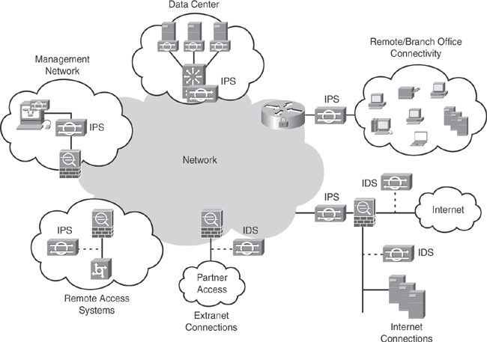
Deploying IPS
Figure: Cisco IDS/IPS Network wide Deployment
Notes:
Cisco offers a wide range of IDS/IPS solutions that can be deployed in various network segments throughout the network architecture as required. These comprehensive deployment methods offer solutions from small- and medium-sized to large-scale network environments.

Slide 11
Cisco IPS Sensor OS Software
Cisco IPS Sensor software version 6.0 is a comprehensive, end-to-end protection solution for network-based sensors that delivers the latest IPS capabilities, enhanced performance, security improvements, and a range of new enhanced features.
Cisco IPS Sensor Software supports both the IDS and IPS capabilities for hybrid operation, acting simultaneously as an IDS sensor and an IPS sensor.
Notes:
The IPS sensor software is an end to end protection solution for network based sensors delivering IPS capabilities, increased performance and security.
This IPS Sensor Software offers intrusion detection and prevention capabilities to shield the network from multiple threats and safeguard it from both known and unknown attacks before they can affect the network. It can act simultaneously as an IPS sensor and IDS sensor.

Slide 12
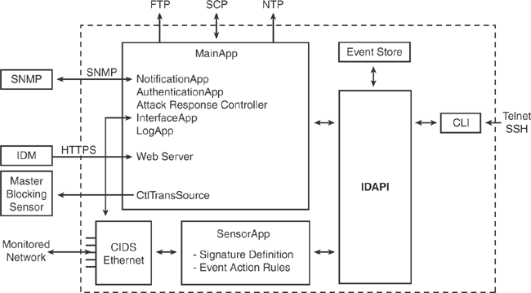
Cisco IPS Sensor Software
Figure 20-6. Cisco IPS Sensor Software System Design
Notes:
The Cisco IPS Sensor OS Software runs on the Linux operating system. The underlying Linux OS has been secured and hardened by removing unnecessary packages from the OS, disabling unused services, restricting network access, and removing access to the shell. This has different components such as– MainApp, CLI (Command Line Interface), SensorApp, Event Store.

Slide 13
Components of Cisco IPS Sensor Software
MainApp
Event Store
SensorApp (Analysis Engine)
Command Line Interface (CLI)
Notes:
MainApp: it is the core engine of the sensor operating system. It is responsible for all major functions, including managing the system processes, configuring the system, starting and stopping other applications, and performing routine maintenance.
Event Store: It is the storage place for all sensor events such as – system messages, errors, alerts.
SensorApp (also known as Analysis Engine): It provides the packet capturing and analyzing capability when monitoring the traffic.
CLI: The command-line interface is the interface through which a user can manage and configure the sensor. CLI can be accessed by using various methods, including direct sensor console, Telnet, or SSH connections.

Slide 14
MainApp
NotificationApp
AuthenticationApp
Attack Response Controller (ARC)
InterfaceApp
LogApp
Web Server
ctlTransSource (Control Transaction server)
Notes:
The MainApp has several sub components:
NotificationApp is responsible for sending SNMP traps that are triggered by sensor alarms, system status, or errors. NotificationApp is also used to capture sensor health through SNMP GET.
AuthenticationApp is responsible for validating user credentials that verify authorization status when a user is performing various configuration and management tasks.
Attack Response Controller (ARC) provides the blocking and shunning capability to the sensor when a signature is triggered. ARC is responsible for managing network devices (routers, switches and firewalls) and can remotely log in to these network devices to dynamically apply access control lists (ACLs).
InterfaceApp: Manages sensor interface settings, such as inline pair, admin state, and bypass mechanism.
LogApp: Responsible for storing all the application logs to a log file on the sensor and all the error messages to the Event Store.
Web Server: The web-based server engine enables the user to manage the sensor through a GUI interface. It also provides the communication interface to other IPS devices that use the RDEP2 protocol.
ctlTransSource (also known as Control Transaction server): Responsible for sending control transactions that are mainly used to enable ARC's master blocking sensor capability.

Slide 15
Sensor Software—Communication Protocols
IDAPI
RDEP2
IDIOM
IDCONF
SDEE
CIDEE
Notes:
The sensor OS applications communicate with each other through a common API called IDAPI. External remote applications (such as other sensors, management applications, and third-party software) communicate with the sensor through RDEP2 and SDEE protocols. This section describes the various communication protocols used by the Cisco IPS sensor software.
IDAPI: The IPS applications use a interprocess communication API called IDAPI to communicate with each other. IDAPI is used to handle internal communications within the software architecture. Each application registers to the IDAPI to send and receive events and control transactions. IDAPI is the binding interface through which all the applications communicate.
RDEP2: RDEP2 is another communication protocol used in the IPS sensor software, primarily for external communications. RDEP2 is an application-level communications protocol used to exchange IPS events, IP logs, configurations, and control messages between IPS clients and IPS servers. RDEP2 communications consist of request and response messages between RDEP2 clients and RDEP2 servers.
IDIOM: IDIOM is a data format standard that defines the event messages reported by the IPS, as well as the operational messages which are used to configure and control intrusion-detection systems.
IDCONF: Cisco IPS sensor software manages its configuration by using XML documents. IDCONF specifies the XML schema including IPS control transactions.
SDEE: It is the extension of RDEP2 protocol.
CIDEE: extension to SDEE protocol.

Slide 16
Sensor Software—User Roles
Administrator
Operator
Viewer
Service
Notes:
The CLI for the sensor software permits multiple users to connect to the sensor at the same time. Users can be created locally in the sensor configuration. Each user is associated with a specific role that controls the user privileges and an established boundary of what the user can and cannot do.
Administrator: This user role has the highest level of privileges. Administrators have unrestricted view access and can perform all functions on the sensor.
Operator: This user role has the second-highest level of privileges. Operators have unrestricted view access and can perform limited functions such as tuning signatures, modifying their own passwords, and assigning configuration to virtual sensors.
Viewer: This user role has the lowest level of privileges. Viewers can view configuration and event data and can modify their own passwords.
Service: This user role does not have direct access to the CLI. It is a special role that allows bypassing the CLI.

Slide 17
Sensor Software—Partitions
Application partition
Maintenance partition
Recovery partition
Notes:
The IPS sensor software has 3 partitions:
Application partition: The main partition, which holds the full IPS system image.
Maintenance partition: It is a special purpose IPS image. It is used to reimage the application partition. When the maintenance partition is reimaged, all configuration settings are lost.
Recovery partition: It is used for the recovery of the sensor. Booting into the recovery partition enables you to completely reimage the application partition. Network settings are preserved, but all other configuration is lost.

Slide 18
Sensor Software—Signatures and Signature Engines
Signature: A signature is a description of a network traffic pattern that attackers use while conducting network-based attacks.
Signature Engine: A signature engine is a component of the Cisco IPS that is designed to support many signatures in a certain category.
The signature engines are designed to perform a wide range of functions, such as pattern matching, stateful pattern matching, protocol decoding, deep-packet inspection, and other heuristic methods.
Notes:
The network-based IPS sensor monitors network traffic with a collection of predefined and user-defined signatures that can be grouped into various signature engines.
The IPS sensor monitors network traffic and generates alerts when it detects malicious activity by matching the traffic to specific signatures. Cisco IPS Sensor Software is preloaded with a wide range of signatures for varying protocols. The sensor software also supports the configuration of user-defined custom signatures.
The sensor software uses the signature engines to examine network traffic for intrusive activity with similar characteristics. For example, the TCP-based string engine handles signatures that search for specific textual strings in TCP traffic only.

Slide 19
Sensor Software—IPS Events
Types of IPS data that are communicated by various functional units:
Intrusion events
Error events
Status events
Control transaction log events
Attack response events
Debug events
Control transaction events
Notes:
The sensor software's system applications generate various IPS events to report the occurrence of some stimulus. Every event is a data representation—for example, the alerts generated by SensorApp or errors generated by any application.
IPS events are generated on demand by the application instances within the sensor OS. They usually do not have a specific destination. They are stored locally and then retrieved by one or more application instances as needed.
The following seven types of data are communicated by the various functional units in the sensor software:
Intrusion events: Events produced by SensorApp. The sensor detects and reports the intrusion events.
Error events: Events caused by any hardware or software malfunctions.
Status events: Events reported when changes in the application's status occur; for example, the sensor configuration has been updated.
Control transaction log events: Results of a control transaction logged by the sensor.
Attack response events are the actions for the Attack Response Controller (ARC); for example, a block request was triggered.
Debug events: Events used for troubleshooting and debugging that provide detailed status.
Control transaction data: Data associated with control transactions—for example, session logs and configuration data to or from an application.
These types of data are collectively referred to as IPS data.

Slide 20
Types of IPS events
evAlert
evStatus
evError
evLogTransaction
evShunRqst
Notes:
evAlert: These are alert event messages, generated to report a signature being triggered. SensorApp writes these events into the event store. Alert events can be viewed by using the CLI and IDM Event Viewer.
evStatus: These are Status event messages, generated to report the status and actions of the IPS applications.
evError: Error event messages , generated to report errors that occurred while attempting response actions.
evLogTransaction: Log transaction messages ,generated to report the control transactions processed by each sensor application.
evShunRqst: Block request messages are generated to report when the Attack Response Controller (ARC) issues a block request.
Each IPS event is stored in the local sensor database known as the Event Store.
Each event is stored with a time stamp and a unique, monotonic, ascending ID. SensorApp is the only application that writes "alert" events into the Event Store. All other applications write log, status, and error events into the Event Store.
An IPS event action is triggered when a signature is matched and an action is required to mitigate the situation.

Slide 21
Sensor Software—IPS Risk Rating (RR)
RR allows users to make informed decisions on the IPS inline drop actions and provides users with greater confidence by enhancing the reliability of the inline deployment.
RR is a multidimensional formula that is applied on a per-signature basis. RR has a value between 0 and 100; the higher the RR value, the greater the confidence that the event detected is an indication of malicious activity.
Notes:
The IPS sensor software offers a unique Risk Rating (RR) numerical integer that allows users to make informed decisions on the IPS inline drop actions. RR is primarily used internally and is a significant number within the sensor to determine the proper action to take on an event.
RR is a multidimensional formula that is applied on a per-signature basis. The RR is calculated from several components. RR has a value between 0 and 100; the higher the RR value, the greater the confidence that the event detected is an indication of malicious activity.
RR represents a numerical quantification of the risk associated with a particular event on the network. The calculation takes into account the value of the network asset being attacked (for example, a server), so it is configured on a per-signature basis.
The RR is reported in the evIdsAlert.

Slide 22
Risk Rating Calculation
Signature Fidelity Rating (SFR)
Attack Severity rating (ASR)
Target Value Rating (TVR)
Attack Relevancy Rating (ARR)
Promiscuous Delta (PD)
Watch List Rating (WLR)
RR = ((ASR*TVR*SFR)/10000)+ARR-PD+WLR
Notes:
Signature Fidelity Rating (SFR): A weight associated with how well this signature might perform in the absence of specific knowledge of the target. The SFR is configured per signature and indicates how accurately the signature detects the event or condition it describes..
Attack Severity Rating (ASR): A weight associated with the severity of a successful exploit of the vulnerability. The ASR is configured per signature and indicates how dangerous the event detected is.
Target Value Rating (TVR): A weight associated with the perceived value of the target. TVR is a user-configurable value (zero, low, medium, high, or mission critical) that identifies the importance of a network asset (through its IP address). For example, assign a higher TVR value to the web server than the TVR assigned to a desktop node. TVR is configured in the Event Action Rules policy.
Attack Relevancy Rating (ARR): A weight associated with the relevancy of the targeted OS. ARR is a derived value (relevant, unknown, or not relevant) is determined at alert time.
Promiscuous Delta (PD): A weight associated with the PD is in the range of 0 to 30 and is configured per signature.
Watch List Rating (WLR): A weight associated with the CSA MC watch-list in the range of 0 to 100. (CSA MC only uses the range 0 to 35.) If the attacker for the alert is found on the watch list, the WLR for that attacker is added to the rating.
The formula to calculate the RR follows:
RR = ((ASR*TVR*SFR)/10000)+ARR-PD+WLR

Slide 23
Sensor Software—IPS Interfaces
Command and control interface
Sensing interface (aka Sniffing interface)
Notes:
The Command and Control interface is used for managing and configuring the sensor. It has an IP address and is permanently enabled. It receives security and status events from the sensor and queries the sensor for statistics. Command and Control interface is statically mapped to a specific physical interface depending on the sensor model. This mapping cannot be changed, and this interface cannot be used as a sensing interface.
Sensing interfaces are purpose-built interfaces used by the sensor to monitor and analyze network traffic. Each sensor has one or more sensing interfaces depending on the sensor model. Sensing interfaces can operate individually in promiscuous mode, or they can be paired to create inline interfaces for inline sensing mode.

Slide 24
Sensor Software—IPS Interface Modes
Promiscuous mode
Inline interface mode
Inline VLAN pair mode
VLAN Group mode
Notes:
Promiscuous mode: Packets in promiscuous mode do not flow through the sensor. The sensor depends on a mirrored copy of the packet sent to the sensor. The sensor analyzes the copy of the packet rather than the actual packet on the wire. The packets are copied using network taps, the traffic mirroring SPAN feature, or selective mirroring using the VACL feature on the switch.
Inline interface mode: This type of mode is the most effective method for detecting and preventing network intrusion. Inline interface mode puts the sensor directly in the middle of the traffic flow. The inline mode will affect packet-forwarding rates by making them slower and adding latency.
Inline VLAN pair mode: Inline VLAN pair mode is also known as Inline-on-a-Stick. This mode is similar to the inline interface mode, with an extended enhanced capability to associate VLANs in pairs on a physical interface. Therefore, it is known as inline VLAN pair mode.
VLAN group mode: In VLAN Group mode, each physical interface or inline interface can be divided into VLAN group subinterfaces, each of which consists of a group of VLANs on that particular interface. VLAN Group mode provides the capability of applying multiple policies to the same sensor.

Slide 25
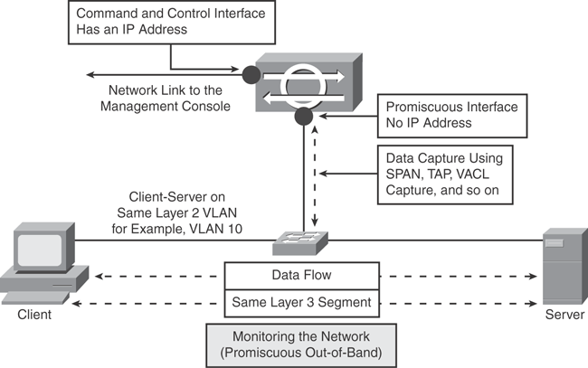
Promiscuous mode
Figure: Cisco IDS Sensor in Promiscuous Mode
Notes:
This is the command and control interface, which has an IP address. This is the promiscuous interface having no IP address. The data is being exchanged between client and server. This data is captured using SPAN, TAP, VACL capture, etc. There is no effect on transmission of data between client and server.
Monitoring traffic in promiscuous mode can be seen as an advantage because the sensor does not affect the packet flow with the forwarded traffic. However, the disadvantage is that the sensor cannot stop malicious traffic from reaching its intended target for certain types of attacks, such as atomic attacks (single-packet attacks).

Slide 26
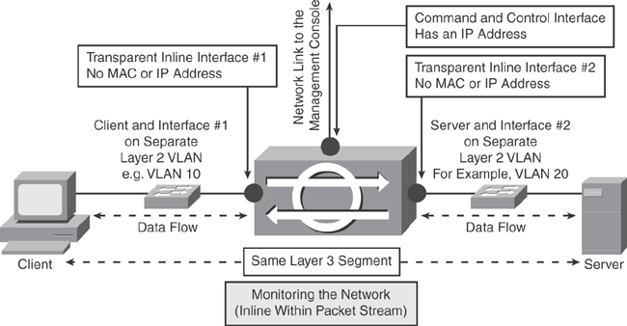
Inline interface mode
Figure: Cisco IPS Sensor in Inline Interface Mode
Notes:
Inline mode gives the IPS sensor the capability to drop malicious traffic and stop attacks before they reach the intended target, thus providing a preventive protection service.
Inline mode analyzes traffic not only on Layer 3 and 4, but it also inspects upper layers within the payload of the packet for more sophisticated embedded attacks (Layers 3 to 7).
In inline interface pair mode, a packet comes in through the first interface of the pair on the sensor and goes out the second interface of the pair. The packet is sent to the second interface of the pair unless that packet is being denied or modified by a signature.
A Layer 2 segmentation is required for inline mode to work; that is, the client and the first interface are on a separate VLAN, whereas the server and the second interface are on a separate VLAN. The Layer 3 network remains unchanged.

Slide 27
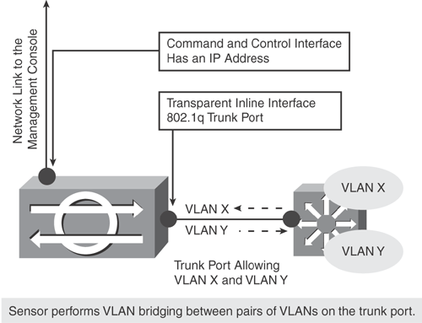
Inline VLAN pair mode
Figure: Cisco IPS Sensor in Inline VLAN Pair Mode
Notes:
The sensing interface in the inline VLAN pair mode acts as an 802.1q trunk port, and the sensor performs VLAN bridging between pairs of VLANs on the trunk port.
Packets received on one of the paired VLANs are analyzed and then forwarded to the other VLAN in the pair. The sensor bridges VLANs together on the same physical interface by creating, in effect, subinterfaces that allow the sensor to bring packets incoming on VLAN X and outgoing on VLAN Y.
The sensor inspects the traffic it receives on each VLAN in each pair and can either forward the packets on the other VLAN in the pair or drop the packet if an intrusion attempt is detected. The IPS sensor can be configured to simultaneously bridge up to 255 VLAN pairs on each sensing interface.
The advantage of inline VLAN pairing mode is that multiple VLAN pairs per physical interface reduce the need to have many physical interfaces per chassis.

Slide 28
VLAN Group mode
In VLAN Group mode, each physical interface or inline interface can be divided into VLAN group subinterfaces, each of which consists of a group of VLANs on that particular interface. With the introduction of multiple virtual sensors, the sensor can monitor one or more of these interfaces.
VLAN Group mode provides the capability of applying multiple policies to the same sensor. This allows the sensor to emulate multiple interfaces; with only a few interfaces, the sensor can seem to have many interfaces.

Slide 29
Sensor Software—IPS Blocking (Shun)
Host block: Blocks all traffic from a given IP address.
Connection block: Blocks all traffic from a specific source IP address to a given destination IP address and destination port.
Network block: Blocks all traffic from a given network subnet.
Notes:
Cisco IPS Sensor software supports dynamic response action by blocking the offending traffic during an attack. The Attack Response Controller (ARC) function in the sensor software is responsible for managing network devices to respond to suspicious events by blocking (shunning) network access from attacking hosts and networks.
There are 3 types of blocking: Host block, Connection block, Network block
The ARC performs blocking by using Access control lists. Other non-IOS devices and security appliances that do not support ACL use the shun function to enforce blocking.

Slide 30
Sensor Software—IPS Rate Limiting
It provides the capability of reducing the effect of a denial of service (DoS) attack or network attack, instead of blocking it entirely.
Notes:
In addition to blocking, the Cisco IPS Sensor software also supports dynamic response action by rate limiting traffic in protected networks for specified traffic classes on network devices. The Attack Response Controller (ACR) is responsible for rate limiting.
The rate limiting feature provides the capability of reducing the effect of a denial of service (DoS) attack or network attack, instead of blocking it entirely.

Slide 31
Sensor Software—IPS Virtualization
Virtual sensors can be effectively used to monitor multiple data streams, apply different configurations to different sets of traffic, monitor two network segments with overlapping IP spaces with one sensor, or monitor concurrently both the inside and outside of a firewall with one sensor.
Multiple virtual sensors can be hosted on the same appliance, each configured with different signature behavior and traffic feeds.
Each virtual sensor is associated with a specifically named signature definition, event action rules, and anomaly detection configuration.
The sensor can receive data inputs from one or many monitored data streams.
Notes:
The IPS sensor software uses the SensorApp to perform packet analysis and alert detection. The sensor monitors traffic that flows through specified interfaces mentioned previously.
The IPS Sensor Software OS Version 6.0 introduces the concept of virtualization, whereby virtual sensors can be created in the Analysis Engine. Version 6.0 supports up to four virtual sensors.

Slide 32
Sensor Software—IPS Security Policies
Signature definition policy
Event action rules policy
Anomaly detection policy
Notes:
The IPS Sensor Software OS allows the creation of multiple security policies and the application of those multiple policies to the individual virtual sensors.
Multiple security policies can be customized and created for multiple virtual sensors based on different requirements and can be applied per VLAN or physical interface.

Slide 33
Sensor Software—IPS Anomaly Detection (AD)
The AD solution detects worm-infected hosts and worm-based attacks.
AD detects the following two situations:
  The network starts to become congested by worm traffic.
  A single worm-infected source enters the network and starts scanning for other vulnerable hosts.
Notes:
IPS Sensor Software OS Version 6.0 introduces the Anomaly Detection (AD) function built in to the sensor software architecture.

Slide 34
Zones in IPS AD
Internal zone
Illegal zone
External zone
Notes:
The AD works by subdividing the network into various zones, thereby enabling it to characterize the traffic patterns. A zone is a set of destination IP addresses.
Internal zone: All the traffic that comes to your IP address range. Configure the internal zone with the IP address range of the internal network. By default, the internal zone contains no IP address range.
Illegal zone: The range of IP addresses that should never be seen in normal traffic—for example, unallocated IP addresses or part of your internal IP address range that is unused. Packets that do not match the set of IP addresses in the internal or illegal zone are handled by the external zone. By default, the illegal zone contains no IP address range.
External zone: All the traffic that goes to the Internet. The external zone is the default zone with the default range of 0.0.0.0–255.255.255.255.

Slide 35
Modes in AD
Learn mode
Detect mode
Inactive mode
Notes:
The sensor does not depend on signatures. Instead, it learns primarily normal activity and establishes the network baseline for predictable behavior patterns.
Initially, the AD conducts a learning process when the most normal state of the network is reflected. Using this baseline, AD derives a set of policy thresholds that best fit the normal network.
After a normal network baseline is established, the sensor can detect any anomalies that deviated from the normal behavior pattern and take dynamic response actions accordingly.
There are 3 modes in Anomaly detection:
Learn mode: As mentioned earlier, AD is in the initial learning mode for the default period of 24 hours that is required to establish the normal baseline of the network. This is assuming that during this phase (learning), no attack is being carried out, or else the baseline will be misled. The initial baseline is known as the knowledge base (KB) of the network traffic.
Detect mode: This is the default mode for the AD, and for ongoing operation, the sensor should remain in detect mode 24 hours a day, 7 days a week. In this mode, the AD detects attacks based on the initial KB. AD will send alerts for any traffic flows that violate thresholds in the KB or that deviate from the normal behavior pattern. In addition, the AD records gradual changes to the KB that do not violate the thresholds and thus creates a new KB. The new KB is periodically saved and takes the place of the old KB, thus maintaining an up-to-date KB.
Inactive mode: This mode is used to disable AD monitoring by putting it in the inactive mode. Under certain circumstances, AD should be in inactive mode—for example, if the sensor is running in an asymmetric environment.

Slide 36
IPS High Availability
High availability is defined as building into the network the capability of the network to cope with the loss of a component while preserving network functionality.
There are three possible solutions to resolve situations in which the inline IPS device may fail:
  Fail- open mechanism
  Failover mechanism
  Load- balancing mechanism
Notes:
Deploying an IPS sensor into the inline mode introduces a new device in the data path that can possibly fail and prevent traffic from flowing.
Fail-open mechanism: A hardware or software fail-open mechanism that is able to detect problems and bypass the sensor, in the event of a device failure. Traffic stream should go uninterrupted through the device without inspection when required.
Failover mechanism: A redundancy mechanism that can provide one or more data paths through the network to allow packets, in the event of a device failure. The secondary path can be set up to either go through a backup IPS sensor or through a plain wire.
Load-balancing mechanism: A hardware or software load-balancing feature to split the traffic load across multiple devices; this can achieve both higher data rates and redundant paths in the event of a device failure.

Slide 37
Fail- open mechanism
Hardware-based fail-open mechanism
Software-based fail-open mechanism
Notes:
The hardware-based fail-open mechanism works by closing a circuit based on power loss, link failure, or potential software triggers. The hardware-based fail-open mechanism provides uninterrupted access to the network, thereby allowing packets to pass directly uninspected, bypassing the sensor. The hardware-based bypass is not efficient and remains a single point of failure because a physical layer failure or a problem in a device can still cause the network to shut down.
The software-based fail-open mechanism works by building the intelligence within the sensor software, through a built-in software feature that passes packets when a failure is detected. This feature is in most cases user configurable, allowing a user three choices: On, Off, and Auto. The Bypass Off prevents a bypass from occurring. This is designed for network instances where the flow of uninspected is not desired. The Bypass On forces the sensor to pass all packets uninspected. This is useful for troubleshooting when a network problem is detected dynamically, and the IPS device is a suspect. The Bypass Auto lets the sensor inspect packets until for some reason the sensor is not forwarding the packets. At that point, the Bypass Auto feature comes into action to ensure that traffic continues to flow uninterrupted and uninspected.

Slide 38
Failover mechanism
Layer 3: PIX/ASA Failover, Cisco IOS HSRP
Layer 2: Spanning Tree
Notes:
Network failover allows the network to recover from a device or physical layer failure.
Traditional IPS sensors (usually the non-Layer 3) cannot detect or control network failover. Traditional IPS sensors function like a wire, and a failure of the sensor would look like a failure of a wire. The network will respond accordingly. Fail-open capabilities may help but cannot truly solve the issue.

Slide 39
Load-Balancing Technique
Cisco IPS sensors can be deployed inline as part of an EtherChannel (EC) to provide redundancy.

Slide 40
Summary
Networks today are becoming increasingly vulnerable to hostile attacks and infections such as viruses and worms that spread rapidly, crippling the entire network. With this growing threat, networks need to be designed and equipped with the sophisticated intelligence to diagnose and mitigate these threats in real-time.
The chapter examined the core concepts for the Cisco IPS Sensor OS Software, such as the sensor system architecture, sensor communication protocols, signature and signature engines, IPS events and event actions, IPS Virtualization, and load-balancing techniques.

Slide 41
References
Bhaji, Yusuf. CCIE Professional Development Series Network Security Technologies and Solutions. 2008.
Information on trunk port- http://www.cisco.com/en/US/docs/switches/datacenter/nexus5000/sw/configuration/guide/cli/AccessTrunk.pdf
Signature engine- http://www.cisco.com/en/US/docs/security/ips/5.1/configuration/guide/idm/dmSgEng.html#wp1044249
Sensor software-http://www.cisco.com/en/US/docs/security/ips/5.1/configuration/guide/idm/dmArch.html

Slide 42
Thank you!!!!

