Slide 1

Network Security Essentials
Sixth Edition
by William Stallings
Notes:
Lecture slides prepared for “Network Security Essentials”, 6/e, by William Stallings, Chapter 9 – “IP Security”.

Slide 2
Chapter 9
IP Security
Notes:
There are application-specific security mechanisms for a number of application
areas, including electronic mail (S/MIME, PGP), client/server (Kerberos), Web access
(Secure Sockets Layer), and others. However, users have security concerns that
cut across protocol layers. For example, an enterprise can run a secure, private IP
network by disallowing links to untrusted sites, encrypting packets that leave the
premises, and authenticating packets that enter the premises. By implementing security
at the IP level, an organization can ensure secure networking not only for
applications that have security mechanisms but also for the many security-ignorant
applications.
IP-level security encompasses three functional areas: authentication, confidentiality,
and key management. The authentication mechanism assures that a received
packet was, in fact, transmitted by the party identified as the source in the packet
header. In addition, this mechanism assures that the packet has not been altered in
transit. The confidentiality facility enables communicating nodes to encrypt messages
to prevent eavesdropping by third parties. The key management facility is concerned
with the secure exchange of keys.
We begin this chapter with an overview of IP security (IPsec) and an introduction
to the IPsec architecture. We then look at each of the three functional areas in
detail. Appendix D reviews Internet protocols.

Slide 3
outline
9.1 IP Security Overview
9.2 IP Security Policy
9.3 Encapsulating Security Payload
9.4 Combining Security Associations
9.5 Internet Key Exchange
9.6 Cryptographic Suites
Notes:
333 In 1994, the Internet Architecture Board (IAB) issued a report titled “Security in
the Internet Architecture” (RFC 1636). The report identified key areas for security
mechanisms. Among these were the need to secure the network infrastructure from
unauthorized monitoring and control of network traffic and the need to secure end-user-
to-end-user traffic using authentication and encryption mechanisms.
To provide security, the IAB included authentication and encryption as necessary
security features in the next-generation IP, which has been issued as IPv6.
Fortunately, these security capabilities were designed to be usable both with the
current IPv4 and the future IPv6. This means that vendors can begin offering these
features now, and many vendors now do have some IPsec capability in their products.
The IPsec specification now exists as a set of Internet standards.

Slide 4
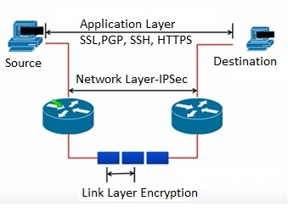
Security at different layers
Source: https://www.rfwireless-world.com/Terminology/IPsec.html

Slide 5
IP Security Overview
RFC 1636
  “Security in the Internet Architecture”
  Issued in 1994 by the Internet Architecture Board (IAB)
  Identifies key areas for security mechanisms
    Need to secure the network infrastructure from unauthorized monitoring and control of network traffic
    Need to secure end-user-to-end-user traffic using authentication and encryption mechanisms
  IAB included authentication and encryption as necessary security features in the next generation IP (IPv6)
    The IPsec specification now exists as a set of Internet standards
Notes:
555 In 1994, the Internet Architecture Board (IAB) issued a report titled “Security in
the Internet Architecture” (RFC 1636). The report identified key areas for security
mechanisms. Among these were the need to secure the network infrastructure from
unauthorized monitoring and control of network traffic and the need to secure end-user-
to-end-user traffic using authentication and encryption mechanisms.
To provide security, the IAB included authentication and encryption as necessary
security features in the next-generation IP, which has been issued as IPv6.
Fortunately, these security capabilities were designed to be usable both with the
current IPv4 and the future IPv6. This means that vendors can begin offering these
features now, and many vendors now do have some IPsec capability in their products.
The IPsec specification now exists as a set of Internet standards.

Slide 6
Applications of IPsec
IPsec provides the capability to secure communications across a LAN, private and public WANs, and the Internet
Principal feature of IPsec is that it can encrypt and/or authenticate all traffic at the IP level.
  Thus all distributed applications (remote logon, client/server, e-mail, file transfer, Web access) can be secured
Examples include:
Secure branch office connectivity over the Internet
Secure remote access over the Internet
Establishing extranet and intranet connectivity with partners
Enhancing electronic commerce security
Notes:
IPsec provides the capability to secure communications across a LAN, across private
and public WANs, and across the Internet. Examples of its use include:
• Secure branch office connectivity over the Internet: A company can build a
secure virtual private network over the Internet or over a public WAN. This
enables a business to rely heavily on the Internet and reduce its need for private
networks, saving costs and network management overhead.
• Secure remote access over the Internet: An end user whose system is equipped
with IP security protocols can make a local call to an Internet Service Provider
(ISP) and gain secure access to a company network. This reduces the cost of
toll charges for traveling employees and telecommuters.
• Establishing extranet and intranet connectivity with partners: IPsec can be
used to secure communication with other organizations, ensuring authentication
and confidentiality and providing a key exchange mechanism.
• Enhancing electronic commerce security: Even though some Web and electronic
commerce applications have built-in security protocols, the use of IPsec
enhances that security. IPsec guarantees that all traffic designated by the network
administrator is both encrypted and authenticated, adding an additional
layer of security to whatever is provided at the application layer.
The principal feature of IPsec that enables it to support these varied applications
is that it can encrypt and/or authenticate all traffic at the IP level. Thus, all
distributed applications (including remote logon, client/server, e-mail, file transfer,
Web access, and so on) can be secured.

Slide 7
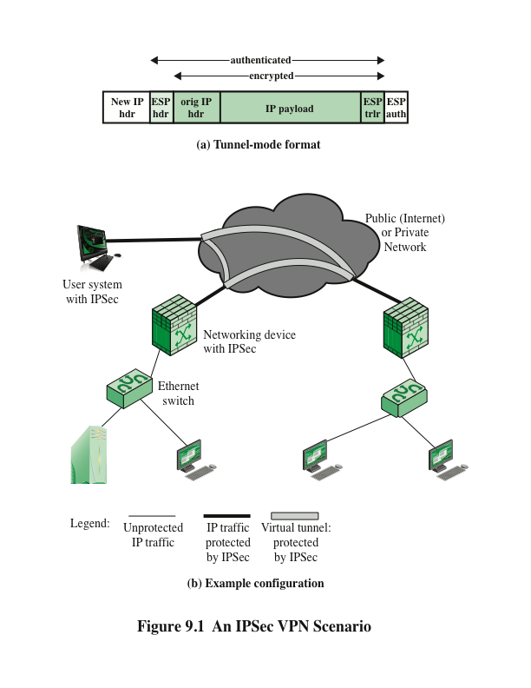
ESP: Encapsulating Security Payload
Notes:
Figure 9.1a shows a simplified packet format for
an IPsec option known as tunnel mode, described subsequently. Tunnel mode makes
use of an IPsec function, a combined authentication/encryption function
called Encapsulating Security Payload (ESP), and a key exchange function. For VPNs,
both authentication and encryption are generally desired, because it is important
both to (1) assure that unauthorized users do not penetrate the VPN, and (2) assure
that eavesdroppers on the Internet cannot read messages sent over the VPN.
Figure 9.1b is a typical scenario of IPsec usage. An organization maintains
LANs at dispersed locations. Nonsecure IP traffic is conducted on each LAN. For
traffic offsite, through some sort of private or public WAN, IPsec protocols are used.
These protocols operate in networking devices, such as a router or firewall, that
connect each LAN to the outside world. The IPsec networking device will typically
encrypt all traffic going into the WAN and decrypt traffic coming from the WAN;
these operations are transparent to workstations and servers on the LAN. Secure
transmission is also possible with individual users who dial into the WAN. Such user
workstations must implement the IPsec protocols to provide security.

Slide 8
Benefits of IPSec
Some of the benefits of IPsec:
  When IPsec is implemented in a firewall or router, it provides strong security that can be applied to all traffic crossing the perimeter.
    Traffic within a company or workgroup does not incur the overhead of security-related processing.
  IPsec in a firewall is resistant to bypass if all traffic from the outside must use IP and the firewall is the only means of entrance from the Internet into the organization
  IPsec is below the transport layer (TCP, UDP) and so is transparent to applications.
    There is no need to change software on a user or server system when IPsec is implemented in the firewall or router.
  IPsec can be transparent to end users.
    There is no need to train users on security mechanisms, issue keying material on a per-user basis, or revoke keying material when users leave the organization.
  IPsec can provide security for individual users if needed.
    This is useful for offsite workers and for setting up a secure virtual subnetwork within an organization for sensitive applications.
Notes:
Some of the benefits of IPsec:
• When IPsec is implemented in a firewall or router, it provides strong security
that can be applied to all traffic crossing the perimeter. Traffic within
a company or workgroup does not incur the overhead of security-related
processing.
• IPsec in a firewall is resistant to bypass if all traffic from the outside must use
IP and the firewall is the only means of entrance from the Internet into the
organization.
• IPsec is below the transport layer (TCP, UDP) and so is transparent to applications.
There is no need to change software on a user or server system when
IPsec is implemented in the firewall or router. Even if IPsec is implemented in
end systems, upper-layer software, including applications, is not affected.
• IPsec can be transparent to end users. There is no need to train users on security
mechanisms, issue keying material on a per-user basis, or revoke keying
material when users leave the organization.
• IPsec can provide security for individual users if needed. This is useful for offsite
workers and for setting up a secure virtual subnetwork within an organization
for sensitive applications.

Slide 9
Routing Applications of IPsec
IPsec can play a vital role in the routing architecture required for internetworking.
IPsec can assure that:
A router advertisement comes from an authorized router
A router seeking to establish or maintain a neighbor relationship with a router in another routing domain is an authorized router
A redirect message comes from the router to which the initial IP packet was sent
A routing update is not forged
Notes:
In addition to supporting end users and protecting premises systems and networks,
IPsec can play a vital role in the routing architecture required for internetworking.
[HUIT98] lists the following examples of the use of IPsec. IPsec can assure that
• A router advertisement (a new router advertises its presence) comes from an
authorized router.
• A neighbor advertisement (a router seeks to establish or maintain a neighbor
relationship with a router in another routing domain) comes from an authorized
router.
• A redirect message comes from the router to which the initial IP packet was sent.
• A routing update is not forged.
Without such security measures, an opponent can disrupt communications or
divert some traffic. Routing protocols such as Open Shortest Path First (OSPF) should
be run on top of security associations between routers that are defined by IPsec.

Slide 10
IPsec Documents
Covers the general concepts, security requirements, definitions, and mechanisms defining IPsec technology
The current specification is RFC4301, Security Architecture for the Internet Protocol
Authentication Header (AH)
An extension header to provide message authentication
The current specification is RFC 4302, IP Authentication Header
Encapsulating Security Payload (ESP)
Consists of an encapsulating header and trailer used to provide encryption or combined encryption/authentication
The current specification is RFC 4303, IP Encapsulating Security Payload (ESP)
A collection of documents describing the key management schemes for use with IPsec
The main specification is RFC 7296, Internet Key Exchange (IKEv2) Protocol, but there are a number of related RFCs
Cryptographic algorithms
This category encompasses a large set of documents that define and describe cryptographic algorithms for encryption, message authentication, pseudorandom functions (PRFs), and cryptographic key exchange
Other
There are a variety of other IPsec-related RFCs, including those dealing with security policy and management information base (MIB) content
Architecture
Internet Key Exchange (IKE)
Notes:
IPsec encompasses three functional areas: authentication, confidentiality, and key
management. The totality of the IPsec specification is scattered across dozens of
RFCs and draft IETF documents, making this the most complex and difficult to
grasp of all IETF specifications. The best way to grasp the scope of IPsec is to consult
the latest version of the IPsec document roadmap, which as of this writing is RFC
6071 [IP Security (IPsec) and Internet Key Exchange (IKE) Document Roadmap ,
February 2011]. The documents can be categorized into the following groups.
• Architecture: Covers the general concepts, security requirements, definitions,
and mechanisms defining IPsec technology. The current specification is RFC
4301, Security Architecture for the Internet Protocol .
• Authentication Header (AH): AH is an extension header to provide message
authentication. The current specification is RFC 4302, IP Authentication
Header . Because message authentication is provided by ESP, the use of AH
is deprecated. It is included in IPsecv3 for backward compatibility but should
not be used in new applications. We do not discuss AH in this chapter.
• Encapsulating Security Payload (ESP): ESP consists of an encapsulating
header and trailer used to provide encryption or combined encryption/authentication.
The current specification is RFC 4303, IP Encapsulating Security
Payload (ESP) .
• Internet Key Exchange (IKE): This is a collection of documents describing the
key management schemes for use with IPsec. The main specification is RFC
7296, Internet Key Exchange (IKEv2) Protocol , but there are a number of
related RFCs.
• Cryptographic algorithms: This category encompasses a large set of documents
that define and describe cryptographic algorithms for encryption, message authentication,
pseudorandom functions (PRFs), and cryptographic key exchange.
• Other: There are a variety of other IPsec-related RFCs, including those dealing
with security policy and management information base (MIB) content.

Slide 11
IPsec Services
IPsec provides security services at the IP layer by enabling a system to:
  Select required security protocols
  Determine the algorithm(s) to use for the service(s)
  Put in place any cryptographic keys required to provide the requested services
  Recall the two-phased approach with secure network communications:
    Phase one: Before data exchanges between two ends, security parameters are negotiated and SAs (security associations) are created; shared keys are also produced.
    Phase two: IPsec packets are exchanged between the two ends.
  RFC 4301 lists the following services:
  Access control
  Connectionless integrity
  Data origin authentication
  Rejection of replayed packets (a form of partial sequence integrity)
  Confidentiality (encryption)
  Limited traffic flow confidentiality
Notes:
IPsec provides security services at the IP layer by enabling a system to select required
security protocols, determine the algorithm(s) to use for the service(s), and
put in place any cryptographic keys required to provide the requested services. Two
protocols are used to provide security: an authentication protocol designated by the
header of the protocol, Authentication Header (AH); and a combined encryption/
authentication protocol designated by the format of the packet for that protocol,
Encapsulating Security Payload (ESP). RFC 4301 lists the following services:
• Access control
• Connectionless integrity
• Data origin authentication
• Rejection of replayed packets (a form of partial sequence integrity)
• Confidentiality (encryption)
• Limited traffic flow confidentiality

Slide 12
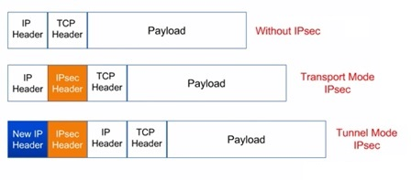
Ipsec modes
In the Transport mode, the original IP header is kept.
In the Tunnel mode, a new IP header is added.
Source of diagram: https://www.rfwireless-world.com/Terminology/IPsec.html

Slide 13
Ipsec modes (cont.)
Transport Mode
Provides protection primarily for upper-layer protocols
Examples include a TCP or UDP segment or an ICMP packet
Typically used for end-to-end communication between two hosts
ESP in transport mode encrypts and optionally authenticates the IP payload but not the IP header.
AH in transport mode authenticates the IP payload and selected portions of the IP header.
Tunnel Mode
Provides protection to the entire IP packet
Used when one or both ends of a security association (SA) are a security gateway
A number of hosts on networks behind firewalls may engage in secure communications without implementing IPsec. Q: a valid assumption?
ESP in tunnel mode encrypts and optionally authenticates the entire inner IP packet, including the inner IP header.
AH in tunnel mode authenticates the entire inner IP packet and selected portions of the outer IP header.
Notes:
Both AH and ESP support two modes of use: transport and tunnel mode. The operation
of these two modes is best understood in the context of a description of ESP,
which is covered in Section 9.3. Here we provide a brief overview.
Transport mode provides protection primarily for upper-layer
protocols. That is, transport mode protection extends to the payload of an IP packet.
Examples include a TCP or UDP segment or an ICMP packet, all of which operate
directly above IP in a host protocol stack. Typically, transport mode is used for endto-
end communication between two hosts (e.g., a client and a server, or two workstations).
When a host runs AH or ESP over IPv4, the payload is the data that normally
follow the IP header. For IPv6, the payload is the data that normally follow both the
IP header and any IPv6 extensions headers that are present, with the possible exception
of the destination options header, which may be included in the protection.
ESP in transport mode encrypts and optionally authenticates the IP payload
but not the IP header. AH in transport mode authenticates the IP payload and selected
portions of the IP header.
Tunnel mode provides protection to the entire IP packet. To achieve
this, after the AH or ESP fields are added to the IP packet, the entire packet plus
security fields is treated as the payload of new outer IP packet with a new outer IP
header. The entire original, inner, packet travels through a tunnel from one point of
an IP network to another; no routers along the way are able to examine the inner IP
header. Because the original packet is encapsulated, the new, larger packet may have
totally different source and destination addresses, adding to the security. Tunnel
mode is used when one or both ends of a security association (SA) are a security
gateway, such as a firewall or router that implements IPsec. With tunnel mode, a
number of hosts on networks behind firewalls may engage in secure communications
without implementing IPsec. The unprotected packets generated by such hosts
are tunneled through external networks by tunnel mode SAs set up by the IPsec
software in the firewall or secure router at the boundary of the local network.
ESP in tunnel mode encrypts and optionally authenticates the entire inner IP
packet, including the inner IP header. AH in tunnel mode authenticates the entire
inner IP packet and selected portions of the outer IP header.

Slide 14
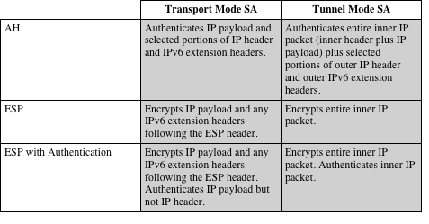
Ipsec modes (cont.)
Table 9.1 Tunnel Mode and Transport Mode Functionality
Notes:
Table 9.1 summarizes transport and tunnel mode functionality.

Slide 15
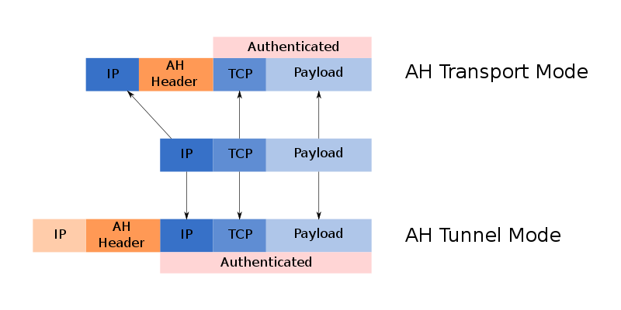
Ipsec modes (cont.)
Source of diagrams: https://en.wikipedia.org/wiki/IPsec

Slide 16
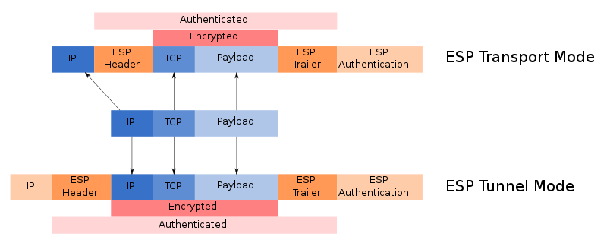
Ipsec modes (cont.)
Source of diagrams: https://en.wikipedia.org/wiki/IPsec

Slide 17
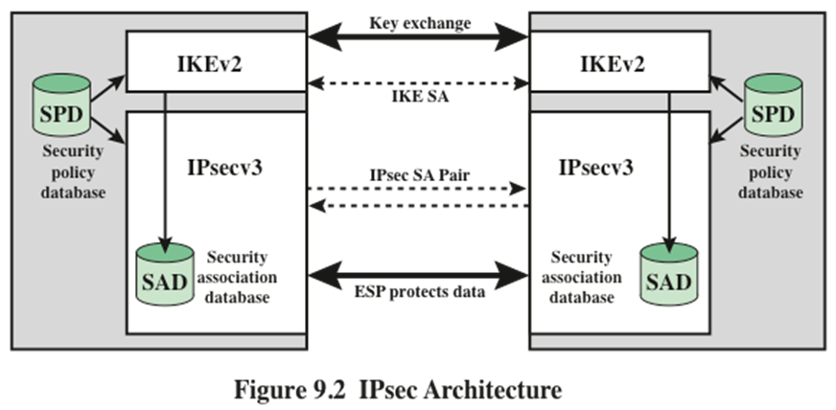
Ipsec policy is determined primarily by the interaction of the SAD and the SPD.
A Security Association (SA) is a one-way logical connection between a sender and a receiver that affords security services to the traffic carried on it.
  An IPsec SA pair is needed to support two-way communications.
Notes:
Fundamental to the operation of IPsec is the concept of a security policy applied
to each IP packet that transits from a source to a destination. IPsec policy is determined
primarily by the interaction of two databases, the security association
database (SAD) and the security policy database (SPD) . This section provides an
overview of these two databases and then summarizes their use during IPsec operation.
Figure 9.2 illustrates the relevant relationships.

Slide 18
Security Association (SA)
Each SA is uniquely identified by three parameters:
Security Parameters Index (SPI)
A 32-bit unsigned integer assigned to this SA
IP Destination Address
Address of the destination endpoint of the SA, which may be an end-user system or a network system such as a firewall or router
Security protocol identifier
Indicates whether the association is an AH or ESP security association
A field from the outer IP header
Carried in the AH or ESP headers
in any IP packet, the security association is uniquely identified by the Destination Address in the IPv4 or IPv6 header and the SPI in the enclosed extension header (AH or ESP).
Notes:
A key concept that appears in both the authentication and confidentiality mechanisms
for IP is the security association (SA). An association is a one-way logical
connection between a sender and a receiver that affords security services to the traffic
carried on it. If a peer relationship is needed for two-way secure exchange, then
two security associations are required.
A security association is uniquely identified by three parameters.
• Security Parameters Index (SPI): A 32-bit unsigned integer assigned to this
SA and having local significance only. The SPI is carried in AH and ESP headers
to enable the receiving system to select the SA under which a received
packet will be processed.
• IP Destination Address: This is the address of the destination endpoint of the
SA, which may be an end-user system or a network system such as a firewall
or router.
• Security Protocol Identifier: This field from the outer IP header indicates
whether the association is an AH or ESP security association.
Hence, in any IP packet, the security association is uniquely identified by the
Destination Address in the IPv4 or IPv6 header and the SPI in the enclosed extension
header (AH or ESP).

Slide 19
Security Association Database (SAD)
Defines the parameters associated with each SA
Normally defined by the following parameters in a SAD entry:
  Security parameter index (SPI)
    32 bits; selected by the receiving end of an SA
    An SA: Sender (outbound SA) → Receiver (inbound SA)
  Sequence number counter
    32 bits; in the AH or ESP headers
  Sequence counter overflow
  Anti-replay window
  AH information
  ESP information
  Lifetime of this security association
  IPsec protocol mode (tunnel, transport, or wildcard?)
    “The wildcard mode allows the same SA to be used for either tunnel or transport traffic on a per packet basis, e.g., by different sockets.” (https://www.ietf.org/rfc/rfc2401.txt, 1998) NOTE: The wildcard mode is not found in the current version (RFC 4301, 2005)
  Path MTU
Notes:
In each IPsec implementation, there is a nominal Security Association Database
that defines the parameters associated with each SA. A security association is normally
defined by the following parameters in an SAD entry.
• Security Parameter Index: A 32-bit value selected by the receiving end of an
SA to uniquely identify the SA. In an SAD entry for an outbound SA, the SPI
is used to construct the packet’s AH or ESP header. In an SAD entry for an
inbound SA, the SPI is used to map traffic to the appropriate SA.
• Sequence Number Counter: A 32-bit value used to generate the Sequence
Number field in AH or ESP headers, described in Section 9.3 (required for
all implementations).
• Sequence Counter Overflow: A flag indicating whether overflow of the
Sequence Number Counter should generate an auditable event and prevent
further transmission of packets on this SA (required for all implementations).
• Anti-Replay Window: Used to determine whether an inbound AH or ESP
packet is a replay, described in Section 9.3 (required for all implementations).
• AH Information: Authentication algorithm, keys, key lifetimes, and related
parameters being used with AH (required for AH implementations).
• ESP Information: Encryption and authentication algorithm, keys, initialization
values, key lifetimes, and related parameters being used with ESP
(required for ESP implementations).
• Lifetime of this Security Association: A time interval or byte count after
which an SA must be replaced with a new SA (and new SPI) or terminated,
plus an indication of which of these actions should occur (required for all
implementations).
• IPsec Protocol Mode: Tunnel, transport, or wildcard.
• Path MTU: Any observed path maximum transmission unit (maximum size of
a packet that can be transmitted without fragmentation) and aging variables
(required for all implementations).
The key management mechanism that is used to distribute keys is coupled to
the authentication and privacy mechanisms only by way of the Security Parameters
Index (SPI). Hence, authentication and privacy have been specified independent of
any specific key management mechanism.
IPsec provides the user with considerable flexibility in the way in which IPsec
services are applied to IP traffic. As we will see later, SAs can be combined in a
number of ways to yield the desired user configuration. Furthermore, IPsec provides
a high degree of granularity in discriminating between traffic that is afforded
IPsec protection and traffic that is allowed to bypass IPsec, as in the former case
relating IP traffic to specific SAs.

Slide 20
Security Policy Database (SPD)
The means by which IP traffic is related to specific SAs (or no SA in the case of traffic allowed to bypass IPsec)
  Contains entries, each of which defines a subset of IP traffic and points to an SA for that traffic
In more complex environments, there may be multiple entries that potentially relate to a single SA or multiple SAs associated with a single SPD entry
  Each SPD entry is defined by a set of IP and upper-layer protocol field values called selectors.
  These selectors are used to filter outgoing traffic in order to map it into a particular SA.
    Compare the values of the selector fields against the SPD to find a matching SPD entry, which will point to zero or more SAs.
    Determine the SA, if any, for this packet and its associated SPI.
    Do the required IPsec processing (i.e., AH or ESP processing).
Notes:
The means by which IP traffic is related to specific SAs (or no SA in the case of
traffic allowed to bypass IPsec) is the nominal Security Policy Database (SPD). In
its simplest form, an SPD contains entries, each of which defines a subset of IP traffic
and points to an SA for that traffic. In more complex environments, there may
be multiple entries that potentially relate to a single SA or multiple SAs associated
with a single SPD entry. The reader is referred to the relevant IPsec documents for
a full discussion.
Each SPD entry is defined by a set of IP and upper-layer protocol field values,
called selectors . In effect, these selectors are used to filter outgoing traffic in order
to map it into a particular SA. Outbound processing obeys the following general
sequence for each IP packet.
1. Compare the values of the appropriate fields in the packet (the selector fields)
against the SPD to find a matching SPD entry, which will point to zero or
more SAs.
2. Determine the SA if any for this packet and its associated SPI.
Do the required IPsec processing (i.e., AH or ESP processing).

Slide 21
SPD Entries
The following selectors determine an SPD entry:
Remote IP address
This may be a single IP address, an enumerated list or range of addresses, or a wildcard (mask) address.
The latter two are required to support more than one destination system sharing the same SA (e.g., behind a firewall)
Local IP address
This may be a single IP address, an enumerated list or range of addresses, or a wildcard (mask) address.
The latter two are required to support more than one source system sharing the same SA.
Next layer protocol
The IP protocol header includes a field that designates the protocol operating over IP.
Name
A user identifier from the operating system
Not a field in the IP or upper-layer headers but is available if IPsec is running on the same operating system as the user
Local and remote ports
These may be individual TCP or UDP port values, an enumerated list of ports, or a wildcard port
Notes:
The following selectors determine an SPD entry:
• Remote IP Address: This may be a single IP address, an enumerated list or
range of addresses, or a wildcard (mask) address. The latter two are required
to support more than one destination system sharing the same SA (e.g., behind
a firewall).
• Local IP Address: This may be a single IP address, an enumerated list or range
of addresses, or a wildcard (mask) address. The latter two are required to support
more than one source system sharing the same SA (e.g., behind a firewall).
• Next Layer Protocol: The IP protocol header (IPv4, IPv6, or IPv6 Extension)
includes a field (Protocol for IPv4, Next Header for IPv6 or IPv6 Extension)
that designates the protocol operating over IP. This is an individual protocol
number, ANY, or for IPv6 only, OPAQUE. If AH or ESP is used, then this IP
protocol header immediately precedes the AH or ESP header in the packet.
• Name: A user identifier from the operating system. This is not a field in the IP
or upper-layer headers but is available if IPsec is running on the same operating
system as the user.
• Local and Remote Ports: These may be individual TCP or UDP port values,
an enumerated list of ports, or a wildcard port.

Slide 22
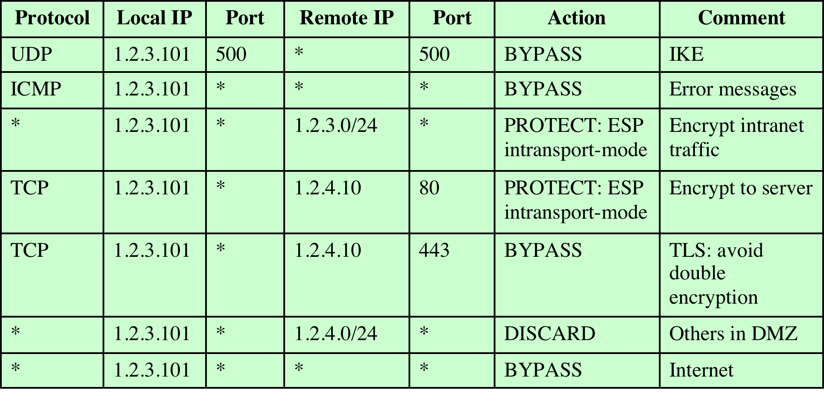
Table 9.2 Host SPD Example
Notes:
Table 9.2 provides an example of an SPD on a host system (as opposed to
a network system such as a firewall or router). This table reflects the following
configuration: A local network configuration consists of two networks. The
basic corporate network configuration has the IP network number 1.2.3.0/24.
The local configuration also includes a secure LAN, often known as a DMZ,
that is identified as 1.2.4.0/24. The DMZ is protected from both the outside
world and the rest of the corporate LAN by firewalls. The host in this example
has the IP address 1.2.3.10, and it is authorized to connect to the server 1.2.4.10
in the DMZ.
The entries in the SPD should be self-explanatory. For example, UDP port
500 is the designated port for IKE. Any traffic from the local host to a remote host
for purposes of an IKE exchange bypasses the IPsec processing.

Slide 23
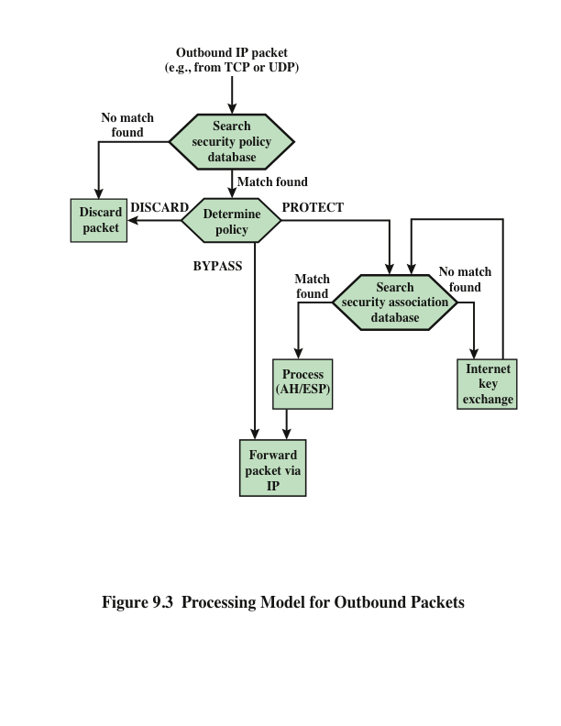
IPsec is executed on a packet-by-packet basis.
  Each outbound packet is processed by the IPsec logic before transmission.
    If no entry is found, then IKE is invoked to create an SA with the appropriate keys and an entry is made in the SA.
Notes:
Figure 9.3 highlights the main elements of IPsec processing
for outbound traffic. A block of data from a higher layer, such as TCP, is passed
down to the IP layer and an IP packet is formed, consisting of an IP header and an
IP body. Then the following steps occur:
1. IPsec searches the SPD for a match to this packet.
2. If no match is found, then the packet is discarded and an error message is
generated.
3. If a match is found, further processing is determined by the first matching
entry in the SPD. If the policy for this packet is DISCARD, then the packet is
discarded. If the policy is BYPASS, then there is no further IPsec processing;
the packet is forwarded to the network for transmission.
4. If the policy is PROTECT, then a search is made of the SAD for a matching
entry. If no entry is found, then IKE is invoked to create an SA with the appropriate
keys and an entry is made in the SA.
5. The matching entry in the SAD determines the processing for this packet.
Either encryption, authentication, or both can be performed, and either transport
or tunnel mode can be used. The packet is then forwarded to the network
for transmission.

Slide 24
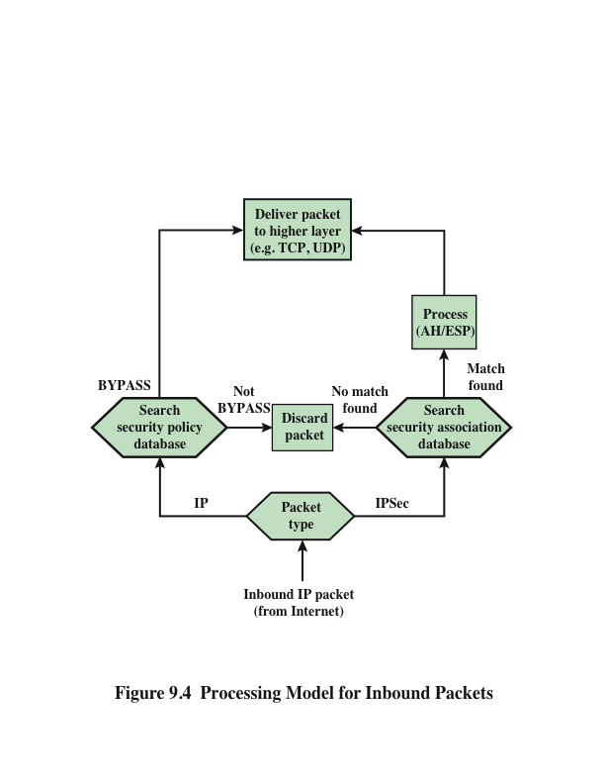
IPsec is executed on a packet-by-packet basis.
  Each inbound packet is processed before the packet contents being passed on to the next higher layer.
  Q: What packets would be discarded?
Notes:
Figure 9.4 highlights the main elements of IPsec processing for
inbound traffic. An incoming IP packet triggers the IPsec processing.
The following steps occur:
1. IPsec determines whether this is an unsecured IP packet or one that has ESP
or AH headers/trailers, by examining the IP Protocol field (IPv4) or Next
Header field (IPv6).
2. If the packet is unsecured, IPsec searches the SPD for a match to this packet.
If the first matching entry has a policy of BYPASS, the IP header is processed
and stripped off and the packet body is delivered to the next higher layer, such
as TCP. If the first matching entry has a policy of PROTECT or DISCARD, or
if there is no matching entry, the packet is discarded.
3. For a secured packet, IPsec searches the SAD. If no match is found, the packet
is discarded. Otherwise, IPsec applies the appropriate ESP or AH processing.
Then, the IP header is processed and stripped off and the packet body is delivered
to the next higher layer, such as TCP.

Slide 25
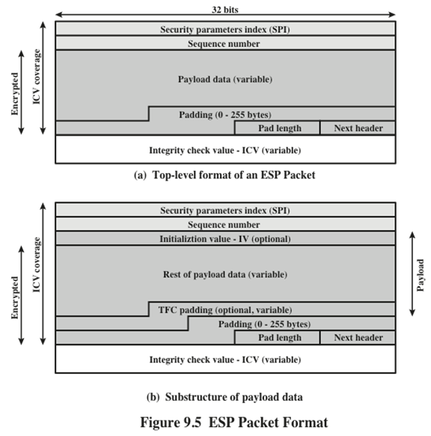
ESP can be used to provide a bunch of security services.
The set of services provided depends on options selected at the time of SA establishment and on the location of the implementation in the network.
IV: Initialization value/vector
TFC: Traffic Flow confidentiality
Notes:
Figure 9.5a shows the top-level format of an ESP packet. It contains the following
fields.
• Security Parameters Index (32 bits): Identifies a security association.
• Sequence Number (32 bits): A monotonically increasing counter value; this
provides an anti-replay function, as discussed for AH.
• Payload Data (variable): This is a transport-level segment (transport mode)
or IP packet (tunnel mode) that is protected by encryption.
• Padding (0–255 bytes): The purpose of this field is discussed later.
• Pad Length (8 bits): Indicates the number of pad bytes immediately preceding
this field.
• Next Header (8 bits): Identifies the type of data contained in the payload data
field by identifying the first header in that payload (e.g., an extension header
in IPv6, or an upper-layer protocol such as TCP).
• Integrity Check Value (variable): A variable-length field (must be an integral
number of 32-bit words) that contains the Integrity Check Value computed
over the ESP packet minus the Authentication Data field.
When any combined mode algorithm is employed, the algorithm itself is expected
to return both decrypted plaintext and a pass/fail indication for the integrity
check. For combined mode algorithms, the ICV that would normally appear at the
end of the ESP packet (when integrity is selected) may be omitted. When the ICV
is omitted and integrity is selected, it is the responsibility of the combined mode
algorithm to encode within the Payload Data an ICV-equivalent means of verifying
the integrity of the packet.
Two additional fields may be present in the payload (Figure 9.5b). An initialization
value (IV) , or nonce, is present if this is required by the encryption or
authenticated encryption algorithm used for ESP. If tunnel mode is being used, then
the IPsec implementation may add traffic flow confidentiality (TFC) padding after
the Payload Data and before the Padding field, as explained subsequently.

Slide 26
Encapsulating Security Payload (ESP)
Used to encrypt the Payload Data, Padding, Pad Length, and Next Header fields
  If the algorithm requires cryptographic synchronization data then these data may be carried explicitly at the beginning of the Payload Data field
An optional ICV field is present only if the integrity service is selected and is provided by either a separate integrity algorithm or a combined mode algorithm that uses an ICV
  ICV is computed after the encryption is performed.
    This order of processing facilitates reducing the impact of DoS attacks. Q: Why?
    Because the ICV is not protected by encryption, a keyed integrity algorithm must be employed to compute the ICV. Q: Like what?
The Padding field serves several purposes:
  If an encryption algorithm requires the plaintext to be a multiple of some number of bytes, the Padding field is used to expand the plaintext to the required length
  Used to assure alignment of Pad Length and Next Header fields
  Additional padding may be added to provide partial traffic-flow confidentiality by concealing the actual length of the payload.
Notes:
The Payload Data, Padding, Pad Length, and Next Header fields are encrypted by
the ESP service. If the algorithm used to encrypt the payload requires cryptographic
synchronization data, such as an initialization vector (IV), then these data may be
carried explicitly at the beginning of the Payload Data field. If included, an IV is
usually not encrypted, although it is often referred to as being part of the ciphertext.
The ICV field is optional. It is present only if the integrity service is selected
and is provided by either a separate integrity algorithm or a combined mode algorithm
that uses an ICV. The ICV is computed after the encryption is performed.
This order of processing facilitates rapid detection and rejection of replayed or
bogus packets by the receiver prior to decrypting the packet, hence potentially
reducing the impact of denial of service (DoS) attacks. It also allows for the possibility
of parallel processing of packets at the receiver that is decryption can take
place in parallel with integrity checking. Note that because the ICV is not protected
by encryption, a keyed integrity algorithm must be employed to compute
the ICV.
The Padding field serves several purposes:
• If an encryption algorithm requires the plaintext to be a multiple of some
number of bytes (e.g., the multiple of a single block for a block cipher), the
Padding field is used to expand the plaintext (consisting of the Payload Data,
Padding, Pad Length, and Next Header fields) to the required length.
• The ESP format requires that the Pad Length and Next Header fields be right
aligned within a 32-bit word. Equivalently, the ciphertext must be an integer
multiple of 32 bits. The Padding field is used to assure this alignment.
• Additional padding may be added to provide partial traffic-flow confidentiality
by concealing the actual length of the payload.

Slide 27

Anti-Replay in IPsec
  A replay attack is one in which an attacker obtains a copy of an authenticated packet and later transmits it to the intended destination.
  The receipt of duplicate, authenticated IP packets may disrupt service in some way or may have some other undesired consequence.
  The Sequence Number field is designed to thwart such attacks.
    Each time that a packet is sent on this SA, the sender increments the counter and places the value in the Sequence Number field.
    If the limit of $2^{32}$ − 1 is reached, the sender should terminate this SA and negotiate a new SA with a new key.
Notes:
A replay attack is one in which an attacker obtains a copy of an authenticated
packet and later transmits it to the intended destination. The receipt of duplicate,
authenticated IP packets may disrupt service in some way or may have some other
undesired consequence. The Sequence Number field is designed to thwart such attacks.
First, we discuss sequence number generation by the sender, and then we
look at how it is processed by the recipient.
When a new SA is established, the sender initializes a sequence number
counter to 0. Each time that a packet is sent on this SA, the sender increments the
counter and places the value in the Sequence Number field. Thus, the first value
to be used is 1. If anti-replay is enabled (the default), the sender must not allow
the sequence number to cycle past 2³² - 1 back to zero. Otherwise, there would
be multiple valid packets with the same sequence number. If the limit of 2³² - 1
is reached, the sender should terminate this SA and negotiate a new SA with a
new key.
Because IP is a connectionless, unreliable service, the protocol does not
guarantee that packets will be delivered in order and does not guarantee that all
packets will be delivered. Therefore, the IPsec authentication document dictates
that the receiver should implement a window of size W , with a default of W = 64.
The right edge of the window represents the highest sequence number, N , so far
received for a valid packet. For any packet with a sequence number in the range from
N - W + 1 to N that has been correctly received (i.e., properly authenticated), the
corresponding slot in the window is marked (Figure 9.6). Inbound processing proceeds
as follows when a packet is received:
1. If the received packet falls within the window and is new, the MAC is checked.
If the packet is authenticated, the corresponding slot in the window is marked.
2. If the received packet is to the right of the window and is new, the MAC is
checked. If the packet is authenticated, the window is advanced so that this
sequence number is the right edge of the window, and the corresponding slot
in the window is marked.
3. If the received packet is to the left of the window or if authentication fails, the
packet is discarded; this is an auditable event.

Slide 28
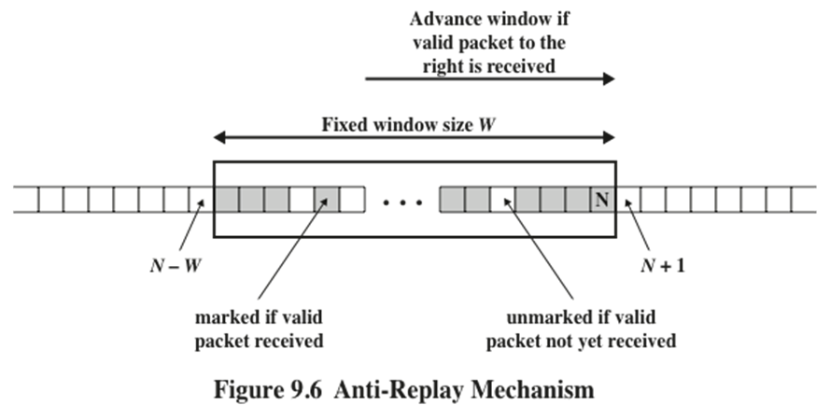
Anti-Replay (cont.)
  The receiver should implement a window of size W, with a default of W=64.
    The right edge of the window represents the highest sequence number, N, so far received for a valid packet.
    The range of valid sequence numbers: N-W+1 to N
    If the received packet is to the left of the window or if authentication fails, the packet is discarded; this is an auditable event.
Notes:
A replay attack is one in which an attacker obtains a copy of an authenticated
packet and later transmits it to the intended destination. The receipt of duplicate,
authenticated IP packets may disrupt service in some way or may have some other
undesired consequence. The Sequence Number field is designed to thwart such attacks.
First, we discuss sequence number generation by the sender, and then we
look at how it is processed by the recipient.
When a new SA is established, the sender initializes a sequence number
counter to 0. Each time that a packet is sent on this SA, the sender increments the
counter and places the value in the Sequence Number field. Thus, the first value
to be used is 1. If anti-replay is enabled (the default), the sender must not allow
the sequence number to cycle past 2³² - 1 back to zero. Otherwise, there would
be multiple valid packets with the same sequence number. If the limit of 2³² - 1
is reached, the sender should terminate this SA and negotiate a new SA with a
new key.
Because IP is a connectionless, unreliable service, the protocol does not
guarantee that packets will be delivered in order and does not guarantee that all
packets will be delivered. Therefore, the IPsec authentication document dictates
that the receiver should implement a window of size W , with a default of W = 64.
The right edge of the window represents the highest sequence number, N , so far
received for a valid packet. For any packet with a sequence number in the range from
N - W + 1 to N that has been correctly received (i.e., properly authenticated), the
corresponding slot in the window is marked (Figure 9.6). Inbound processing proceeds
as follows when a packet is received:
1. If the received packet falls within the window and is new, the MAC is checked.
If the packet is authenticated, the corresponding slot in the window is marked.
2. If the received packet is to the right of the window and is new, the MAC is
checked. If the packet is authenticated, the window is advanced so that this
sequence number is the right edge of the window, and the corresponding slot
in the window is marked.
3. If the received packet is to the left of the window or if authentication fails, the
packet is discarded; this is an auditable event.

Slide 29
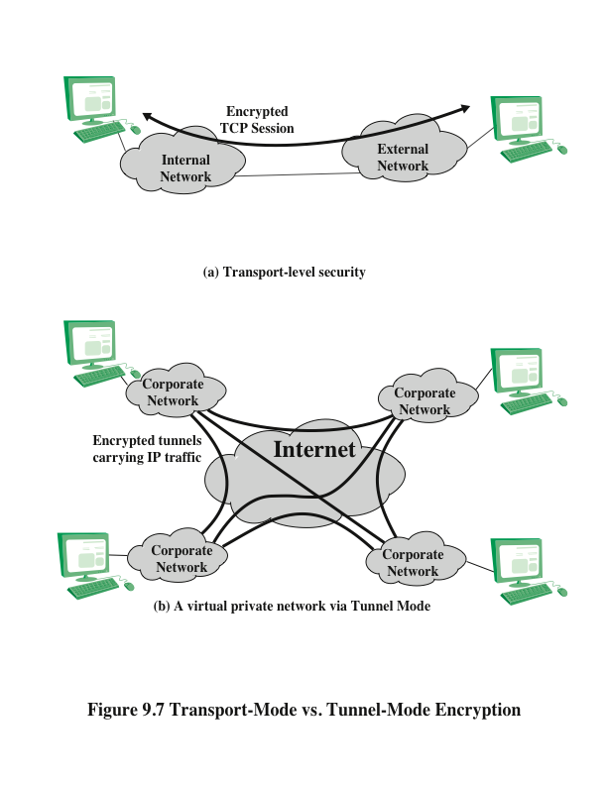
Transport mode: host-to-host
Tunnel mode: Used when one or both ends of a security association (SA) are a security gateway
Notes:
Figure 9.7 shows two ways in which the IPsec ESP service can be used. In the
upper part of the figure, encryption (and optionally authentication) is provided directly
between two hosts. Figure 20.7b shows how tunnel mode operation can be
used to set up a virtual private network . In this example, an organization has four
private networks interconnected across the Internet. Hosts on the internal networks
use the Internet for transport of data but do not interact with other Internet-based
hosts. By terminating the tunnels at the security gateway to each internal network,
the configuration allows the hosts to avoid implementing the security capability.
The former technique is supported by a transport mode SA, while the latter technique
uses a tunnel mode SA.
In this section, we look at the scope of ESP for the two modes. The considerations
are somewhat different for IPv4 and IPv6. We use the packet formats of
Figure 9.8a as a starting point.

Slide 30
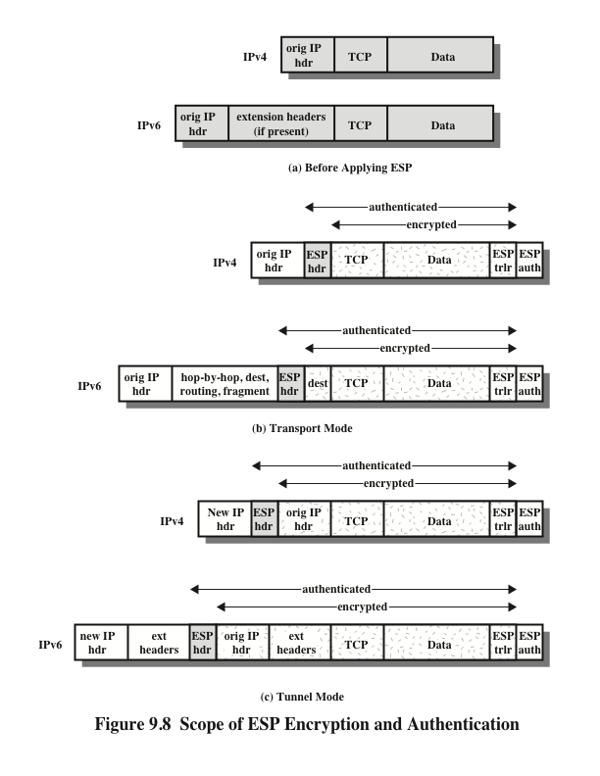
Notes:
Transport mode ESP is used to encrypt and optionally authenticate
the data carried by IP (e.g., a TCP segment), as shown in Figure 9.8b.
For this mode using IPv4, the ESP header is inserted into the IP packet immediately
prior to the transport-layer header (e.g., TCP, UDP, ICMP), and an ESP
trailer (Padding, Pad Length, and Next Header fields) is placed after the IP packet.
If authentication is selected, the ESP Authentication Data field is added after the
ESP trailer. The entire transport-level segment plus the ESP trailer are encrypted.
Authentication covers all of the ciphertext plus the ESP header.
In the context of IPv6, ESP is viewed as an end-to-end payload; that is, it is
not examined or processed by intermediate routers. Therefore, the ESP header appears
after the IPv6 base header and the hop-by-hop, routing, and fragment extension
headers. The destination options extension header could appear before or after
the ESP header, depending on the semantics desired. For IPv6, encryption covers
the entire transport-level segment plus the ESP trailer plus the destination options
extension header if it occurs after the ESP header. Again, authentication covers the
ciphertext plus the ESP header.
Transport mode operation may be summarized as follows.
1. At the source, the block of data consisting of the ESP trailer plus the entire
transport-layer segment is encrypted and the plaintext of this block is replaced
with its ciphertext to form the IP packet for transmission. Authentication is
added if this option is selected.
2. The packet is then routed to the destination. Each intermediate router needs
to examine and process the IP header plus any plaintext IP extension headers
but does not need to examine the ciphertext.
3. The destination node examines and processes the IP header plus any plaintext
IP extension headers. Then, on the basis of the SPI in the ESP header, the
destination node decrypts the remainder of the packet to recover the plaintext
transport-layer segment.
Transport mode operation provides confidentiality for any application that
uses it, thus avoiding the need to implement confidentiality in every individual application.
One drawback to this mode is that it is possible to do traffic analysis on
the transmitted packets.
Tunnel mode ESP is used to encrypt an entire IP packet
(Figure 9.8c). For this mode, the ESP header is prefixed to the packet and then the
packet plus the ESP trailer is encrypted. This method can be used to counter traffic
analysis.
Because the IP header contains the destination address and possibly source
routing directives and hop-by-hop option information, it is not possible simply to
transmit the encrypted IP packet prefixed by the ESP header. Intermediate routers
would be unable to process such a packet. Therefore, it is necessary to encapsulate
the entire block (ESP header plus ciphertext plus Authentication Data, if present)
with a new IP header that will contain sufficient information for routing but not for
traffic analysis.
Whereas the transport mode is suitable for protecting connections between
hosts that support the ESP feature, the tunnel mode is useful in a configuration that
includes a firewall or other sort of security gateway that protects a trusted network
from external networks. In this latter case, encryption occurs only between an external
host and the security gateway or between two security gateways. This relieves
hosts on the internal network of the processing burden of encryption and simplifies
the key distribution task by reducing the number of needed keys. Further, it thwarts
traffic analysis based on ultimate destination.

Slide 31
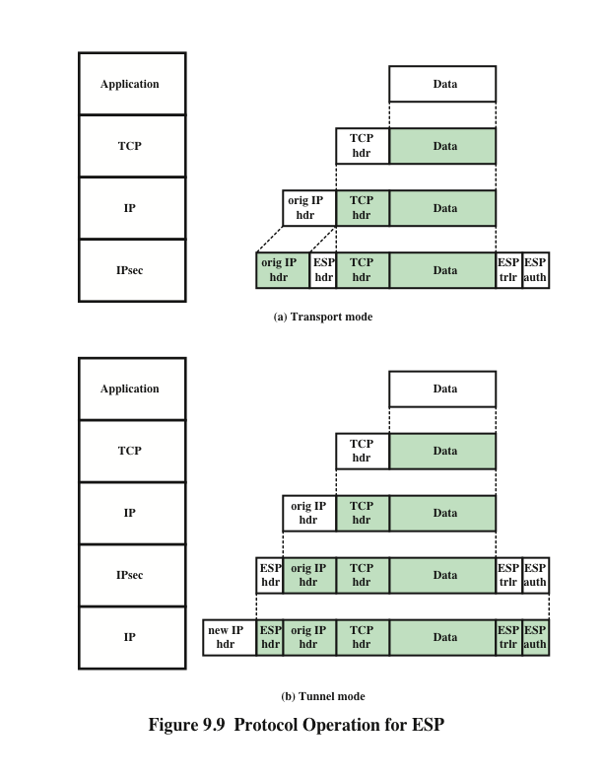
Notes:
Figure 9.9 shows the protocol architecture for the two modes.

Slide 32
ESP with Authentication Option
In this approach, the first user applies ESP to the data to be protected and then appends the authentication data field
  For both cases authentication applies to the ciphertext rather than the plaintext
Transport mode ESP
Authentication and encryption apply to the IP payload delivered to the host, but the IP header is not protected
Tunnel mode ESP
Authentication applies to the entire IP packet delivered to the outer IP destination address and authentication is performed at that destination
The entire inner IP packet is protected by the privacy mechanism for delivery to the inner IP destination
Notes:
Encryption and authentication can be combined in order to transmit an IP packet
that has both confidentiality and authentication between hosts. We look at several
approaches.
This approach is illustrated in Figure 9.8.
In this approach, the user first applies ESP to the data to be protected and then
appends the authentication data field. There are actually two subcases:
• Transport mode ESP: Authentication and encryption apply to the IP payload
delivered to the host, but the IP header is not protected.
• Tunnel mode ESP: Authentication applies to the entire IP packet delivered
to the outer IP destination address (e.g., a firewall), and authentication is performed
at that destination. The entire inner IP packet is protected by the privacy
mechanism for delivery to the inner IP destination.
For both cases, authentication applies to the ciphertext rather than the plaintext.

Slide 33
Combining Security Associations
An individual SA can implement either the AH or ESP protocol but not both.
Security association bundle
  Refers to a sequence of SAs through which traffic must be processed to provide a desired set of IPsec services
  The SAs in a bundle may terminate at different endpoints or at the same endpoint
May be combined into bundles in two ways:
Transport adjacency
Refers to applying more than one security protocol to the same IP packet without invoking tunneling
This approach allows for only one level of combination
Iterated tunneling
Refers to the application of multiple layers of security protocols effected through IP tunneling
This approach allows for multiple levels of nesting
Notes:
An individual SA can implement either the AH or ESP protocol but not both.
Sometimes a particular traffic flow will call for the services provided by both AH
and ESP. Further, a particular traffic flow may require IPsec services between
hosts and, for that same flow, separate services between security gateways, such as
firewalls. In all of these cases, multiple SAs must be employed for the same traffic
flow to achieve the desired IPsec services. The term security association bundle refers
to a sequence of SAs through which traffic must be processed to provide a desired
set of IPsec services. The SAs in a bundle may terminate at different endpoints
or at the same endpoints.
Security associations may be combined into bundles in two ways:
• Transport adjacency: Refers to applying more than one security protocol to
the same IP packet without invoking tunneling. This approach to combining
AH and ESP allows for only one level of combination; further nesting yields
no added benefit since the processing is performed at one IPsec instance: the
(ultimate) destination.
• Iterated tunneling: Refers to the application of multiple layers of security protocols
effected through IP tunneling. This approach allows for multiple levels
of nesting, since each tunnel can originate or terminate at a different IPsec site
along the path.
The two approaches can be combined, for example, by having a transport SA between
hosts travel part of the way through a tunnel SA between security gateways.
One interesting issue that arises when considering SA bundles is the order in
which authentication and encryption may be applied between a given pair of endpoints
and the ways of doing so.

Slide 34
Transport Adjacency
Another way to apply authentication after encryption is to use two bundled transport SAs, with the inner being an ESP SA and the outer being an AH SA
  In this case ESP is used without its authentication option
  Encryption is applied to the IP payload
  AH is then applied in transport mode
  Advantage of this approach is that the authentication covers more fields
  Disadvantage is the overhead of two SAs versus one SA
Notes:
Another way to apply authentication after encryption is to
use two bundled transport SAs, with the inner being an ESP SA and the outer being
an AH SA. In this case, ESP is used without its authentication option. Because the
inner SA is a transport SA, encryption is applied to the IP payload. The resulting
packet consists of an IP header (and possibly IPv6 header extensions) followed
by an ESP. AH is then applied in transport mode, so that authentication covers
the ESP plus the original IP header (and extensions) except for mutable fields.
The advantage of this approach over simply using a single ESP SA with the ESP
authentication option is that the authentication covers more fields, including the
source and destination IP addresses. The disadvantage is the overhead of two SAs
versus one SA.

Slide 35
Transport-Tunnel Bundle
The use of authentication prior to encryption might be preferable for several reasons:
  It is impossible for anyone to intercept the message and alter the authentication data without detection
  It may be desirable to store the authentication information with the message at the destination for later reference
One approach is to use a bundle consisting of an inner AH transport SA and an outer ESP tunnel SA
  Authentication is applied to the IP payload plus the IP header
  The resulting IP packet is then processed in tunnel mode by ESP
    The result is that the entire authenticated inner packet is encrypted and a new outer IP header is added
Notes:
The use of authentication prior to encryption might
be preferable for several reasons. First, because the authentication data are protected
by encryption, it is impossible for anyone to intercept the message and alter
the authentication data without detection. Second, it may be desirable to store the
authentication information with the message at the destination for later reference.
It is more convenient to do this if the authentication information applies to the unencrypted
message; otherwise the message would have to be reencrypted to verify
the authentication information.
One approach to applying authentication before encryption between two hosts
is to use a bundle consisting of an inner AH transport SA and an outer ESP tunnel
SA. In this case, authentication is applied to the IP payload plus the IP header (and
extensions) except for mutable fields. The resulting IP packet is then processed in
tunnel mode by ESP; the result is that the entire, authenticated inner packet is encrypted
and a new outer IP header (and extensions) is added.

Slide 36
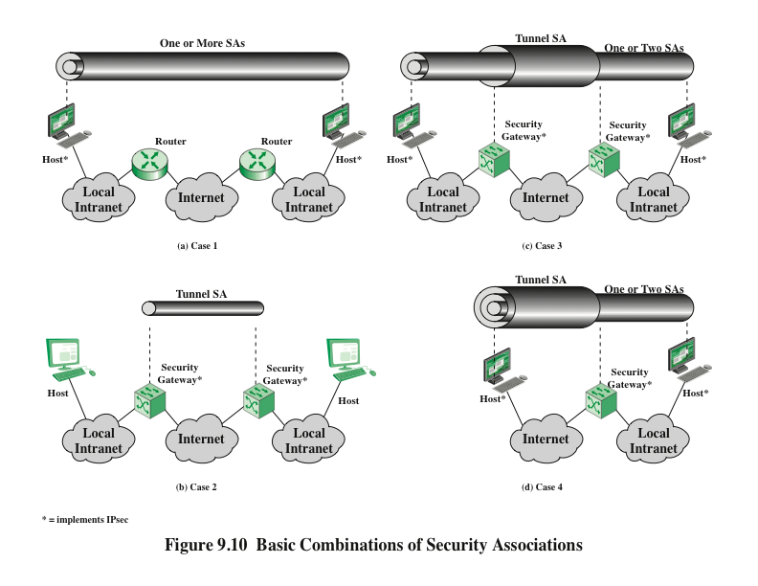
Notes:
The IPsec Architecture document lists four examples of combinations of SAs that
must be supported by compliant IPsec hosts (e.g., workstation, server) or security
gateways (e.g., firewall, router). These are illustrated in Figure 9.10. The lower
part of each case in the figure represents the physical connectivity of the elements;
the upper part represents logical connectivity via one or more nested SAs. Each SA
can be either AH or ESP. For host-to-host SAs, the mode may be either transport
or tunnel; otherwise it must be tunnel mode.

Slide 37
Internet Key Exchange
(IKE)
The key management portion of IPsec involves the determination and distribution of secret keys.
  A typical requirement is four keys for communication between two applications.
    Transmit and receive pairs for both integrity and confidentiality
The IPsec Architecture document mandates support for two types of key management:
Manual
A system administrator manually configures each system with its own keys and with the keys of other communicating systems
This is practical for small, relatively static environments
Automated
Enables the on-demand creation of keys for SAs and facilitates the use of keys in a large distributed system with an evolving configuration
Notes:
The key management portion of IPsec involves the determination and distribution
of secret keys. A typical requirement is four keys for communication
between two applications: transmit and receive pairs for both integrity and confidentiality.
The IPsec Architecture document mandates support for two types of
key management:
• Manual: A system administrator manually configures each system with its own
keys and with the keys of other communicating systems. This is practical for
small, relatively static environments.
• Automated: An automated system enables the on-demand creation of keys
for SAs and facilitates the use of keys in a large distributed system with an
evolving configuration.

Slide 38
ISAKMP/Oakley
The default automated key management protocol of IPsec
Consists of:
  Oakley Key Determination Protocol
    A key exchange protocol based on the Diffie-Hellman algorithm but providing added security.
    Generic in that it does not dictate specific formats
  Internet Security Association and Key Management Protocol (ISAKMP)
    Provides a framework for Internet key management and provides the specific protocol support, including formats, for negotiation of security attributes
    Consists of a set of message types that enable the use of a variety of key exchange algorithms
Notes:
The default automated key management protocol for IPsec is referred to as
ISAKMP/Oakley and consists of the following elements:
• Oakley Key Determination Protocol: Oakley is a key exchange protocol
based on the Diffie-Hellman algorithm but providing added security. Oakley
is generic in that it does not dictate specific formats.
• Internet Security Association and Key Management Protocol (ISAKMP):
ISAKMP provides a framework for Internet key management and provides
the specific protocol support, including formats, for negotiation of security
attributes.
ISAKMP by itself does not dictate a specific key exchange algorithm; rather,
ISAKMP consists of a set of message types that enable the use of a variety of key
exchange algorithms. Oakley is the specific key exchange algorithm mandated for
use with the initial version of ISAKMP.
In IKEv2, the terms Oakley and ISAKMP are no longer used, and there
are significant differences from the use of Oakley and ISAKMP in IKEv1.
Nevertheless, the basic functionality is the same.

Slide 39
Features of IKE Key Determination
Algorithm is characterized by five important features:
1.
2.
3.
4.
5.
It employs a mechanism known as cookies to thwart clogging attacks
It enables the two parties to negotiate a group; this, in essence, specifies the global parameters of the Diffie-Hellman key exchange
It uses nonces to ensure against replay attacks
It enables the exchange of Diffie-Hellman public key values
It authenticates the Diffie-Hellman exchange to thwart man-in-the-middle-attacks
Notes:
The IKE key determination algorithm is
characterized by five important features:
1. It employs a mechanism known as cookies to thwart clogging attacks.
2. It enables the two parties to negotiate a group ; this, in essence, specifies the
global parameters of the Diffie-Hellman key exchange.
3. It uses nonces to ensure against replay attacks.
4. It enables the exchange of Diffie-Hellman public key values.
5. It authenticates the Diffie-Hellman exchange to thwart man-in-the-middle
attacks.

Slide 40
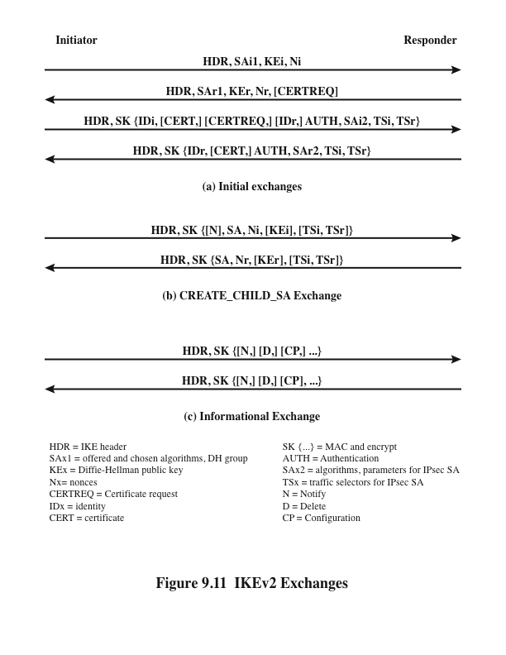
Notes:
The IKEv2 protocol involves the exchange of messages in
pairs. The first two pairs of exchanges are referred to as the initial exchanges
(Figure 9.11a). In the first exchange, the two peers exchange information concerning
cryptographic algorithms and other security parameters they are willing to use
along with nonces and Diffie-Hellman (DH) values. The result of this exchange is to
set up a special SA called the IKE SA (see Figure 9.2). This SA defines parameters
for a secure channel between the peers over which subsequent message exchanges
take place. Thus, all subsequent IKE message exchanges are protected by encryption
and message authentication. In the second exchange, the two parties authenticate
one another and set up a first IPsec SA to be placed in the SADB and used for
protecting ordinary (i.e. non-IKE) communications between the peers. Thus, four
messages are needed to establish the first SA for general use.
The CREATE_CHILD_SA exchange can be used to establish further SAs
for protecting traffic. The informational exchange is used to exchange management
information, IKEv2 error messages, and other notifications.

Slide 41
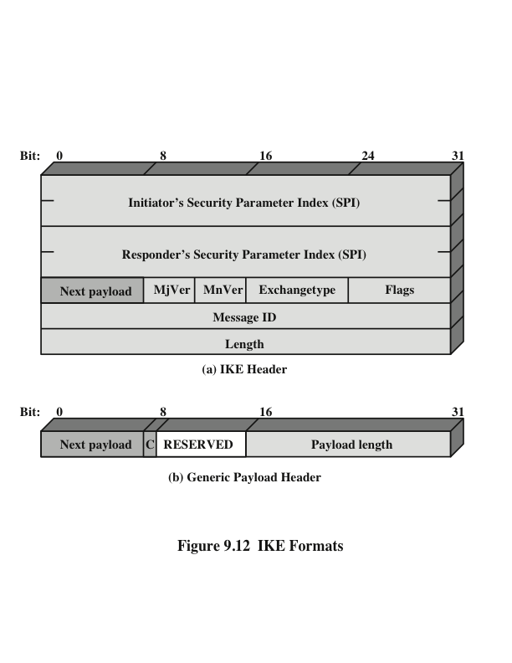
Notes:
Figure 9.12a shows the header format for an IKE message. It consists of the
following fields.
• Initiator SPI (64 bits): A value chosen by the initiator to identify a unique IKE
security association (SA).
• Responder SPI (64 bits): A value chosen by the responder to identify a unique
IKE SA.
• Next Payload (8 bits): Indicates the type of the first payload in the message;
payloads are discussed in the next subsection.
• Major Version (4 bits): Indicates major version of IKE in use.
• Minor Version (4 bits): Indicates minor version in use.
• Exchange Type (8 bits): Indicates the type of exchange; these are discussed
later in this section.
• Flags (8 bits): Indicates specific options set for this IKE exchange. Three bits
are defined so far. The initiator bit indicates whether this packet is sent by
the SA initiator. The version bit indicates whether the transmitter is capable
of using a higher major version number than the one currently indicated. The
response bit indicates whether this is a response to a message containing the
same message ID.
• Message ID (32 bits): Used to control retransmission of lost packets and
matching of requests and responses.
• Length (32 bits): Length of total message (header plus all payloads) in octets.
All IKE payloads begin with the same generic payload header
shown in Figure 9.12b. The Next Payload field has a value of 0 if this is the last
payload in the message; otherwise its value is the type of the next payload. The
Payload Length field indicates the length in octets of this payload, including the
generic payload header.
The critical bit is 0 if the sender wants the recipient to skip this payload if it
does not understand the payload type code in the Next Payload field of the previous
payload. It is set to 1 if the sender wants the recipient to reject this entire message if
it does not understand the payload type.

Slide 42
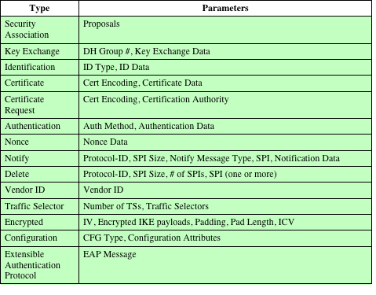
Table 9.3
IKE Payload Types
Notes:
Table 9.3 summarizes the payload types defined for IKE and lists the fields,
or parameters, that are part of each payload. The SA payload is used to begin the
establishment of an SA. The payload has a complex, hierarchical structure. The
payload may contain multiple proposals. Each proposal may contain multiple protocols.
Each protocol may contain multiple transforms. And each transform may
contain multiple attributes. These elements are formatted as substructures within
the payload as follows.
• Proposal: This substructure includes a proposal number, a protocol ID (AH,
ESP, or IKE), an indicator of the number of transforms, and then a transform
substructure. If more than one protocol is to be included in a proposal,
then there is a subsequent proposal substructure with the same proposal
number.
• Transform: Different protocols support different transform types. The transforms
are used primarily to define cryptographic algorithms to be used with a
particular protocol.
• Attribute: Each transform may include attributes that modify or complete the
specification of the transform. An example is key length.
The Key Exchange payload can be used for a variety of key exchange techniques,
including Oakley, Diffie-Hellman, and the RSA-based key exchange used
by PGP. The Key Exchange data field contains the data required to generate a session
key and is dependent on the key exchange algorithm used.
The Identification payload is used to determine the identity of communicating
peers and may be used for determining authenticity of information. Typically the
ID Data field will contain an IPv4 or IPv6 address.
The Certificate payload transfers a public-key certificate. The Certificate
Encoding field indicates the type of certificate or certificate-related information,
which may include the following:
• PKCS #7 wrapped X.509 certificate
• PGP certificate
• DNS signed key
• X.509 certificate—signature
• X.509 certificate—key exchange
• Kerberos tokens
• Certificate Revocation List (CRL)
• Authority Revocation List (ARL)
• SPKI certificate
At any point in an IKE exchange, the sender may include a Certificate Request
payload to request the certificate of the other communicating entity. The payload
may list more than one certificate type that is acceptable and more than one certificate
authority that is acceptable.
The Authentication payload contains data used for message authentication
purposes. The authentication method types so far defined are RSA digital signature,
shared-key message integrity code, and DSS digital signature.
The Nonce payload contains random data used to guarantee liveness during
an exchange and to protect against replay attacks.
The Notify payload contains either error or status information associated with
this SA or this SA negotiation. The following table lists the IKE notify messages.
The Delete payload indicates one or more SAs that the sender has deleted
from its database and that therefore are no longer valid.
The Vendor ID payload contains a vendor-defined constant. The constant is
used by vendors to identify and recognize remote instances of their implementations.
This mechanism allows a vendor to experiment with new features while maintaining
backward compatibility.
The Traffic Selector payload allows peers to identify packet flows for processing
by IPsec services.
The Encrypted payload contains other payloads in encrypted form. The encrypted
payload format is similar to that of ESP. It may include an IV if the encryption
algorithm requires it and an ICV if authentication is selected.
The Configuration payload is used to exchange configuration information between
IKE peers.
The Extensible Authentication Protocol (EAP) payload allows IKE SAs to
be authenticated using EAP, which was discussed in Chapter 5.

Slide 43
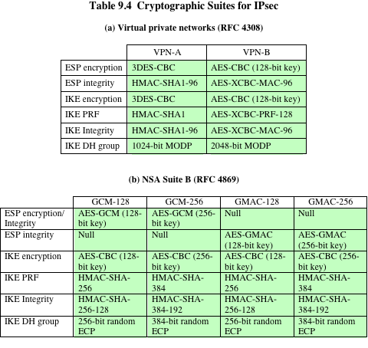
(Table 9.4 can be found on page 318 in the textbook)
Notes:
The IPsecv3 and IKEv3 protocols rely on a variety of types of cryptographic algorithms.
As we have seen in this book, there are many cryptographic algorithms of
each type, each with a variety of parameters, such as key size. To promote interoperability,
two RFCs define recommended suites of cryptographic algorithms and
parameters for various applications.
RFC 4308 defines two cryptographic suites for establishing virtual private networks.
Suite VPN-A matches the commonly used corporate VPN security used in
older IKEv1 implementations at the time of the issuance of IKEv2 in 2005. Suite
VPN-B provides stronger security and is recommended for new VPNs that implement
IPsecv3 and IKEv2.
Table 9.4a lists the algorithms and parameters for the two suites. There are
several points to note about these two suites. Note that for symmetric cryptography,
VPN-A relies on 3DES and HMAC, while VPN-B relies exclusively on AES. Three
types of secret-key algorithms are used:
• Encryption: For encryption, the cipher block chaining (CBC) mode is used.
• Message authentication: For message authentication, VPN-A relies on HMAC
with SHA-1 with the output truncated to 96 bits. VPN-B relies on a variant of
CMAC with the output truncated to 96 bits.
• Pseudorandom function: IKEv2 generates pseudorandom bits by repeated
use of the MAC used for message authentication.
RFC 6379 defines four optional cryptographic suites that are compatible with
the United States National Security Agency’s Suite B specifications. In 2005, the
NSA issued Suite B, which defined the algorithms and strengths needed to protect
both sensitive but unclassified (SBU) and classified information for use in
its Cryptographic Modernization program [LATT09]. The four suites defined in
RFC 6379 provide choices for ESP and IKE. The four suites are differentiated by
the choice of cryptographic algorithm strengths and a choice of whether ESP is to
provide both confidentiality and integrity or integrity only. All of the suites offer
greater protection than the two VPN suites defined in RFC 4308.
Table 9.4b lists the algorithms and parameters for the two suites. As with
RFC 4308, three categories of secret key algorithms are listed:
• Encryption: For ESP, authenticated encryption is provided using the GCM
mode with either 128-bit or 256-bit AES keys. For IKE encryption, CBC is
used, as it was for the VPN suites.
• Message authentication: For ESP, if only authentication is required, then
GMAC is used. As discussed in Chapter 12, GMAC is simply the authentication
portion of GMC. For IKE, message authentication is provided using
HMAC with one of the SHA-3 hash functions.
• Pseudorandom function: As with the VPN suites, IKEv2 in these suites generates
pseudorandom bits by repeated use of the MAC used for message
authentication.
For the Diffie-Hellman algorithm, the use of elliptic curve groups modulo
a prime is specified. For authentication, elliptic curve digital signatures are listed.
The original IKEv2 documents used RSA-based digital signatures. Equivalent or
greater strength can be achieved using ECC with fewer key bits.

Slide 44
Summary
IP security overview
  Applications of IPsec
  Benefits of IPsec
  Routing applications
  IPsec documents
  IPsec services
  Transport and tunnel modes
IP security policy
  Security associations
  Security association database
  Security policy database
  IP traffic processing
  Cryptographic suites
Encapsulating security payload
  ESP format
  Encryption and authentication algorithms
  Padding
  Anti-replay service
  Transport and tunnel modes
Combining security associations
  Authentication plus confidentiality
  Basic combinations of security associations
Internet key exchange
  Key determination protocol
  Header and payload formats
Notes:
Chapter 9 summary.

