Slide 1
Presenter: Prajakta Sangore
HONEYPOT
Instructor: Dr. T Andrew Yang
Network Security: CSCI 5235

Slide 2
Agenda
Introduction to Honeypot
Honeytoken
Types of Honeypots
Honeypot Implementation
Advantages and Disadvantages
Role of Honeypot in Network Security
Legal issues faced by Honeypot
Vulnerabilities and Solutions
Difference between Honeypot and IDS

Slide 3
Introduction to Honeypot
“A honeypot is a security resource whose value lies in being probed, attacked or compromised.”
                Lance Spitzner,
                Honeypots: Tracking Hackers
A decoy computer
A computer system – to capture all the traffic directed to it

Slide 4
Honeytoken
A honeypot:- not a computer
A digital entity
Flexible tool to detect malicious attempt
Enter a fake credit card number in database
Configure the IDS to watch access to that number
E.g excel file, powerpoint presentation, databse entry, fake login etc..

Slide 5
Types of Honeypots
HONEYPOT
Interaction
Low
Medium
High
Purpose
Research
Production

Slide 6
Research Honeypot
Study of
  Attackers
  Attack pattern
  Attackers motives and behavior
Users:
  Universities
  Governments
  Military or large corporations interested in learning more about threats
  Students or researchers to study cyberthreats

Slide 7
Research Honeypot
Security level: Provides very low security to the organization
Uses:
  Tremendous value to research field
  Instrumental in discovering worms

Slide 8
Production Honeypot
Used within an commercial organization
Security level: Provides immediate security to the organization
Working
  They mirror the production network of the company
  Thus invites attackers and expose them to organization vulnerabilities
Gives lesser information about the attackers then research honeypot

Slide 9
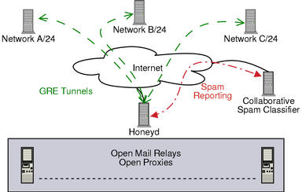
Low Interaction
Level of interaction between the intruder and the system
Emulates some part of the
services of the system
No access to the OS
Passive IDS : Can’t modify
Easy to deploy,maintain
Used to analyze spammers
E.g Honeyd: Figure 1: honeyd [1]

Slide 10
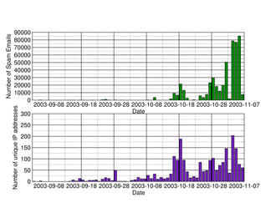
Result of honeyd scanning

Slide 11
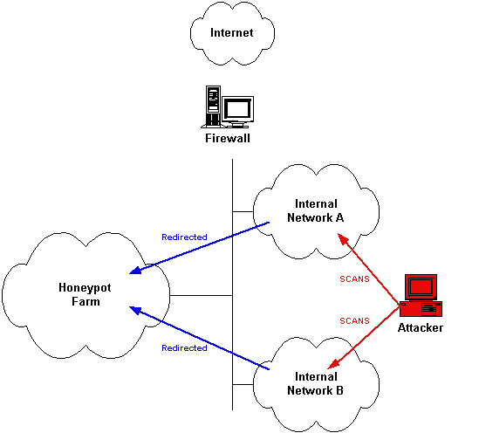
Medium Interaction
No OS in the systems
Complicated
simulated services
Better illusion of
the OS to attacker
e.g. Mwcollect,
nepenthes, honeytrap
More complex attacks can
be logged and analyzed
Figure 2: Medium interaction [2]

Slide 12
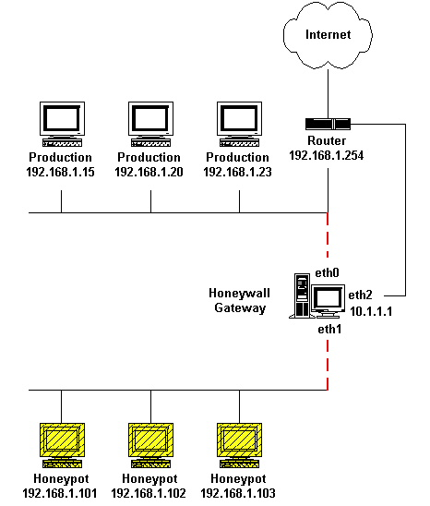
High interaction
Most complex and time consuming
Contain actual OS
Attacker has more
resources to attack
Closely monitored
Large amount of
data acquired
E.g Honeynet Figure 3: Honeynet [3]

Slide 13
Honeypot Implementation
Factors to consider :
  What kind of data used in honeypot systems?
  How to prevent honeypot as source of attack?
  Whether to build a honeypot or not to do so?
  Location of your honeypot.

Slide 14
Advantages of using a honeypot
Data Value
  Provides with less but valuable data
Resource
  No resource exhaustion
Simplicity
  No fancy algorithms,
  No database
Return of investments
  Justifies it’s own value,
  Also investments in other security resources

Slide 15
Disadvantages of using a honeypot
Narrow vision of honeypot
  Alarms only when attacked
Fingerprinting
  Can be used when detected by attacker
Risk
  Introduce risks to the environment
Honeypots never used as a replacement, but play a part in providing security

Slide 16
Role of Honeypot in Network Security
Prevention
  Honeypots add little value
  May introduce risks
Deterrence method
Advertising the presence of Honeypot to attackers
Deception method
Waste attackers time
As long as vulnerable systems present : No honeypot can prevent the attack

Slide 17
Role of Honeypot in Network Security
Detection
  False positives: The boy who cried the wolf
  False negatives: System failed to detect the attack
  Data Aggregation: Value of data in determining an attack

Slide 18

Legal Issues
Entrapment
  Concern for a honeypot owners.
  Attackers may argue entrapment
Privacy
  Restrictions on monitoring the network
  Privacy policies , terms of agreement etc..
Liability
  Potential lawsuits filed against owners

Slide 19
Vulnerabilities and Solutions
1] Identifying a Honeypot
  The value diminishes upon detection
  Many tools to discover the honeypots
  e.g Spamming industries - Honeypot Hunter
Solution:
  Decide how important detection is to you.
  Customize your honeypot.

Slide 20
Vulnerabilities and Solutions
2] Exploiting a Honeypot
  Effect on the environment after the honey pot is detected by attacker
Solution:
  Several layers of control
  Close monitoring of high interaction honeypot
  Terminating connections in case of an outbound attack.

Slide 21
Vulnerabilities and Solutions
3] Attacker Clientele
  Effect of deploying incorrect type of honeypot.
  Using RedHat 7.3 for protecting e-commerce website.
Solution:
  Locate Honeypot in proper place, and at proper time
  Honeypot should have correct bait.
  Use of CVS is required for e-commerce website.

Slide 22
Difference between IDS and Honeypot
 | IDS | Honeypot
Alerting about the attack | May not issue alert: Attack is recent | No such issue
False positives alarm | Yes: Untuned IDS alerts too many False positives | No
Volume of Data | Can’t cope with network traffic on large network | All the data received is unauthorised

Slide 23
Conclusion
Honeypots are interesting sociological and technical experiment.
In future attacks will use more advanced type of spoofing techniques
Role of honeypots will hence become more important
Also in future honeypot or honeynet can be implemented as a part of a computing lab

Slide 24
References
[1] Honeyd Research: Honeypots Against Spam- http://www.honeyd.org/spam.php
[2] Honeypot and Honeynet - http://drunkgeisha.noblogs.org/
[3] Intrusion Prevention Systems- http://www.iu.hio.no/teaching/materials/MS004A/index.phtml?show=L90.en&
  week=12
[5] Iyatiti Mokube and Michele Adams, “Honeypots: Concepts, Approaches, and Challenges”, Armstrong Atlantic State University, Savannah
[6] Problems and Challenges faced by Honeypots by Lance Spitzner; http://www.symantec.com/connect/articles/problems-and-challenges-honeypots
[7] Kyumin Lee, James Caverleee, Steve Webb, “The Social Honeypot Project: Protecting Online Communities from Spammers” Texas A&M University, College Station, Texas,
and Georgia Institute of Technology Atlanta
[8] The value of honeypots Chapter 4- “Honeypots: Tracking Hackers” by Lance Spitzner

Slide 25

Any Questions

Slide 26
Thank You

