Slide 1
Security of Web Applications
Michal Zalewski, The Tangled Web: A Guide to Securing Modern Web Applications, No Starch Press; 1 edition (November 15, 2011).
+ other sources

Slide 2
The WWW protocols
HTTP was created as a simple request-and-response protocol between a web browser and a web server.
A request is in the form of an URL.
Processing of a request:
  The url is resolved by the DNS to get the IP address of the web server;
  A TCP connection is established between the browser and the server at port 80;
  The browser sends an HTTP request over this connection to the server.

Slide 3
Evolution of Web applications
Early web applications
  Web sites for posting information
  static
  Attacks: defacing, distributing malwares
Later web applications are true online “applications”.
  The Web has become a universal platform.
  Interactive
  User-contributed content
  User-tailored content
  Dynamic
  Internet applications vs Intranet applications

Slide 4
Why are web applications vulnerable?
Public access
HTTP lacks strong security mechanisms.
  “When taking a look at the past decade, it is difficult not to be slightly disappointed: Nearly every single noteworthy online application devised so far has had to pay a price for the corners cut in the early days of the Web.” (Zalewski, The Tangled Web, 2011).
Many web application developers are not knowledgeable about security.
Web applications often connect to back-end servers.
  → turning the web server into a jumping board for the attackers to attack the back-end servers
Lower layer vulnerabilities may impact the application layer.

Slide 5
RFCs: protocols, Internet standards
https://www.rfc-editor.org/

Slide 6
Sample Network Organization
Demilitarized Zone (DMZ)
Inner Firewall
DNS Server(DMZ)
Intranet
Mail Server
Corporate data subnet
Customer data subnet
Web Server
Log Server
Internal
DNS Server(internal)
Outer Firewall
Mail server
Internet
Development subnet
Q: Why is this model becoming obsolete?
→ The move from perimeter-based model to zero-trust model

Slide 7
Threats against web applications
Leakage of sensitive data
  eavesdropping
  industrial/military espionage
System/service downtime
  Denial of Service attacks
False data
  Invalid user input
  Command injections
  SQL injections
Hijacked sessions
Spreading viruses and other malwares
Impact on the physical systems

Slide 8
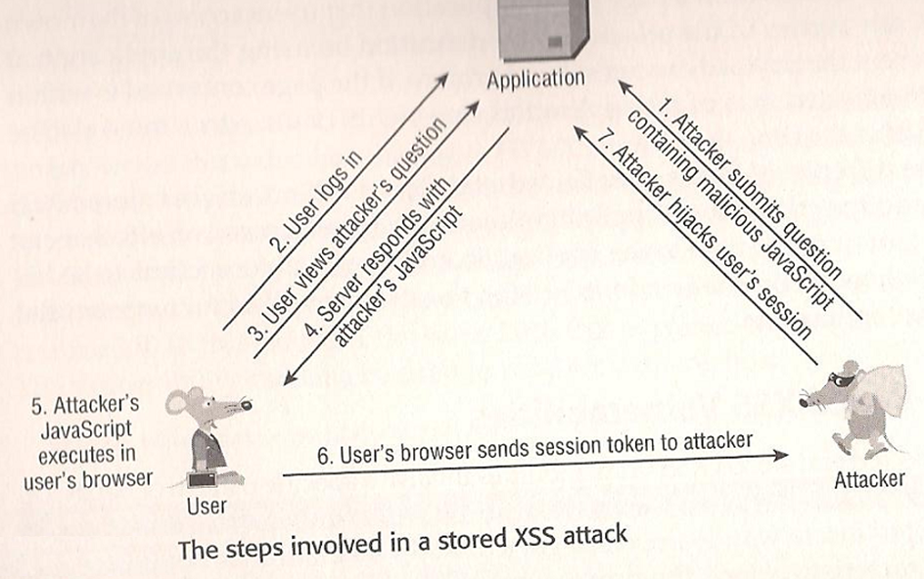
XSS (cross-site scripting) leads to session hijacking

Slide 9
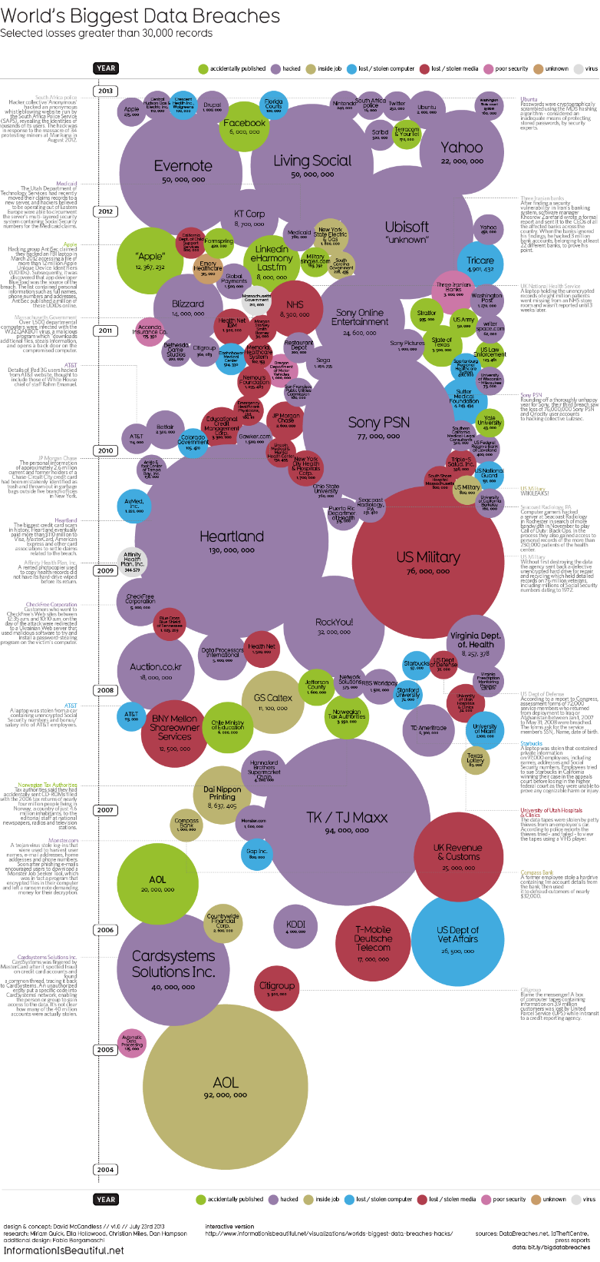
History of data breaches
https://informationisbeautiful.net/visualizations/worlds-biggest-data-breaches-hacks/

Slide 10
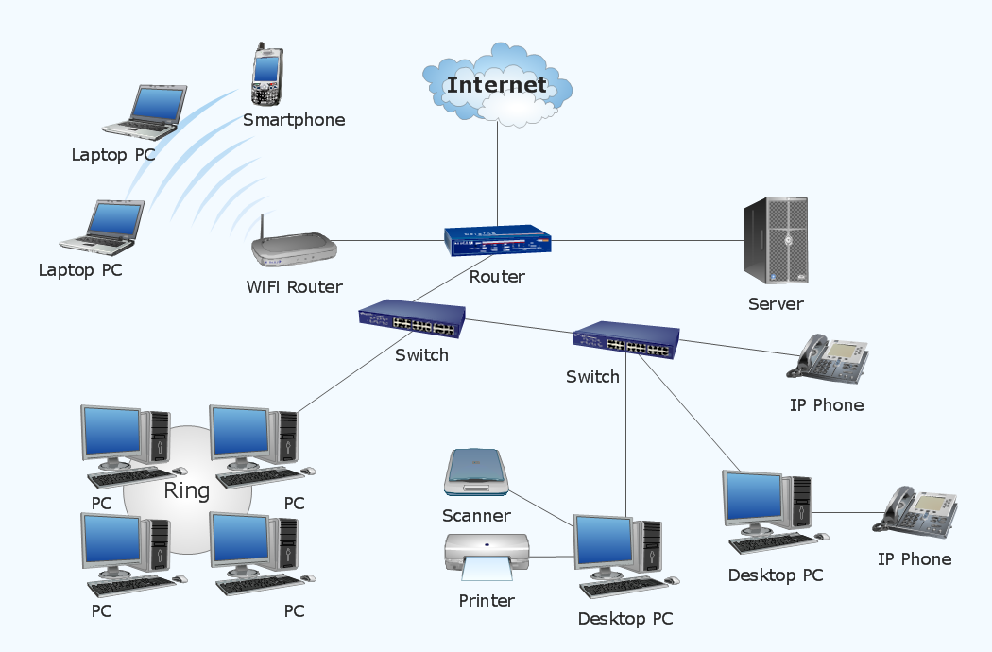
Q: Is your computer system secure?
Q1: What is a networked system?
Q2: What does securing a networked system mean?

Slide 11
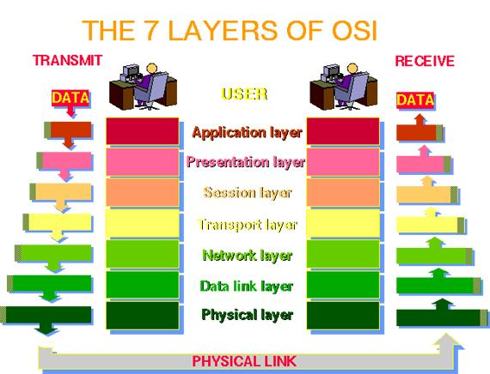
The ISO/OSI Network Reference Model

Slide 12
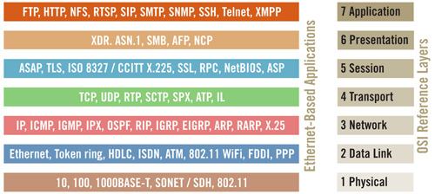

Slide 13
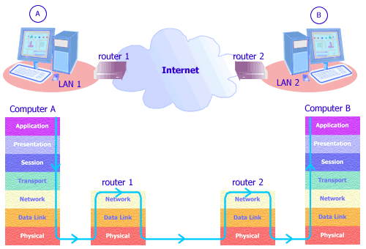

Slide 14
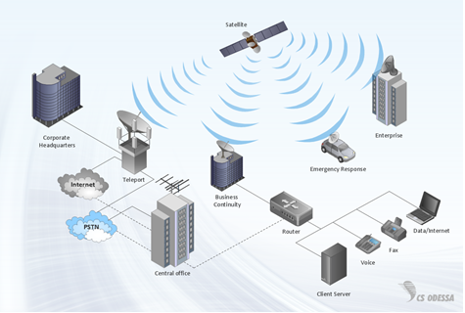
A networked system ?
Two or more nodes connected to support applications running over that network
  Two computers directly hooked together
  Local area networks (LAN), Metropolitan area networks (MAN), Wide area networks (WAN)
  Wireless networks, Mobile networks
  Internet/Intranet/Extranet
  Cloud
  Virtual private networks
  Network virtualization
  WSN
  Ad hoc networks
  …

Slide 15
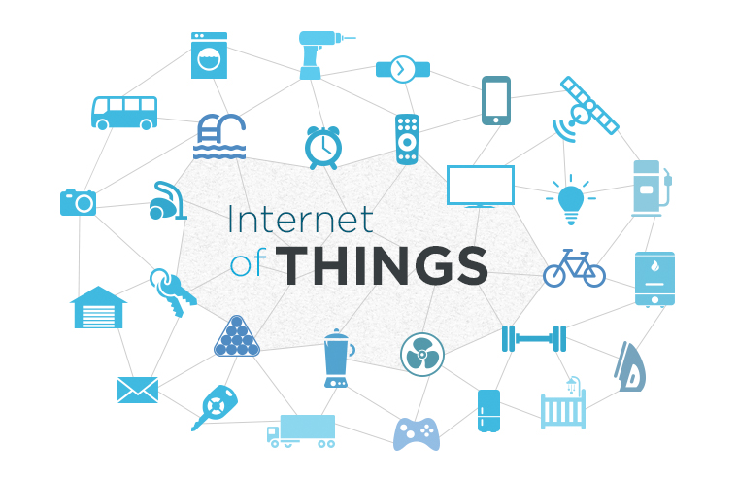
Assets in a computer system
Assets ?
  Network devices (hubs, switches, routers, firewalls, …)
  Medium (cables, radio transmission)
  Network appliances (authentication servers, gateways)
  Servers (Web servers, database servers, application servers, …)
  Workstations
  Things – IoT
  Software applications
  Data
  People ?
  …

Slide 16
Assumptions (wrt cybersecurity)
An attacker may exploit any vulnerabilities in your system.
A successful breach at a certain layer within a device may get propagated to other layers.
A successful breach of a device may get propagated to other devices.
Any data/message transmitted over the network is considered available to the hacker.
The hacker is knowledgeable about the underlying computer/network protocols.

Slide 17

Is your computer system secure?
Q2: What does securing a computer system mean?
The process of building security into a system
The multi facets of security

Slide 18
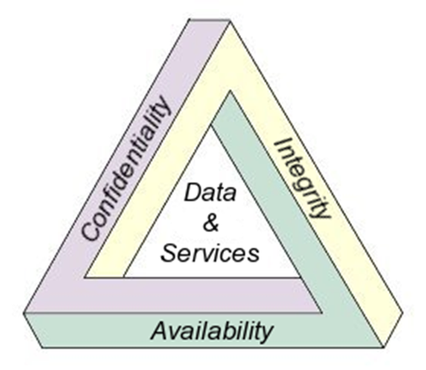
Security ?

Slide 19
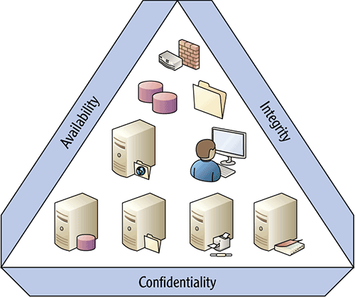
Securing a networked system ?

Slide 20
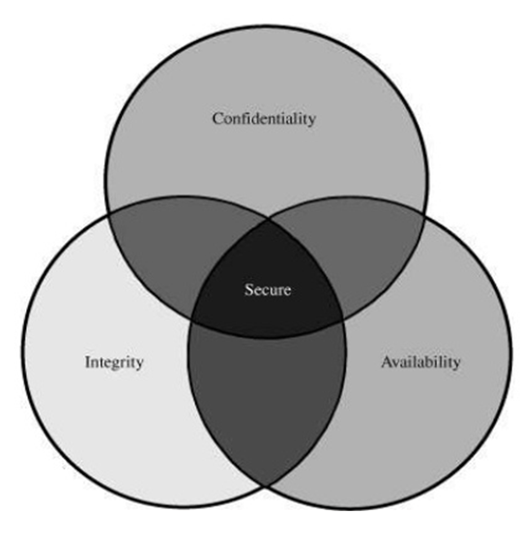
The multi layers of Cybersecurity

Slide 21
Security services ?
Confidentiality
Data integrity
Origin integrity / Authentication
Availability (e.g., Anti-replay)
Non-repudiability
Privacy
Access control
Anonymity
Anti-traffic-analysis
  …
NOTE:
Do not confuse services with mechanisms.

Slide 22
Security mechanisms?
Encryption/Decryption
  Symmetric encryption
  Asymmetric encryption (aka public key encryption)
Hashing / Message digests
Message Authentication Codes (MAC)
Digital signatures
Digital certificates
Key exchanges
Access Control (authentication, authorization, accounting)
Firewalls, Gateways
  …

Slide 23
Why is HTTPS not sufficient?
HTTPS: HTTP over SSL (Secure Socket Layer)
SSL is a certificate-based security mechanism.
SSL provides confidentiality, data integrity, and origin integrity. How?
SSL does not stop attacks that directly target the server or client components of an application.
Conclusion: SSL is not a cure-all for securing web applications.

Slide 24
Fundamental issue with web vulnerabilities
Users are outside the application’s direct control.
  Valid users with valid devices
  Valid users with compromised devices
  Malicious users with malicious devices
Attackers may use crafted input to compromise the application, by interfering with its logic and behavior, therefore gaining unauthorized access to its data and functionality.

Slide 25
Crafted user input
Attackers may use crafted input to compromise the application.
  Interfere with any data transmitted btwn the client and the server (request params, cookies, HTTP headers, …)
  Send requests in any sequence or submit parameters out of the anticipated order
  Replay attacks
  Use additional tools alongside or independently of the browser
Conclusion: The Web application must assume that all input from the user is potentially malicious.

Slide 26
The expanding network perimeter
The traditional concept of ‘network perimeter’ does not work.
User devices are often outside the corporate network.
  BYOD
Web applications are the potential gateways for attacks.
  A HTTP or HTTPS server must process all inbound requests.
  A web server often connects to back-end servers.
  A web application may involve cross-domain integration (e.g., mash-up, 3rd-party widgets).

Slide 27
Summary
While older vulnerabilities may have been patched, new vulnerabilities continue to be discovered and exploited.
A recent trend is increased attacks against users or user devices.
New technological advances may bring new vulnerabilities – cloud, social networks, etc.
SSL is not a cure-all.

