Slide 1
Public Key Infrastructure
From notes accompanying the book Computer & Internet Security: A Hands-on Approach, 2nd Edition, by Wenliang Du

Slide 2
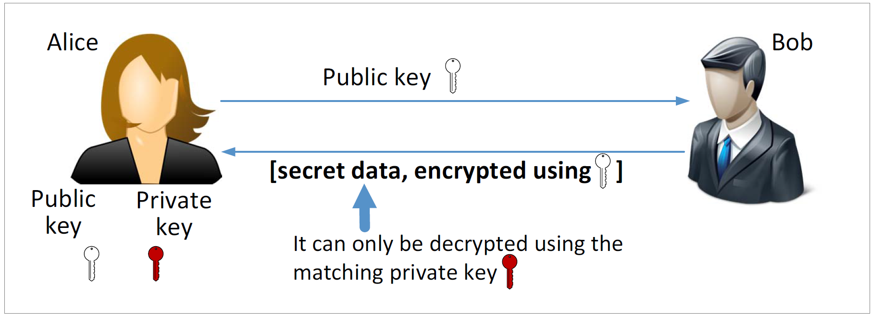
Public Key Cryptography

Slide 3
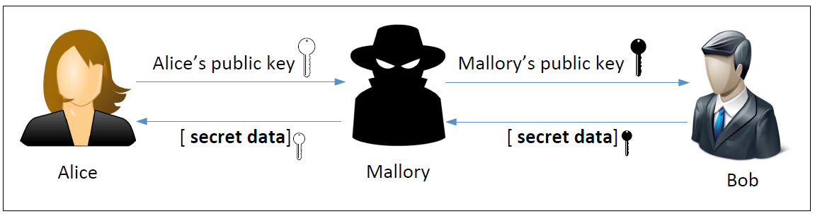
Man-in-the-Middle (MITM) Attack

Slide 4
What Is the Fundamental Problem?
Fundamental Problem: Bob has no way to tell whether the public key he has received belongs to Alice or not.
Solution:
  Find a trusted party to verify the identity
  Bind an identity to a public key in a certificate
  The certificate cannot be forged or tampered with (using digital signature)
Notes:
Alice can not trust the certificate signing to be done over the internet as that may also be under attack by a MITM. She has to go in person.
After sending the certificate to Bob, even if Mallory intercepts the traffic; she cannot replace Alice’s public key with her own, as that would invalidate the DMV’s signature
There is no way for Mallory to get a certificate from DMV for her public key with Alice’s name as the DMV will not approve it

Slide 5
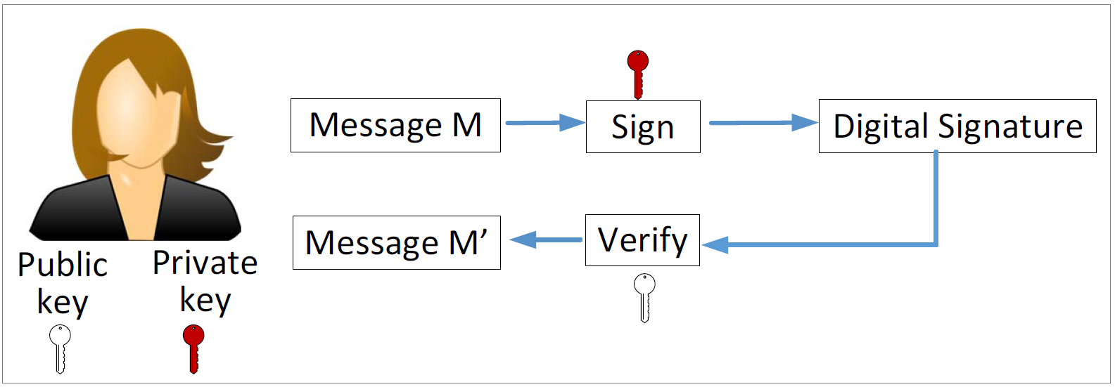
Digital Signature
If the signature is not tampered with, M’ will be the same as M
Only Alice can sign (she has the private key)
Everybody can verify (public key is known publically)

Slide 6
Defeating MITM Attacks using Digital Signature
Alice needs to go to a trusted party to get a certificate.
After verifying Alice’s identity, the trusted party issues a certificate with Alice’s name and her public key.
Alice sends the entire certificate to Bob.
Bob verifies the certificate using the trusted party’s public key.
Bob now knows the true owner of a public key.

Slide 7
Public Key Infrastructure
Certificate Authority (CA): a trusted party, responsible for verifying the identity of users, and then bind the verified identity to a public keys.
Digital Certificates: A document certifying that the public key included inside does belong to the identity described in the document.
  X.509 standard

Slide 8
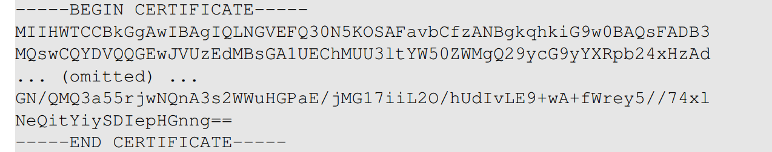
Digital Certificate
Let’s get paypal’s certificates
Save the above data to paypal.pem, and use the following command decode it (see next slide)
Notes:
An Actual X.509 certificate contains binary data. Therefore when stored in files, X.509 certificates use encoders.
A common scheme used here is Base64 encoder and are usually saved in a file with PEM extension (Privacy Enhanced Mail)
We can copy and paste the content into a file (paypal.pem) and run another openssl command to decode it.
The following commands decodes it to raw binary data, but we cannot view it using a text editor. We should use something like ghex :
Openssl x509 –in paypal.pem –outform der > paypal.der
The best way to view an X.509 certificate it to convert PEM to text :
openssl x509 –in paypal.pem –text -noout

Slide 9
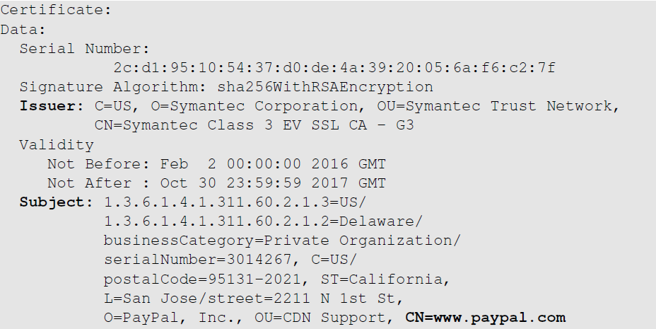
Example of X.509 Certificate (1st Part)
The CA’s identity
(Symantec)
The owner of the certificate
(paypal)

Slide 10
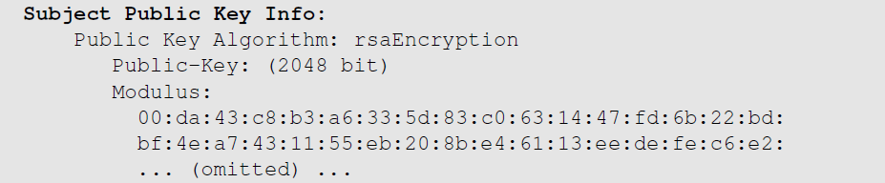
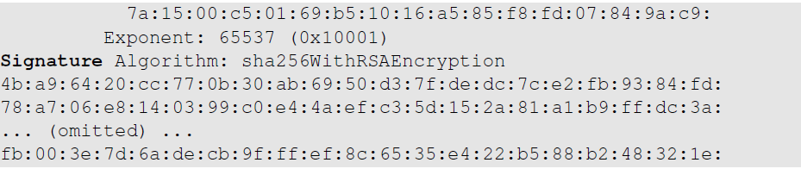
Example of X.509 Certificate (2nd Part)
Public key
CA’s signature

Slide 11
The Core Functionalities of CA
Verify the subject
  Ensure that the person applying for the certificate either owns or represents the identity in the subject field.
Signing digital certificates
  CA generates a digital signature for the certificate using its private key.
  Once the signature is applied, the certificate cannot be modified.
  Signatures can be verified by anyone with the CA’s public key.
Notes:
Verify the subject
CA needs to check whether the application owns the domain or not
For example applicant wants to get a certificate for www.example.com to verify whether the applicant owns the domain or not, the CA may give the applicant a randomly generated number and ask the applicant to put it on the website http://www.example.com/proof.txt
If the applicant is able to do that, the domain ownership will be verified
Some of the verification can be done using online sources such as WHOIS etc
Not all information is available online, therefore sometimes legal experts or authorities, such as lawyers and government officials may be involved

Slide 12
Being a Certificate Authority
Let’s go through the process
  How a CA issues certificates
  How to get a certificate from a CA
  How to set up a web server using a certificate
Notes:
Scenario:
A bank needs a X.509 certificate and it will have to go to a CA. We will use ModelCA to refer to this CA in our emulation.

Slide 13
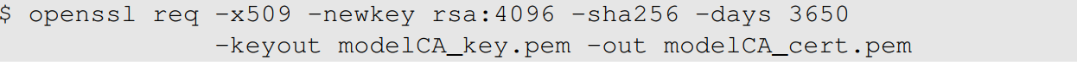
CA Setup
Our CA will be called ModelCA
We need to set up the following for ModelCA:
  Generate public/private key pair
  Create a X.509 certificate (who is going to sign it?)
  We assume ModelCA is a root CA, so it is going to sign the certificate itself, i.e. self-signed.
The following command generates a self-signed X.509 certificate

Slide 14
Discussion Question
Question: If the ModelCA’s certificate is self-signed, how do we verify it?
Answer: There is no way to verify it. We just make sure that the certificate is obtained in a trusted way
  Come with the operating system (if we trust OS, we trust the cert.)
  Come with the software (if we trust the software, we trust the cert.)
  Manually added (if we trust our own decision, we trust the cert.)
  Sent to us by somebody whom we don’t trust (don’t trust the cert.)

Slide 15
Get a Certificate from CA: Step 1
Step 1: Generate a public/private key pair
RSA key size
Encrypt the ouput file using AES (128-bit)
Contains both private and public keys

Slide 16
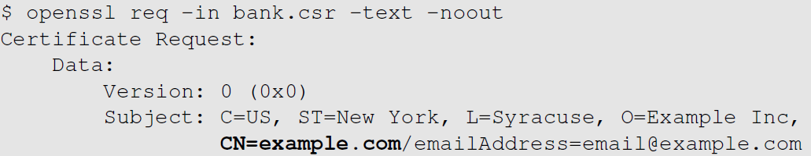
Get a Certificate from CA: Step 2
Step 2: Generate a certificate signing request (CSR); identity information needs to be provided
CA will verify this subject information
Notes:
It should be noted that the signature in the request is generated by the requesters using its own private key
The purpose of this signature is to prevent an entity from requesting a bogus certificate of someone else’s public key

Slide 17
CA: Issuing X.509 Certificate
We (the bank) need to send the CSR file to ModelCA.
ModelCA will verify that we are the actual owner of (or can represent) the identity specified in the CSR file.
If the verification is successful, ModelCA issues a certificate
The CSR file
The X.509 certificate will be saved here
ModelCA’s self-signed certificate
ModelCA’s private key
Notes:
In the real world, the bank would submit its CSR file to a CA, who will issue a signed certificate after verifying the information in the CSR
If openssl refusesd to generate certificates, it is very likely that some of the fields in the request do not match with those of the CA
Matching rules are specified in /usr/lib/ssl/openssl.cnf
By default we see “policy=policy_match”
We can change it to “policy=policy_anything”

Slide 18
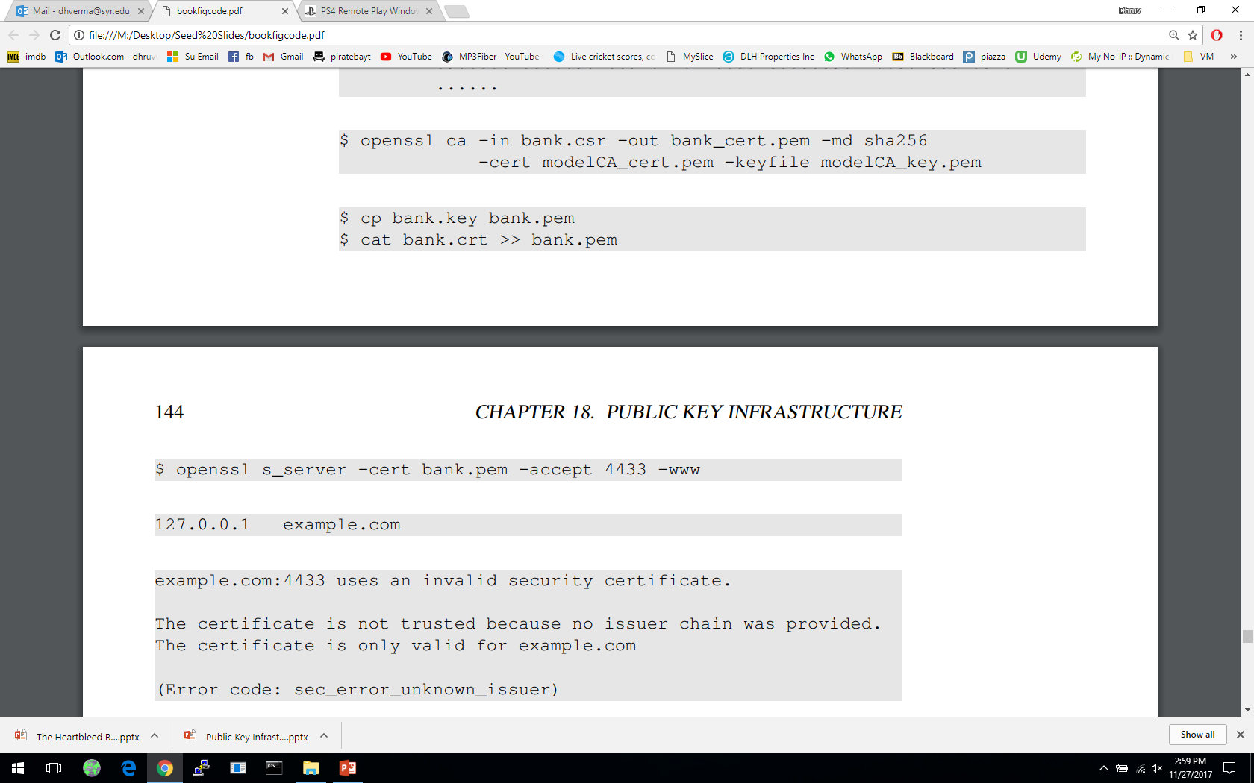
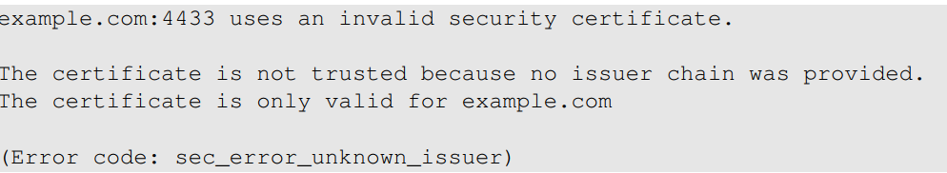
Deploying Public Key Certificate in Web Server
We will first use openssl’s built-in server to set up an HTTPS web server
Access the server using Firefox (https://example.com:4433), we get the following error message. Why?
Notes:
Browsers have a list of trusted CA’s and ModelCA is not on that list. If a CA is not trusted, none of the certificates issued by that CA will be trusted
Firefox allows us to manually add certificates.

Slide 19
Answer to the Question in the Previous Slide
Firefox needs to use ModelCA’s public key to verify the certificate
Firefox does not have ModelCA’s public key certificate
We can manually add ModelCA’s certificate to Firefox
Goto
Import ModelCA_cert.pem

Slide 20
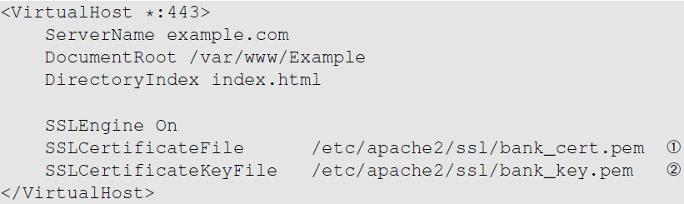
Apache Setup for HTTPS
We add the following VirtualHost entry to the Apache configuration file:
The server’s certificate
The server’s private key
Note: Apache configuration file is located at
/etc/apache2/sites-available/default

Slide 21
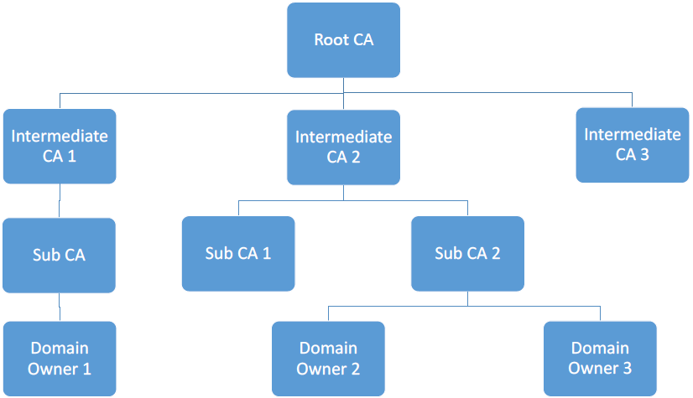
Root and Intermediate Certificate Authorities
There are many CAs in the real world, and they are organized in a hierarchical structure.

Slide 22
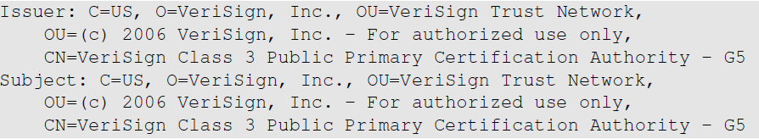
Root CAs and Self-Signed Certificate
A root CA’s public key is also stored in an X.509 certificate. It is self-signed.
Self-signed: the entries for the issuer and the subject are identical.
How can they be trusted?
  Public keys of root CAs are pre-installed in the OS, browsers and other software
Same
Notes:
As long as we trust the software, we are trusting the public keys that come with it.

Slide 23
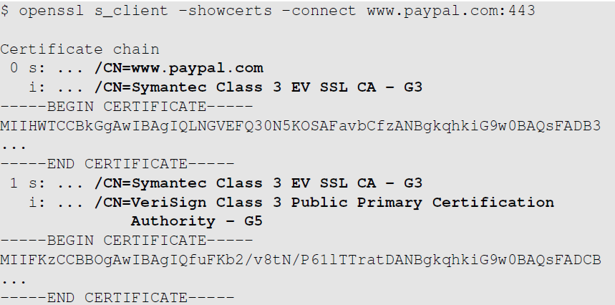
Intermediate CAs and Chain of Trust
Paypal’s certificate
B
A is used to verify B
Intermediate CA’s certificate
A
Something else is need to verify A (certificate from another intermediate CA or root CA)
Notes:
Root CA vouches for intermediate CA
Intermediate CA can then issue certificate for other users.
In the figure,
Certificate chain is obtained from Paypal:
It contains two certificates. First one payapal’s certificate, issued by a CA called “Symantec Class 3 EV SSL CA –G3”
This is an intermediate CA which is certified by another CA “VeriSign Class 3 Public Primary CA G5”
VeriSign-G5 is the root CA

Slide 24
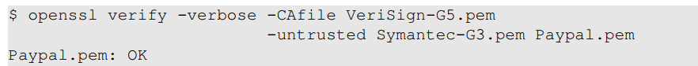
Manually Verifying a Certificate Chain
Paypal.pem: Save Paypal’s certificate to a file called
Symatec-g3.pem: Save certificate from “Symantec Class 3 EV SSL CA – G3”
VeriSign-G5.pem: Save the VeriSign-G5’s certificate from the browser
Root CA’s certificate
Chain of certificates
Notes:
In the command used, the untrusted option provides a certificate chain, the last of which has to be the domain server’s certificate
The CAfile option specifies a trusted CA
If everything works fine, an OK will be printed out

Slide 25


Creating Certificates for Intermediate CA
When generating a certificate for an intermediate CA, we need to do something special:
The extension field of the certificate will look as follows:
TRUE means the certificate can be used verify other certificates, i.e, the owner is a CA. For non-CA certificates, this field is FALSE.
Notes:
First figure
Command similar to the one used in issuing certificate for server.
This command includes the “-extensions v3_ca” option
This option tells openssl to set the CA entry in the certificate’s extension field to TRUE – indicating that certificate belongs to an intermediate CA
Second figure
CA field in a non-CA certificate will have value FALSE, which means that the certificate cannot be used to verify other certificates or the owner of the certificate cannot serve as a CA

Slide 26
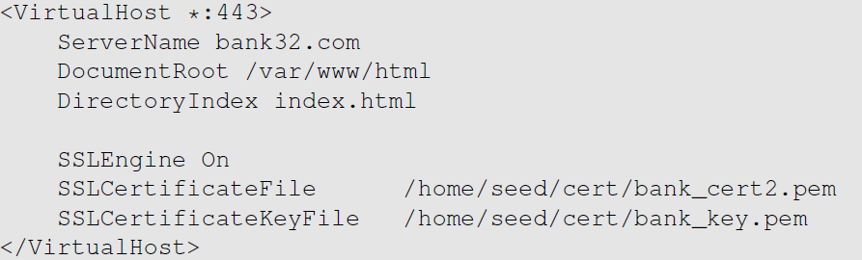
Apache Setup
A server has a responsibility to send out all the intermediate CA’s certificates needed for verifying its own certificate.
In Apache, all certificates including those from Intermediate CAs are put inside the certificate file listed in the directive.
Notes:
When a browser/client asks for certificate of a web server, it should send out the certificates of all the involved intermediate CAs along with its own.
Add the entry shown in the figure to Apache’s configuration file located in /etc/apache2/sites-available/default-ssl.conf .

Slide 27
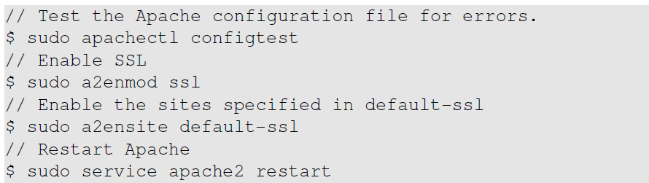
Restart Apache

Slide 28
Trusted CAs in the Real World
Not all of the trusted CAs are present in all browsers.
According to W3Techs in April 2017, Comodo takes most of the market share followed by IdenTrust, Symantec Group, GoDaddy Group, GlobalSign and DigiCert.
The list of trusted CAs supported by browser can be found:
  For the Chrome browser:
    Settings -> Show advanced settings -> Manage Certificates
  For the Firefox browser:
    Edit -> Preferences -> Advanced -> Certificates -> View Certificates -> Certificate Manager -> Authorities
Notes:
Chrome:
On the window we get after clicking Manage Certificates, there will be several tabs. One tab is for root CAs and another for intermediate.
Click on these tabs to view the list.
Firefox:
Under the Authorities Tab, you can view the list of certificate strusted by Firefox, including those from root and intermediate CAs.

Slide 29
How PKI Defeats the MITM Attack
Assume that Alice wants to visit https://example.com
When the server sends its public key to Alice, an attacker intercepts the communication. The attacker can do the following things:
  Attacker forwards the authentic certificate from example.com
  Attacker creates a fake certificate
  Attacker sends his/her own certificate to Alice

Slide 30
Attacker Forwards the Authentic Certificate
Attacker (Mike) forwards the authentic certificate
Alice sends to the server a secret, encrypted using the public key.
The secret is used for establishing an encrypted channel between Alice and server
Mike doesn’t know the corresponding private key, so he cannot find the secret.
Mike can’t do much to the communication, except for DoS.
MITM attack fails.

Slide 31
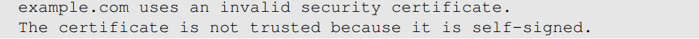
Attacker Creates a Fake Certificate
Attacker (Mike) creates fraudulent certificate for the example.com domain.
Mike replaces the server’s public with his own public key.
Trusted CAs will not sign Mike’s certificate request as he does not own example.com.
Mike can sign the fraudulent certificate by himself and create a self-signed certificate.
Alice’s browser will not find any trusted certificate to verify the received certificate and will give the following warning:
MITM attack fails if the user decide to terminate the connection
Notes:
Attacker has to compromise a CA to get a valid signature; this is not easy.
The attack will be successful if the user ignores the warnings and continues.

Slide 32
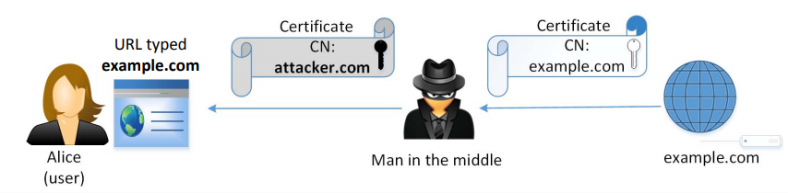
Attacker Sends His/Her Own Certificate
Attacker’s certificate is valid.
Browser checks if the identity specified in the subject field of the certificate matches the Alice’s intent.
  There is a mismatch: attacker.com ≠ example.com
Browser terminates handshake protocol: MITM fails

Slide 33
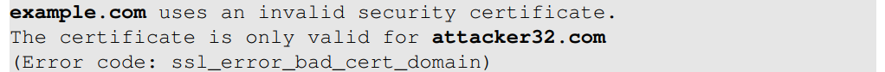
Emulating an MITM Attack
DNS Attack is a typical approach to achieve MITM
  We emulate an DNS attack by manually changing the /etc/hosts file on the user’s machine to map example.com to the IP address of the attacker’s machine.
On attacker’s machine we host a website for example.com.
  We use the attacker’s X.509 certificate to set up the server
  The Common name field of the certificate contains attacker32.com
When we visit example.com, we get an error message:

Slide 34
The Importance of Verifying Common Name
During TLS/SSL handshake browsers conduct two important validations
  Checks whether the received certificate is valid or not.
  Verifies whether the subject (Common Names) in the certificate is the same as the hostname of the server.
Not verifying the common name is a common mistake in software
Notes:
First validation:
A valid certificate only ensures that the public key contained in the certificate belongs to the subject described in the subject field, but it does not say whether he subject is the intended subject or not. This is the job of second validation.
First validation carried out by SSL library. It is application’s responsibility to do the second validation.

Slide 35
The Man-In-The-Middle Proxy
Proxy creates a self-signed CA certificate, which is installed on the user’s browser
The routing on the user machine is configured; all outgoing HTTPS traffic is directed towards the proxy machine
When user tries to visit an HTTPS site:
  Proxy intercepts communication
  Creates a fake certificate
  Browser already has the proxy’s certificate in its trusted list to be able to verify all the fake certificates
  Proxy becomes MITM
Notes:
HTTPS proxy creates fake certificate for each of the HTTPS websites user visits
Fake certificate signed by proxy
User’s machine is “fooled” to establish an SSL connection with the proxy
Proxy not an attacker any more; so we can’t call it an MITM attack because of the trust that is already placed on the proxy by the user.

Slide 36
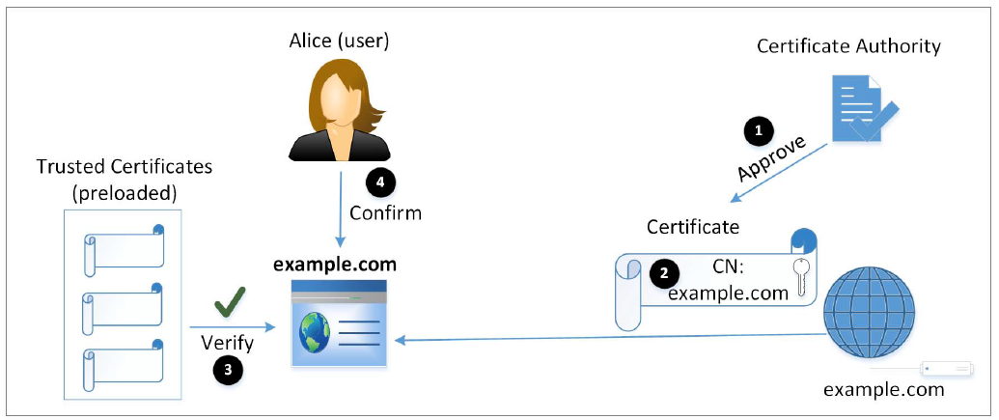
Attacks Surfaces on PKI
Notes:
1- We can not trust what is said by a public key, we have to rely on a third-party CA to conduct necessary checks to ensure the correctness of the owner information.
This is essential to defeat MITM attacks; client can know whether a received public key belongs to the intended server or not.
2- After CA verifies the identity, it will generate a certificate for the owner. Certificate should not be forged or tampered with. This is guaranteed by the one-way hash function and the digital signature algorithm.
3- Integrity of certificate protected by CA’s signature. To verify signature, we need CA’s public key. The public key (trusted certificate) must be preloaded by the client.
4- The client ensures that the subject in the certificate and user’s intention matches.

Slide 37
Attack on CA’s Verification Process
CA’s job has two parts:
  Verify the relationship between certificate applicant and the subject information inside the certificate
  Put a digital signature on the certificate
Case study: Comodo Breach [March 2011]
  Popular root CA.
  The approval process in Southern Europe was compromised.
  Nine certificates were issued to seven domains and hence the attacker could provide false attestation.
  One of the affected domain (a key domain for the Firefox browser): addons.mozilla.org
Notes:
If the CA doesn’t do a good job conducting the subject verification, or the verification process is compromised, an attacker may be able to get a certificate that contains the target subject and the attacker’s public key (now the attacker knows the corresponding pubic key). With this fake certificate, the attacker can launch an MITM attack.
The primary task of a registration authority is to attest to the authenticity of the company/client requesting the certificate.

Slide 38
Attack on CA’s Signing Process
If the CA’s private key is compromised, attackers can sign a certificate with any arbitrary data in the subject field.
Case Study: the DigiNotar Breach [June-July 2011]
  A top commercial CA
  Attacker got DigiNotar’s private key
  531 rogue certificates were issued.
  Traffic intended for Google subdomains was intercepted: MITM attack.
How CAs Protect Their Private Key
  Hardware Security Model (HSM)
Notes:
Several of DigiNotar’s CA servers including the ones responsible for issuing government certificates were compromised.
Hardware Secrutiy Model:
Capable of generating and storing cryptographic keys.
Device is tamper-proof. Needs to be accessed physically to get the key.
Generally stored in a vault guarded with physical security and video surveillance

Slide 39
Attacks on Algorithms
Digital Certificates depend on two types of algorithms
  one-way hash function and digital signature
Case Study: the Collision-Resistant Property of One-Way Hash
  At CRYPTO2004, Xiaoyun Wang demonstrated collision attack against MD5.
  In February 2017, Google Research announced SHAttered attack
      Attack broke the collision-resistant property of SHA-1
      Two different PDF files with the same SHA-1 has was created.
    Countermeasures: use stronger algorithm, e.g. SHA256.

Slide 40
Attacks on User Confirmation
After verifying the certificate from the server, client software is sure that the certificate is valid and authentic
In addition, the software needs to confirm that the server is what the user intends to interact with.
Confirmation involves two pieces of information
  Information provided or approved by user
  The common name field inside the server’s certificate
  Some software does not compare these two pieces of information: security flaw

Slide 41
  Attacks on Confirmation: Case Study
  Phishing Attack on Common Name with Unicode
  Zheng found out several browsers do not display the domain name correctly if name contains Unicode.
  xn—80ak6aa92e.com is encoded using Cyrillic characters. But domain name displayed by browser likes like apple.com
  Attack:
    Get a certificate for xn—80ak6aa92e.com
    Get user to visit xn—80ak6aa92e.com, so the common name is matched
    User’s browser shows that the website is apple.com. User can be fooled.
  Had the browser told the user that the actual domain is not the real apple.com, the user would stop.
Notes:
Some Unicode characters look like ASCII and they can cause confusion.
Possible to write a string in Cyrillic characters that looks like apple.com in ASCII. When combined in digital certificate these similarities will cause security problems.
Attacker can purchase the domain and get a certificate with www.xn—80ak6aa92e.com as its common name. When user redirected to this URL; browser will verify common name and server name and find that it matches.
Browser then display server name in the URL field and it will look like apple.com which defeats user confirmation step.
If browser told the user that the actual domain is not apple.com, the user would have stopped.

Slide 42
Types of Digital Certificate
Domain Validated Certificates (DV)
Organizational Validated Certificates (OV)
Extended Validated Certificates (EV)

Slide 43
Domain Validated Certificates (DV)
  Most popular type of certificate.
  The CA verifies the domain records to check if the domain belongs to applicant.
  Domain Control Validation (DCV) is performed on domain name in the certificate request.
  DCV uses information in the WHOIS database
  DCV is conducted via
  Email
  HTTP
  DNS
Notes:
WHOIS database - online repository storing information about domain name registration
Via Email: traditional method. CA fetches the administrator email from domain name supplied in certificate request, then sends email to the email address. If the link in th email is clicked, the domain will be verified. CA now trusts that the applicant owns or manages the domain contained in the certificate request.
Via HTTP: the hash vale of the certificate request is generated and given to the applicant. Applicant creates a file bearing the hash value in its name. The file is placed on a web server inside the domain requested. If CA can get this file, the domain is verified.
Via DNS: the hash value of the certificate request is generated and given to the applicant. Applicant enters a DNS CNAME record for the domain. If the CA can get the hash value back from the corresponding DNS query, the domain is verified.

Slide 44
Organizational Validated Certificates (OV)
  Not very popular type of certificate.
  CAs verify the following before issuing OV certificates:
    Domain control validation.
    Applicant’s identity and address.
    Applicant’s link to organization.
    Organization’s address.
    Organization’s WHOIS record.
    Callback on organization’s verified telephone number.

Slide 45
Extended Validated Certificates (EV)
  CAs issuing EV certificates require documents that are legally signed from registration authorities.
  EV CA validate the following information:
    Domain control validation.
    Verify the identity, authority, signature and link of the individual.
    Verify the organization's physical address and telephone number.
    Verify the operational existence.
    Verify the legal and proper standings of the organization.
    EV certificate, hence, costs higher but is trustworthy.
Notes:
DV certificate only verifies that the applicant has the control of the domain but doesn’t say anything about the organization that owns the domain
EV certificates provide a more thorough background checking on the organization.

Slide 46
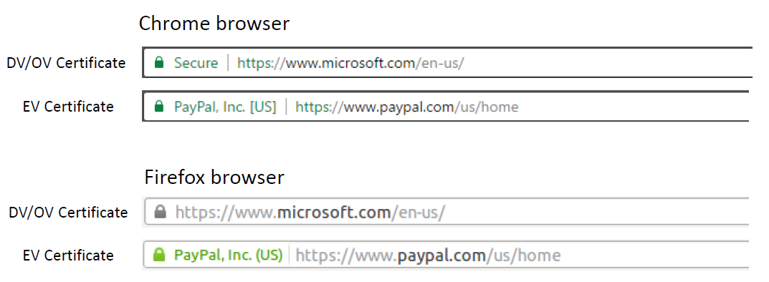
How Browsers Display Certificate Types
Notes:
Browser have separate list for EV-compliant CAs.
CA is EV compliant if it follows all the standards and implement security controls for its infrastructure and can prove its security to browser vendors through third party audits.
EV compliant certificates cannot be added manually for most browsers.
If an EV certificate is verified, browser displays extra information to indicate that the website uses an EV certificate.
The image shows how browsers display the info for three scenarios:
- the website’s certificate can not be verified
- the website is using a DV or OV certificate
- the website is using an EV certificate

Slide 47
Summary
MITM attacks on public key cryptography
Public-Key Infrastructure
X.509 digital certificate
Certificate Authority and how CA signs certificate
How PKI defeats MITM attacks
Attacks on PKI
Different types of digital certificate

