Slide 1
PNT Web Based Knowledge Portal Project
Group Name: PNT
Group Members: Prabin Joshi and Ngoc Vu

Slide 2
Content
Technology Used
Functions
Security Issues
System Configuration
SSH Configuration
Database Schema
Demo

Slide 3
Techology
Three tier web application
Web technology: PHP
Web server: Apache
Database: Mysql Server

Slide 4
Functions
Users
  Post articles, write comment on particular article
  Create group and mange group permission (access control)
  Each user and article can be ranked
Admin
  Manage groups and users on entire system
  Collect statistics about user behaviors (group activity, user activity …)

Slide 5
Security Issues
Password hashing with salt
User account activation code sending to email
Recaptcha
Sql Injection prevention (using mysql_real_escape_string function)
Secure connection between web browser and web server.
Future work: support secure connection between web application and database (mysql) using ODBC driver and SSH

Slide 6
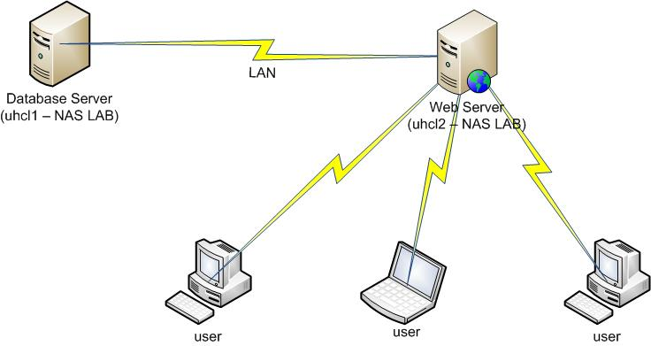
System Configuration

Slide 7
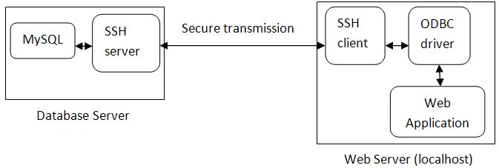
SSH Configuration
(uhcl1)
Forward port 3306 of uhcl1 to port 3307 of uhcl2
Connection string for ODBC driver: localhost:3307, username, password
(uhcl2)

Slide 8
Database Schema
create
*
*
Users
Groups
Permissions
1
1
*
*
*
Articles
has
Comments
1
*

Slide 9
DEMO

