Slide 1
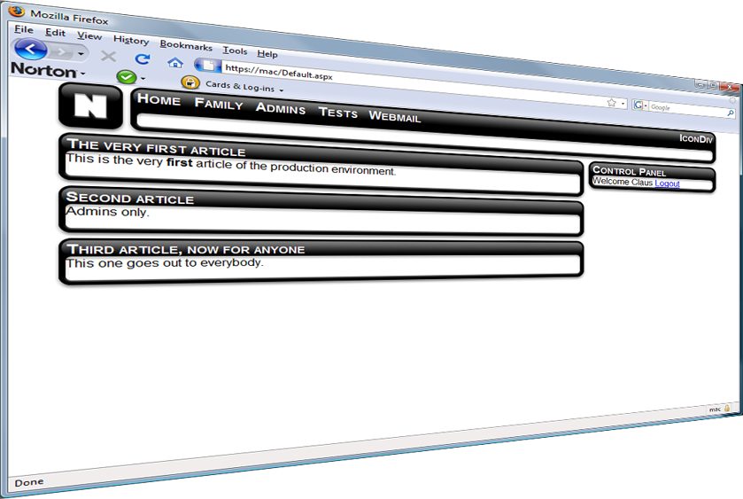
Web Security Project
Family Blog
By
Claus Nilsson

Slide 2
Family Blog
Users: Family and friends
Purpose: Securely share news

Slide 3
Site map

Slide 4
Architecture

Slide 5
Design
3 tiered design
  Presentation layer (client)
  Business layer (web server)
  Data layer (database server)

Slide 6
Security
Access
  ASP.NET membership controls
Confidentiality
  SSL
  Hamachi
  No caching
Scripting Attacks
  XSS/SQL injection
  HTML rewrite

