Slide 1

Network Security Essentials
Fifth Edition
by William Stallings
Notes:
Lecture slides prepared for “Network Security Essentials”, 5/e, by William Stallings, Chapter 3 – “Public Key Cryptography and Message Authentication”.

Slide 2
Chapter 3
Public Key Cryptography and Message Authentication
Notes:
In addition to message confidentiality, message authentication is an important network
security function. This chapter examines three aspects of message authentication.
First, we look at the use of message authentication codes and hash functions to
provide message authentication. Then we look at public-key encryption principles
and two specific public-key algorithms. These algorithms are useful in the exchange
of conventional encryption keys. Then we look at the use of public-key encryption
to produce digital signatures, which provides an enhanced form of message
authentication.

Slide 3
Every Egyptian received two names, which were known respectively as the true name and the good name, or the great name and the little name; and while the good or little name was made public, the true or great name appears to have been carefully concealed.
—The Golden Bough, Sir James George Frazer
To guard against the baneful influence exerted by strangers is therefore an elementary dictate of savage prudence. Hence before strangers are allowed to enter a district, or at least before they are permitted to mingle freely with the inhabitants, certain ceremonies are often performed by the natives of the country for the purpose of disarming the strangers of their magical powers, or of disinfecting, so to speak, the tainted atmosphere by which they are supposed to be surrounded.
—The Golden Bough, Sir James George Frazer
Notes:
Encryption protects against passive attack (eavesdropping). A different requirement
is to protect against active attack (falsification of data and transactions).
Protection against such attacks is known as message authentication.
A message, file, document, or other collection of data is said to be authentic
when it is genuine and comes from its alleged source. Message authentication is a
procedure that allows communicating parties to verify that received messages are
authentic. The two important aspects are to verify that the contents of the message
have not been altered and that the source is authentic. We may also wish to
verify a message’s timeliness (it has not been artificially delayed and replayed) and
sequence relative to other messages flowing between two parties. All of these concerns
come under the category of data integrity as described in Chapter 1.

Slide 4
Approaches to Message Authentication
Using conventional encryption
Without message encryption
Symmetric encryption alone is not a suitable tool for data authentication
  We assume that only the sender and receiver share a key, so only the genuine sender would be able to encrypt a message successfully
  The receiver assumes that no alterations have been made and that sequencing is proper if the message includes an error detection code and a sequence number
  If the message includes a timestamp, the receiver assumes that the message has not been delayed beyond that normally expected for network transit
An authentication tag is generated and appended to each message for transmission
The message itself is not encrypted and can be read at the destination independent of the authentication function at the destination
Because the message is not encrypted, message confidentiality is not provided
Notes:
It would seem possible to perform authentication simply by the use of symmetric
encryption. If we assume that only the sender and receiver share a key (which
is as it should be), then only the genuine sender would be able to encrypt a message
successfully for the other participant, provided the receiver can recognize a
valid message. Furthermore, if the message includes an error-detection code and a
sequence number, the receiver is assured that no alterations have been made and
that sequencing is proper. If the message also includes a timestamp, the receiver is
assured that the message has not been delayed beyond that normally expected for
network transit.
\
In fact, symmetric encryption alone is not a suitable tool for data authentication.
To give one simple example, in the ECB mode of encryption, if an attacker
reorders the blocks of ciphertext, then each block will still decrypt successfully.
However, the reordering may alter the meaning of the overall data sequence.
Although sequence numbers may be used at some level (e.g., each IP packet), it is
typically not the case that a separate sequence number will be associated with each
b -bit block of plaintext. Thus, block reordering is a threat.
In this section, we examine several approaches to message authentication that do
not rely on encryption. In all of these approaches, an authentication tag is generated
and appended to each message for transmission. The message itself is not encrypted
and can be read at the destination independent of the authentication function at the
destination.
Because the approaches discussed in this section do not encrypt the message,
message confidentiality is not provided. As was mentioned, message encryption by
itself does not provide a secure form of authentication. However, it is possible to
combine authentication and confidentiality in a single algorithm by encrypting a
message plus its authentication tag. Typically, however, message authentication is
provided as a separate function from message encryption.
There is a place for both authentication and encryption in meeting security
requirements.

Slide 5
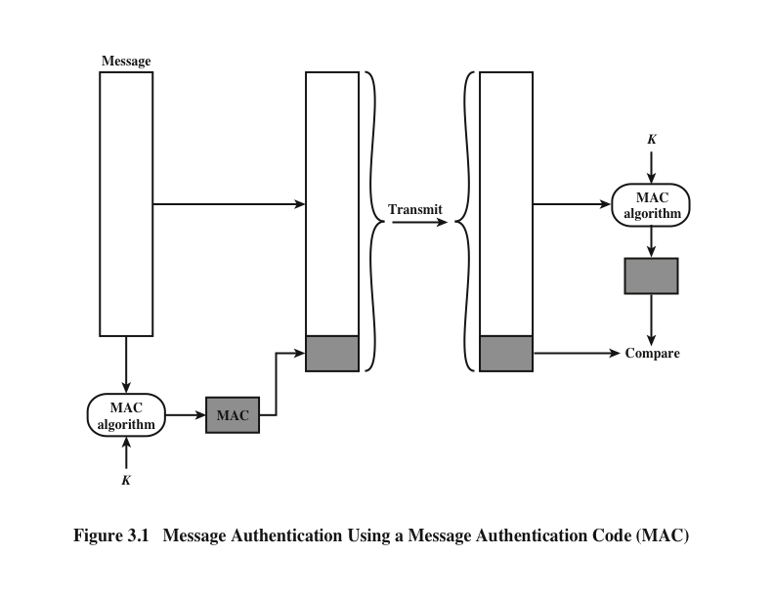
Notes:
One authentication technique involves the use
of a secret key to generate a small block of data, known as a message authentication
code (MAC) , that is appended to the message.
This technique assumes that
two communicating parties, say A and B, share a common secret key K_{AB}. When
A has a message to send to B, it calculates the message authentication code as a
function of the message and the key: MAC_{M} = F(K_{AB} , M ). The message plus code
are transmitted to the intended recipient. The recipient performs the same calculation
on the received message, using the same secret key, to generate a new message
authentication code. The received code is compared to the calculated code
(Figure 3.1).
If we assume that only the receiver and the sender know the identity
of the secret key, and if the received code matches the calculated code, then the following
statements apply:
1. The receiver is assured that the message has not been altered. If an attacker
alters the message but does not alter the code, then the receiver’s calculation
of the code will differ from the received code. Because the attacker is assumed
not to know the secret key, the attacker cannot alter the code to correspond to
the alterations in the message.
2. The receiver is assured that the message is from the alleged sender. Because
no one else knows the secret key, no one else could prepare a message with a
proper code.
3. If the message includes a sequence number (such as is used with HDLC and
TCP), then the receiver can be assured of the proper sequence, because an
attacker cannot successfully alter the sequence number.
A number of algorithms could be used to generate the code. The NIST specification,
FIPS PUB 113, recommends the use of DES. DES is used to generate an
encrypted version of the message, and the last number of bits of ciphertext are used
as the code. A 16- or 32-bit code is typical.
The process just described is similar to encryption. One difference is that the
authentication algorithm need not be reversible, as it must for decryption. Because
of the mathematical properties of the authentication function, it is less vulnerable to
being broken than encryption.

Slide 6
One-way Hash Functions
Accepts a variable-size message M as input and produces a fixed-size message digest H(M) as output
Does not take a secret key as input
To authenticate a message, the message digest is sent with the message in such a way that the message digest is authentic
Notes:
An alternative to the message authentication code is
the one-way hash function . As with the message authentication code, a hash function
accepts a variable-size message M as input and produces a fixed-size message
digest H(M ) as output. Unlike the MAC, a hash function does not take a secret key
as input. To authenticate a message, the message digest is sent with the message in
such a way that the message digest is authentic.

Slide 7
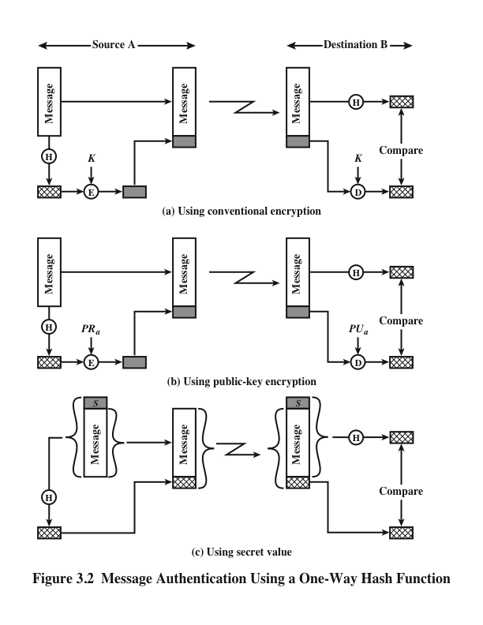
Notes:
Figure 3.2 illustrates three ways in which the message can be authenticated.
The message digest can be encrypted using conventional encryption (part a); if
it is assumed that only the sender and receiver share the encryption key, then
authenticity is assured. The message digest can be encrypted using public-key
encryption (part b); this is explained in Section 3.5. The public-key approach
has two advantages: (1) It provides a digital signature as well as message
authentication. (2) It does not require the distribution of keys to communicating
parties.
These two approaches also have an advantage over approaches that encrypt
the entire message in that less computation is required. Nevertheless, there has
been interest in developing a technique that avoids encryption altogether.
Figure 3.2c shows a technique that uses a hash function but no encryption for
message authentication. Because the secret value itself is
not sent, it is not possible for an attacker to modify an intercepted message. As long
as the secret value remains secret, it is also not possible for an attacker to generate
a false message.
A variation on the third technique, called HMAC, is the one adopted for
IP security (described in Chapter 9); it also has been specified for SNMPv3
(Chapter 13).

Slide 8
Secure Hash Functions
Is important not only in message authentication but in digital signatures
Purpose is to produce a “fingerprint” of a file, message, or other block of data
To be useful for message authentication, a hash function H must have the following properties:
Notes:
The purpose of a hash function is to produce a “fingerprint” of a file, message, or
other block of data. To be useful for message authentication, a hash function H
must have the following properties:
1. H can be applied to a block of data of any size.
2. H produces a fixed-length output.
3. H(x ) is relatively easy to compute for any given x , making both hardware and
software implementations practical.
4. For any given code h , it is computationally infeasible to find x such that
H(x ) = h. A hash function with this property is referred to as one-way or
preimage resistant .
5. For any given block x, it is computationally infeasible to find y x with
H(y) = H(x). A hash function with this property is referred to as second preimage
resistant. This is sometimes referred to as weak collision resistant.
6. It is computationally infeasible to find any pair (x, y) such that H(x) = H(y).
A hash function with this property is referred to as collision resistant. This is
sometimes referred to as strong collision resistant.
A hash function that satisfies the first five properties in the preceding list is
referred to as a weak hash function. If the sixth property is also satisfied, then it is
referred to as a strong hash function. The sixth property, collision resistant, protects
against a sophisticated class of attack known as the birthday attack.

Slide 9
Security of Hash Functions
There are two approaches to attacking a secure hash function:
  Cryptanalysis
    Involves exploiting logical weaknesses in the algorithm
  Brute-force attack
    The strength of a hash function against this attack depends solely on the length of the hash code produced by the algorithm
Notes:
As with symmetric encryption, there are two approaches to attacking a secure hash
function: cryptanalysis and brute-force attack. As with symmetric encryption algorithms,
cryptanalysis of a hash function involves exploiting logical weaknesses in the
algorithm.
The strength of a hash function against brute-force attacks depends solely on
the length of the hash code produced by the algorithm.
If collision resistance is required (and this is desirable for a general-purpose
secure hash code), then the value 2^{n/2} determines the strength of the hash code
against brute-force attacks. Van Oorschot and Wiener [VANO94] presented a
design for a $10 million collision search machine for MD5, which has a 128-bit
hash length, that could find a collision in 24 days. Thus, a 128-bit code may be
viewed as inadequate. The next step up, if a hash code is treated as a sequence
of 32 bits, is a 160-bit hash length. With a hash length of 160 bits, the same
search machine would require over four thousand years to find a collision. With
today’s technology, the time would be much shorter, so that 160 bits now
appears suspect.

Slide 10
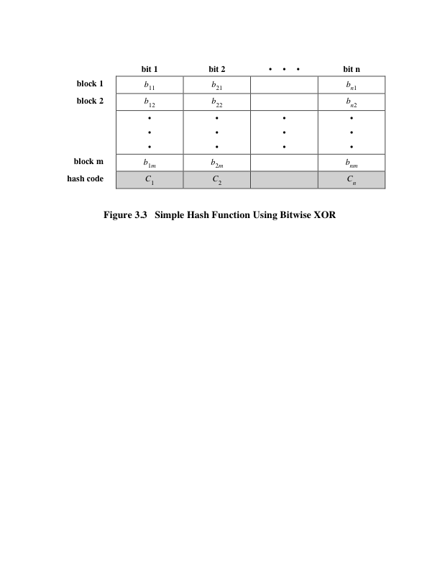
Notes:
All hash functions operate using the following general principles. The input (message,
file, etc.) is viewed as a sequence of n -bit blocks. The input is processed one
block at a time in an iterative fashion to produce an n -bit hash function.
One of the simplest hash functions is the bit-by-bit exclusive-OR (XOR) of
every block.
Figure 3.3 illustrates this operation; it produces a simple parity for each bit
position and is known as a longitudinal redundancy check.

Slide 11
The sha Secure Hash function
SHA was developed by NIST and published as a federal information processing standard (FIPS 180) in 1993
Was revised in 1995 as SHA-1 and published as FIPS 180-1
  The actual standards document is entitled “Secure Hash Standard”
Based on the hash function MD4 and its design closely models MD4
Produces 160-bit hash values
In 2005 NIST announced the intention to phase out approval of SHA-1 and move to a reliance on SHA-2 by 2010
Notes:
In recent years, the most widely used hash function has been the Secure Hash
Algorithm (SHA). Indeed, because virtually every other widely used hash function
had been found to have substantial cryptanalytic weaknesses, SHA was more or
less the last remaining standardized hash algorithm by 2005. SHA was developed
by the National Institute of Standards and Technology (NIST) and published as a
federal information processing standard (FIPS 180) in 1993. When weaknesses were
discovered in SHA (now known as SHA-0), a revised version was issued as FIPS
180-1 in 1995 and is referred to as SHA-1 . The actual standards document is entitled
“Secure Hash Standard.” SHA is based on the hash function MD4, and its design
closely models MD4.
SHA-1 produces a hash value of 160 bits.
In 2005, NIST announced the intention to phase out approval of SHA-1 and
move to a reliance on SHA-2 by 2010.

Slide 12
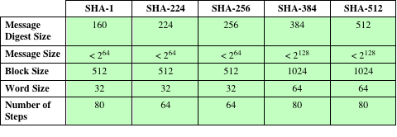
Table 3.1
Comparison of SHA Parameters
Note: All sizes are measured in bits.
Notes:
In 2002, NIST produced a revised
version of the standard, FIPS 180-2, that defined three new versions of SHA with
hash value lengths of 256, 384, and 512 bits known as SHA-256, SHA-384, and
SHA-512, respectively. Collectively, these hash algorithms are known as SHA-2 .
These new versions have the same underlying structure and use the same types of
modular arithmetic and logical binary operations as SHA-1. A revised document
was issued as FIP PUB 180-3 in 2008, which added a 224-bit version (Table 3.1).
SHA-1 and SHA-2 are also specified in RFC 6234, which essentially duplicates the
material in FIPS 180-3 but adds a C code implementation.

Slide 13
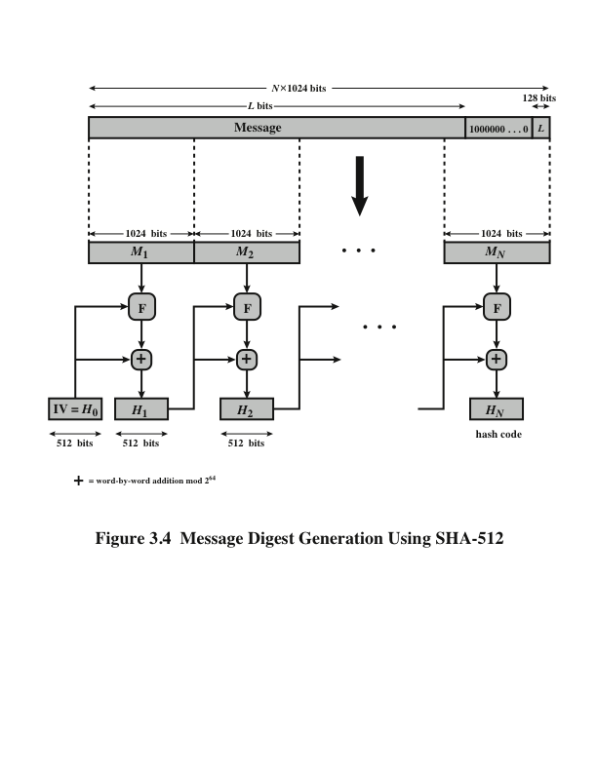
Notes:
The algorithm takes as input a message with a maximum length of less than
2¹²⁸ bits and produces as output a 512-bit message digest. The input is processed in
1024-bit blocks. Figure 3.4 depicts the overall processing of a message to produce a
digest.

Slide 14
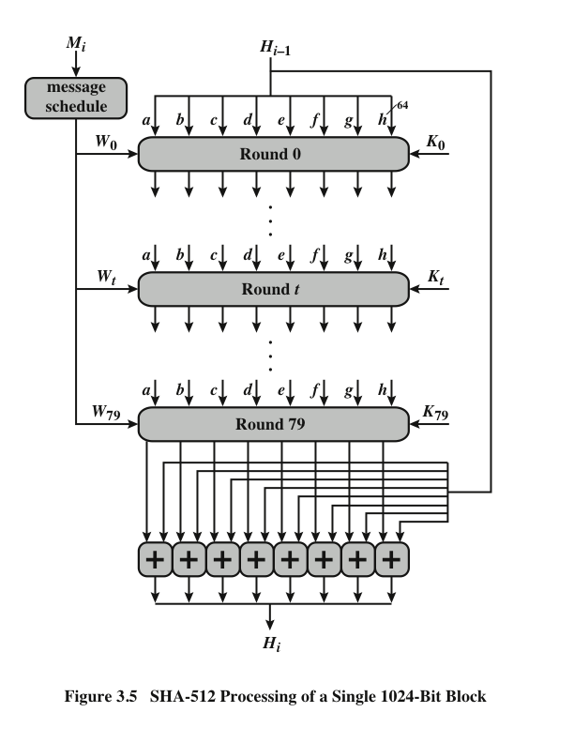
Notes:
The heart of the algorithm
is a module that consists of 80 rounds; this module is labeled F in Figure 3.4.
The logic is illustrated in Figure 3.5.

Slide 15
Sha-3
Notes:
SHA-2, particularly the 512-bit version, would appear to provide unassailable security.
However, SHA-2 shares the same structure and mathematical operations
as its
predecessors, and this is a cause for concern. Because it would take years to find a
suitable replacement for SHA-2, should it become vulnerable, NIST announced in
2007 a competition to produce the next-generation NIST hash function, which is to
be called SHA-3. Following are the basic requirements that must be satisfied by any
candidate for SHA-3:
1. It must be possible to replace SHA-2 with SHA-3 in any application by a simple
drop-in substitution. Therefore, SHA-3 must support hash value lengths of
224, 256, 384, and 512 bits.
2. SHA-3 must preserve the online nature of SHA-2. That is, the algorithm must
process comparatively small blocks (512 or 1024 bits) at a time instead of
requiring that the entire message be buffered in memory before processing it.
In 2012, NIST selected a winning submission and formally published SHA-3.
A detailed presentation of SHA-3 is provided in Chapter 15.

Slide 16
HMAC
There has been an increased interest in developing a MAC derived from a cryptographic hash code, such as SHA-1
  Cryptographic hash functions generally execute faster in software than conventional encryption algorithms such as DES
  Library code for cryptographic hash functions is widely available
  A hash function such as SHA-1 was not designed for use as a MAC and cannot be used directly for that purpose because it does not rely on a secret key
There have been a number of proposals for the incorporation of a secret key into an existing hash algorithm
  The approach that has received the most support is HMAC
Notes:
In recent years, there has been increased interest in developing a MAC derived
from a cryptographic hash code, such as SHA-1. The motivations for this interest
are as follows:
• Cryptographic hash functions generally execute faster in software than conventional
encryption algorithms such as DES.
• Library code for cryptographic hash functions is widely available.
A hash function such as SHA-1 was not designed for use as a MAC and cannot
be used directly for that purpose because it does not rely on a secret key. There have
been a number of proposals for the incorporation of a secret key into an existing hash
algorithm. The approach that has received the most support is HMAC [BELL96a,
BELL96b]. HMAC has been issued as RFC 2104, has been chosen as the mandatory-to-
implement MAC for IP Security, and is used in other Internet protocols, such as
Transport Layer Security (TLS) and Secure Electronic Transaction (SET).

Slide 17
HMAC Design Objectives
To use, without modifications, available hash functions --- in particular, hash functions that perform well in software, and for which code is freely and widely available
To allow for easy replaceability of the embedded hash function in case faster or more secure hash functions are found or required
To preserve the original performance of the hash function without incurring a significant degradation
To use and handle keys in a simple way
To have a well understood cryptographic analysis of the strength of the authentication mechanism based on reasonable assumptions on the embedded hash function
Notes:
RFC 2104 lists the following design objectives for
HMAC.
• To use, without modifications, available hash functions. In particular, hash
functions that perform well in software, and for which code is freely and
widely available
• To allow for easy replaceability of the embedded hash function in case faster
or more secure hash functions are found or required
• To preserve the original performance of the hash function without incurring a
significant degradation
• To use and handle keys in a simple way
• To have a well-understood cryptographic analysis of the strength of the
authentication mechanism based on reasonable assumptions on the embedded
hash function
The first two objectives are important to the acceptability of HMAC. HMAC
treats the hash function as a “black box.” This has two benefits. First, an existing
implementation of a hash function can be used as a module in implementing
HMAC. In this way, the bulk of the HMAC code is prepackaged and ready to use
without modification. Second, if it is ever desired to replace a given hash function
in an HMAC implementation, all that is required is to remove the existing hash
function module and drop in the new module. This could be done if a faster hash
function were desired. More important, if the security of the embedded hash function
were compromised, the security of HMAC could be retained simply by replacing
the embedded hash function with a more secure one
.
The last design objective in the preceding list is, in fact, the main advantage
of HMAC over other proposed hash-based schemes. HMAC can be proven secure
provided that the embedded hash function has some reasonable cryptographic
strengths. We return to this point later in this section, but first we examine the structure
of HMAC.

Slide 18
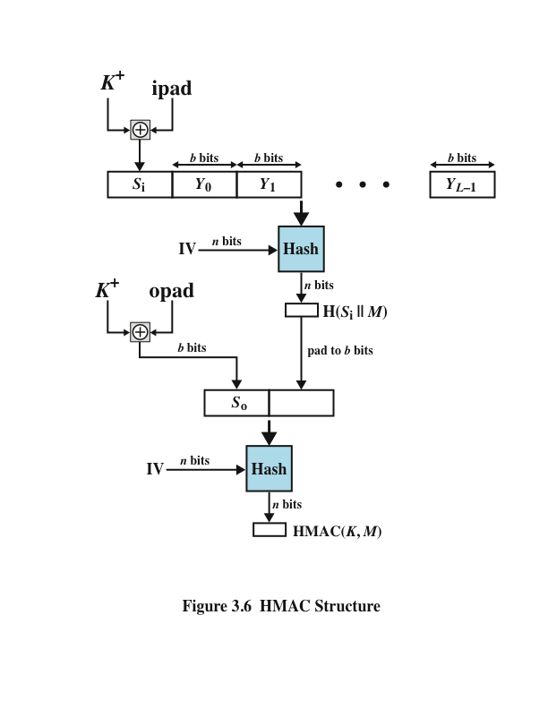
Notes:
Figure 3.6 illustrates the overall operation of HMAC.

Slide 19
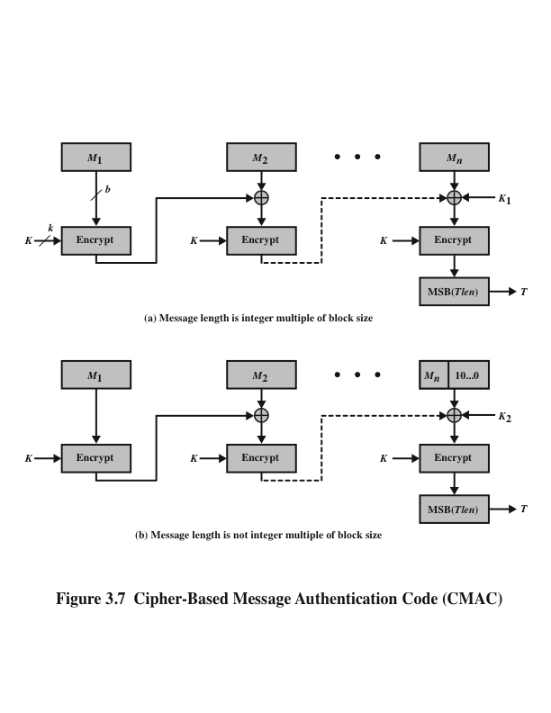
Notes:
The Cipher-based
Message Authentication Code mode of operation is for use with AES and triple
DES. It is specified in NIST Special Publication 800-38B.

Slide 20
Counter with Cipher Block Chaining-Message Authentication Code (CCM)
NIST standard SP 800-38C
Referred to as an authenticated encryption mode
  “Authenticated encryption” is a term used to describe encryption systems that simultaneously protect confidentiality and authenticity of communications
A single key is used for both encryption and MAC algorithms
Notes:
The
Counter with Cipher Block Chaining-Message Authentication Code (CCM)
mode of operation, defined in NIST SP 800-38C, is referred to as an authenticated
encryption
mode. “Authenticated encryption” is a term used to describe encryption
systems that simultaneously protect confidentiality and authenticity (integrity) of
communications. Many applications and protocols require both forms of security,
but until recently the two services have been designed separately.
The key algorithmic ingredients of CCM are the AES encryption algorithm
(Section 2.2), the CTR mode of operation (Section 2.5), and the CMAC authentication
algorithm. A single key K is used for both encryption and MAC algorithms.

Slide 21
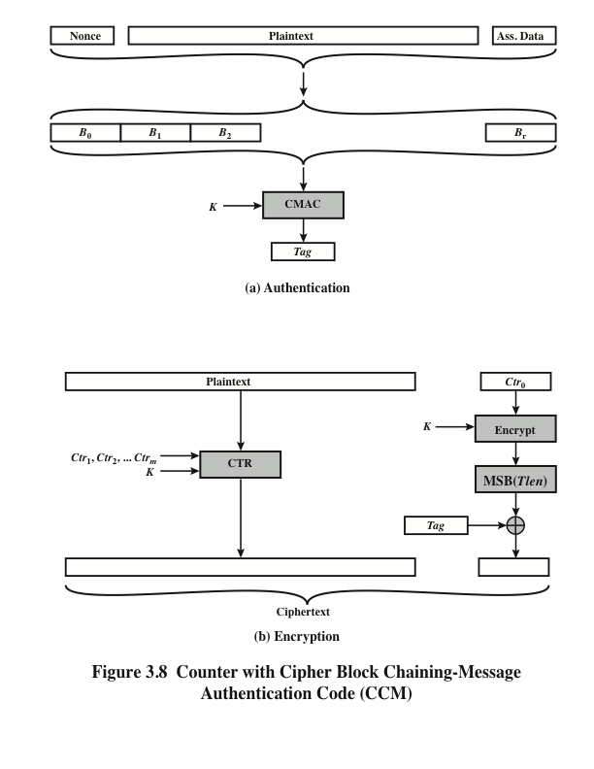
Notes:
Figure 3.8 illustrates the operation of CCM. For authentication, the input
includes the nonce, the associated data, and the plaintext. This input is formatted as
a sequence of blocks B₀ through B_{r} . The first block contains the nonce plus some
formatting bits that indicate the lengths of the N , A , and P elements. This is followed
by zero or more blocks that contain A , followed by zero of more blocks that
contain P. The resulting sequence of blocks serves as input to the CMAC algorithm,
which produces a MAC value with length Tlen , which is less than or equal to the
block length (Figure 3.8a).
For encryption, a sequence of counters is generated that must be independent
of the nonce. The authentication tag is encrypted in CTR mode using the single
counter Ctr₀ . The Tlen most significant bits of the output are XORed with the tag
to produce an encrypted tag. The remaining counters are used for the CTR mode
encryption of the plaintext (Figure 2.11). The encrypted plaintext is concatenated
with the encrypted tag to form the ciphertext output (Figure 3.8b).

Slide 22
Public-Key encryption structure
First publicly proposed by Diffie and Hellman in 1976
Based on mathematical functions rather than on simple operations on bit patterns
Is asymmetric, involving the use of two separate keys
Notes:
Public-key encryption, first publicly proposed by Diffie and Hellman in 1976
[DIFF76], is the first truly revolutionary advance in encryption in literally thousands
of years. Public-key algorithms are based on mathematical functions rather
than on simple operations on bit patterns, such as are used in symmetric encryption
algorithms. More important, public-key cryptography is asymmetric, involving the
use of two separate keys—in contrast to the symmetric conventional encryption,
which uses only one key. The use of two keys has profound consequences in the
areas of confidentiality, key distribution, and authentication.
Before proceeding, we should first mention several common misconceptions
concerning public-key encryption. One is that public-key encryption is more
secure from cryptanalysis than conventional encryption. In fact, the security of any
encryption scheme depends on (1) the length of the key and (2) the computational
work involved in breaking a cipher. There is nothing in principle about either conventional
or public-key encryption that makes one superior to another from the
point of view of resisting cryptanalysis. A second misconception is that public-key
encryption is a general-purpose technique that has made conventional encryption
obsolete. On the contrary, because of the computational overhead of current public-
key encryption schemes, there seems no foreseeable likelihood that conventional
encryption will be abandoned. Finally, there is a feeling that key distribution
is trivial when using public-key encryption, compared to the rather cumbersome
handshaking involved with key distribution centers for conventional encryption.
In fact, some form of protocol is needed, often involving a central agent, and the
procedures involved are no simpler or any more efficient than those required for
conventional encryption.

Slide 23
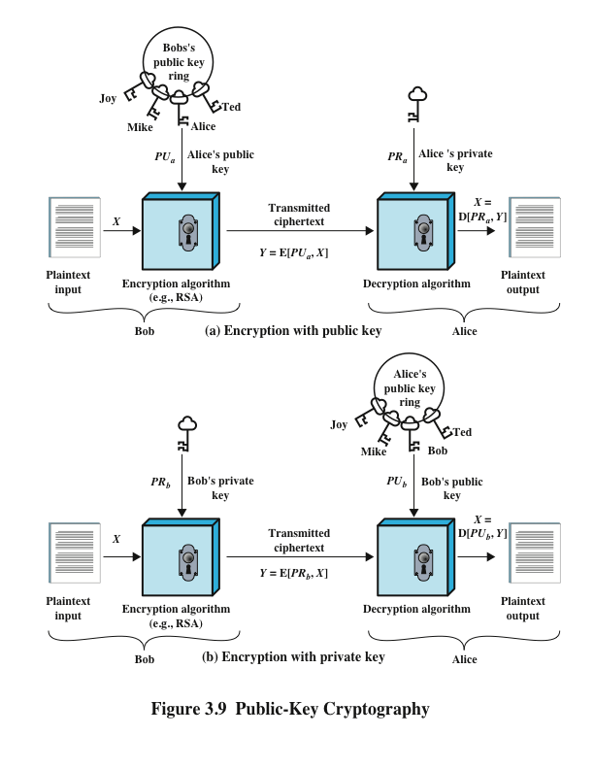
Notes:
A public-key encryption scheme has six ingredients (Figure 3.9a).
• Plaintext: This is the readable message or data that is fed into the algorithm as
input.
• Encryption algorithm: The encryption algorithm performs various transformations
on the plaintext.
• Public and private key: This is a pair of keys that have been selected so that if
one is used for encryption, the other is used for decryption. The exact transformations
performed by the encryption algorithm depend on the public or
private key that is provided as input.
• Ciphertext: This is the scrambled message produced as output. It depends on
the plaintext and the key. For a given message, two different keys will produce
two different ciphertexts.
• Decryption algorithm: This algorithm accepts the ciphertext and the matching
key and produces the original plaintext.
The key used in conventional encryption is typically referred to as a secret
key . The two keys used for public-key encryption are referred to as the public key
and the private key . Invariably, the private key is kept secret, but it is referred
to as a private key rather than a secret key to avoid confusion with conventional
encryption.

Slide 24
Applications for public-key cryptosystems
Public-key systems are characterized by the use of a cryptographic type of algorithm with two keys, one held private and one available publicly
Depending on the application, the sender uses either the sender’s private key, the receiver’s public key, or both to perform some type of cryptographic function
Notes:
Before proceeding, we need to clarify one aspect of public-key cryptosystems that
is otherwise likely to lead to confusion. Public-key systems are characterized by
the use of a cryptographic type of algorithm with two keys, one held private and
one available publicly. Depending on the application, the sender uses either the
sender’s private key, the receiver’s public key, or both to perform some type of
cryptographic function. In broad terms, we can classify the use of public-key cryptosystems
into three categories:
• Encryption/decryption: The sender encrypts a message with the recipient’s
public key.
• Digital signature: The sender “signs” a message with its private key. Signing
is achieved by a cryptographic algorithm applied to the message or to a small
block of data that is a function of the message.
• Key exchange: Two sides cooperate to exchange a session key. Several different
approaches are possible, involving the private key(s) of one or both
parties.

Slide 25
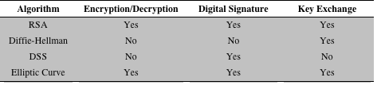
Table 3.2 applications for public-key cryptosystems
Notes:
Some algorithms are suitable for all three applications, whereas others can be
used only for one or two of these applications. Table 3.2 indicates the applications
supported by the algorithms discussed in this chapter: RSA and Diffie–Hellman.
This table also includes the Digital Signature Standard (DSS) and elliptic-curve
cryptography, also mentioned later in this chapter.

Slide 26
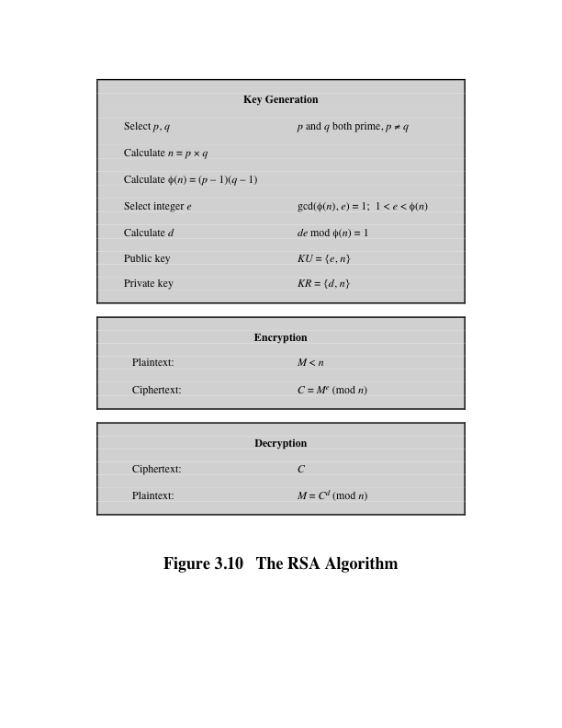
Notes:
The two most widely used public-key algorithms are RSA and Diffie–Hellman.
We look at both of these in this section and then briefly introduce two other
algorithms.
One of the first public-key schemes was developed in 1977 by Ron Rivest, Adi
Shamir, and Len Adleman at MIT and first published in 1978 [RIVE78]. The
RSA scheme has since that time reigned supreme as the most widely accepted and
implemented approach to public-key encryption. RSA is a block cipher in which the
plaintext and ciphertext are integers between 0 and n - 1 for some n.
Figure 3.10 summarizes the RSA algorithm.

Slide 27
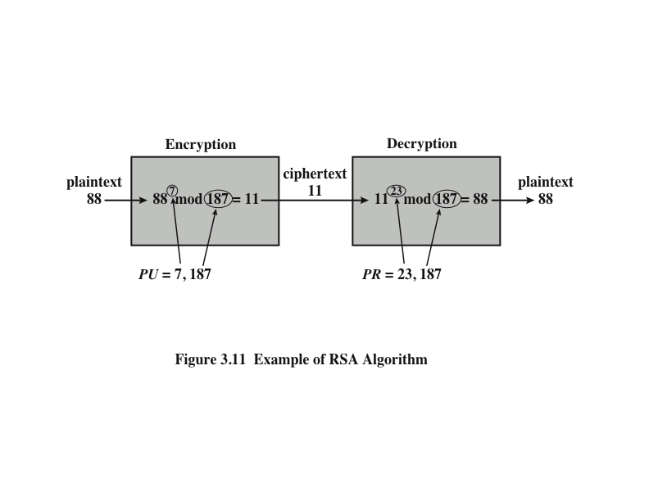
Notes:
An example, from [SING99], is shown in Figure 3.11.

Slide 28
Diffie-Hellman Key Exchange
First published public-key algorithm
A number of commercial products employ this key exchange technique
Purpose of the algorithm is to enable two users to exchange a secret key securely that then can be used for subsequent encryption of messages
  The algorithm itself is limited to the exchange of the keys
Depends for its effectiveness on the difficulty of computing discrete logarithms
Notes:
The first published public-key algorithm appeared in the seminal paper by Diffie
and Hellman that defined public-key cryptography [DIFF76] and is generally
referred to as the Diffie–Hellman key exchange . A number of commercial products
employ this key exchange technique.
The purpose of the algorithm is to enable two users to exchange a secret key
securely that then can be used for subsequent encryption of messages. The algorithm
itself is limited to the exchange of the keys.
The Diffie–Hellman algorithm depends for its effectiveness on the difficulty
of computing discrete logarithms.

Slide 29
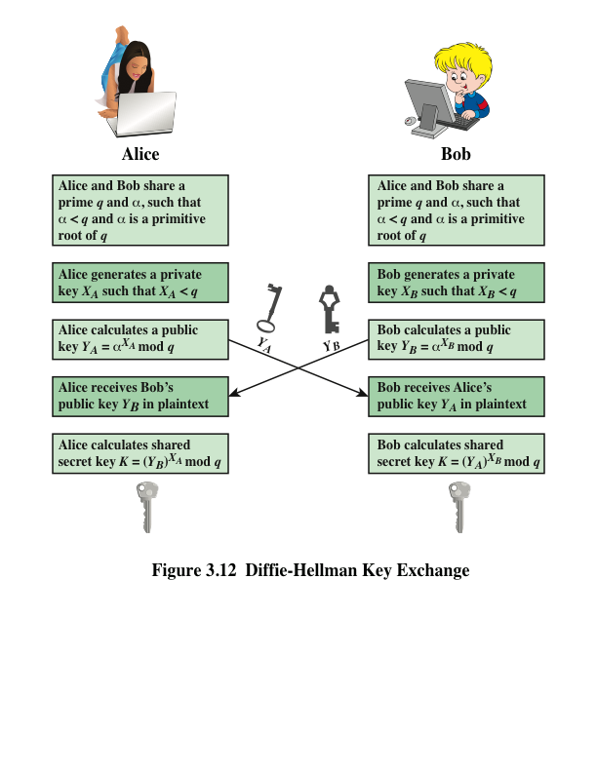
Notes:
The Diffie–Hellman key exchange is summarized in Figure 3.12.

Slide 30
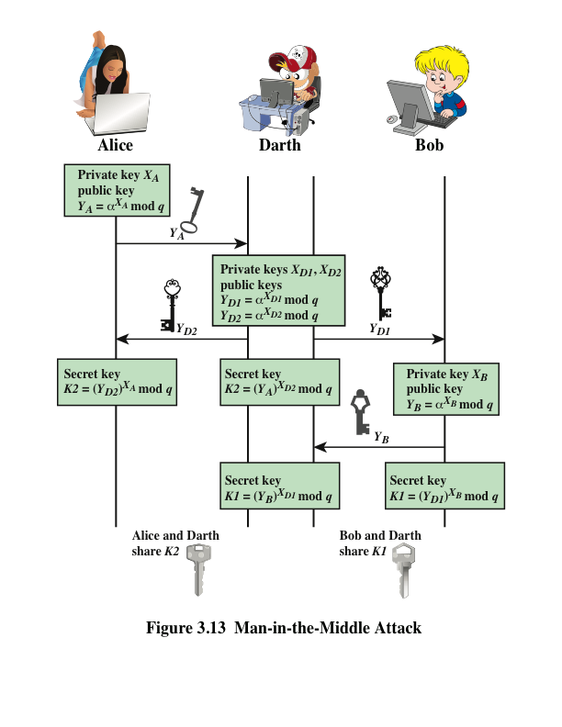
Notes:
The protocol depicted in Figure 3.12 is insecure
against a man-in-the-middle attack. Suppose Alice and Bob wish to exchange keys,
and Darth is the adversary. The attack proceeds as follows (Figure 3.13).

Slide 31
Digital Signature standard (DSS)
FIPS PUB 186
Makes use of the SHA-1 and presents a new digital signature technique, the Digital Signature Algorithm (DSA)
Originally proposed in 1991 and revised in 1993 and again in 1996
Uses an algorithm that is designed to provide only the digital signature function
Unlike RSA, it cannot be used for encryption or key exchange
Notes:
The National Institute of Standards and Technology
(NIST) has published Federal Information Processing Standard FIPS PUB 186,
known as the Digital Signature Standard (DSS) . The DSS makes use of the SHA-1
and presents a new digital signature technique, the Digital Signature Algorithm
(DSA). The DSS was originally proposed in 1991 and revised in 1993 in response to
public feedback concerning the security of the scheme. There was a further minor revision
in 1996. The DSS uses an algorithm that is designed to provide only the digital
signature function. Unlike RSA, it cannot be used for encryption or key exchange.

Slide 32
Elliptic-curve cryptology (ECC)
Technique is based on the use of a mathematical construct known as the elliptic curve
Principal attraction of ECC compared to RSA is that it appears to offer equal security for a far smaller bit size, thereby reducing processing overhead
The confidence level in ECC is not yet as high as that in RSA
Notes:
The vast majority of the products and standards
that use public-key cryptography for encryption and digital signatures use RSA.
The bit length for secure RSA use has increased over recent years, and this has
put a heavier processing load on applications using RSA. This burden has ramifications,
especially for electronic commerce sites that conduct large numbers of secure
transactions. Recently, a competing system has begun to challenge RSA: elliptic
curve cryptography (ECC) . Already, ECC is showing up in standardization efforts,
including the IEEE P1363 Standard for Public-Key Cryptography.
The principal attraction of ECC compared to RSA is that it appears to offer
equal security for a far smaller bit size, thereby reducing processing overhead. On
the other hand, although the theory of ECC has been around for some time, it is
only recently that products have begun to appear and that there has been sustained
cryptanalytic interest in probing for weaknesses. Thus, the confidence level in ECC
is not yet as high as that in RSA.
ECC is fundamentally more difficult to explain than either RSA or Diffie–
Hellman, and a full mathematical description is beyond the scope of this book.
The technique is based on the use of a mathematical construct known as the
elliptic curve.

Slide 33
Summary
Approaches to message authentication
  Authentication using conventional encryption
  Message authentication without message encryption
Secure hash functions
  Hash function requirements
  Security of hash functions
  Simple hash functions
  The SHA secure hash function SHA-3
  Digital signatures
Message authentication codes
  HMAC
  MACs based on block ciphers
Public-key cryptography principles
  Public-key encryption structure
  Applications for public-key cryptosystems
  Requirements for public-key cryptography
Public-key cryptography algorithms
  The RSA public-key encryption algorithm
  Diffie-Hellman key exchange
  Other public-key cryptography algorithms
Notes:
Chapter 3 summary.

