Slide 1
Chapter 20
Hashing / Hash tables

Slide 2
Outline
Basic definitions
Different hashing techniques
  Linear probing
  Quadratic probing
  Separate chaining hashing
Comparing hashing with binary search trees

Slide 3
Basic definitions
Problem definition:
  Given a set of items (S) and a given item (i), define a data structure that supports operations such as find/insert/delete i in constant time.
A solution:
  A hashing function h maps a large data set into a small index set.
  Typically the function involves the mod( ) operation.
Example hashing function:
  Let S be a set of 10,000 employee records.
  Let LName be the LastName attribute of the employee record.
  Suppose each array item can hold up to k employee records.
  Suppose the array is of size N. (Then Nk > 10,000)
  Given an employee e, h(e) = e.LName.toInteger( ) % N.

Slide 4
Design of a hash function
Two concerns:
  The hash function should be simple enough.
  The hash function should distribute the data items evenly over the whole array.
Why?
  For (a): efficiency
  For (b): to avoid collision, and to make good use of array space.

Slide 5
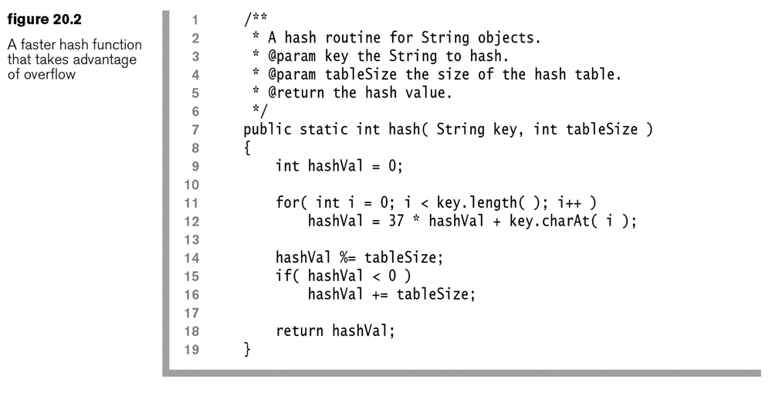
A sample hash function in Java
Exercise: What are the respective hash codes of the following strings: Doe, Smith, Stevenson? Suppose tableSize is 10.

Slide 6
  Linear probing
Collision: Given the hash function h, h(x) returns a position that is already occupied.
Linear probing:
  When a collision occurs, search sequentially in the array until an empty cell is found (to insert the new data item).
  Wrap around if necessary.
Example below.

Slide 7
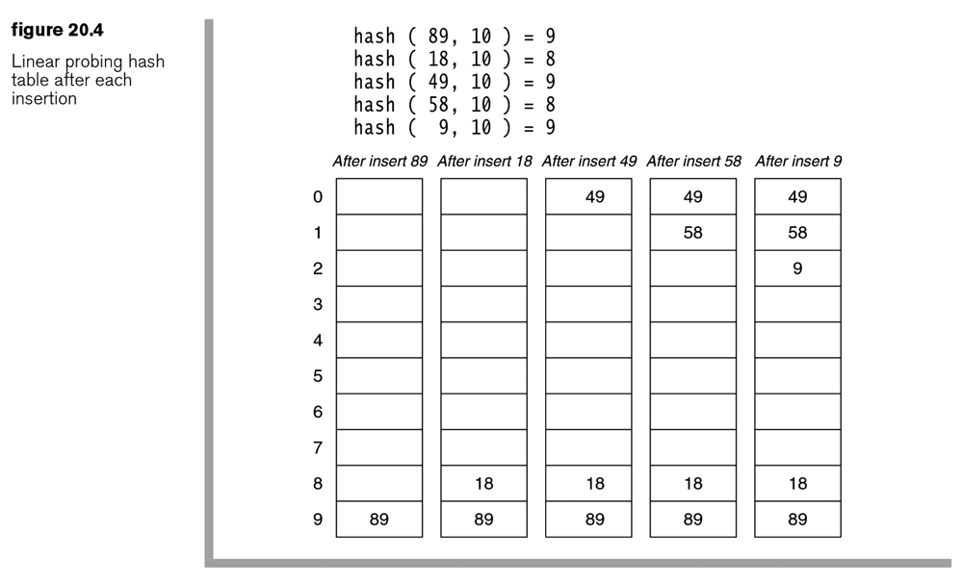
Linear probing: example h(k,n) = k % n

Slide 8
Linear probing: insert
Q: What’s the worst case cost when inserting an item using linear hashing?
  N ?
Q: What’s the average cost?
  Theorem 20.2 (next page)
The performance of the hash table depends on how full the table is.
  The load factor (λ) of a hash table is the fraction of the table that is full (between 0 and 1).

Slide 9
Theorem 20.2
The average number of cells examined in an insertion using linear probing is roughly
  (1+1/(1- λ)²)/2, where λ is the load factor.
Exercises:
  When the table is half full, what’s the average cost of inserting an item?
  How if the load factor is 25%?
  How if the load factor is 75%?
Why?
  Primary clustering
lf | average cost
0.25 | 1.39
0.50 | 2.50
0.75 | 8.50

Slide 10
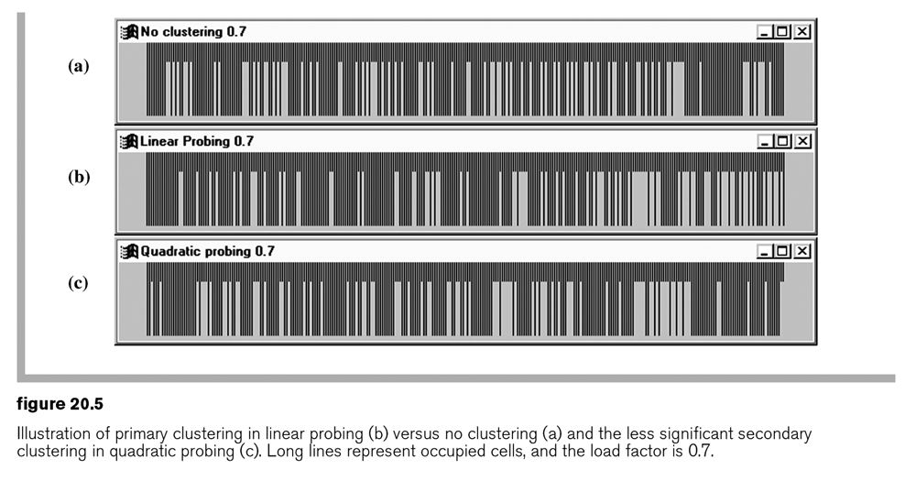
  Primary clustering
Large blocks of occupied cells are formed in the hash table.
Impact?
  Any key that hashes into a cluster requires excessive attempts to resolve the collision.
  Plus, that insertion increases the size of the cluster.

Slide 11
Linear probing: search/find
Find(k): If the data item k cannot be found at the h(k) position, search sequentially until either k is found or an empty cell is reached; in the latter case k does not exist in the array.
Cost? Theorem 20.3
  The average number of cells examined in an unsuccessful search using linear probing is roughly (1+1/(1- λ)²)/2.
  The average number of cells examined in a successful search using linear probing is roughly (1+1/(1- λ))/2.

Slide 12
Linear probing: delete
Delete (k)
Cost ?
  Cost of searching for k
  Cost of fill up the left space

Slide 13
  Quadratic probing
Goal: To eliminate the primary clustering problem of linear probing
Strategy: by examining certain cells away from the original probe point when a collision occurs using F(i) = i²
  Let H = h(k) = hash (k, n).
  If H is occupied and not equal to k, search H+1, H+2², H+3², …, until found or all possible locations are exhausted.

Slide 14
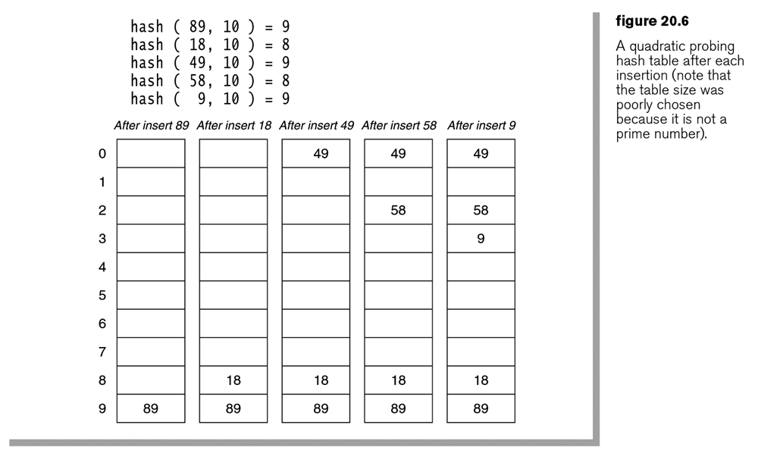
Quadratic probing: example

Slide 15
Theorem 20.4
When quadratic probing is used, a new element can always be inserted when the following prerequisites are met:
  The size of the hash table, M, is a prime number.
  At least M/2 of the table entries are empty.
Overhead of quadratic hashing:
  The hash table needs to be at least half-empty.
  → Rehashing of the hash table is needed.

Slide 16
Rehashing
A technique to dynamically expand the size of the hash table when, for example, the table is half full in quadratic hashing.
Two steps:
  Create a larger table.
  Create a new hash function (for example, the table size has changed).
  Use the new hash function to add the existing data items from the old table to the new table.

Slide 17
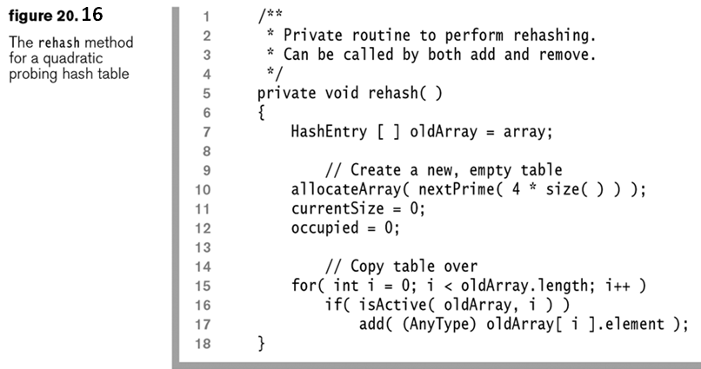
Rehashing: example in Java

Slide 18
  Separate chaining hashing
A more space-efficient hashing method than quadratic hashing.
The hash table is implemented as an array of linked list.
  The returned value of the hash function points to the linked list where the item is to be inserted or found.
Challenge: The linked lists should be kept short.

Slide 19
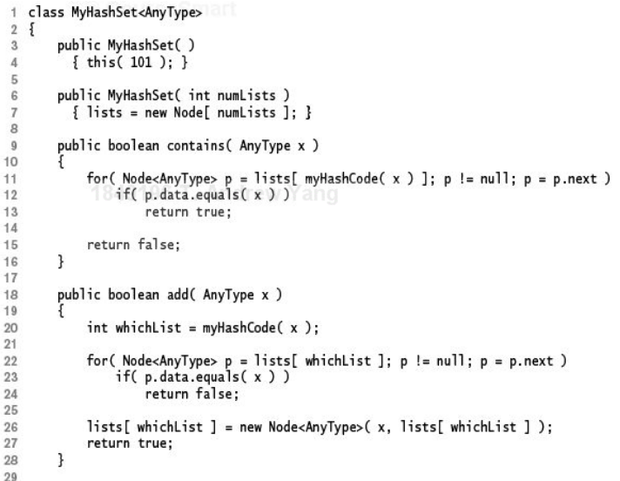
Figure 20.20 (a): See class Node next page
Error ?

Slide 20
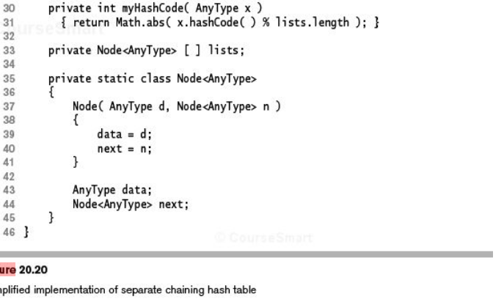
Figure 20.20 (b)

Slide 21
Exercise: hashing with separate chaining
Insert the same sequence of numbers as in figure 20.6 into an array of 10 elements, using separate chaining hashing.
Assumption: myHashCode (n) = n % 10

Slide 22
  Separate chaining hashing: analysis
Let M be the size of the hash table.
Let N be the total number of data items in the hash table. Then,
  The average length of the linked list = N/M.
  Also called the load factor (lf). Note: different from the load factor (λ) in earlier discussions.
  The average number of probes for an insertion = lf.
  The average number of probes for an unsuccessful search = lf.
  The average number of probes for a successful search = 1+lf/2.

Slide 23
  Hashing vs Binary search tree
operations | Binary search tree | Hashing
Find | O(log N) | Constant
Insert | O(log N) | Constant
Delete | O(log N) | Constant
findMin/findMax | O(log N) | Not supported
printAllSorted | O(N logN) | Not supported
Overhead ?

