Slide 1
Chapter 6.6, 11, 16
Stacks

Slide 2
Outline
Intro. to Stacks
java.util.Stack
Example programs

Slide 3
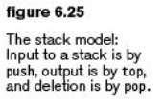
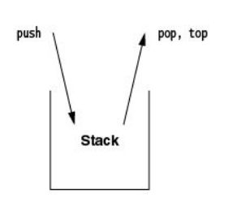
Stacks
A data structure in which access is restricted to the most recently inserted item.
Supported operations:
  push( n): add n to the top of the stack
  pop( ): remove the object at the top of the stack and return that object
  top( ): aka. peek( )
  return the object at the top of the stack
All three operations take constant time.

Slide 4
Stacks
Special features:
  Last in, first out (LIFO)
  First in, last out (FILO)
  top( ) and pop( ) returns the most recently pushed item in the stack.

Slide 5
Applications of Stack
In compiler design:
  Evaluation of balanced expressions
    e = 3 * (5 – (8 + 2) * 4)+ 8 / (4 + 2)
    Q: How would a Stack help to evaluate this expression?
    See 11.1 balanced symbol checker & 11.2 a simple calculator
  Evaluation of function/method calls
    e.g., main() → f1( ) → f2( ) and f3( ), etc.
    A function tree (next).

Slide 6
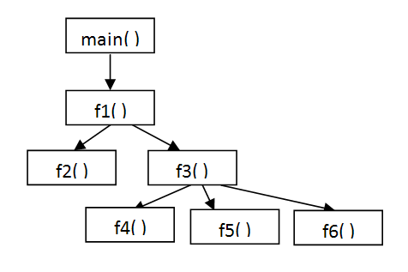
Function tree
Q: How would a stack be used to manage the function calls?
Q: How would the local variables and their values be managed across functions?
Q: recursive functions ?

Slide 7
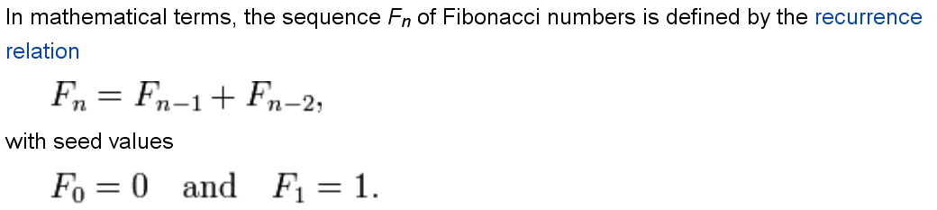
Evaluation of a recursive function call
Q: What is F(5)? F(10)?
Note: Fibonacci is known to deliver poor performance when implemented as a recursive function.

Slide 8
Evaluation of a recursive function call
Revisit the evaluation of maxSumRec( ):
  private static int maxSumRec( int [ ] a, int left, int right )
  int [ ] a = {-10,20,30,-40,50,60};
The call: maxSumRec(a, 0, 5)
  maxSumRec(a,0,2), maxSumRec(a,3,5)
  …
Q: How would a stack be used to maintain all the variables and returned values?

Slide 9
Implementation of Stack
A Stack may be implemented as an Array or a Linked List.
Stack as a dynamic array:
  ArrayStack.java (Figure 16.2 – 16.7)
    Private<AnyType> [ ] theArray;
    private int topOfStack;
Stack as a linked list:
  ListStack.java (Figure 16.19 – 16.21)
    private ListNode<AnyType> topOfStack;

Slide 10
Implementation of Stack
Based on the ArrayStack.java (Figure 16.2 – 16.7) and related programs, complete the following exercises.
  Run the ArrayStackDemo application (available at http://sce.uhcl.edu/yang/teaching/JavaProgrammingExamplesandRelatedTopics.htm#stacks).
  Add an instance variable (and appropriate methods) to keep track of the size of the stack.
Run the ListStack.java (Figure 16.19 – 16.21) application.

Slide 11
java.util.Stack
http://download.oracle.com/javase/6/docs/api/java/util/Stack.html
  java.lang.Object
  -- java.util.AbstractCollection<E>
  -- java.util.AbstractList<E>
  -- java.util.Vector<E>
  -- java.util.Stack<E>
Sample applications using the Stack class (http://sce.uhcl.edu/yang/teaching/JavaProgrammingExamplesandRelatedTopics.htm#stacks)
  StackDemo
  StackPerson

