Slide 1
Chapter 6.5, 17
Linked Lists

Slide 2
Outline
Intro. to Linked Lists
Compared with ArrayLists
Example programs

Slide 3
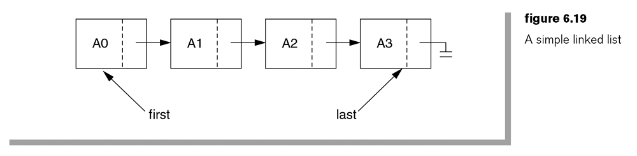
Linked Lists
A collection of entities, typically identically typed, into records/nodes.
The nodes are typically stored in noncontiguous manner.
Each node has one or more fields to store values/objects, and a field to store a reference/link to the next node in the list.
first.data = ?
first.next = ?
first.next.data = ?
last.data = ? last.next = ?
Clas ListNode {
Object data;
ListNode next;
}

Slide 4
Linked Lists
To add a new node to the end of an existing linked list:
  last.next = new ListNode( );
  last = last.next;
  last.data = x;
  Last.next = null;
Q: How to build the list from the scratch?
Q: How to search for an element and, if found, remove it from the list?

Slide 5
See http://sce.uhcl.edu/yang/teaching/JavaProgrammingExamplesandRelatedTopics.htm#linkedlist (ListNode.htm) for an example program.
public static ListNode findAndRemove (ListNode list, int key) {
int foundNodes = 0;
ListNode tempNode = list;
ListNode previous = list;
for (int i=0; tempNode != null; tempNode = tempNode.next, i++){
if (tempNode.data == key) { // found
foundNodes++; // one such node is found
if (tempNode == previous) { // first node
list = tempNode.next; // discard the original first
}
else if (tempNode == list.last) { //last node
list.last = previous; //discard the original last
list.last.next = null;
}
else { // somewhere in the middle
previous.next = tempNode.next; //bypass the current node
}
list.numberOfNodes--;
}
else { // not found in this node
previous=tempNode; //previous advances only when no node was found and deleted
}
} //for
System.out.println("Found " + foundNodes + " nodes with " + key);
return list;
}

Slide 6
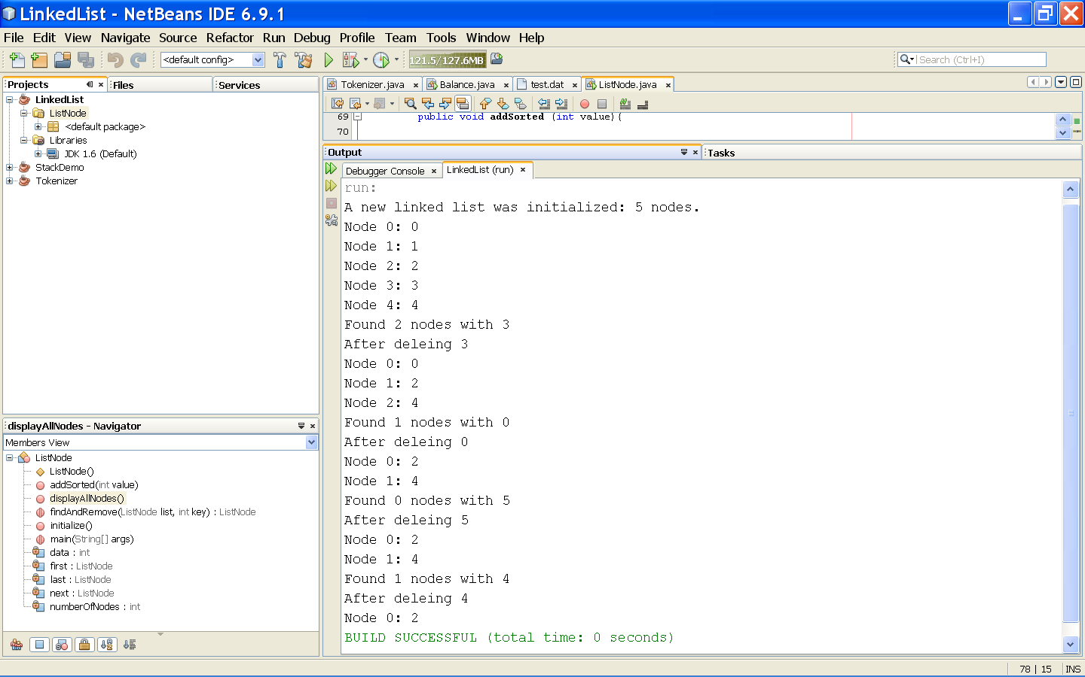
Sample output

Slide 7
LinkedList in Java
http://download.oracle.com/javase/6/docs/api/java/util/LinkedList.html
Class LinkedList<E>
java.lang.Object
java.util.AbstractCollection<E>
java.util.AbstractList<E>
java.util.AbstractSequentialList<E>
java.util.LinkedList<E>

Slide 8
Methods in LinkedList
add( )
addLast( )
addFirst( )
contains()
get( )
getFirst( )
getLast( )
remove( )
remove(int index)
set( )
size( )
…

Slide 9
ListIteratorhttp://download.oracle.com/javase/6/docs/api/java/util/ListIterator.html
public interface ListIterator<E>
extends Iterator<E>
  An iterator for lists that allows the programmer to traverse the list in either direction, modify the list during iteration, and obtain the iterator's current position in the list.
  A ListIterator has no current element; its cursor position always lies between the element that would be returned by a call to previous() and the element that would be returned by a call to next().
  An iterator for a list of length n has n+1 possible cursor positions:
Element(0) Element(1) Element(2) ... Element(n-1)
cursor positions: ^ ^ ^ ... ^ ^
Q: What does li.previous() and li.next() refer to immediately after li is constructed?
  ListIterator li = listA.listIterator();

Slide 10
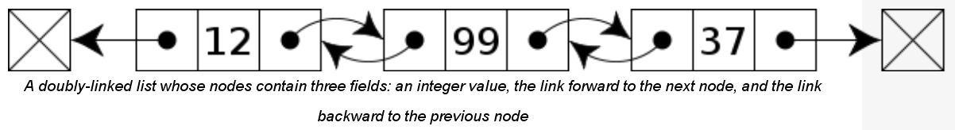
Doubly-Linked List: Each node contains, besides the next-node link, a second link pointing to the previous node in the sequence. The two links may be called forward(s) and backwards, or next and prev(ious). Source: http://en.wikipedia.org/wiki/Linked_list
Multiply-linked list: Each node contains two or more link fields, each field being used to connect the same set of data records in a different order (e.g., by name, by department, by date of birth, etc.).

Slide 11
Java.util.linkedlist Examples
Example 1: http://www.roseindia.net/java/jdk6/LinkedListExample.shtml
Example 2: http://www.idevelopment.info/data/Programming/java/collections/LinkedListExample.java

Slide 12
LinkedList vs ArrayList ?
Operations | LinkedList | ArrayList
get( ) | Inefficient Requires link traversal | Fast (constant time given the index value)
Delete an item | Efficient | Inefficient May require moving the items upward
Add an item | Efficient | Inefficient May require moving the items downward
Binary Search ? | ? | Log (N)
Q: Can you do a binary search on a linked list (even if the list is pre-sorted)?
A: excellent presentation at http://webdocs.cs.ualberta.ca/~holte/T26/binary-search.html

