Slide 1
Intro. to Data Structures
- Roughly based on Chapter 6

Slide 2
What?
A data structure is a representation of data and the operations allowed on that data.
An object in OOP?
ADT (abstract data type): a data structure that is defined indirectly by the operations that may be performed on it, and the mathematical properties of those operations.
Example data structures:
  Arrays
  Stacks
  Queues
  Linked lists
  Trees
  Graphs
  …
Q: What do we have without data structures?

Slide 3
Why?
Data structures provide various abstractions (structures and operations) and can therefore be used for computer applications that benefit from such abstractions.
A data structure is used along with algorithms to achieve efficiency.
Good performance (aka. efficiency) of a computer application depends on well-designed data structures and their related algorithms.
For example: exhaustive search vs binary search on arrays

Slide 4
When do we use a data structure?
Whenever its use is justified in a program, usually depending on the requirements and constraints.
Where do we use a data structure?

Slide 5
How are data structures supported in a programming languages ?
As built-in features of the language
  Arrays are supported by most high-level languages
  Linked lists in some
  Hash tables (or associated arrays) in some
  Records
  ADTs
  Classes in OOP
As features defined in libraries or packages

Slide 6
How do we learn to use data structures?
Understand the fundamental features of various data structures – the structure, the operations
Learn how to evaluate the efficiency of a data structure and related algorithms.
Evaluate different implementations of the same data structure for their respective performance.
Apply the learned knowledge in programming projects.
Practice! Practice!

Slide 7
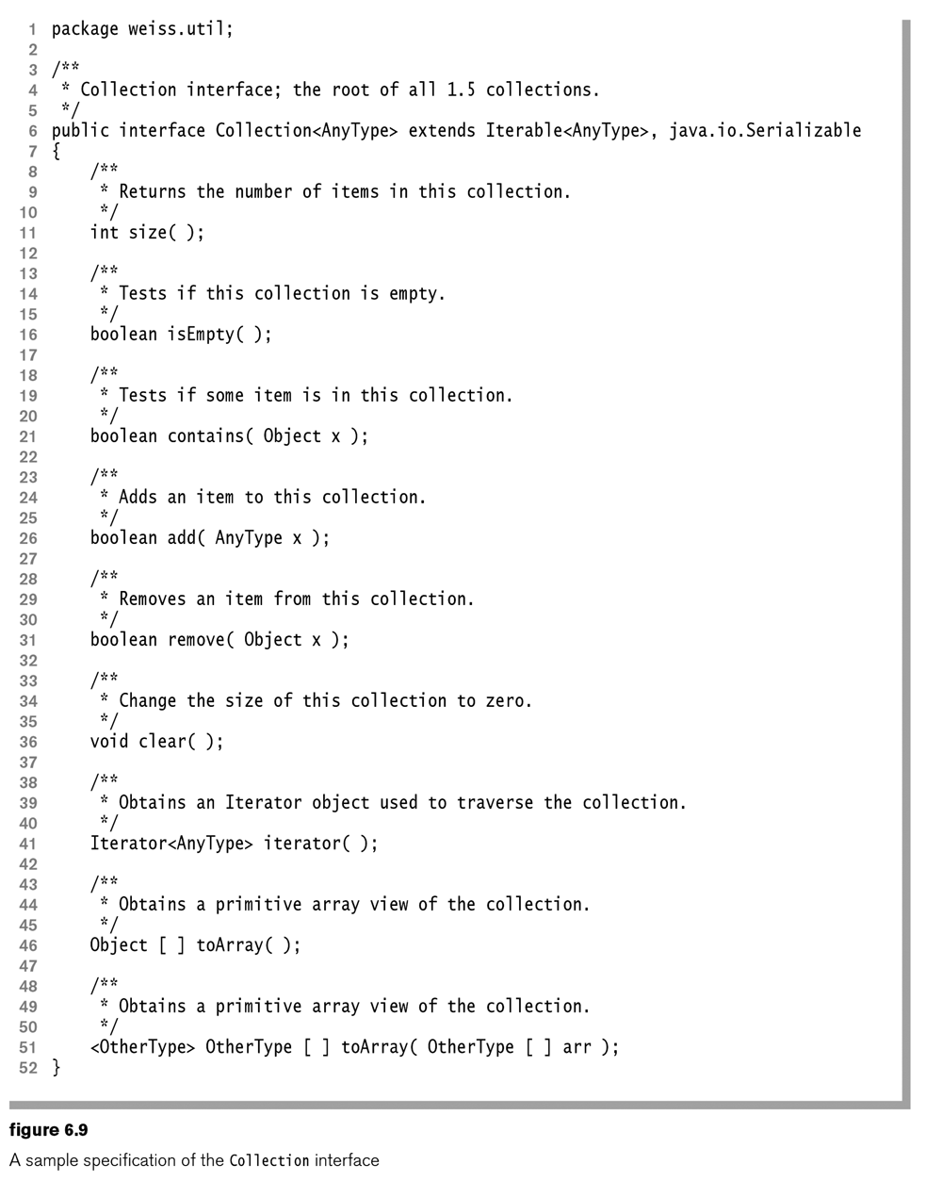
Common operations in a data structure

Slide 8
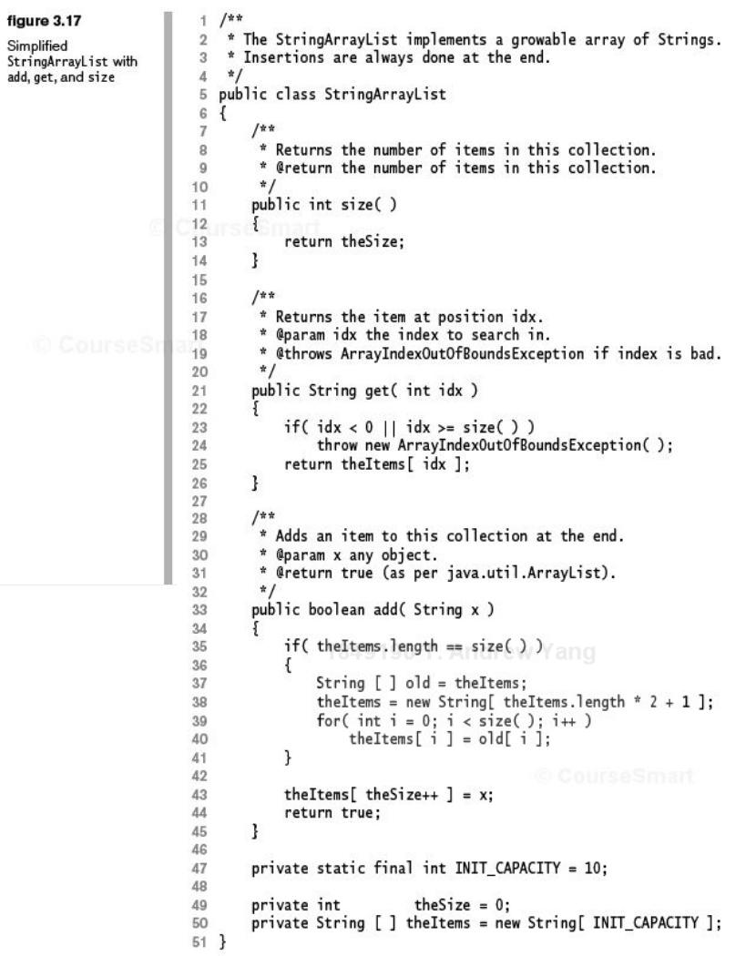
An example StringArrayList
Q: data?
Q: operations ?
Dynamic
array expansion
Q: anything missing ?

Slide 9
The iterator pattern
A common technique used in accessing an aggregate object such as arrays
e.g., printing all items in array v
    for (int i=0; i < v.length; i++) {
    _{System.out.println ( v[i] );}
    }
Exercises: Assuming v is an integer array, define the following as a method.
  Add all the items in v and return the sum.
  Reverse the values in v.
  Expand the capacity of v by doubling it.

Slide 10
The static search problem (Sec. 5.6)
Given an integer X and an array A, return the position of X in A or an indication that it is not present. If X occurs more than once, return any occurrence. The array A is never altered.
Many applications: looking up a person, a book, a product, …
Different solutions (algorithms) exist.
  Sequential search
  Binary search
  …

Slide 11
Evaluation of different algorithms
For each of the algorithms:
  Any prerequisites?
  Cost of unsuccessful search
  Worst case scenario for successful search
  Best case scenario for successful search
  Average case scenario
Contexts of comparison?
  Elapsed time only (assuming the whole array is in memory)
  Memory use?
  Disk access?
  Network latency?

