Slide 1
Chapter 6.6, 16
+ 13.2 (event-driven simulation)
Queues

Slide 2
Outline
Intro. to Queues
java.util.Queue interface
Example programs

Slide 3
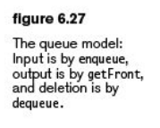
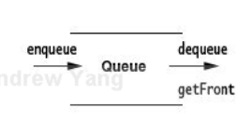
Queue
Typical application of Queue:
  A collection designed for holding elements prior to processing.
Supported operations:
  enqueue (n): add n at the back of the queue
  dequeue( ): remove the object at the front /head of the queue and return that object
  getFront( ): aka. element( ), peek( )
  return the object at the front of the queue (w/o removing it from the queue)
All three operations take constant time.

Slide 4
Queues
Special features:
  (typically) First in, first out (FIFO)
    - dequeue( ) and getFront( ) returns the least recently added item in the queue.
  Exceptions: priority queues
    Items in a priority queue are ordered according to some criteria (example: in OS, types of the processes, user privileges, etc.)

Slide 5
Applications of Queue
In any computer applications that need to deal with a waiting list of something.
  e.g., In operating systems: A process queue collects processes that are waiting to use the processor or other system resources.
  e.g., In event-driven simulation: A priority queue stores the list of events that need to be handled by the simulator.
  e.g., ?

Slide 6
Implementation of Queue
A Queue may be implemented as an Array or a Linked List.
as a dynamic array:
  ArrayQueue.java (Figure 16.8 – 16.17)
  private AnyType [ ] theArray;
  private int currentSize;
  private int front;
  private int back;
  private static final int DEFAULT_CAPACITY = 10;

Slide 7
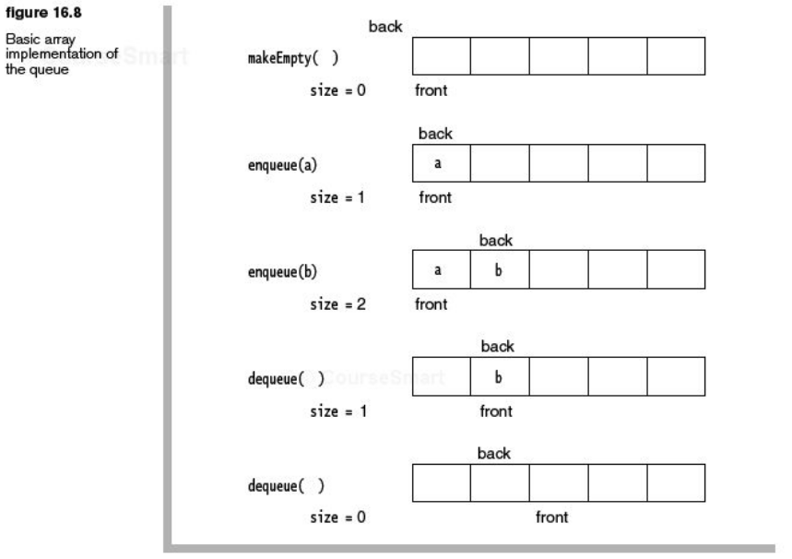

Slide 8
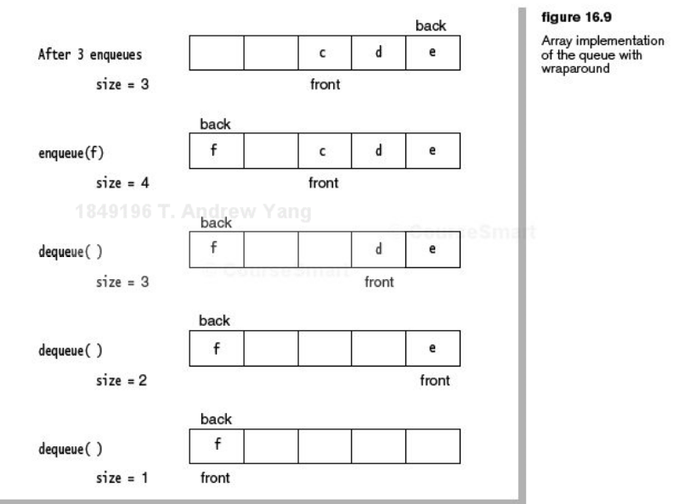

Slide 9
Implementation of Queue
as a linked list:
  ListQueue.java (Figure 16.23 – 16.27)
  See http://sce.uhcl.edu/yang/teaching/JavaProgrammingExamplesandRelatedTopics.htm#queues for an example testing program.

Slide 10
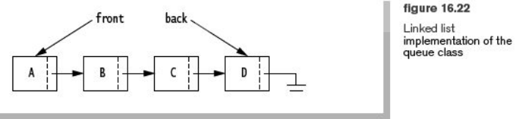
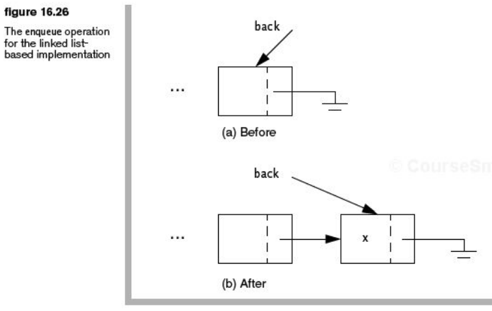

Slide 11
Interface: java.util.Queue
http://download.oracle.com/javase/6/docs/api/java/util/Queue.html
Interface Queue<E>

Slide 12
Array-based queues vs LinkedList-based queues
Operations | LinkedList-based Queues (L) | Array-based Queues (A)
Run time | Both run in constant time per operation.
Space cost | Less space. Allocated when a new node is added. | Estimated space requirement. Doubling the array takes up extra space.
Sequential access | L is not as efficient as A.
Code complexity | A is more complicated than L, owing to codes for wraparound and array doubling.

Slide 13
Double-Ended Queues (deque)
A queue that allows access at both ends.
  Enqueue → addFront, addRear
  Dequeue → removeFront, removeRear
In Java:
  java.util.Deque interface
    http://download.oracle.com/javase/6/docs/api/java/util/Deque.html
  Class ArrayDeque<E>
    http://download.oracle.com/javase/6/docs/api/java/util/ArrayDeque.html
  The LinkedList class can be used as a stack, queue, or deque, because it implements both the List and the Deque interfaces.
http://en.wikipedia.org/wiki/Double-ended_queue

