Slide 1
Chapter 5
Algorithm Analysis

Slide 2
Analysis of Algorithms
An algorithm is “a clearly specified set of instructions the computer will follow to solve a problem”.
Algorithm analysis is “the process of determining the amount of resources, such as time and space, that a given algorithm will require”.
The resources required by an algorithm often depends on the size of the data.
Example: To search a particular value in an array of 10,000,000 integers is going to take more time and memory space than to search an array of 1,000 integers.

Slide 3
Performance factors
How fast a program would run depends on many factors:
  Processor speed
  Amount of available memory
  Construction of the compiler
  Quality of the program
  The size of the data
  The efficiency of the algorithm(s)

Slide 4
Approach for algorithm analysis
  To find a correlation between the size of the data, N, and the cost of running an algorithm given the data.
  The correlation is typically represented as a function.

Slide 5
Example algorithm analysis
Given a program p that implements an algorithm a, which connects to a file server and download a file specified by the user:
  Initial network connection to the server: 2 sec.
  Download speed: 160 K/sec
  Cost formula: T(N) = N/160 + 2 (seconds)
  If data size is 8,000K, T (8000) = 52 sec.
  If data size is 1,000,000K, T = 6,252 sec.
Q: How would the download time be reduced?
A ?

Slide 6
Outline
Review of functions
Functions representing the cost of algorithms
Example algorithm analysis: MaxSumTest.java

Slide 7
Functions
Intuition: a function takes input and produces one output:
  e.g., f(x) = x² , f(x) = sin(x)
Formalism:
  Domain type: D_{f}
  Range type: R_{f}
  [Mapping] Graph:
    G_{f} = { <x, f(x)> | x∈D_{f} , f(x)∈R_{f} } ⊆ D_{f} x R_{f}
  For every x∈D_{f} there is at most one pair <x, f(x)> ∈ G_{f}
Graphs of sample functions:
  Let D = {1,2,3,4,5}. f(x) = x², x ∈ D.
  f(x) = 1/x, x ∈ R.

Slide 8
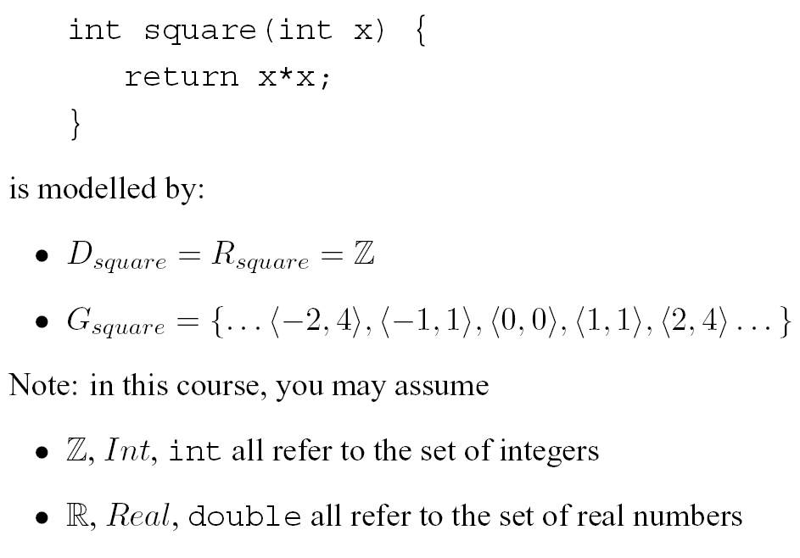
Example: f(x) = x²

Slide 9
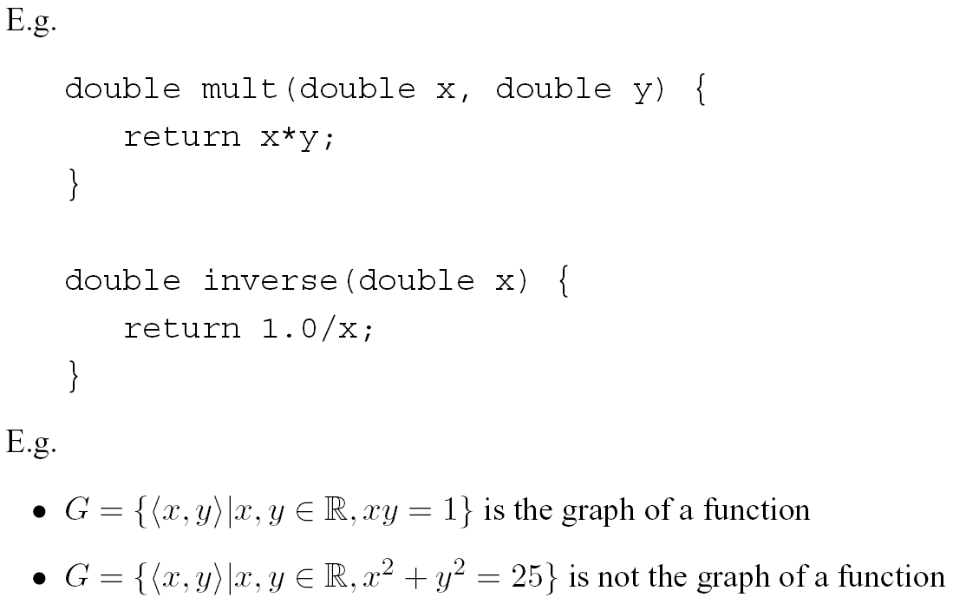
Functional Property
There is an x such that more than one y satisfy y=f(x) [x²+y²=25]
Example: x=0, y₁=5, y₂=-5
For every x there is at most one y such that y=f(x) [y=1/x]

Slide 10
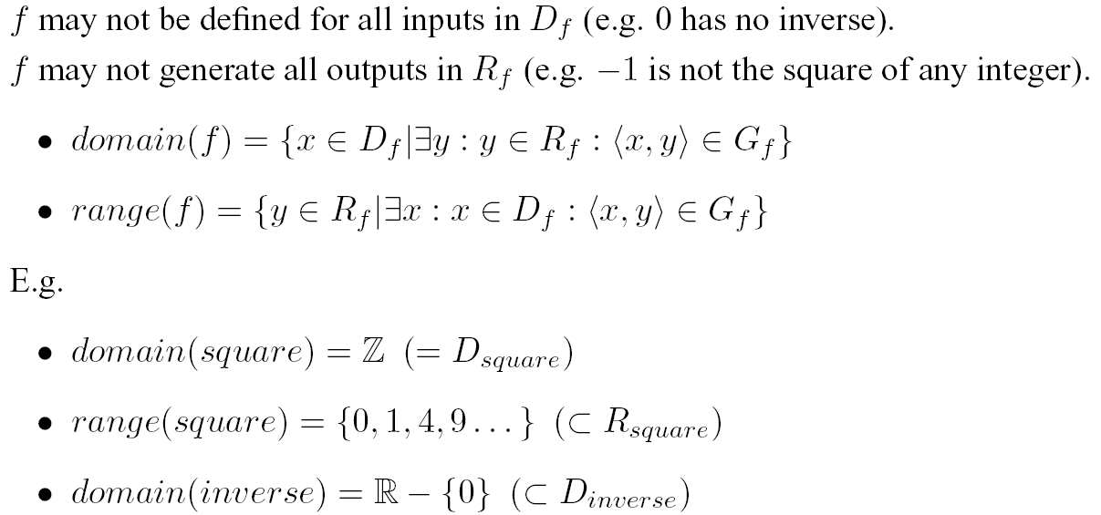
Domain & Range

Slide 11
Why is the efficiency of an algorithm important?
Concerns:
  Efficient use of resources (processor time, memory space)
  Response time / user perception
Typical solutions:
  Use a formula instead of recursion
  Use looping instead of recursion
  Use single loop instead of multiple loops
  Reduce disk access
  …

Slide 12
Efficiency of Algorithms
Example: Implement the following recursively defined sequence as an algorithm/function
    a₁ = 1
    a_{k} = a_{k-1} + k ,,∀ k > 1
  b) As a loop
  Function g (int k) {
    int sum = 0;
    while (k > 0) {
    sum = sum + k;
    k = k -1;
    }
    return sum;
  }
  //Note: Checking for error input is omitted in the codes
  a) As a recursively defined function
    Function f (int k) {
    if (k == 1) return 1;
    else return f(k-1) + k;
    }
  c) As a simple formula
    Function h (int k) {
    return k*(k+1)/2;
    }

Slide 13
Notations
f(x) is Ο(g(x)) : f is of order at most g
f(x) is Θ(g(x)) : f is of order g
f(x) is Ω(g(x)) : f is of order at least g
Let f and g be real-valued functions defined on the set of nonnegative real numbers.
f(x) is Ο(g(x)) : f is of order at most g
  iff there exist positive real numbers a and b s.t.
  |f(x)| ≤ b|g(x)| for all real numbers x > a.
Informally: the growth rate of f(x) ≤ the growth rate of g(x), when x > a.

Slide 14
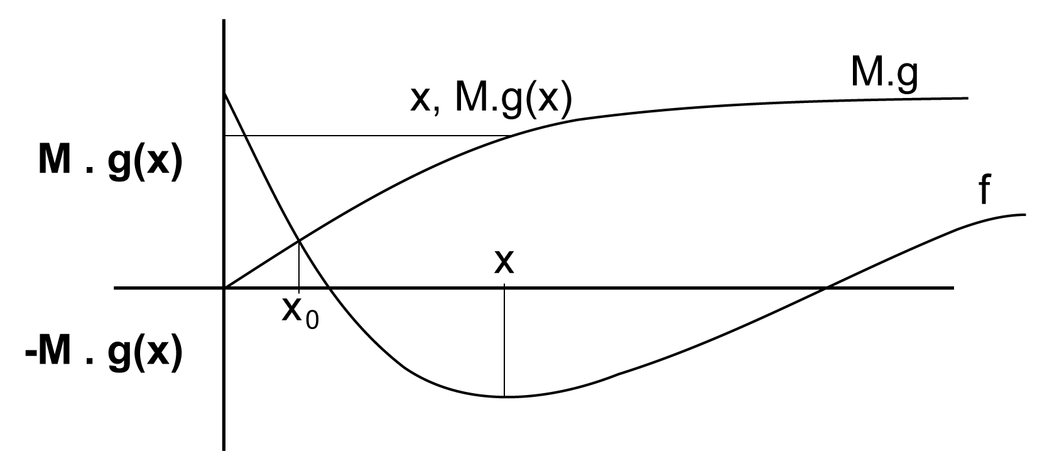
Big O Notation
f is of the order of g, f(x) = O(g(x)), if and only if there exists a positive real number M and a real number x0 such that for all x, |f(x)| <= M|g(x)|, wherever x > x0. (source: http://en.wikipedia.org/wiki/Big_O_notation)

Slide 15
Orders of Power Functions
  For any rational numbers r and s,
  if r <= s, then x^{r} is O(x^{s}).
Examples:
  x² is O(x³)
  100x is O(x²)
  500x^{1/2} is O(x)
  1000x is O(x³) ?
  100x² is O(x²) ?
  2x⁴ + 3x³ + 5 is O(x⁴) ?
Hint:
Focus on the dominant term.

Slide 16
Big Omega Ω
Let f and g be real-valued functions defined on the set of nonnegative real numbers.
f(x) is Ω(g(x)) : f is of order at least g
  iff there exist positive real numbers a and b s.t.
  b|g(x)| ≤ |f(x)| for all real numbers x > a.
Examples:
  x³ is Ω(x²)
  x² is Ω(x)
  x is Ω(x^{1/2})
  x is Ω(3x) ?

Slide 17
Big Theta Θ
Let f and g be real-valued functions defined on the set of nonnegative real numbers.
f(x) is Θ(g(x)) : f is of order g
  iff there exist positive real numbers a, b, and k s.t.
  a|g(x)| ≤ |f(x)| ≤ b|g(x)| for all real numbers x > k.
Theorem 9.2.1 (p.521)
  f is Ω(g) and f is O(g) iff f is Θ(g)
Examples:
  2x⁴ + 3x³ + 5 is Θ(x⁴)

Slide 18
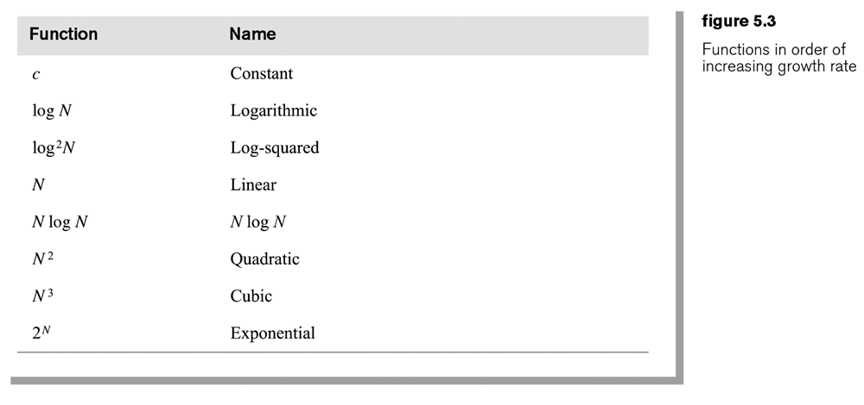
The logarithm: For any B, N > 0, log_{B}^{N} = k if B^{K} = N.
log_{B}^{N} =
Theorem 5.4: For any constant B > 1, log_{B}^{N} = O(log N).
That is, the base does not matter.
Proof? Next page

Slide 19
Proof of theorem 5.4:
For any constant B > 1, log_{B}^{N} = O(log N).
Let K = log_{B}^{N} <1>
B^{K} = N (from the logarithm definition) <2>
Let C = log B <3>
2^{C} = B <4>
B^{K} = (2^{C})^{K} (from <4>) <5>
log N = log B^{K} (from <2>) <6>
So, log N = log (2^{C})^{K} = CK (from <5>,<6>) <7>
log N = C log_{B}^{N} <8>
log_{B}^{N} = (from <8>)
Therefore, log_{B}^{N} = O(log N).

Slide 20
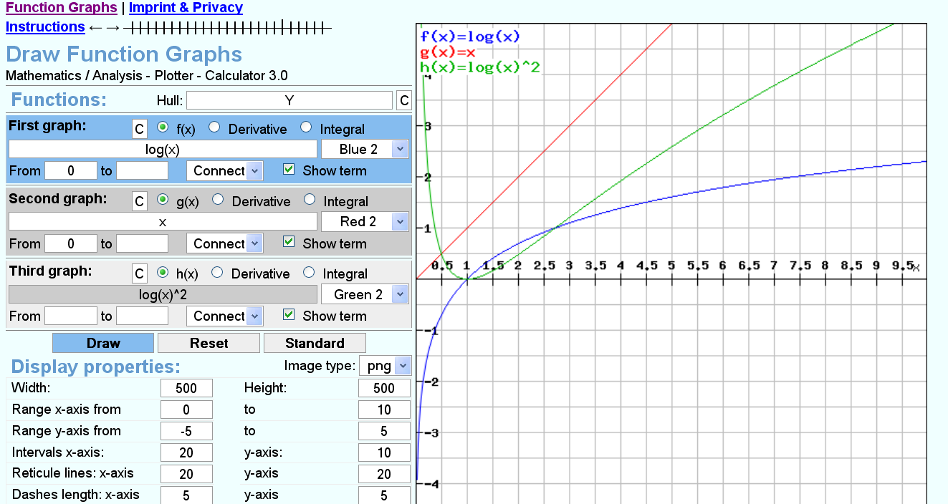
Tools for drawing functions: e.g., http://rechneronline.de/function-graphs/
Note: The default base for log( ) is 10.

Slide 21
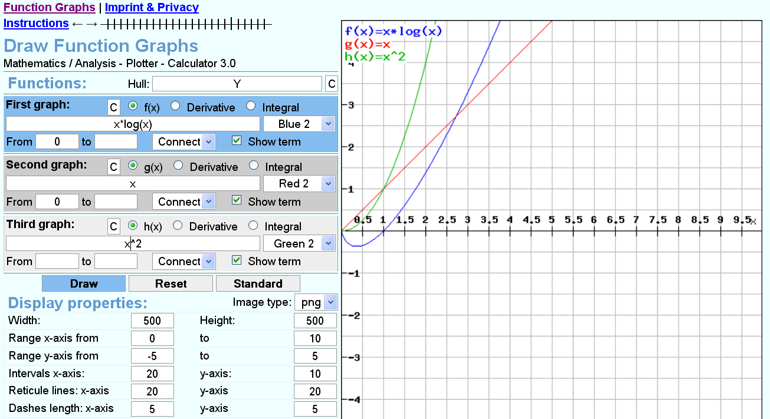

Slide 22
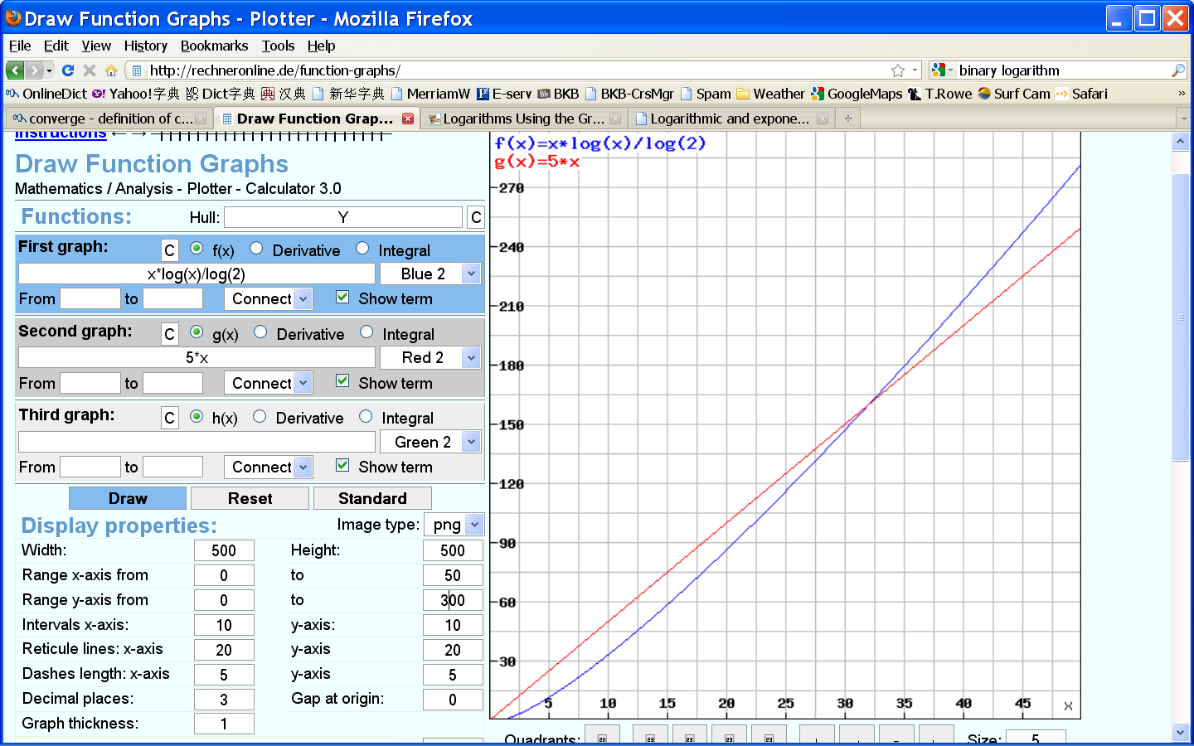
Note: log₂^{X} = logx / log2

Slide 23
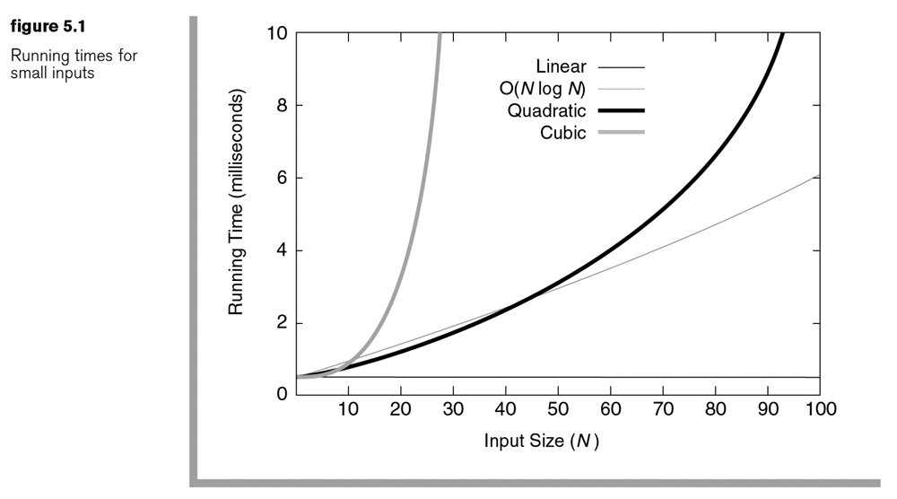
Q: Linear or constant ?

Slide 24
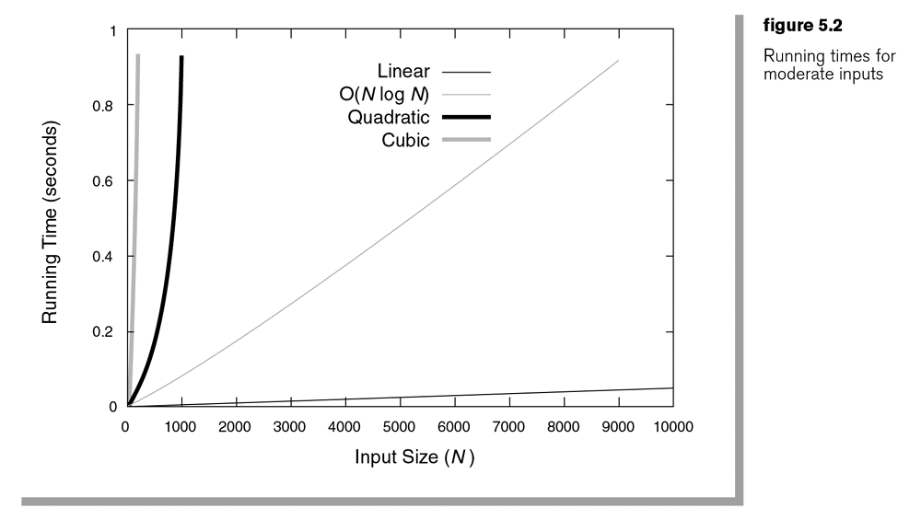

Slide 25
The maximum contiguous subsequence sum problem
Given (possibly negative) integers , A1, A2, …, AN, find (and identify the sequence corresponding to) the maximum value of .
The maximum contiguous sub-sequence sum is zero if all the integers are negative.

Slide 26
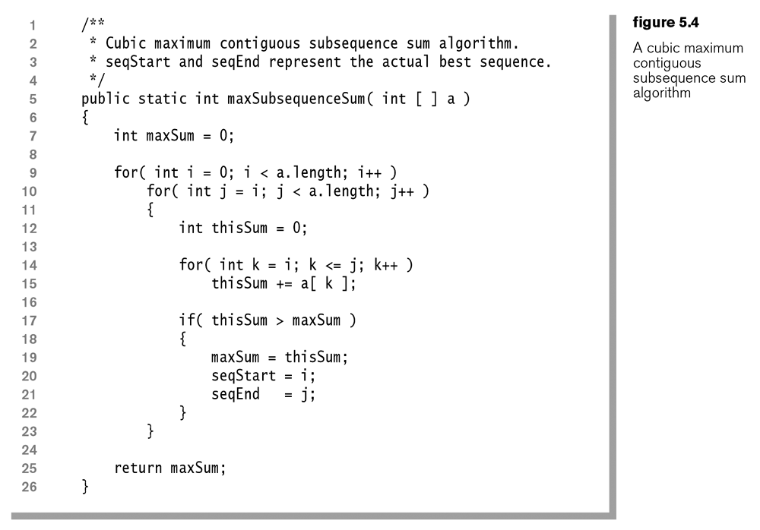

Slide 27
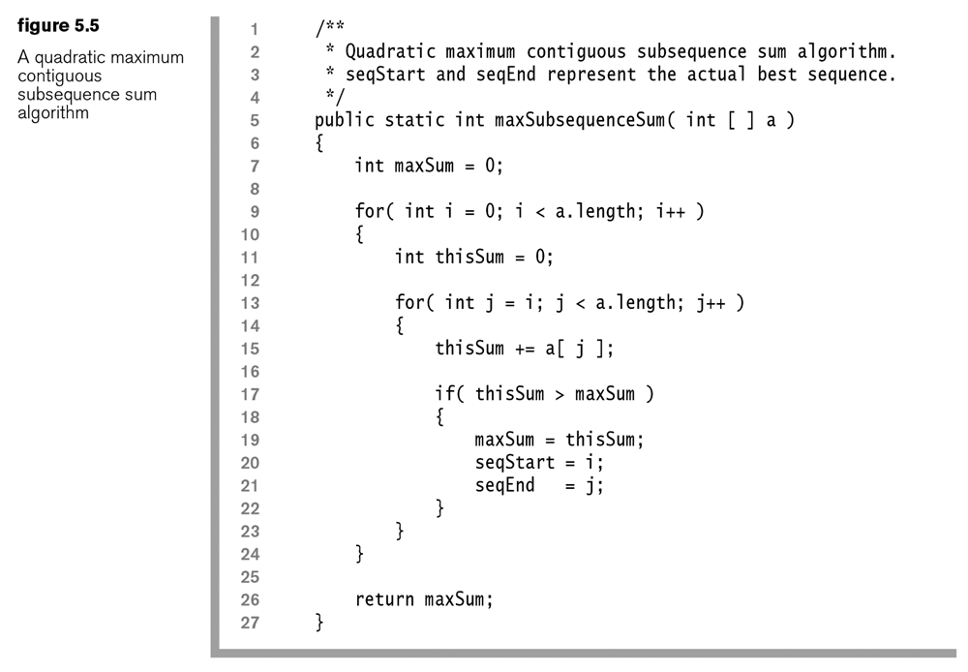

Slide 28
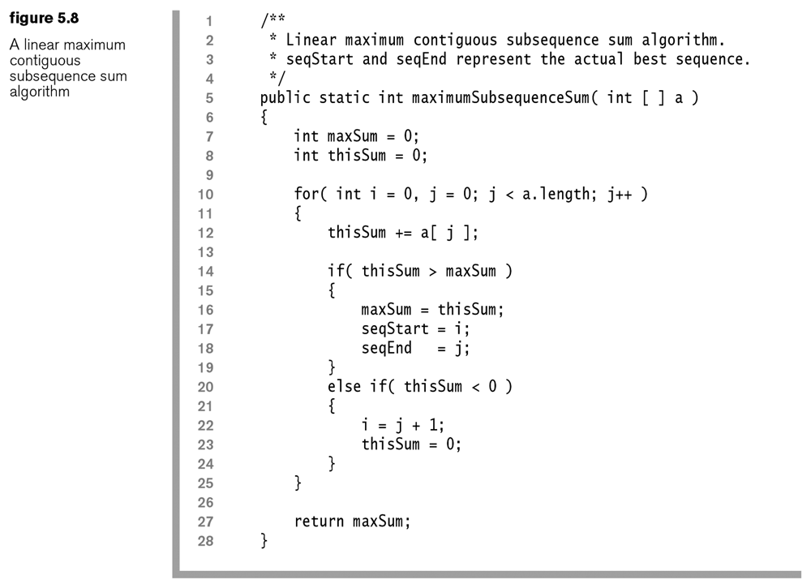

Slide 29
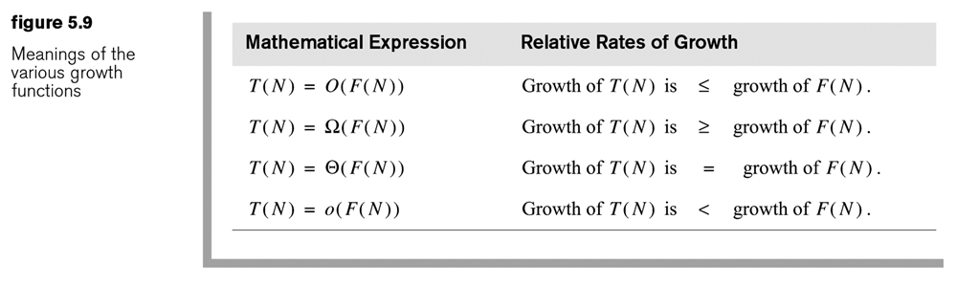

Slide 30
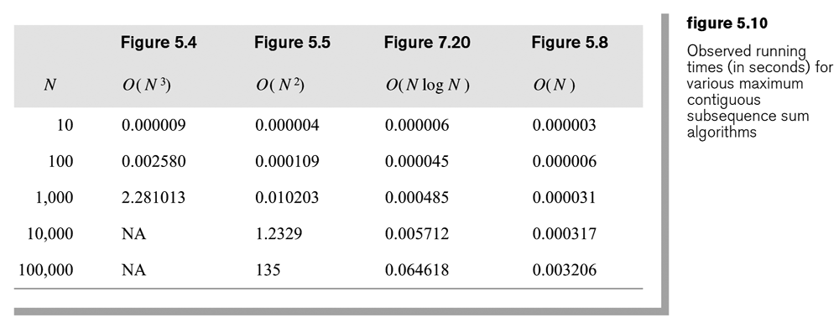

Slide 31
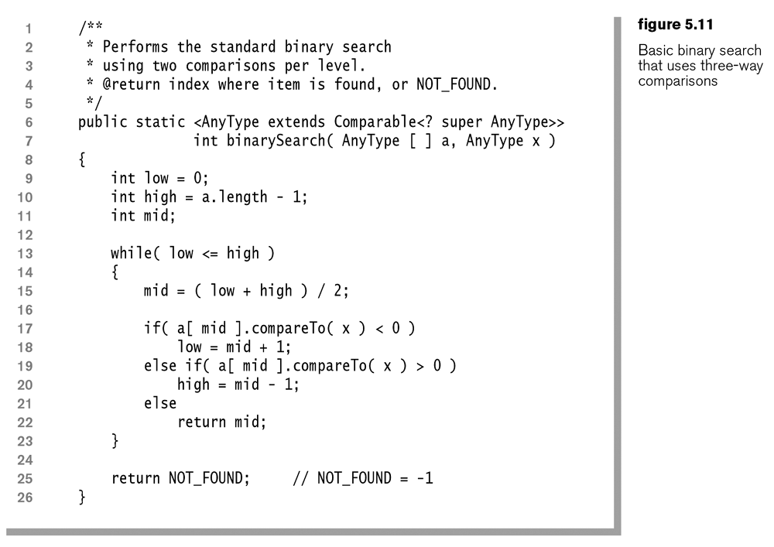
Prerequisite of binary search: The array to be searched must be pre-sorted.
O (log N)

Slide 32
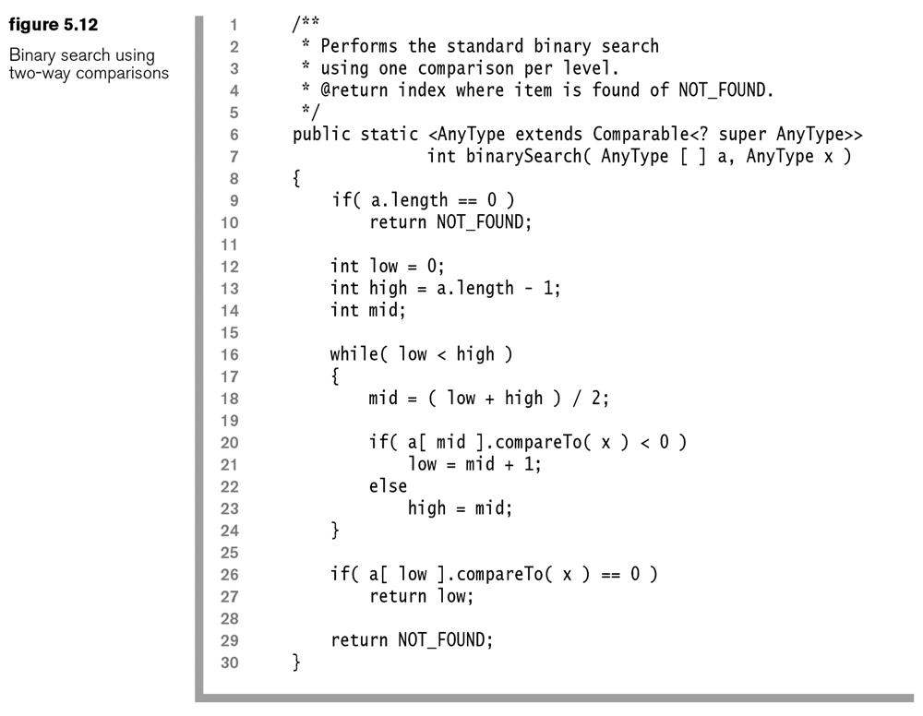

Slide 33
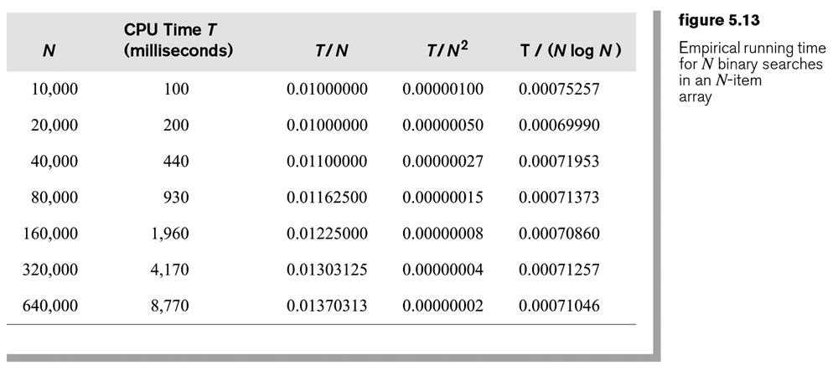
Verifying an algorithm analysis
Method: Check whether the empirically observed running time matches the running time predicted by the analysis.
e.g., The program performs N binary searches given each N.
Increasing …
O(N) is an underestimate.
Decreasing …
O(N²) is an overestimate.
Converging …
O(N log N) is about right.

Slide 34
Limitations of big-O analysis
Not appropriate for small data size
Large constants are ignored in the analysis, but they may affect the actual performance.
e.g., 1000N vs 2 N log N
Q: When will log N > 500?
Cannot differentiate between memory access vs disk access
Infinite memory is assumed
Average-case running time can often be difficult to obtain.

Slide 35
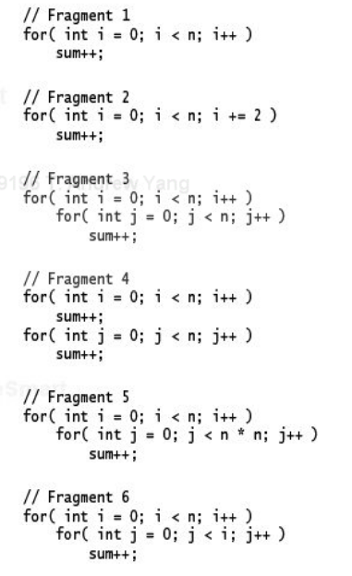
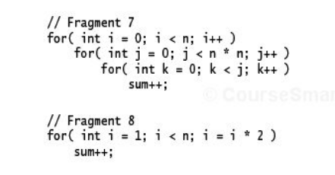
Exercises
Ex 5.20: For each of the following program fragments, give a Big-O analysis of the running time.

Slide 36
Exercises
Ex 5.7: Solving a problem requires running an O(N²) algorithm and then afterwards an O(N) algorithm. What is the total cost of solving the problem?
Ex 5.8: Solving a problem requires running an O(N) algorithm, and then performing N binary searches on an N-element array, and then running another O(N) algorithm. What is the total cost of solving the problem?

Slide 37
Exercises
Ex 5.14: An algorithm take 0.5 ms for input size 100. How long will it take for input size 500 (assuming that low-order terms are negligible) if the running time is as follow:
  linear:
  O(N logN):
  Quadratic:
  Cubic:

Slide 38
Exercises
Four separate questions:
  If an algorithm with running time of O(N) takes 0.5 ms when N = 100, how much time would it take when N = 500?
  …
  …
  …
Hint: Use Excel
 | O(N) | O(N log N) | O(N^2) | O(N^3)
N1 (100) | 0.5 ms | 0.5 ms | 0.5 ms | 0.5 ms
N2 (500) | N2/N1*0.5 | N2*logN2/N1*logN1*0.5 | N2^2/N1^2*0.5 | N2^3/N1^3*0.5
Ex 5.16

