Slide 1
Chapters 2.4, 6
Arrays

Slide 2
Outline
Review of arrays
Arrays in Java
Example programs
Exercises

Slide 3
Arrays
A collection of identically typed entities in one unit/variable.
values
Av[ ]
V₁ | V₂ | V₃ | … | V_{n-1} | V_{n}
0 | 1 | 2 | … | n-2 | n-1
indexes
Array name
Av[0] = v₁
Av[1] = v₂
…
Av[n-2] = v_{n-1}
Av[n-1] = v_{n}

Slide 4
Arrays in Java
Class Arrays (http://download.oracle.com/javase/6/docs/api/java/util/Arrays.html)
  java.lang.Object
  --- java.util.Arrays
http://java.sun.com/docs/books/jls/third_edition/html/arrays.html (Chapter 10 Arrays, the Java Language Specification, 3rd edition, 2005)
In Java, the array is not a primitive type; it is more like an object.
Upper and lower bounds of an array are automatically checked in Java.

Slide 5
A sample program
Array initialization with random numbers
  http://users.cis.fiu.edu/~weiss/dsj4/code/RandomNumbers.java
Exercise: Modify the program so the numbers in the array will be sorted in ascending order, using the sort( ) method.
Exercise: (continued) Modify the above program so the sorted array will be searched for a given number, using the binarySearch( ) method.

Slide 6
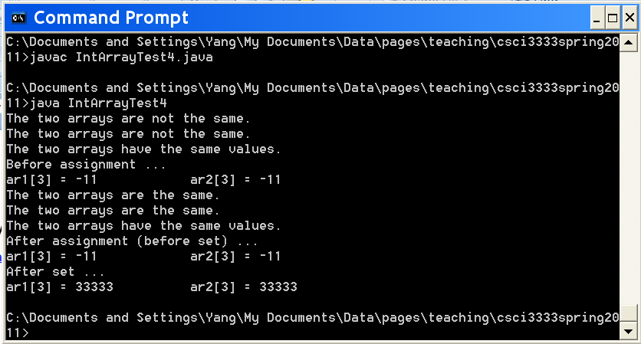
Sample program #2
Array comparisons, etc.
http://sce.uhcl.edu/yang/teaching/JavaProgrammingExamplesandRelatedTopics.htm

Slide 7
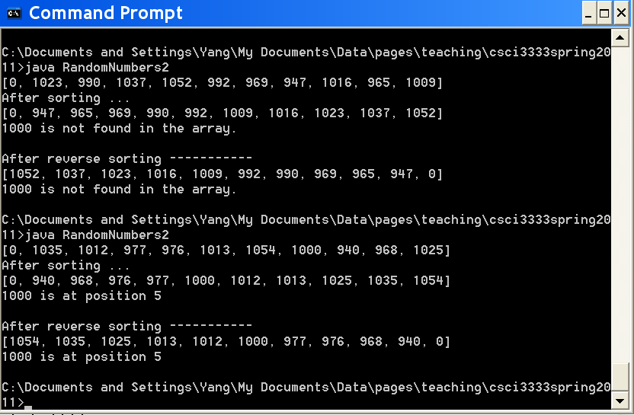
Sample program #3
RandomNumbers2.java:
  Arrays.sort( ) & Arrays.binarySearch( )
  http://sce.uhcl.edu/yang/teaching/JavaProgrammingExamplesandRelatedTopics.htm

Slide 8
ArrayList
http://download.oracle.com/javase/6/docs/api/java/util/ArrayList.html
Class ArrayList<E>
  java.lang.Object
    -- java.util.AbstractCollection<E>
      -- java.util.AbstractList<E>
        -- java.util.ArrayList<E>
Each ArrayList instance has a capacity. The capacity is the size of the array used to store the elements in the list.
The array in an ArrayList is always at least as large as the list size.
As elements are added to an ArrayList, its capacity grows automatically.

Slide 9
ArrayList (cont.)
Methods in ArrayList:
  The size, isEmpty, get, and set operations run in constant time.
  The iterator and listIterator (methods defined in its super class, AbstractList) also run in constant time.
  The add operation runs in amortized constant time, that is, adding n elements requires O(n) time.
  All of the other operations (e.g., clone, contains, remove) run in linear time (roughly speaking).

Slide 10
ArrayList (cont.)
Only objects can be added into an ArrayList.
Primitive types cannot be added into an ArrayList.
Compare:
  Figure 4.25 (wrapper class) ← prior to Java 1.4
  //import weiss.util.ArrayList;
  import java.util.*;
  public class BoxingDemo {
  public static void main( String [ ] args ) {
  ArrayList<Integer> arr = new ArrayList<Integer>( );
  arr.add( new Integer(46) ); // The int 46 is wrapped into the Integer class
  Integer wrapperVal = arr.get(0);
  int val = wrapperVal.get( 0 );
  System.out.println( "Position 0: " + val );
  }
  }

Slide 11
ArrayList (cont.)
  Figure 4.26 (autoboxing) ← for Java 1.5 and higher
  //import weiss.util.ArrayList;
  import java.util.*;
  public class BoxingDemo {
  public static void main( String [ ] args ) {
  ArrayList<Integer> arr = new ArrayList<Integer>( );
  arr.add( 46 ); // The compiler will automatically call the Integer constructor behind the scene to add 46 into the ArrayList.
  int val = arr.get( 0 );
  System.out.println( "Position 0: " + val );
  }
  }

Slide 12
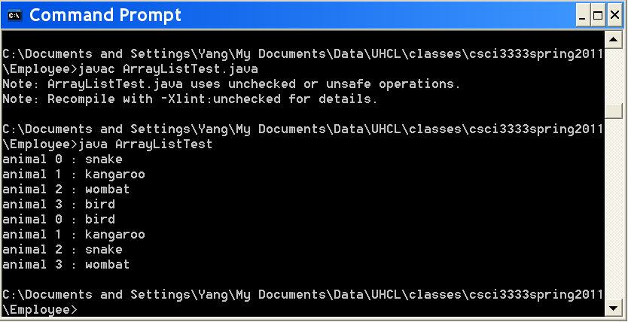
ArrayList Examples
ArrayListTest
in http://sce.uhcl.edu/yang/teaching/JavaProgrammingExamplesandRelatedTopics.htm

Slide 13
ArrayList of user-defined classes
Lab 3
  User-defined classes (e.g., class Employee with multiple attributes)
  Comparators (e.g., by ID, by firstName, by lastName, …)

