Slide 1
Introduction to
Software Development

Slide 2
Outline
The code-compile-debug process for writing a program
The software development process

Slide 3
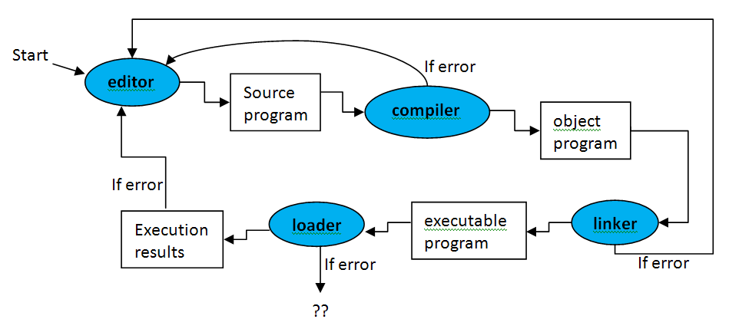
code-compile-debug (ccd)
The process of developing a computer program (when the requirements are clearly defined).
IDE: Integrated Development Environment
  e.g., NetBeans for Java development

Slide 4
How do you develop your class projects?
Understand the given requirements.
Verify that your understanding is correct?
Design the program
  → Program design (e.g., UML diagrams, pseudo-codes)
Verify that your design has captured all the requirements?
Implement the design (by coding each of the classes defined in the UML class diagram). ← The ccd process
Test the implemented program(s).
Verify that your program is a correct implementation of the design?

Slide 5
Limitations of the ccd process
It applies only to the step of developing the programs/codes (i.e., coding).
It only works when the requirements are clearly defined, or little effort is needed to analyze the requirements.
  e.g., class projects
Program-in-small vs program-in-large:
  Developing a large-scale software involves more activities than coding, such as analysis, design, testing, etc.

Slide 6
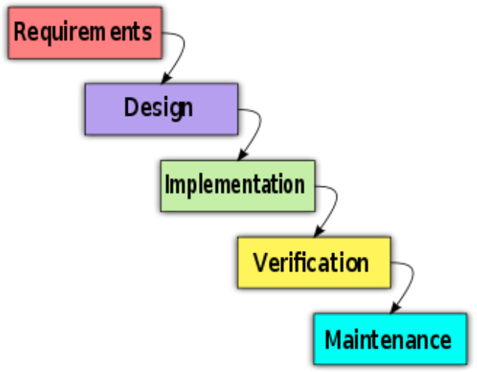
The software development process
The waterfall model for software development and maintenance
  (source: http://en.wikipedia.org/wiki/Waterfall_model)
Q: Have you identified any problem(s) with this model?

Slide 7
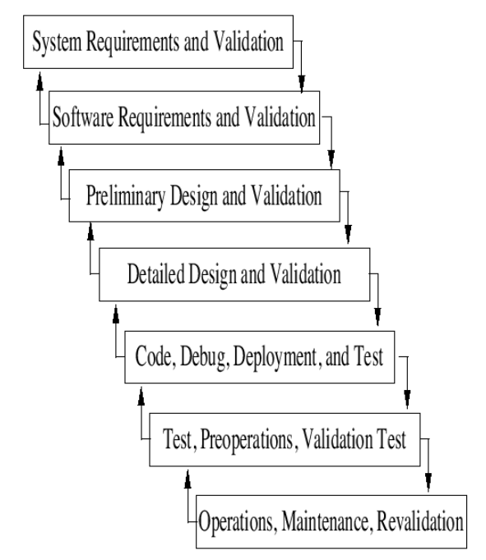
The Boehm-waterfall model
Validation is part of each phase.
Iterative loopbacks
From: http://infolab.stanford.edu/~burback/watersluice/node52.html

Slide 8
Software Development Models
There exist many models for developing large-scale software.
    V model
    Spiral model
    Fast prototyping
    Incremental model
    …
Links
  http://www.scribd.com/doc/36404631/13/Sample-SDLC-Models
  http://www.win.tue.nl/~wsinruur/FormalMethodsCollege/Multiple%20V%20model%20v10.pdf
  http://en.wikipedia.org/wiki/Spiral_model

Slide 9
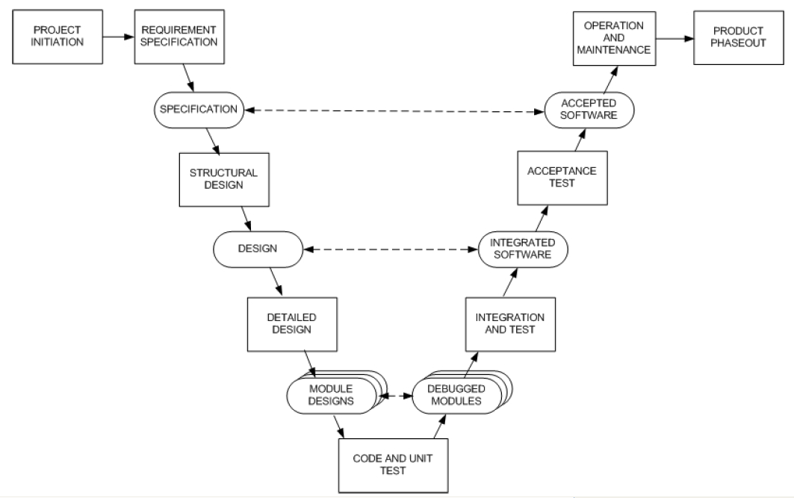
The V Model
From: http://www.win.tue.nl/~wsinruur/FormalMethodsCollege/Multiple%20V%20model%20v10.pdf

