Slide 1
Control Structures
Selections
Repetitions/iterations
Based on slides from Deitel & Associates, Inc.
Revised by T. A. Yang

Slide 2
Outline
Algorithms and control structures
  Selections
  Iterations

Slide 3
4.2 Algorithms
An algorithm is a procedure for solving a problem in terms of
  the actions to execute and
  the order in which these actions execute
An ordered sequence of operations for completing a task
Specifying the order in which statements (actions) execute in a program is called program control.
A program can be controlled by using the control structures provided by the programming languages.
  Common control structures include selections and iterations.

Slide 4
4.3 Pseudocode
Pseudocode is an informal language that helps you develop algorithms without having to worry about the strict details of Java language syntax.
Particularly useful for developing algorithms that will be converted to structured portions of Java programs.
Helps you “think out” a program before attempting to write it in a programming language, such as Java.
Carefully prepared pseudocode can easily be converted to a corresponding Java program.
Try to represent the ‘major’ operations
  e.g., input, output or calculations.

Slide 5
Example Pseudocode
  Goal: Write down the pseudocode of an algorithm that takes a natural number, N, and prints the sum of 1+2+…+N.
  Questions:
    Would both algorithm accomplish the given task?
    Is one better than the other?
Algorithhm-1 | Algorithhm-2
Get N Let Sum = 0 i = 1 While i <= N Sum = Sum + i i = i + 1 Print Sum | Get N If N > 0 then Sum = N Else Sum = 0 Let i = N - 1 While i > 0 Sum = Sum + i i = i - 1 Print Sum

Slide 6
Exercises:
  Trace the algorithms by inputting 5 as the value of N. Verify that both algorithms calculate the correct Sum.
  Trace the algorithms by inputting -3 as the value of N. Verify that both algorithms calculate the correct Sum.
  Revise the algorithms so they will be able to properly handle negative integers.
  Draw flowcharts to represent the revised algorithms.
  Convert the algorithms into Java applications.

Slide 7
4.4 Control Structures
Also referred to as “control statements” (in the terminology of the Java Language Specification )
Edsger Dijkstra (1968). "Go To Statement Considered Harmful". Communications of the ACM 11(3)
Bohm and Jacopini demonstrated that programs could be written without any goto statements.
Structured Programming: All programs can be written in terms of only three control structures — the sequence structure, the selection structure and the repetition structure.
  Sequence: Statements in a program execute one after the other in the order in which they are written.
  Selection: Statements in a program execute depending on whether a given condition is true or false.
  Repetition (or iteration): Statements in a program continue to execute until a given condition is true or false.

Slide 8
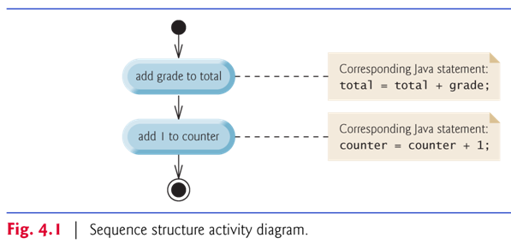
Sequence structure
  The activity diagram in Fig. 4.1 illustrates a typical sequence structure in which two calculations are performed in order.
  A black circle represents the start (initial state) of the workflow.
  An encircled black circle represents the end (final state).

Slide 9
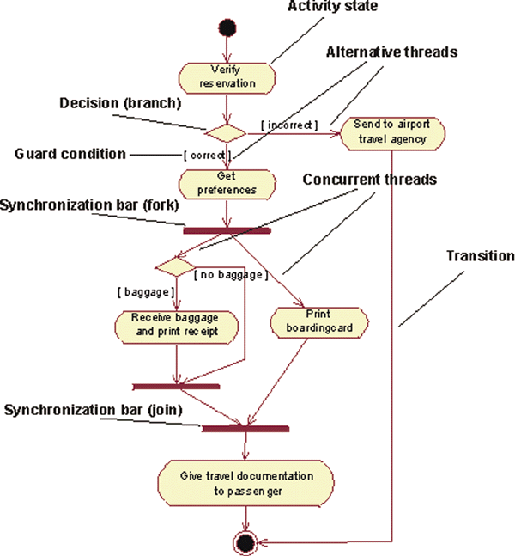
UML
Activity Diagram
Models the workflow (also called the activity) of a portion of a software system.
Composed of symbols similar to those in flowcharting
  Q: What are the main differences?
Clearly show how control structures operate.
Source: http://www.ibm.com/developerworks/rational/library/2802.html

Slide 10
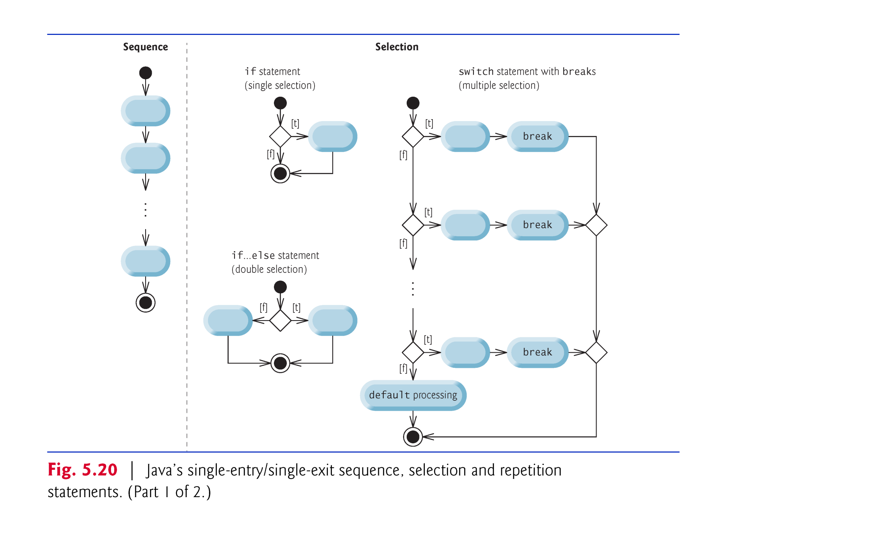
Activity diagrams and structured controls

Slide 11
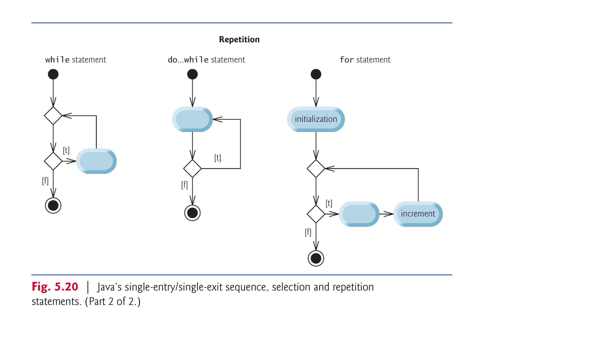
Activity diagrams and structured controls

Slide 12
selection statements
Three types of selection statements.
if statement:
  Performs an action, if a condition is true; skips it, if false.
  Single-selection statement—selects or ignores a single action (or group of actions).
if…else statement:
  Performs an action if a condition is true and performs a different action if the condition is false.
  Double-selection statement—selects between two different actions (or groups of actions).
switch statement
  Performs one of several actions, based on the value of an expression.
  Multiple-selection statement—selects among many different actions (or groups of actions).

Slide 13
repetition (also called looping )
Three repetition statements (also called looping statements)
  Perform statements repeatedly while a loop-continuation condition remains true.
while and for statements perform the action(s) in their bodies zero or more times
  if the loop-continuation condition is initially false, the body will not execute.
The do…while statement performs the action(s) in its body one or more times.
if, else, switch, while, do and for are keywords.
  Appendix C: Complete list of Java keywords.

Slide 14
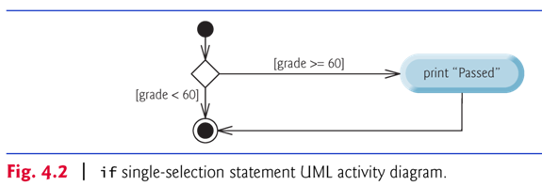
Every program is formed by combining the sequence statement, selection statements (three types) and repetition statements (three types) as appropriate for the algorithm the program implements.
Can model each control statement as an activity diagram.

Slide 15
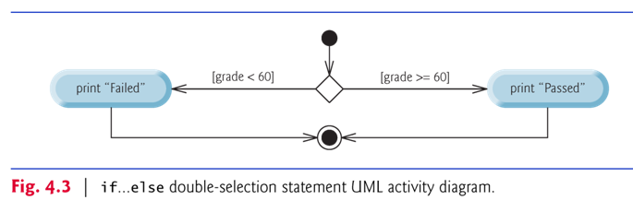

Slide 16
Conditional operator (x ? y : z)
— shorthand of if…else
Ternary operator (takes three operands)
Operands and ?: form a conditional expression
Operand to the left of the ? (x) is a boolean expression — evaluates to a boolean value (true or false)
Second operand between the ? and : (y) is the value if the boolean expression is true
Third operand to the right of the : (z) is the value if the boolean expression evaluates to false.
Example:
    System.out.println(
    studentGrade >= 60 ? "Passed" : "Failed" );
  Evaluates to the string "Passed" if the boolean expression studentGrade >= 60 is true and to the string "Failed" if it is false.

Slide 17
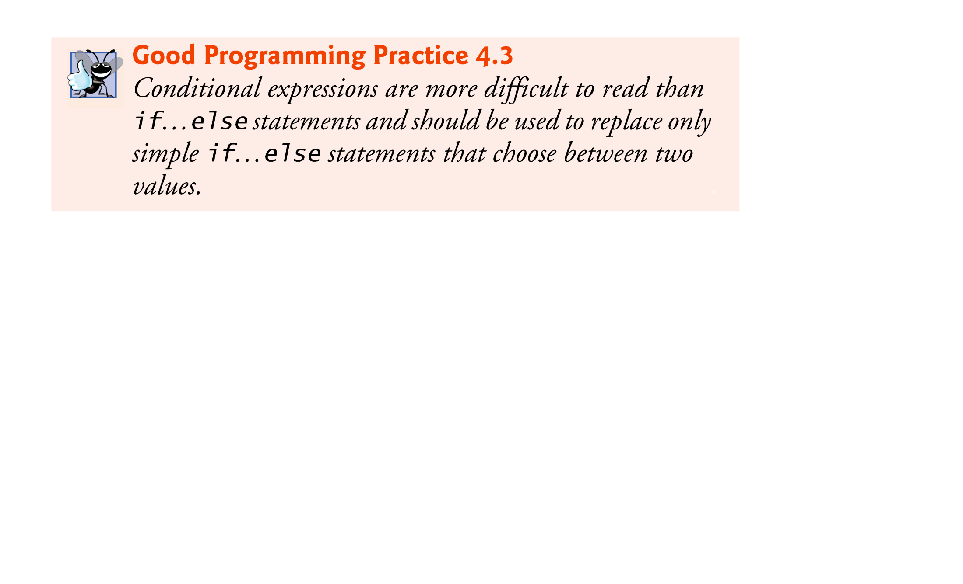

Slide 18
nested if…else statements
Pseudocode:
  If student’s grade is greater than or equal to 90
  Print “A”
  else
  If student’s grade is greater than or equal to 80
  Print “B”
  else
  If student’s grade is greater than or equal to 70
  Print “C”
  else
  If student’s grade is greater than or equal to 60
  Print “D”
  else
  Print “F”
Exercises:
  Draw a flowchart to represent the above pseudocode.
  Draw an activity diagram to represent the above pseudocode.

Slide 19
In Java
    if ( studentGrade >= 90 )
    System.out.println( "A" );
    else if ( studentGrade >= 80 )
    System.out.println( "B" );
    else if ( studentGrade >= 70 )
    System.out.println( "C" );
    else if ( studentGrade >= 60 )
    System.out.println( "D" );
    else
    System.out.println( "F" );

Slide 20
The dangling-else problem
The Java compiler always associates an else with the immediately preceding if unless told to do otherwise by the placement of braces ({ and }).
The following code is not what it appears:
    if ( x > 5 )
    if ( y > 5 )
    System.out.println( "x and y are > 5" );
    else
    System.out.println( "x is <= 5" );
Beware! This nested if…else statement does not execute as it appears. The compiler actually interprets the statement as
    if ( x > 5 )
    if ( y > 5 )
    System.out.println( "x and y are > 5" );
    else
    System.out.println( "x is <= 5" );

Slide 21
To force the nested if…else statement to execute as it was originally intended, we must write it as follows:
    if ( x > 5 )
    {
    if ( y > 5 )
    System.out.println( "x and y are > 5" );
    }
    else
    System.out.println( "x is <= 5" );
Questions: What would be printed for each of the following scenarios?
  x = 6, y = 6
  x = 6, y = 5
  x = 6, y = 0
  x = 5, y = 6
  x = 5, y = 3
Exercises:
  Show the above nested if … else statement as a flowchart.
  Show the above nested if … else statement as an activity diagram.

Slide 22
4.7 while Repetition Statement
Repetition statement — repeats an action while a condition remains true.
Pseudocode
    While there are more items on my shopping list
    Purchase next item and cross it off my list
The repetition statement’s body may be a single statement or a block.
Eventually, the condition will become false. At this point, the repetition terminates, and the first statement after the repetition statement executes.

Slide 23
Example of Java’s while repetition statement:
    Find the first power of 3 larger than 100.
    int product = 3;
    while ( product <= 100 )
    product = 3 * product;
    System.out.printf (“Answer: %d\n“, product);
Exercise: Draw a flowchart to represent the above code segment.

Slide 24
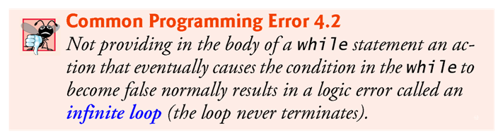
Exercises:
  Trace the screen output of the following code segment:
    int number = 99;
    while ( number <= 100 ) {
    number = number - 2;
    System.out.printf (“number = %d\n“, number);
    }
  Trace the screen output of the following code segment:
    int number = 3;
    int product = 1;
    while ( number <= 100 ) {
    product = product * number;
    System.out.printf (“number = %d\t product = %d\n“, number, product);
    }

Slide 25
4.8 Formulating Algorithms:
Counter-Controlled Repetition
Problem description:
  A class of ten students took a quiz.
  The grades (integers in the range 0 to 100) for this quiz are available to you. Determine the class average on the quiz.
  The class average is equal to the sum of the grades divided by the number of students.
The algorithm for solving this problem on a computer must input each grade, keep track of the total of all grades input, perform the averaging calculation and print the result.
Use counter-controlled repetition to input the grades one at a time.
A variable called a counter (or control variable) controls the number of times a set of statements will execute.
Counter-controlled repetition is often called definite repetition, because the number of repetitions is known before the loop begins executing.

Slide 26
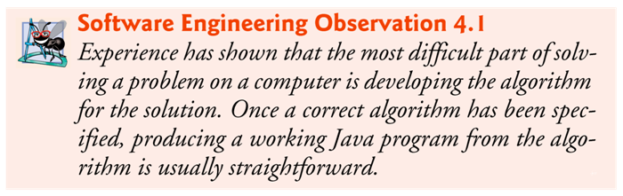
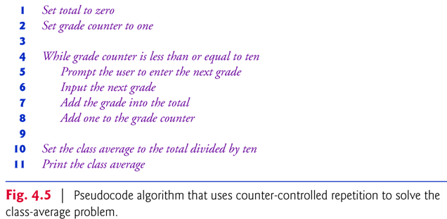
Algorithm Design: Use pseudocodes, flowcharting, or activity diagrams to represent the algorithm/solution.

Slide 27
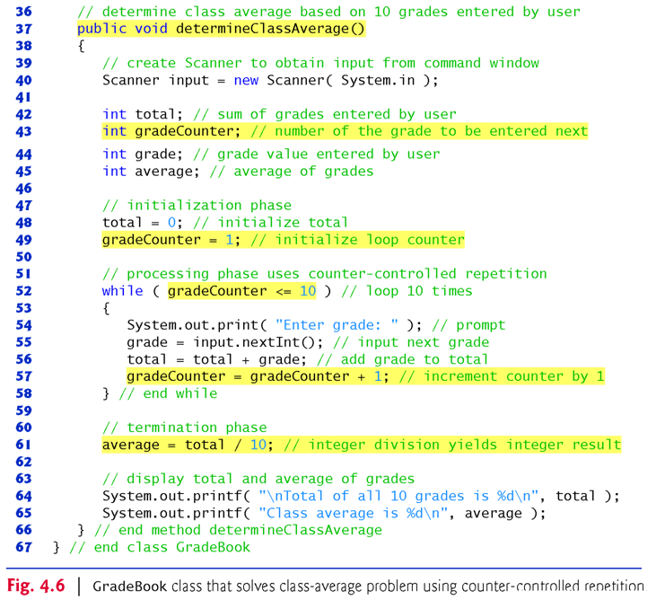

Slide 28
4.9 Formulating Algorithms:
Sentinel-Controlled Repetition
Problem description:
  Develop a class-averaging program that processes grades for an arbitrary number of students each time it is run.
Sentinel-controlled repetition is often called indefinite repetition because the number of repetitions is not known before the loop begins executing.
A special value called a sentinel value (also called a signal value, a dummy value or a flag value) can be used to indicate “end of data entry.”
A sentinel value must be chosen that cannot be confused with an acceptable input value.

Slide 29
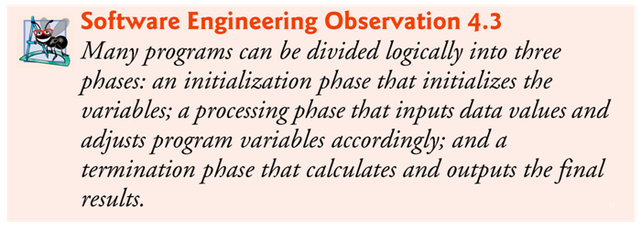
The problem: calculate the class average of grades
Suppose we do not know in advance how many grades are to be processed, so we’ll use sentinel-controlled repetition.
The pseudocode: Fig. 4.8

Slide 30
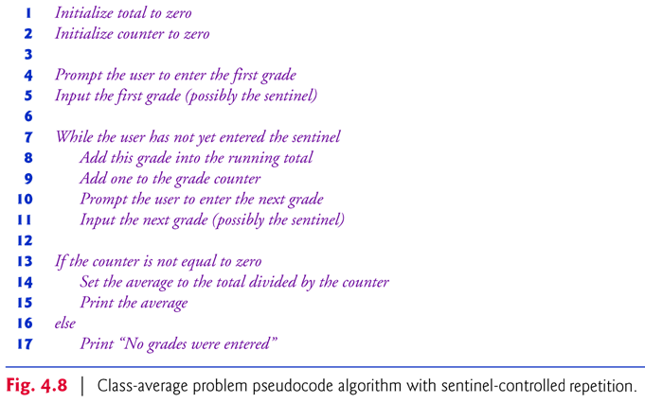

Slide 31
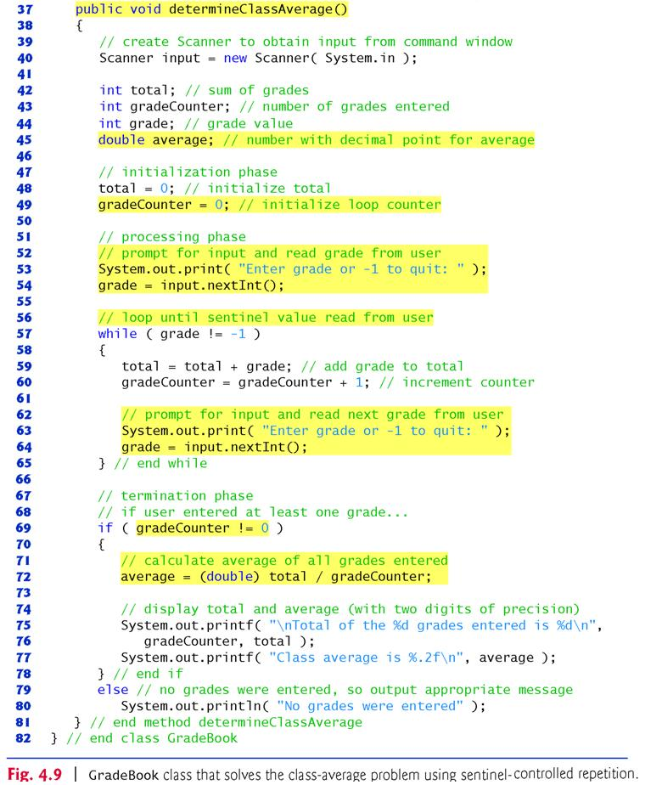

Slide 32
Type Casting
Integer division yields an integer result.
To perform a floating-point calculation with integers, temporarily treat these values as floating-point numbers for use in the calculation.
The unary cast operator (double) creates a temporary floating-point copy of its operand.
Cast operator performs explicit conversion (or type cast).
The value stored in the operand is unchanged.
Java evaluates only arithmetic expressions in which the operands’ types are identical.
Promotion (or implicit conversion) performed on operands.
In an expression containing values of the types int and double, the int values are promoted to double values for use in the expression.

Slide 33
4.11 Compound Assignment Operators
Compound assignment operators abbreviate assignment expressions.
Statements like
variable = variable operator expression;
where operator is one of the binary operators +, -, *, / or % can be written in the form
    variable operator= expression;
Example:
    c = c + 3;
can be written with the addition compound assignment operator, +=, as
    c += 3;
The += operator adds the value of the expression on its right to the value of the variable on its left and stores the result in the variable on the left of the operator.

Slide 34
4.12 Increment and Decrement Operators
Unary increment operator, ++, adds one to its operand
Unary decrement operator, --, subtracts one from its operand
An increment or decrement operator that is prefixed to (placed before) a variable is referred to as the prefix increment or prefix decrement operator, respectively.
  Using the prefix increment (or decrement) operator to add (or subtract) 1 from a variable is known as preincrementing (or predecrementing) the variable.
  Preincrementing (or predecrementing) a variable causes the variable to be incremented (decremented) by 1; then the new value is used in the expression in which it appears.
An increment or decrement operator that is postfixed to (placed after) a variable is referred to as the postfix increment or postfix decrement operator, respectively.
  Using the postfix increment (or decrement) operator to add (or subtract) 1 from a variable is known as postincrementing (or postdecrementing) the variable.
  This causes the current value of the variable to be used in the expression in which it appears; then the variable’s value is incremented (decremented) by 1.

Slide 35
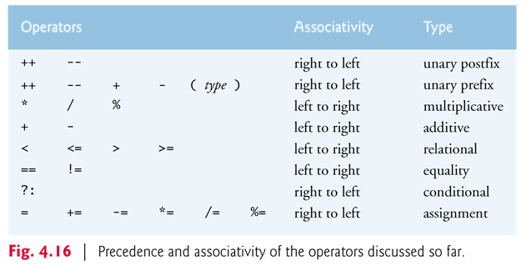

Slide 36
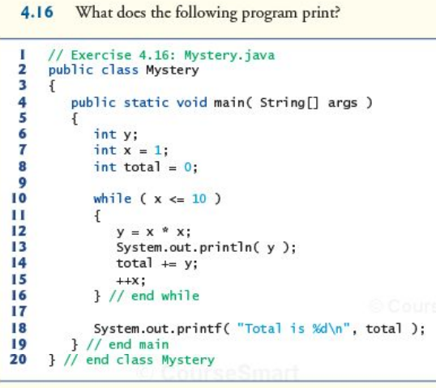
Program Tracing

Slide 37
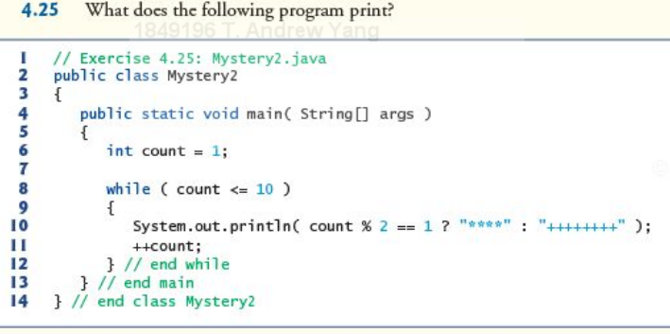
Program Tracing

Slide 38
More Exercises:
  Write down an algorithm (as pseudocode) to show your solution for each of the following problems.
  Given three input numbers, print the numbers from the maximum to the minimum.
  Given the input of indefinite numbers of real numbers, print out the maximum, the minimum, and the average of all the numbers.
  Exercises 4.8, 4.9, 4.15

Slide 39
More Exercises:
  Convert the following pseudocode into a flowchart.
    Let number = 100
    Let sum = 0
    while number >= 10
        sum = sum + number
        number = number / 2
        Print number
    Print number, sum
  What’s the printed output of the above algorithm?

