Slide 1
Computers, Applications, and Java
Based on slides from Deitel & Associates, Inc.
Modified and enhanced by T. A. Yang

Slide 2
Outline
Computers
Programs and Software Applications
Programming languages
Java

Slide 3
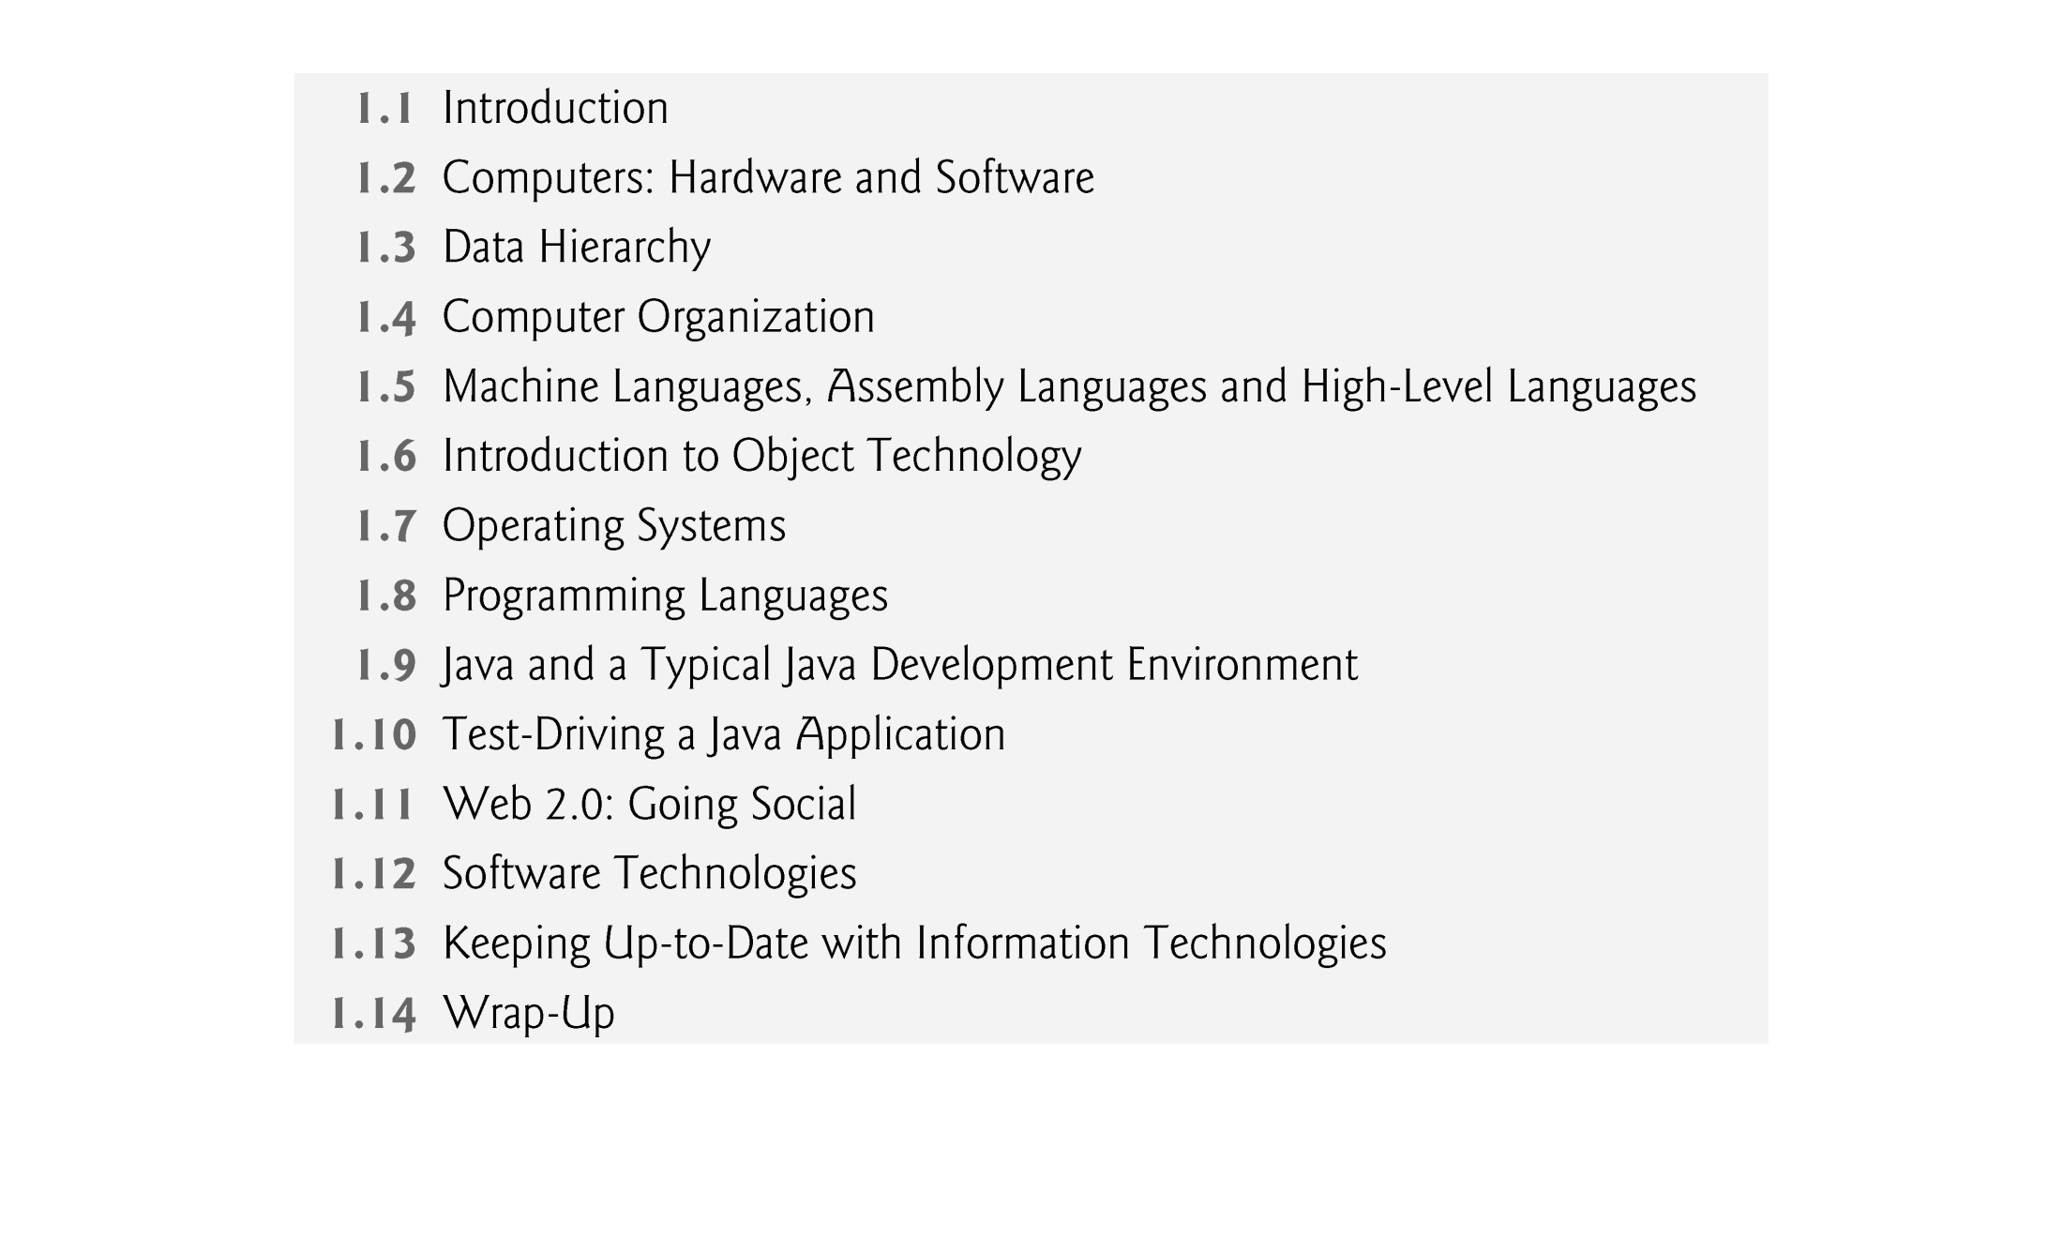
Chapter organization

Slide 4
1.1 Introduction
Java is the world’s most widely used computer programming language.
You’ll learn to write instructions commanding computers to perform tasks.
Software (i.e., the instructions you write) controls hardware (i.e., computers).
You’ll learn object-oriented programming—today’s key programming methodology.
You’ll create and work with many software objects in this class.

Slide 5
1.1 Introduction (Cont.)
Java is the preferred language for meeting many organizations’ enterprise programming needs.
Java has become the language of choice for implementing Internet-based applications and software for devices that communicate over a network.
In use today are more than a billion general-purpose computers and billions more Java-enabled cell phones, smartphones and handheld devices (such as tablet computers).

Slide 6
1.1 Introduction (Cont.)
Java Editions: SE, EE and ME
  This book covers Java Standard Edition 6 (Java SE 6) with optional modules on the new features of Java SE 7
    Used for developing cross-platform, general-purpose applications.
  Java is used in such a broad spectrum of applications that it has two other editions.
    The Java Enterprise Edition (Java EE)
      Geared toward developing large-scale, distributed networking applications and web-based applications.

Slide 7
1.1 Introduction (Cont.)
    Java Micro Edition (Java ME)
      geared toward developing applications for small, memory-constrained devices, such as BlackBerry smartphones.
      c.f., Google’s Android operating system is used on numerous smartphones, tablets (small, lightweight mobile computers with touch screens), e-readers and other devices — uses a customized version of Java not based on Java ME.

Slide 8
1.1 Introduction (Cont.)
Computing in Industry and Research
  Computers are used extensively in academic and industrial research.
  In academic researches, computational science studies how computations using computer hardware, software, and algorithms can be made efficiently to accomplish various tasks.
  Computer science and Information systems students learn the fundamentals of developing computer applications at various level and in various industry.
  Many of the most influential and successful businesses of the last two decades are technology companies, including Apple, IBM, Hewlett Packard, Dell, Intel, Motorola, Cisco, Microsoft, Google, Amazon, Facebook, Twitter, Groupon, Foursquare, Yahoo!, eBay and many more
  These are major employers of people who study computer science, information systems or related disciplines.

Slide 9
1.2 Computers: Hardware and Software
Computer — Device that can perform computations and make logical decisions phenomenally faster than human beings can.
Today’s personal computers can perform billions of calculations in one second — more than a human can perform in a lifetime.
Supercomputers are already performing thousands of trillions (quadrillions) of instructions per second!
Computers process data under the control of sets of instructions called computer programs.

Slide 10
1.2 Computers: Hardware and Software (Cont.)
Computer programs guide the computer through orderly sets of actions specified by people called computer programmers.
The programs that run on a computer are referred to as software (or applications).
You’ll learn today’s key programming methodology that’s enhancing programmer productivity, thereby reducing software-development costs — object-oriented programming (OOP).

Slide 11
1.2 Computers: Hardware and Software (Cont.)
A computer consists of various devices referred to as hardware
  (e.g., the keyboard, screen, mouse, hard disks, memory, DVDs and processing units).
Computing costs are dropping dramatically, owing to rapid developments in hardware and software technologies.
Computers that might have filled large rooms and cost millions of dollars decades ago are now inscribed on silicon chips smaller than a fingernail, costing perhaps a few dollars each.

Slide 12
1.2 Computers: Hardware and Software (Cont.)
Silicon-chip technology has made computing so economical that more than a billion general-purpose computers are in use worldwide, and this is expected to double in the next few years.
Computer chips (microprocessors) control countless devices.
  Embedded systems include anti-lock brakes in cars, navigation systems, smart home appliances, home security systems, cell phones and smartphones, robots, intelligent traffic intersections, collision avoidance systems, video game controllers and more.
  The vast majority of the microprocessors produced each year are embedded in devices other than general-purpose computers.

Slide 13
1.2 Computers: Hardware and Software (Cont.)
Moore’s Law
  For many decades, hardware costs have fallen rapidly.
  Every year or two, the capacities of computers have approximately doubled without any increase in price.
  Observation often is called Moore’s Law.
  Moore’s Law and related observations are especially true in relation to the amount of memory that computers have for programs, the amount of secondary storage (such as disk storage) they have to hold programs and data over longer periods of time, and their processor speeds—the speeds at which computers execute their programs (i.e., do their work).

Slide 14
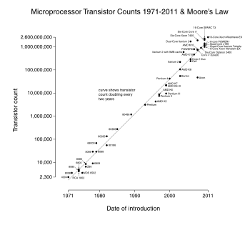
Source: http://en.wikipedia.org/wiki/Moore's_law

Slide 15
1.2 Computers: Hardware and Software (Cont.)
  Similar growth has occurred in the communications field
  Costs have plummeted as enormous demand for communications bandwidth has attracted intense competition.
  Such phenomenal improvement is fostering the Information Revolution.

Slide 16
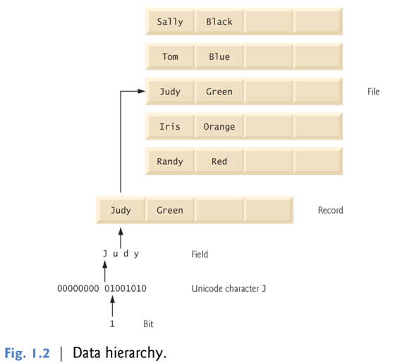
1.3 Data Hierarchy
Data items processed by computers form a data hierarchy that becomes larger and more complex in structure
  bits to characters to fields, and so on

Slide 17
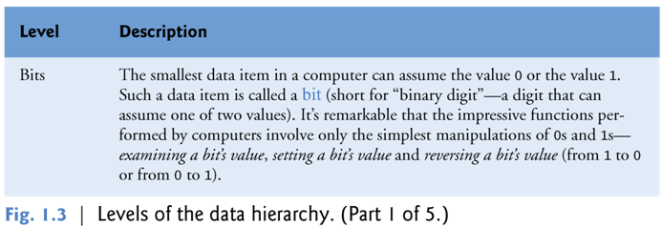
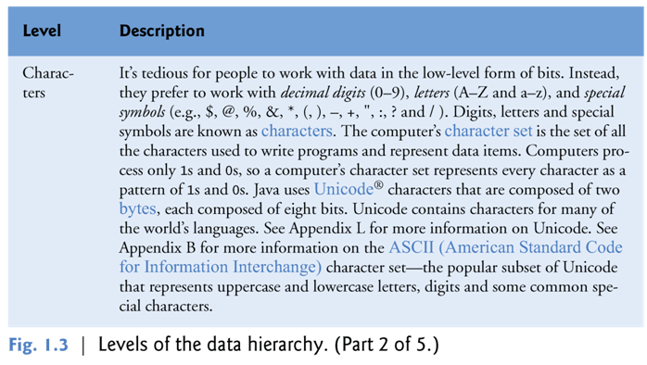

Slide 18
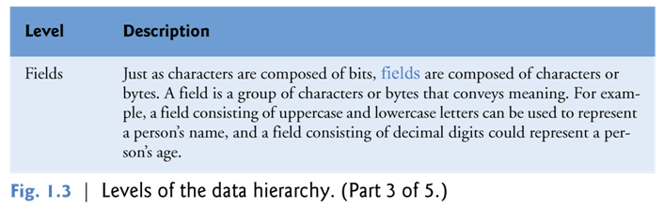
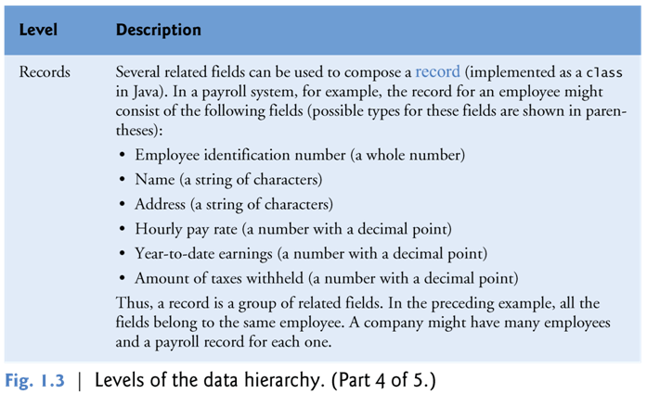

Slide 19
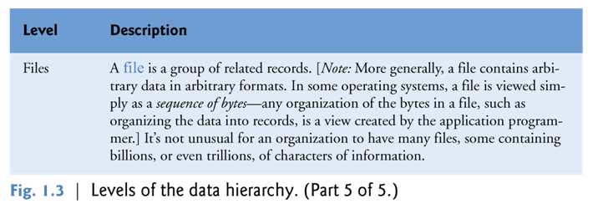

Slide 20
Q: Extension of the hierarchy?

Slide 21
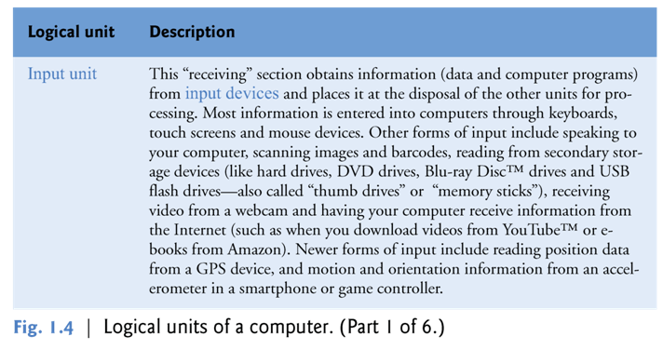
1.4 Computer Organization
Computers can be envisioned as divided into various logical units or sections.

Slide 22
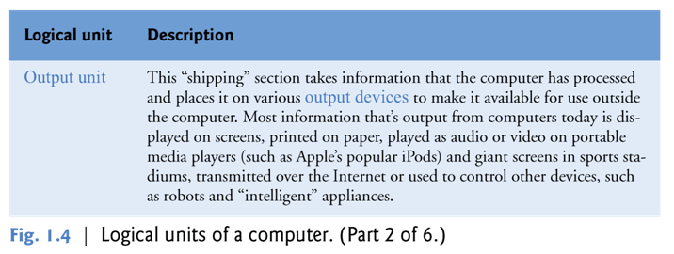
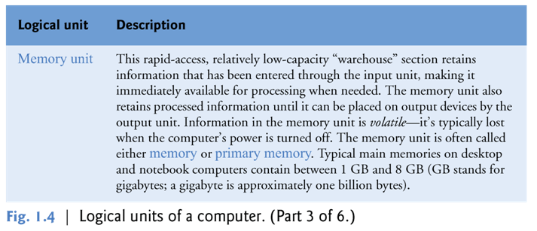

Slide 23
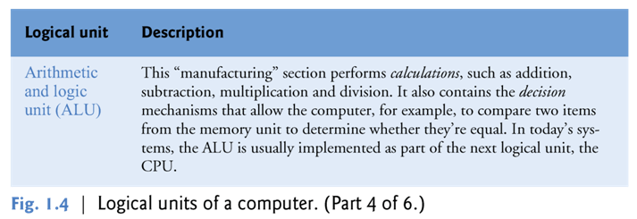
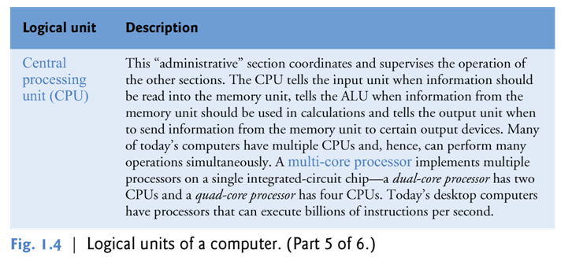

Slide 24
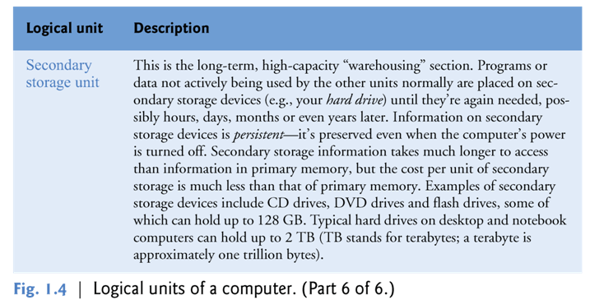
Exercise: Draw a diagram to show the relationships among the various logical units of a computer.

Slide 25
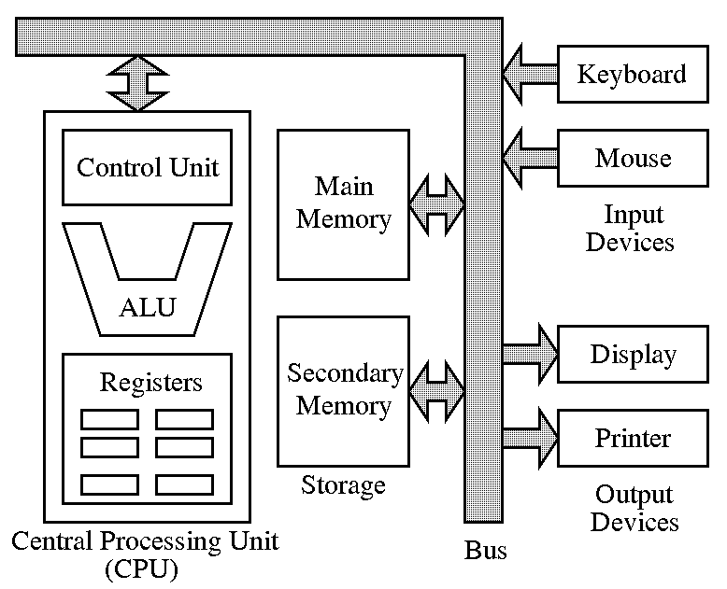
Source: http://cse.iitkgp.ac.in/pds/notes/intro.html
Q: Any changes?

Slide 26
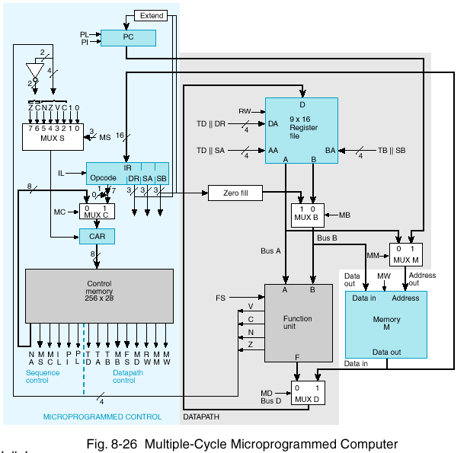
Source: http://flinflon.brandonu.ca/dueck/mpc/diagram.htm

Slide 27
1.5 Machine Languages, Assembly Languages and High-Level Languages
Programmers write instructions in various programming languages, some directly understandable by computers and others requiring intermediate translation steps.
These may be divided into three general types:
  High-level languages
  Assembly languages
  Machine languages

Slide 28
Any computer can directly understand only its own machine language, defined by its hardware design.
  Generally consist of strings of numbers (ultimately reduced to 1s and 0s) that instruct computers to perform their most elementary operations one at a time.
  Machine dependent — a particular machine language can be used on only one type of computer.
English-like abbreviations that represent elementary operations formed the basis of assembly languages.
Translator programs called assemblers convert early assembly-language programs to machine language programs.

Slide 29
High-level languages
  Compilers convert high-level language programs into machine language.
  Allow you to write instructions that look almost like everyday English and contain commonly used mathematical notations.
  A payroll program written in a high-level language might contain a single statement such as
    grossPay = basePay + overTimePay
Compiling a high-level language program into machine language can take a considerable amount of computer time.
Interpreter programs execute high-level language programs directly, although slower than compiled programs run.

Slide 30
1.6 Introduction to Object Technology
Objects, or more precisely, the classes objects come from, are essentially reusable software components.
  There are date objects, time objects, audio objects, video objects, automobile objects, people objects, etc.
  Almost any noun can be reasonably represented as a software object in terms of attributes (e.g., name, color and size) and behaviors (e.g., calculating, moving and communicating).
Using a modular, object-oriented design and implementation approach can make software-development much more productive than was possible with earlier popular techniques like “structured programming”.
Object-oriented programs are often easier to understand, correct and modify.

Slide 31
1.6 Introduction to Object Technology (Cont.)
The Automobile as an Object
  Let’s begin with a simple analogy.
  Goal: Suppose you want to drive a car and make it go faster by pressing its accelerator pedal.
  Design: Before you can drive a car, someone has to design it.
  A car typically begins as engineering drawings, similar to the blueprints that describe the design of a house.
  Drawings include the design for an accelerator pedal.
  Pedal “hides” from the driver the complex mechanisms that actually make the car go faster, just as the brake pedal “hides” the mechanisms that slow the car, and the steering wheel “hides” the mechanisms that turn the car.

Slide 32
The Automobile as an Object (cont.)
  The design of the car enables people with little or no knowledge of how engines, braking and steering mechanisms work to drive a car easily.
  Implementation/Manufacturing: Before you can drive a car, it must be built from the engineering drawings that describe it.
  A completed car has an actual accelerator pedal to make the car go faster, but even that’s not enough—the car won’t accelerate on its own (hopefully!), so the driver must press the pedal to accelerate the car.

Slide 33
1.6 Introduction to Object Technology (Cont.)
Methods and Classes
  Performing a task in a program requires a method.
  The method houses the program statements that actually perform its tasks.
  Hides these statements from its user, just as the accelerator pedal of a car hides from the driver the mechanisms of making the car go faster.
  In Java, we create a program unit called a class to house the set of methods that perform the class’s tasks.
  A class is similar in concept to a car’s engineering drawings, which house the design of an accelerator pedal, steering wheel, and so on.

Slide 34
Sample classes
http://sce.uhcl.edu/yang/teaching/JavaProgrammingExamplesandRelatedTopics.htm
  e.g., StackPerson.htm

Slide 35
1.6 Introduction to Object Technology (Cont.)
Instantiation
  Just as someone has to build a car from its engineering drawings before you can actually drive a car, you must build an object of a class before a program can perform the tasks that the class’s methods define.
  An object is then referred to as an instance of its class.
  Instantiation: the process of creating an instance of a class

Slide 36
1.6 Introduction to Object Technology (Cont.)
Reuse
  Just as a car’s engineering drawings can be reused many times to build many cars, you can reuse a class many times to build many objects.
  Reuse of existing classes when building new classes and programs saves time and effort.
  Reuse also helps you build more reliable and effective systems, because existing classes and components often have gone through extensive testing, debugging and performance tuning.
  Just as the notion of interchangeable parts was crucial to the Industrial Revolution, reusable classes are crucial to the software revolution that has been spurred by object technology.

Slide 37
1.6 Introduction to Object Technology (Cont.)
Messages and Methods Calls
  When you drive a car, pressing its gas pedal sends a message to the car to perform a task—that is, to go faster.
  Similarly, you send messages to an object.
  Each message is implemented as a method call that tells a method of the object to perform its task.

Slide 38
1.6 Introduction to Object Technology (Cont.)
Attributes and Instance Variables
  A car has attributes: color, its number of doors, the amount of gas in its tank, its current speed and its record of total miles driven (i.e., its odometer reading).
  The car’s attributes are represented as part of its design in its engineering diagrams.
  Every car maintains its own attributes.
  Each car knows how much gas is in its own gas tank, but not how much is in the tanks of other cars.

Slide 39
  An object, has attributes that it carries along as it’s used in a program.
  Specified as part of the object’s class.
  A bank account object has a balance attribute that represents the amount of money in the account.
  Each bank account object knows the balance in the account it represents, but not the balances of the other accounts in the bank.
  Attributes are specified by the class’s instance variables.

Slide 40
1.6 Introduction to Object Technology (Cont.)
Encapsulation
  Classes encapsulate (i.e., wrap) attributes and methods into objects — an object’s attributes and methods are intimately related.
  Objects may communicate with one another, but they’re normally not allowed to know how other objects are implemented — implementation details are hidden within the objects themselves.
  Information hiding, as we’ll see, is crucial to good software engineering.

Slide 41
1.6 Introduction to Object Technology (Cont.)
Inheritance
  A new class of objects can be created quickly and conveniently by inheritance — the new class absorbs the characteristics of an existing class, possibly customizing them and adding unique characteristics of its own.
  In our car analogy, an object of class “convertible” certainly is an object of the more general class “automobile,” but more specifically, the roof can be raised or lowered.

Slide 42
1.6 Introduction to Object Technology (Cont.)
Object-Oriented Analysis and Design (OOAD)
  Q: How will you create the code (i.e., the program instructions) for your programs?
    Follow a detailed analysis process for determining your project’s requirements (i.e., defining what the system is supposed to do).
    Develop a design that satisfies them (i.e., deciding how the system should do it).
    Carefully review the design (and have your design reviewed by other software professionals) before writing any code.
    Develop the code.

Slide 43
  Analyzing and designing your system from an object-oriented point of view is called an object-oriented analysis and design (OOAD) process.
  Languages like Java are object oriented.
  Object-oriented programming (OOP) allows you to implement an object-oriented design as a working system.
The UML (Unified Modeling Language)
  The Unified Modeling Language (UML) is the most widely used graphical scheme for modeling object-oriented systems.

Slide 44
1.7 Operating Systems
  Software systems that make using computers more convenient.
  Provide services that allow each application to execute safely, efficiently and concurrently (i.e., in parallel) with other applications.
  The software that contains the core components of the operating system is called the kernel.
  Popular desktop operating systems include Linux, Windows 7 and Mac OS X.
  Popular mobile operating systems used in smartphones and tablets include Google’s Android, BlackBerry OS and Apple’s iOS (for its iPhone, iPad and iPod Touch devices).

Slide 45
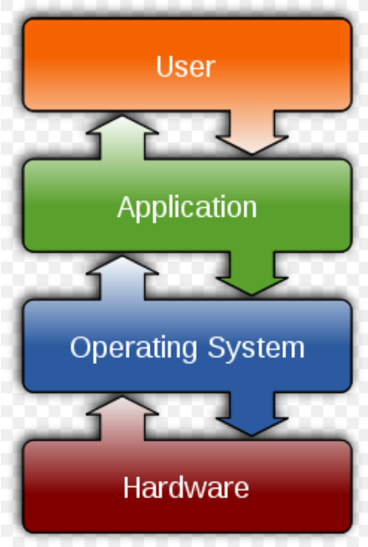
  Source: http://en.wikipedia.org/wiki/Operating_system

Slide 46
1.9 Java and a Typical Java Development Environment
Microprocessors are having a profound impact in intelligent consumer-electronic devices.
1991
  Recognizing this, Sun Microsystems funded an internal corporate research project led by James Gosling, which resulted in a C++-based object-oriented programming language Sun called Java.
  Key goal of Java is to be able to write programs that will run on a great variety of computer systems and computer-control devices.
  This is sometimes called “write once, run anywhere.”

Slide 47
1993
  The web exploded in popularity
  Sun saw the potential of using Java to add dynamic content to web pages. → Java applets and Java servlets
Java garnered the attention of the business community because of the phenomenal interest in the web.
Java is used to develop large-scale enterprise applications, to enhance the functionality of web servers, to provide applications for consumer devices and for many other purposes.
Sun Microsystems was acquired by Oracle in 2009.
As of 2010 97% of enterprise desktops, three billion handsets, and 80 million television devices run Java.
Java is the most widely used software development language in the world.

Slide 48
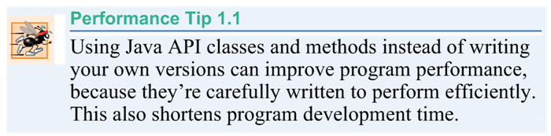
1.9 Java and a Typical Java Development Environment (Cont.)
Java Class Libraries
  Rich collections of existing classes and methods
  Also known as the Java APIs (Application Programming Interfaces).

Slide 49
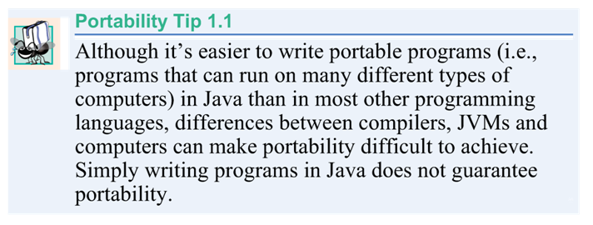

Slide 50
1.9 Java and a Typical Java Development Environment (Cont.)
Java programs normally go through five phases
  edit
  compile
  load
  verify
  execute.
Download the JDK and its documentation from
  http://www.oracle.com/technetwork/java/javase/downloads/index.html
Read the Before You Begin section of this book to ensure that you set up your computer properly to compile and execute Java programs.
Visit Oracle’s New to Java Center at:
    http://www.oracle.com/technetwork/topics/newtojava/overview/index.html

Slide 51
Edit: Phase 1 consists of editing a file with an editor
  Type a Java program (source code) using the editor.
  Make any necessary corrections.
  Save the program.
  A file name ending with the .java extension indicates that the file contains Java source code.
Various editors and IDEs:
  Linux editors: vi and emacs
  Windows editors:
    Notepad
    EditPlus (www.editplus.com)
    TextPad (www.textpad.com)
    jEdit (www.jedit.org).
  Integrated development environments (IDEs)
    Provide tools that support the software development process, including editors for writing and editing programs and debuggers for locating logic errors—errors that cause programs to execute incorrectly.

Slide 52
Popular IDEs
  Eclipse (www.eclipse.org)
  NetBeans (www.netbeans.org)
  jGRASP™ IDE (www.jgrasp.org)
  DrJava IDE (www.drjava.org/download.shtml)
  BlueJ IDE (www.bluej.org/)
  TextPad® Text Editor for Windows® (www.textpad.com/)

Slide 53
Phase 2: Compiling a Java Program into Bytecodes
  Use the command javac (the Java compiler) to compile a program. For example, to compile a program called Welcome.java, you’d type
    javac Welcome.java
  If the program compiles, the compiler produces a .class file called Welcome.class that contains the compiled version of the program.

Slide 54
Java compiler translates Java source code into bytecodes that represent the tasks to execute.
Bytecodes are executed by the Java Virtual Machine (JVM)—a part of the JDK and the foundation of the Java platform.
Virtual machine (VM)—a software application that simulates a computer
  Hides the underlying operating system and hardware from the programs that interact with it.
If the same VM is implemented on many computer platforms, applications that it executes can be used on all those platforms.

Slide 55
Bytecodes are platform independent
  They do not depend on a particular hardware platform.
Bytecodes are portable
  The same bytecodes can execute on any platform containing a JVM that understands the version of Java in which the bytecodes were compiled.
The JVM is invoked by the java command. For example, to execute a Java application called Welcome, you’d type the command
    java Welcome

Slide 56
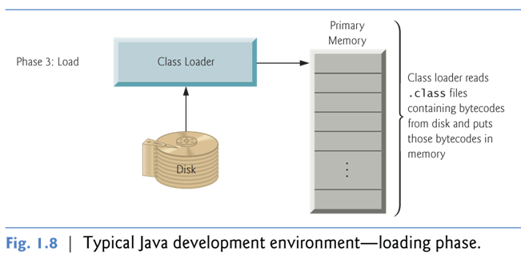
Phase 3: Loading a Program into Memory
  The JVM places the program in memory to execute it — this is known as loading.
  Class loader takes the .class files containing the program’s bytecodes and transfers them to primary memory.
  Also loads any of the .class files provided by Java that your program uses.
The .class files can be loaded from a disk on your system or over a network.

Slide 57
Phase 4: Bytecode Verification
  As the classes are loaded, the bytecode verifier examines their bytecodes
  Ensures that they’re valid and do not violate Java’s security restrictions.
Java enforces strong security to make sure that Java programs arriving over the network do not damage your files or your system (as computer viruses and worms might).

Slide 58
Phase 5: Execution
  The JVM executes the program’s bytecodes.
  JVMs typically execute bytecodes using a combination of interpretation and so-called just-in-time (JIT) compilation.
  Analyzes the bytecodes as they’re interpreted
  A just-in-time (JIT) compiler — known as the Java HotSpot compiler — translates the bytecodes into the underlying computer’s machine language.
  When the JVM encounters these compiled parts again, the faster machine-language code executes.
  Java programs go through two compilation phases:
    One in which source code is translated into bytecodes (for portability across JVMs on different computer platforms) and
    A second in which, during execution, the bytecodes are translated into machine language codes for the actual computer on which the program executes.

Slide 59
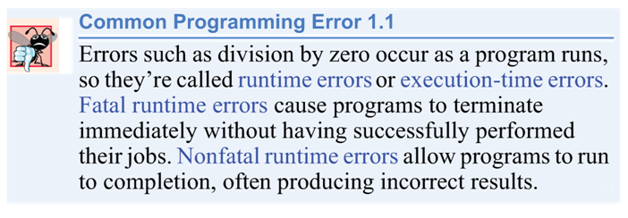

Slide 60
Test-Driving a Java Application
Check your Java setup!
Before you begin, confirm that
  Java is set up properly on your computer, and
  a sample Java program is available as a file in your hard drive or USB drive.
Lab 1 projects

