Slide 1
More on Object-Oriented Programming
Based on slides from Deitel & Associates, Inc.
Revised by T. A. Yang

Slide 2
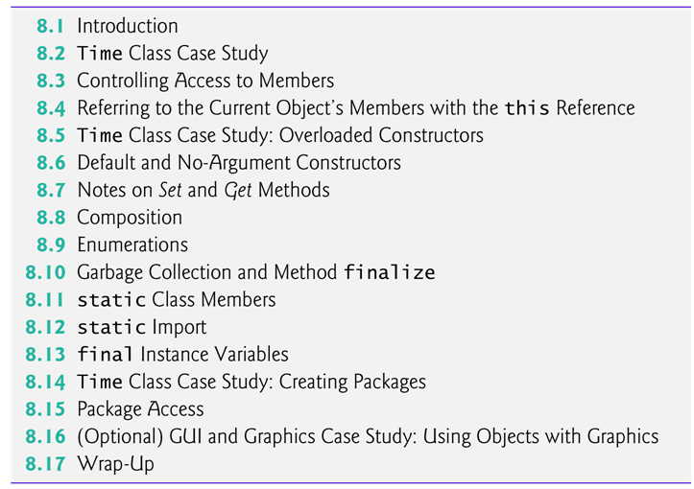

Slide 3
Outline
Review: building classes, controlling access to members of a class, creating constructors
Composition — a capability that allows a class to have references to objects of other classes as members
enum types
static class members
final instance variables
How to organize classes in packages to help manage large applications and promote reuse

Slide 4
8.2 Case Study: Fig. 8.1 (Time1.java)
Class: Time1 represents the time of day.
private int instance variables: hour, minute and second represent the time in universal-time format (24-hour clock format in which hours are in the range 0–23)
public methods
  setTime(), toUniversalString() and toString()
  The set of public methods are called the public services or the public interface that the class provides to its clients.
Exercise: Use a class diagram to show the design of Time1.

Slide 5
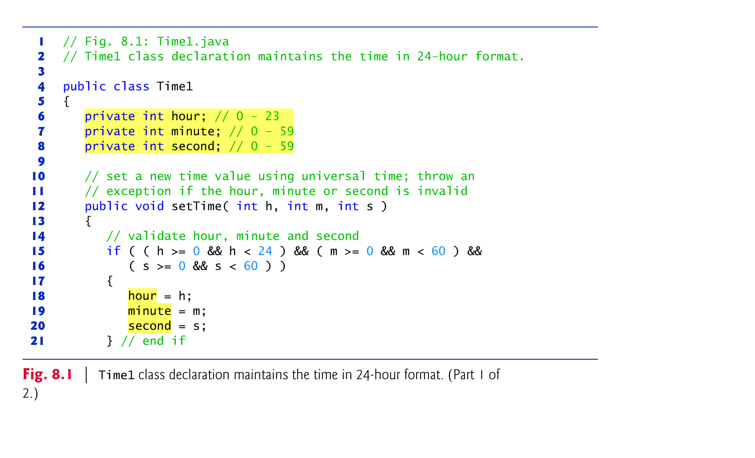

Slide 6
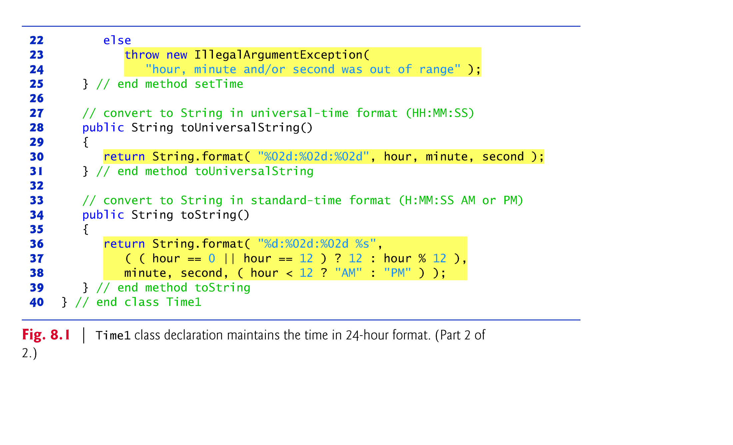

Slide 7
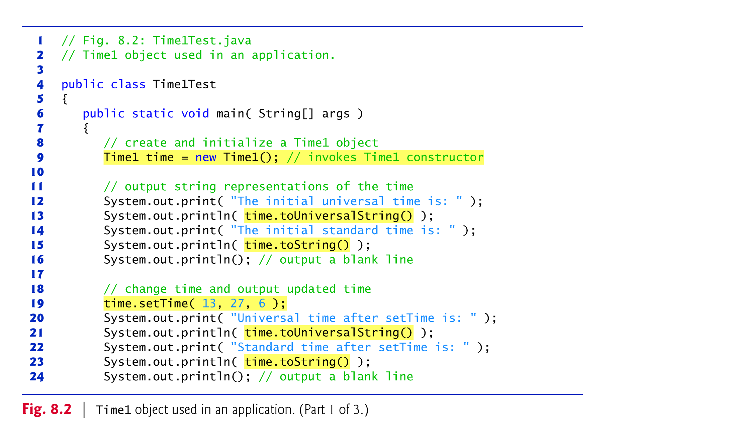
The client application
Fig. 8.2 (TimeTest.java)

Slide 8
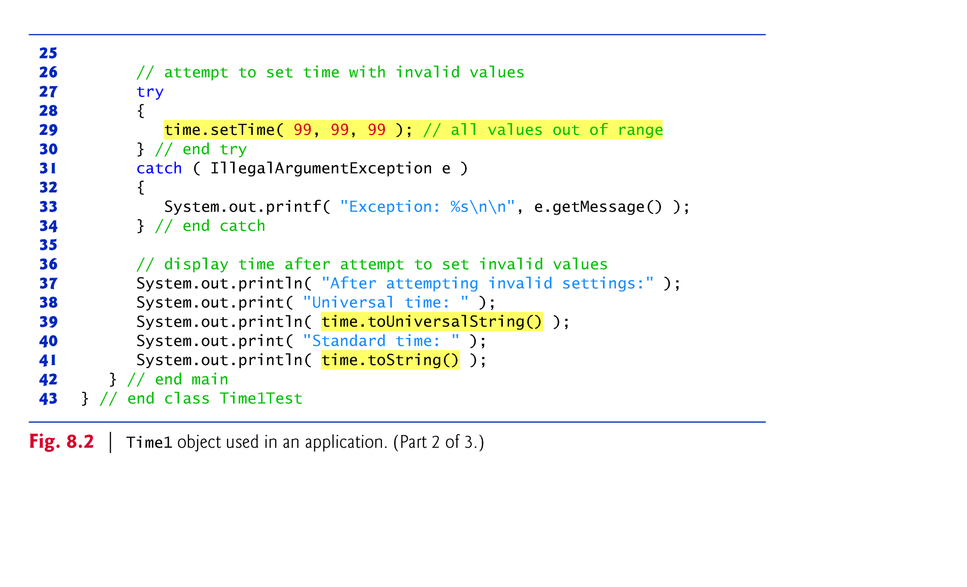
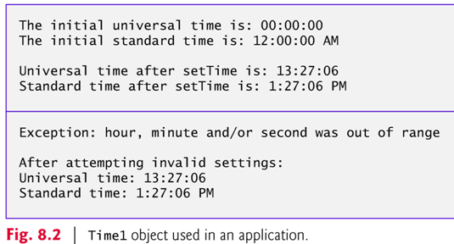
Exercise: Use a class diagram to show the design of this application (Time1, TimeTest, and their associations).

Slide 9
Class Time1 does not declare a constructor, so the class has a default constructor that is supplied by the compiler.
Each instance variable implicitly receives the default value 0 for an int.
  Instance variables also can be initialized when they are declared in the class body, using the same initialization syntax as with a local variable.
Public interface
  Method setTime (lines 12–25) declares three int parameters and uses them to set the time.
  Lines 15–16 test each argument to determine whether the value is in the proper range, and, if so, lines 18–20 assign the values to the hour, minute and second instance variables.

Slide 10
Method setTime() and Exception Handling
For incorrect values, setTime throws an exception of type IllegalArgumentException (lines 23–24)
  Notifies the client code that an invalid argument was passed to the method.
  The client can use try...catch to catch exceptions and attempt to recover from them.
  The throw statement (line 23) creates a new object of type IllegalArgumentException. In this case, we call the constructor that allows us to specify a custom error message.
  After the exception object is created, the throw statement immediately terminates method setTime and the exception is returned to the client code that attempted to set the time.

Slide 11
The principle of data hiding
  The instance variables hour, minute and second are each declared private.
  The actual data representation used within the class is of no concern to the class’s clients.
  Alternatively, Time1 may represent the time internally as the number of seconds since midnight or the number of minutes and seconds since midnight.
  When the actual/internal representations are changed, the clients could continue to use the same public methods/interface and get the same results without being aware of the changes.

Slide 12
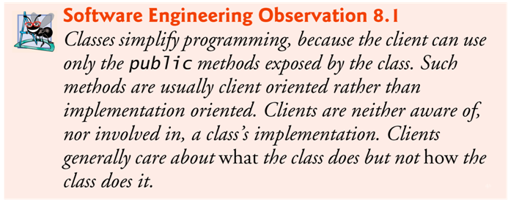
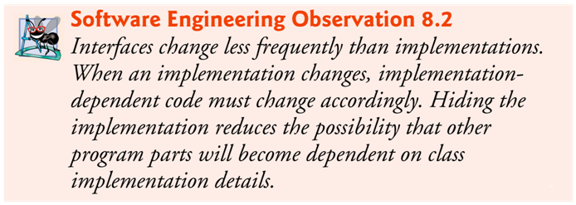

Slide 13
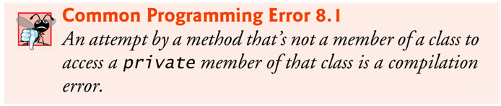
8.3 Controlling Access to Members
Access modifiers public and private control access to a class’s variables and methods.
public methods present to the class’s clients a view of the services the class provides (the class’s public interface).
Clients need not be concerned with how the class accomplishes its tasks.
  For this reason, the class’s private variables and private methods (i.e., its implementation details) are not accessible to its clients.
private class members are not accessible outside the class.
See http://download.oracle.com/javase/tutorial/java/javaOO/accesscontrol.html for complete discussion on access modifiers.

Slide 14
8.4 Referring to the Current Object’s Members with the this Reference
Every object can access a reference to itself with keyword this.
When a non-static method is called for a particular object, the method’s body implicitly uses keyword this to refer to the object’s instance variables and other methods.
  Enables the class’s code to know which object should be manipulated (especially when ambiguity is present).
  Can also use keyword this explicitly in a non-static method’s body.
If a method contains a local variable with the same name as a field, that method uses the local variable rather than the field.
    The local variable shadows the instance variable in the method’s scope.
A method can use the this reference to refer to the shadowed instance variable explicitly.
Example: Fig. 8.4

Slide 15
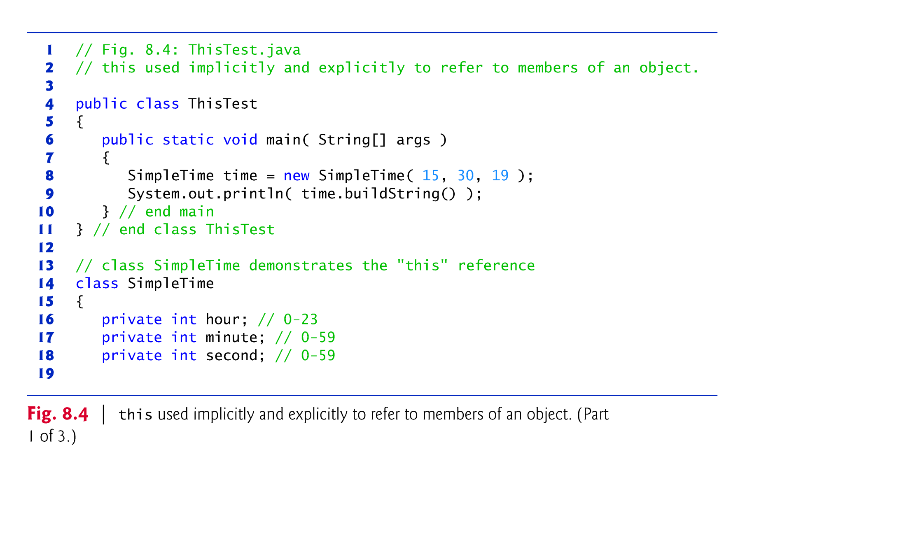

Slide 16
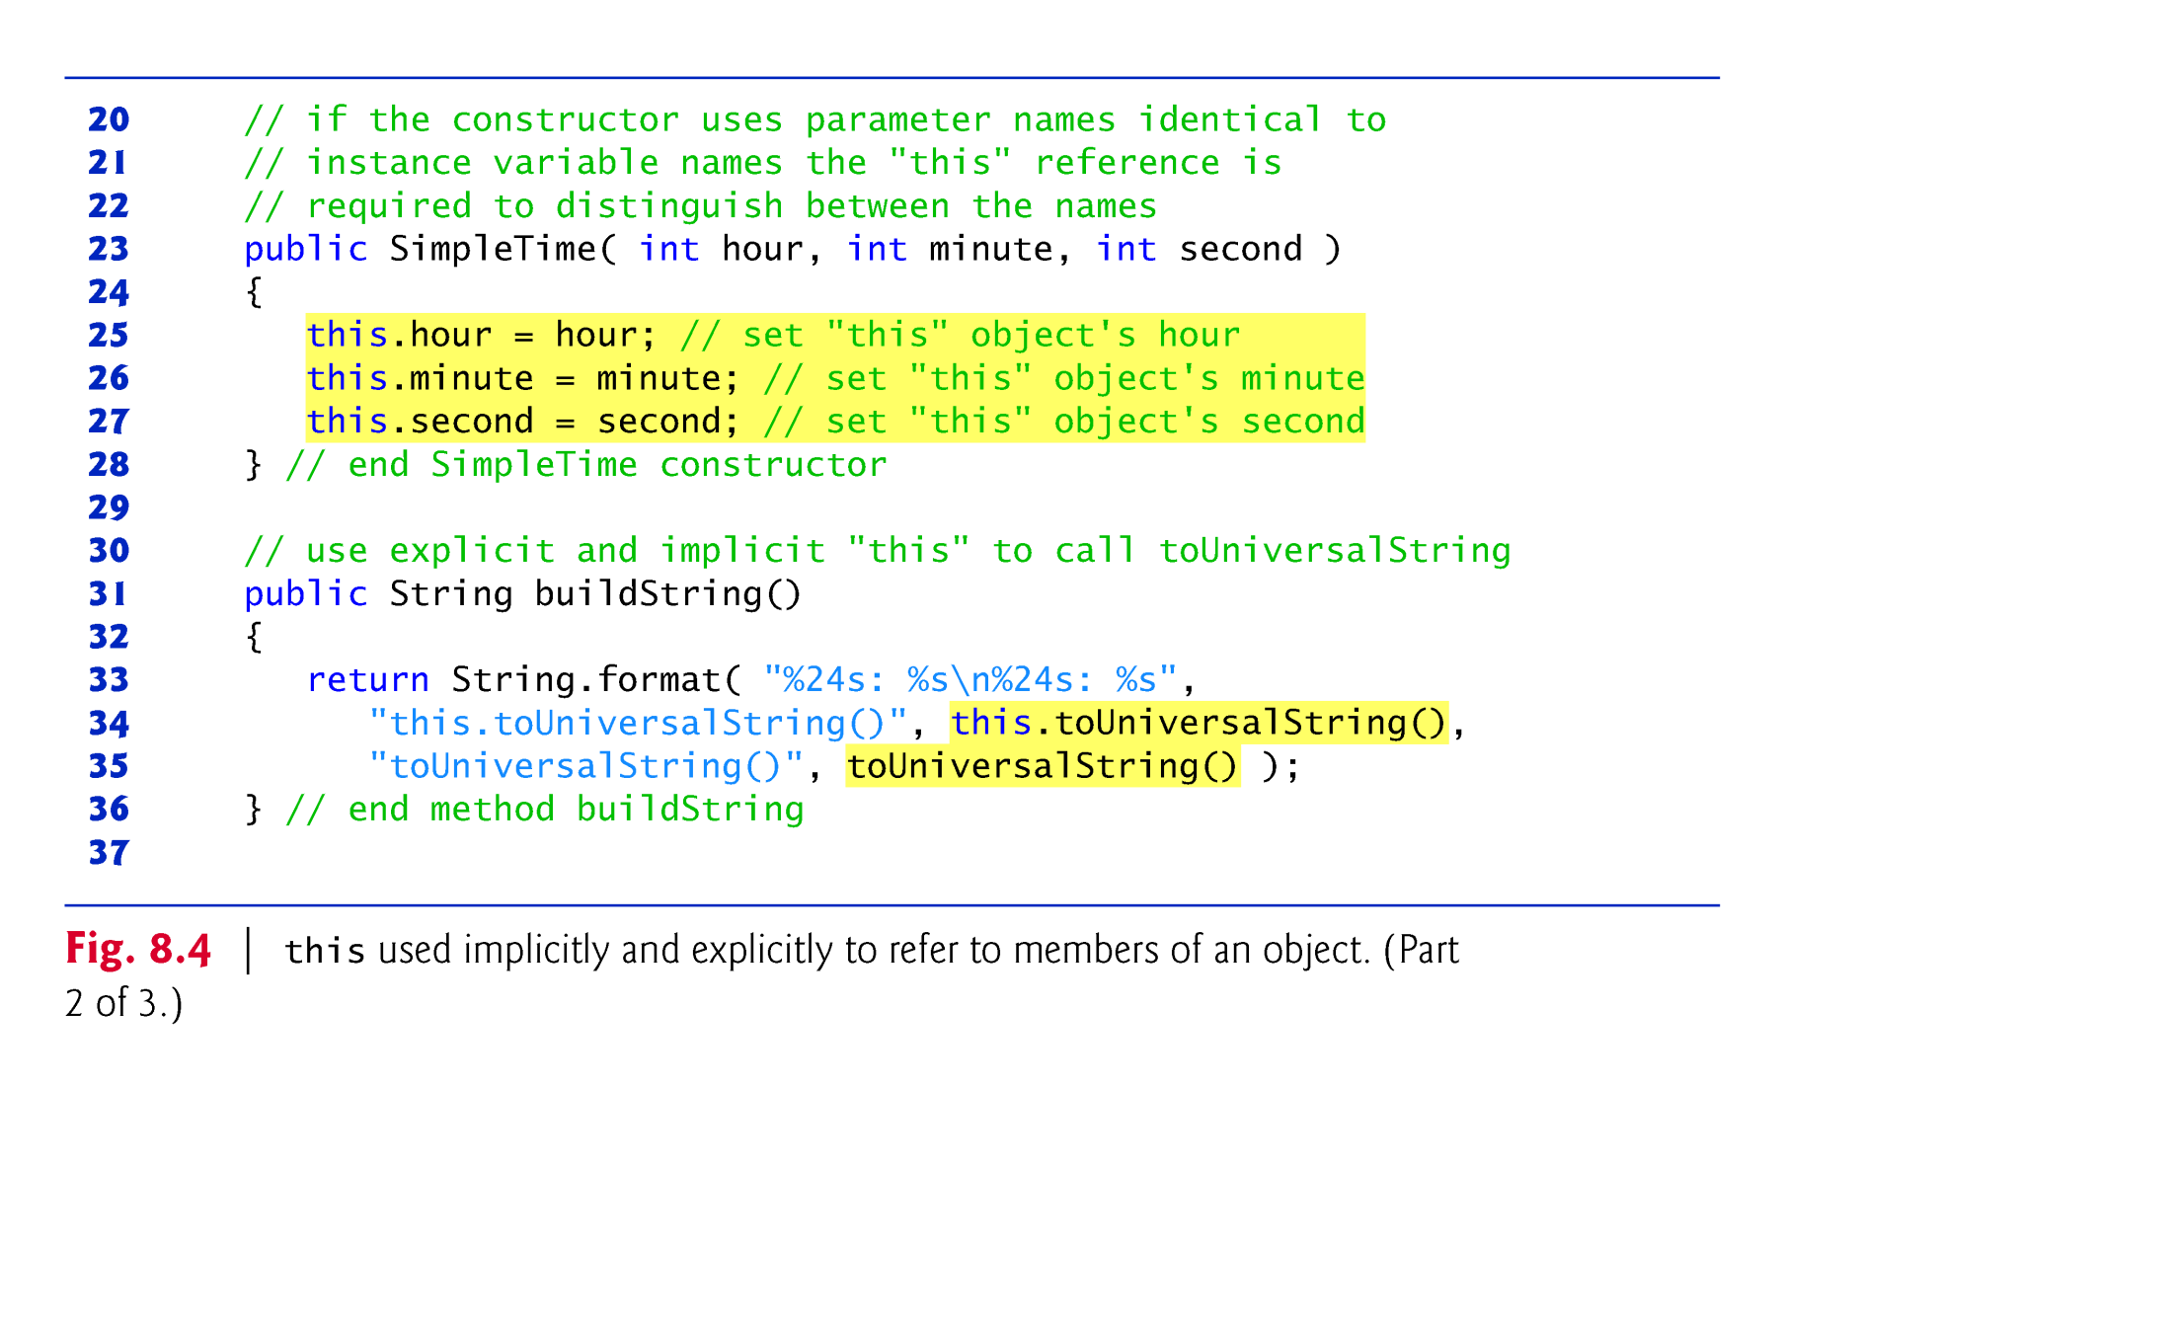
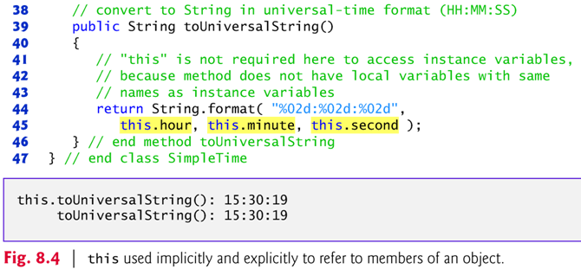

Slide 17
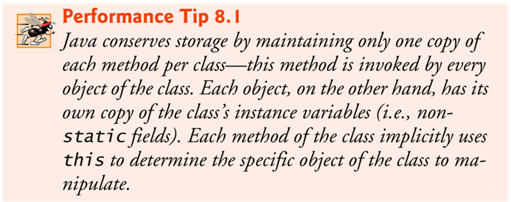

Slide 18
8.5 Overloaded Constructors
Overloaded constructors enable objects of a class to be initialized in different ways.
To overload constructors, simply provide multiple constructor declarations with different signatures.
The compiler differentiates signatures by
  the number of parameters,
  the types of the parameters and
  the order of the parameter types in each signature.

Slide 19
Class Time2 (Fig. 8.5) contains five overloaded constructors that provide convenient ways to initialize objects of the new class Time2.
The compiler invokes the appropriate constructor by matching the number, types and order of the types of the arguments specified in the constructor call with the number, types and order of the types of the parameters specified in each constructor declaration.

Slide 20
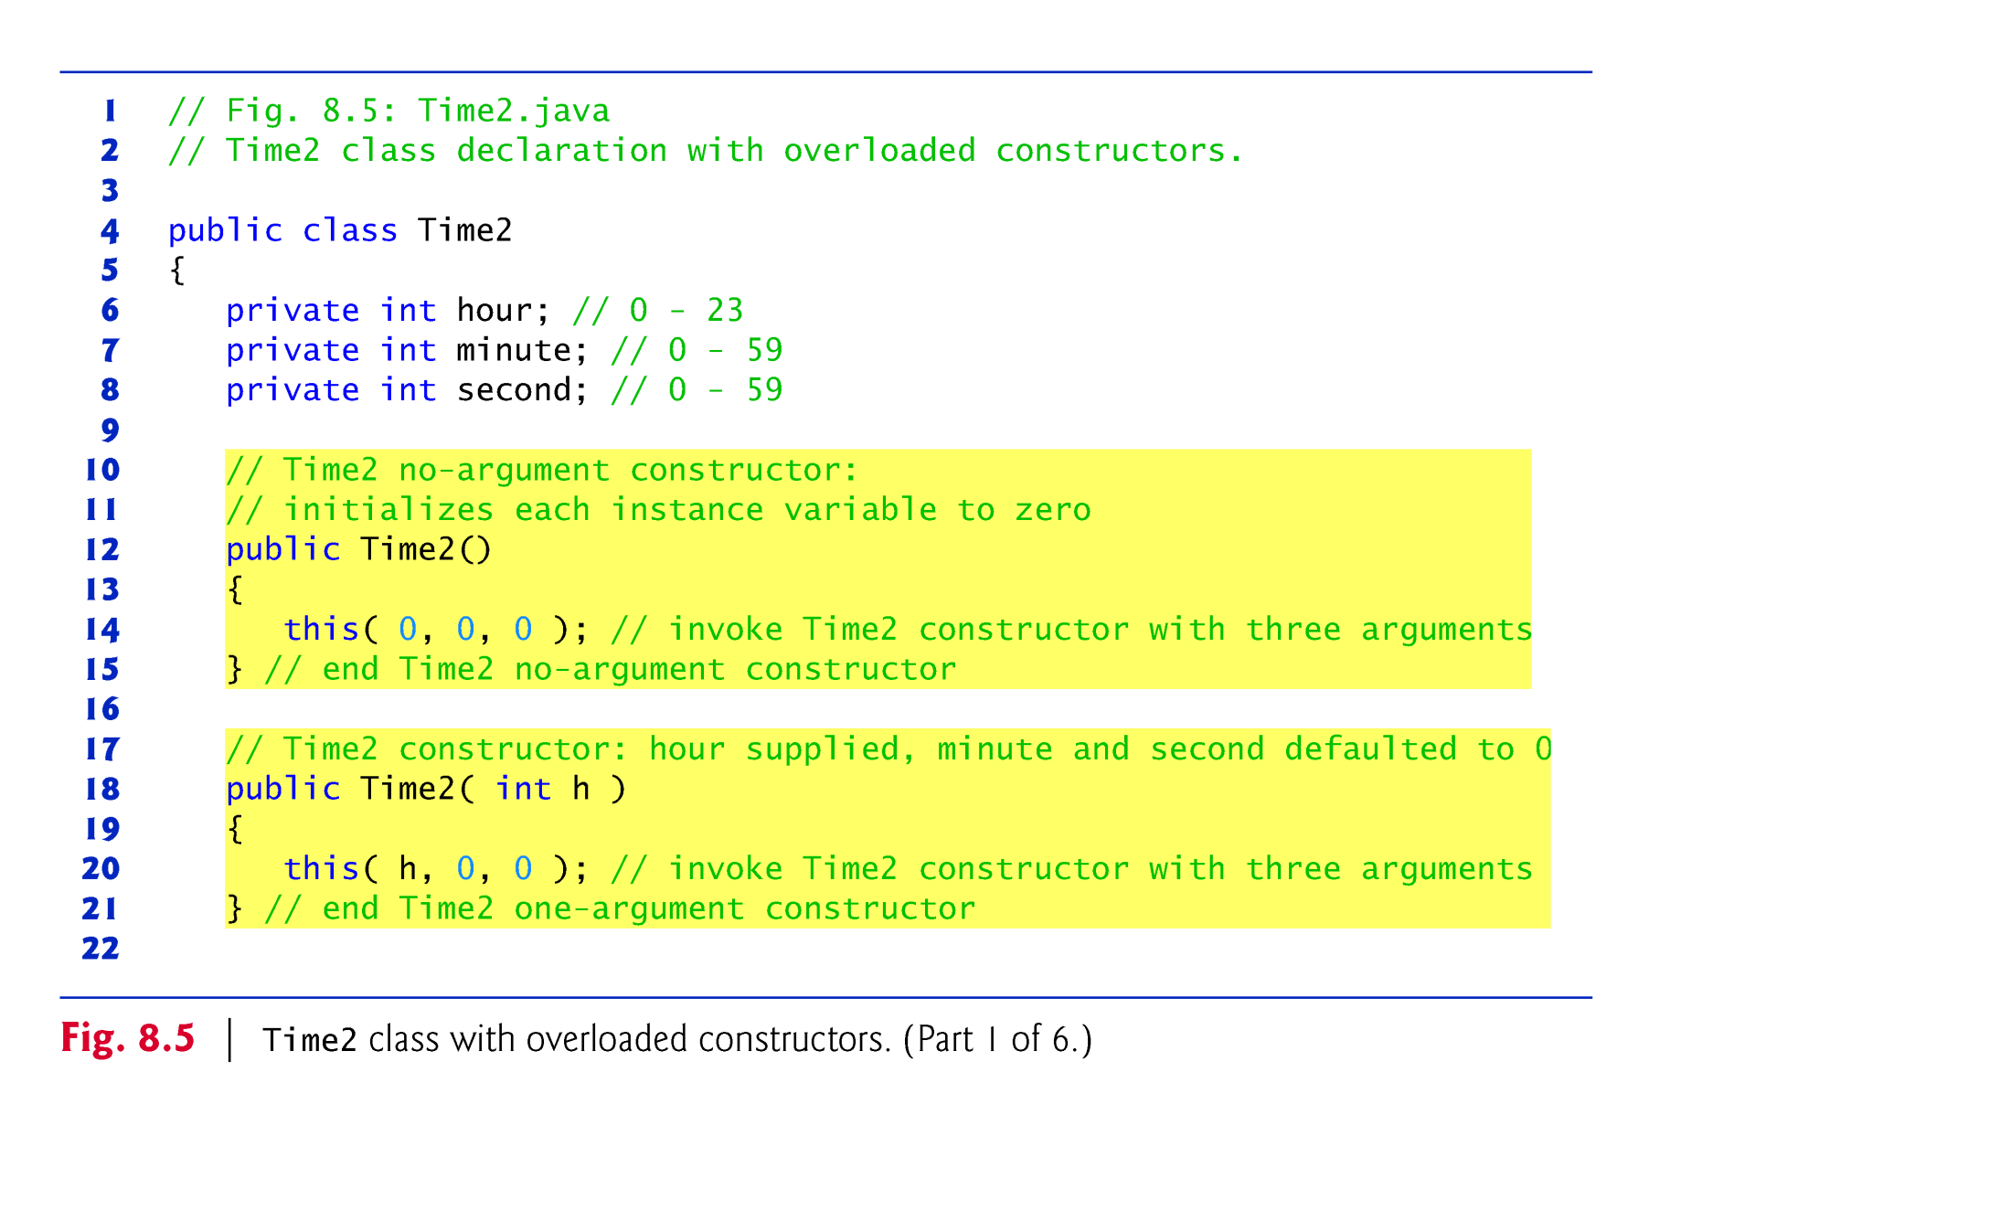

Slide 21
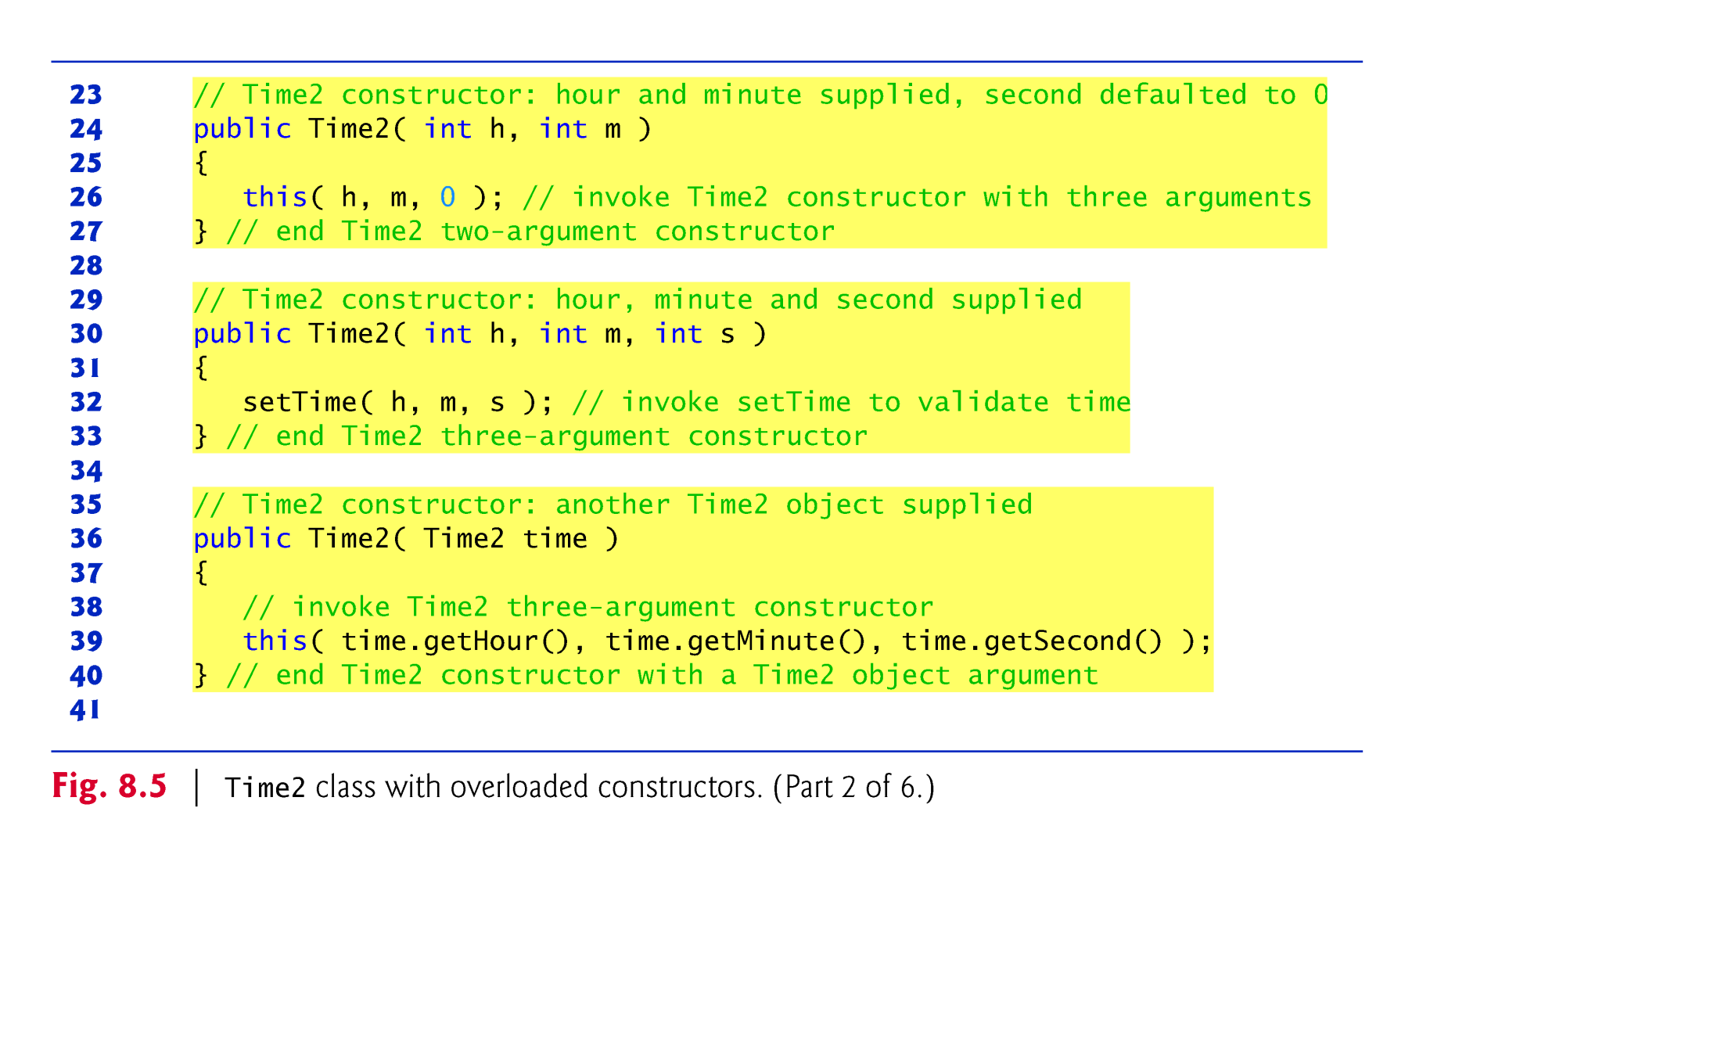

Slide 22
A program can declare a so-called no-argument constructor that is invoked without arguments.
  e.g., public Time2( )
  Such a constructor simply initializes the object as specified in the constructor’s body.
Using this in method-call syntax as the first statement in a constructor’s body invokes another constructor of the same class.
  Popular way to reuse initialization code provided by another of the class’s constructors rather than defining similar code in the no-argument constructor’s body.
Once you declare any constructors in a class, the compiler will not provide a default constructor.

Slide 23
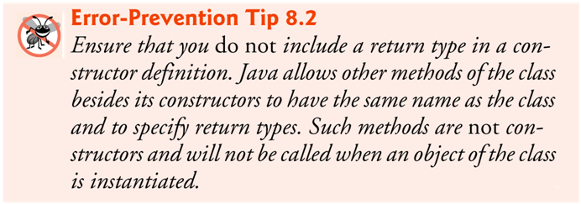

Slide 24
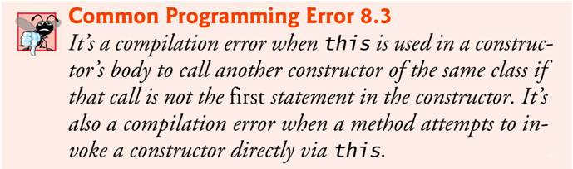
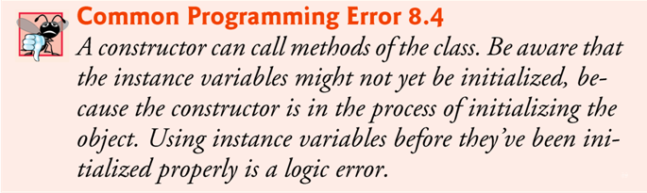

Slide 25
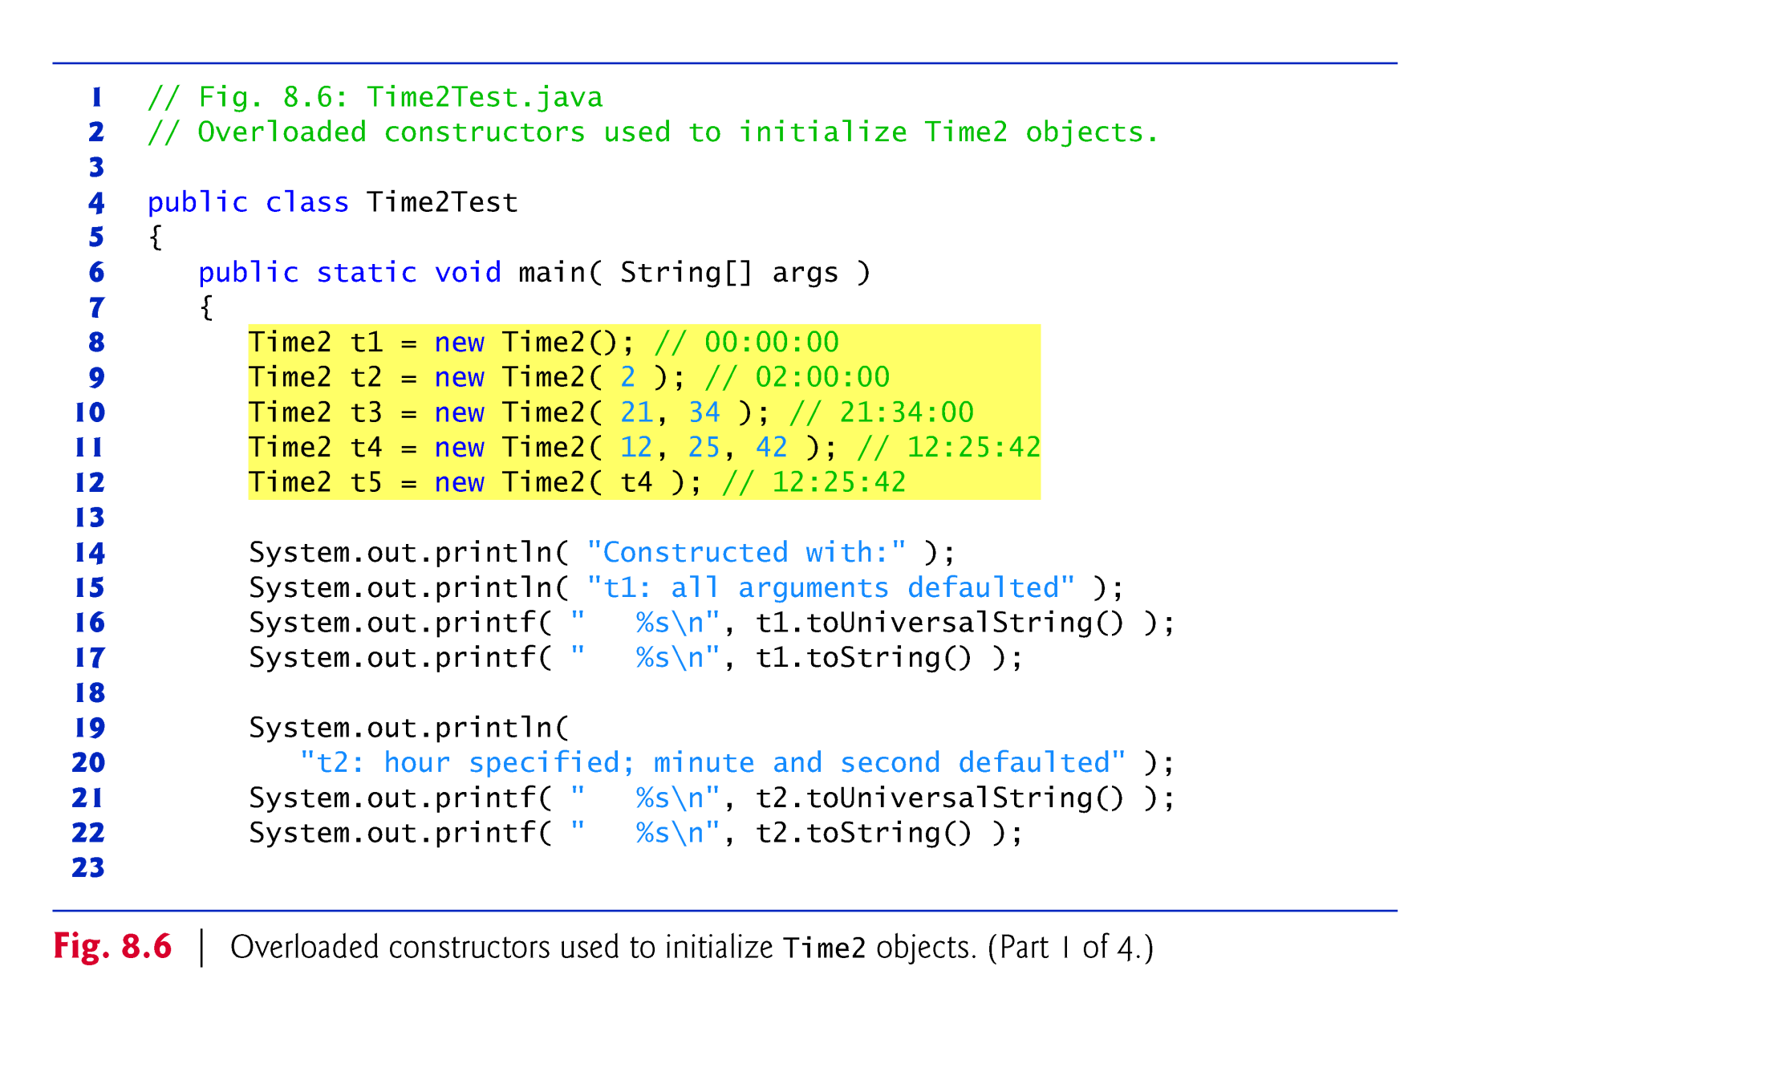
Fig. 8.6: Time2Test.java

Slide 26
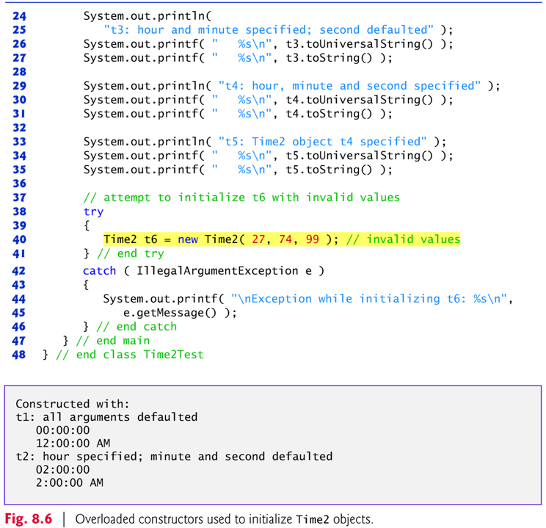

Slide 27
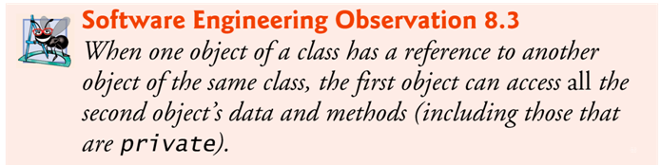
Q: How would we test whether this is true or not?
A: Create a sample Java application that has an object that references another object of the same class as itself.
But, what does that mean exactly?
At least two cases -
  Case 1: In the class definition of class A, there exists an instance variable of type class A.
  Case 2: One of the methods in class A has a local variable of type class A.

Slide 28
Sample application
  (in http://sce.uhcl.edu/yang/teaching/JavaProgrammingExamplesandRelatedTopics.htm#OOP)
  AccessModifiersAndPackages.htm
  // test access modifiers of instance variables and classes of the same package
  A package in Java’s class hierarchy is a folder of related Java classes.
Exercise: Run the sample application and examine the source codes and the output. Determine whether Observation 8.3 (above) is true or false.

Slide 29
8.7 Notes on Set and Get Methods
Classes often provide public methods to allow clients of the class to set (i.e., assign values to) or get (i.e., obtain the values of) private instance variables.
Set methods are also commonly called mutator methods, because they typically change an object’s state—i.e., modify the values of instance variables.
Get methods are also commonly called accessor methods or query methods.

Slide 30
It would seem that providing set and get capabilities is essentially the same as making the instance variables public.
  A public instance variable can be read or written by any method that has a reference to an object that contains that variable.
  If an instance variable is declared private, a public get method certainly allows other methods to access it, but the get method can control how the client can access it.
  A public set method can—and should—carefully scrutinize at-tempts to modify the variable’s value to ensure valid values.
Although set and get methods provide access to private data, it is restricted by the implementation of the methods.

Slide 31
Validity Checking in Set Methods
  The benefits of data integrity do not follow automatically simply because instance variables are declared private
  — you must provide validity checking.
Predicate Methods
  Another common use for accessor methods is to test whether a condition is true or false — such methods are often called predicate methods.
  Example: ArrayList’s isEmpty() method, which returns true if the ArrayList is empty.

Slide 32
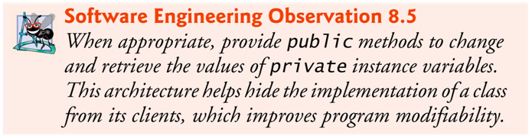

Slide 33
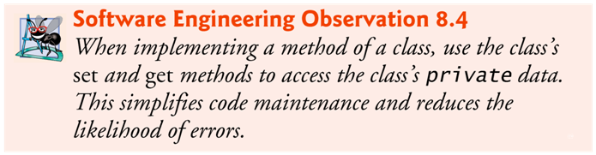
A few words about software maintenance
When developing a software, try your best to reduce future software maintenance overhead.
  How much change would a single change invoke ?
Two rules of thumb (next slide)

Slide 34
Rule #1:
  Member methods of a class can access the class’s private data directly without calling the set and get methods; however, it is highly recommended that only the set and get methods, and no other methods, directly access the private data of a class.
Reason?
  Consider changing the representation of the time from three int values (requiring 12 bytes of memory) to a single int value representing the total number of seconds that have elapsed since midnight (requiring only 4 bytes of memory).
  If we made such a change, only the bodies of the methods that access the private data directly would need to change — in particular, the individual set and get methods for the hour, minute and second.
  There would be no need to modify the bodies of other methods (setTime, toUniversalString or toString) because they do not access the data directly.
  Designing the class in this manner reduces the likelihood of programming errors when altering the class’s implementation.

Slide 35
Rule #2:
It is highly recommended that the constructors do not directly call methods like setHour( ), setMinute( ) and setSecond( ).
Reason?
  (Continued from Rule #1) Duplicating statements in multiple methods or constructors makes changing the class’s internal data representation more difficult.
  Having the Time2 constructors call the constructor with three arguments (or even call setTime() directly) ensures that any changes to the implementation of setTime() will only be made once (rather than in multiple methods).

Slide 36
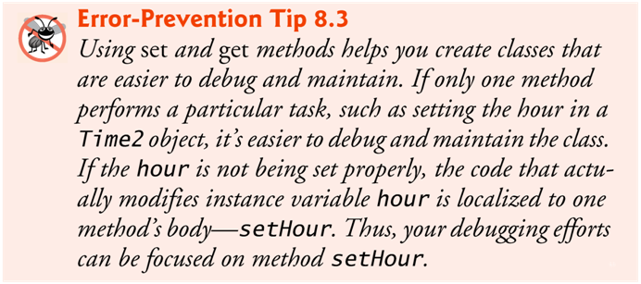

Slide 37
8.8 Composition
A class (say, class A) can have references to objects of other classes (e.g., class B) as members.
This is called composition and is sometimes referred to as a has-a relationship.
  e.g., Class A has an object of type Class B.
  Or Class A is composed of objects of Class B and …
Example: An AlarmClock object needs to know the current time and the time when it’s supposed to sound its alarm, so it’s reasonable to include two references to Time objects in an AlarmClock object.

Slide 38
8.9 Enumerations
The basic enum type defines a set of constants represented as unique identifiers.
Like classes, all enum types are reference types.
An enum type is declared with an enum declaration, which is a comma-separated list of enum constants
The declaration may optionally include other components of traditional classes, such as constructors, fields and methods.

Slide 39
Each enum declaration declares an enum class with the following restrictions:
  enum constants are implicitly final, because they declare constants that shouldn’t be modified.
  enum constants are implicitly static.
  Any attempt to create an object of an enum type with operator new results in a compilation error.
  enum constants can be used anywhere constants can be used, such as in the case labels of switch statements and to control enhanced for statements.
  enum declarations contain two parts — the enum constants and the other members of the enum type.
  An enum constructor can specify any number of parameters and can be overloaded.
For every enum, the compiler generates the static method values that returns an array of the enum’s constants.
When an enum constant is converted to a String, the constant’s identifier is used as the String representation.

Slide 40
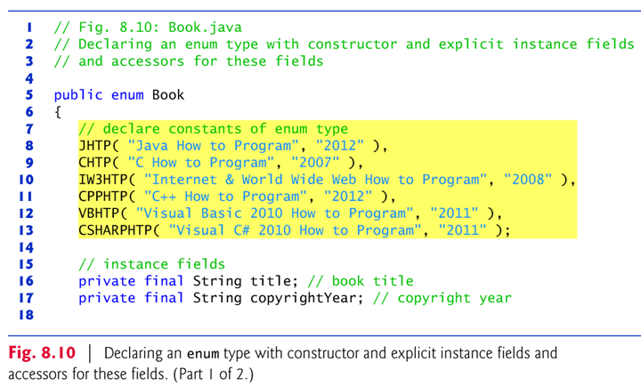
Sample application with enum type
  Fig. 8.10: Book.java

Slide 41
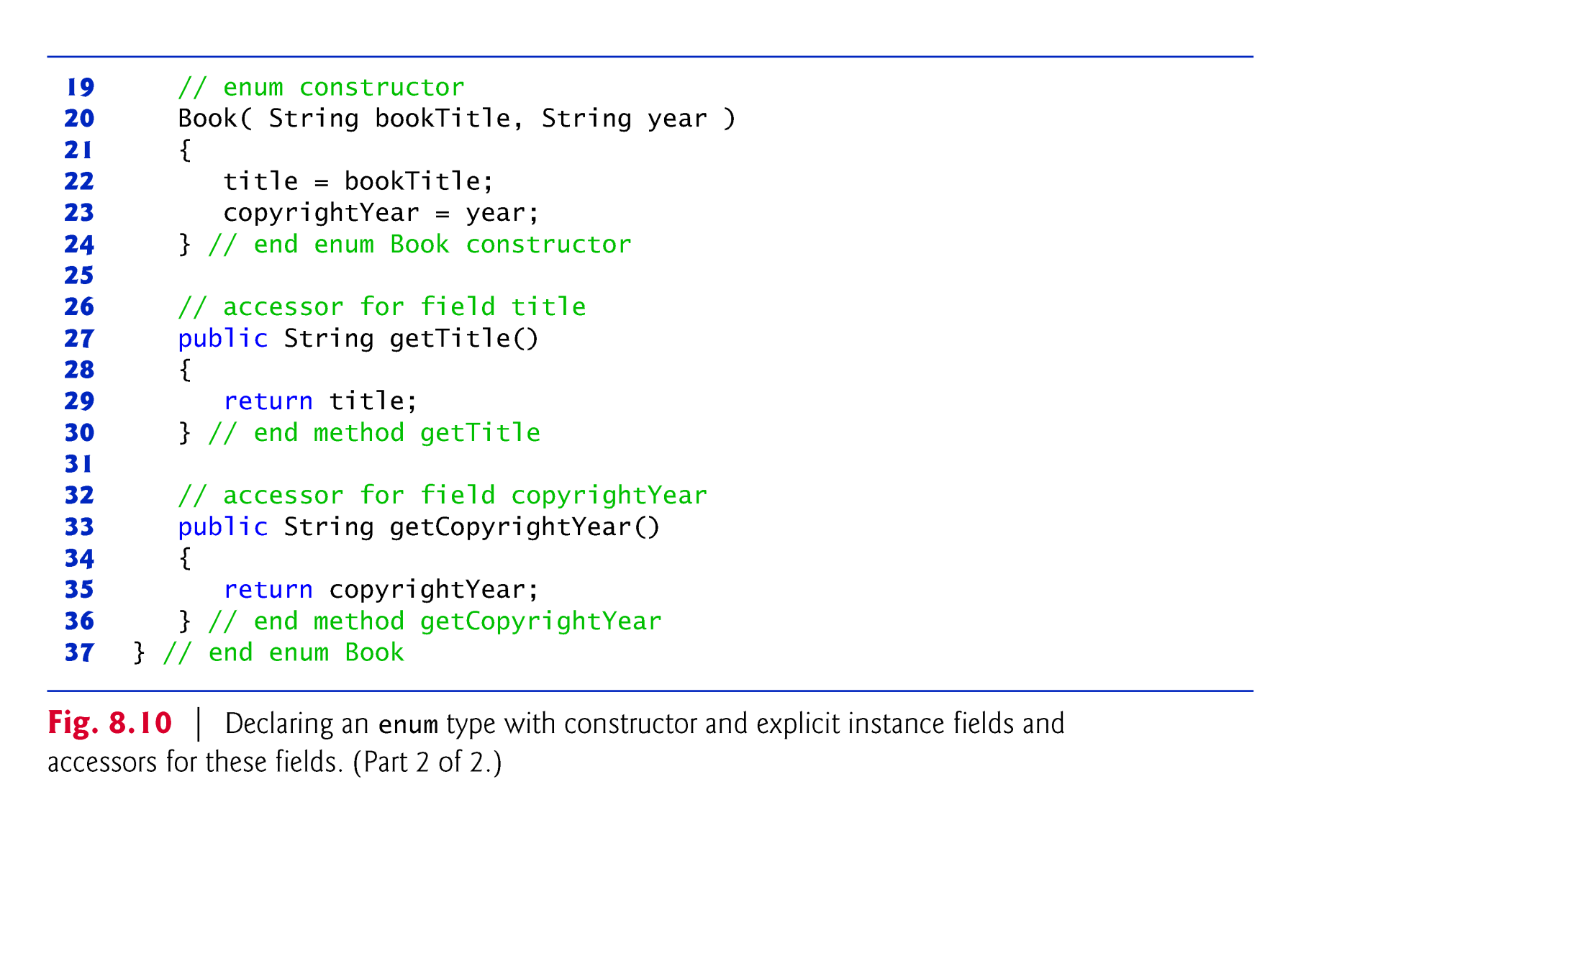

Slide 42
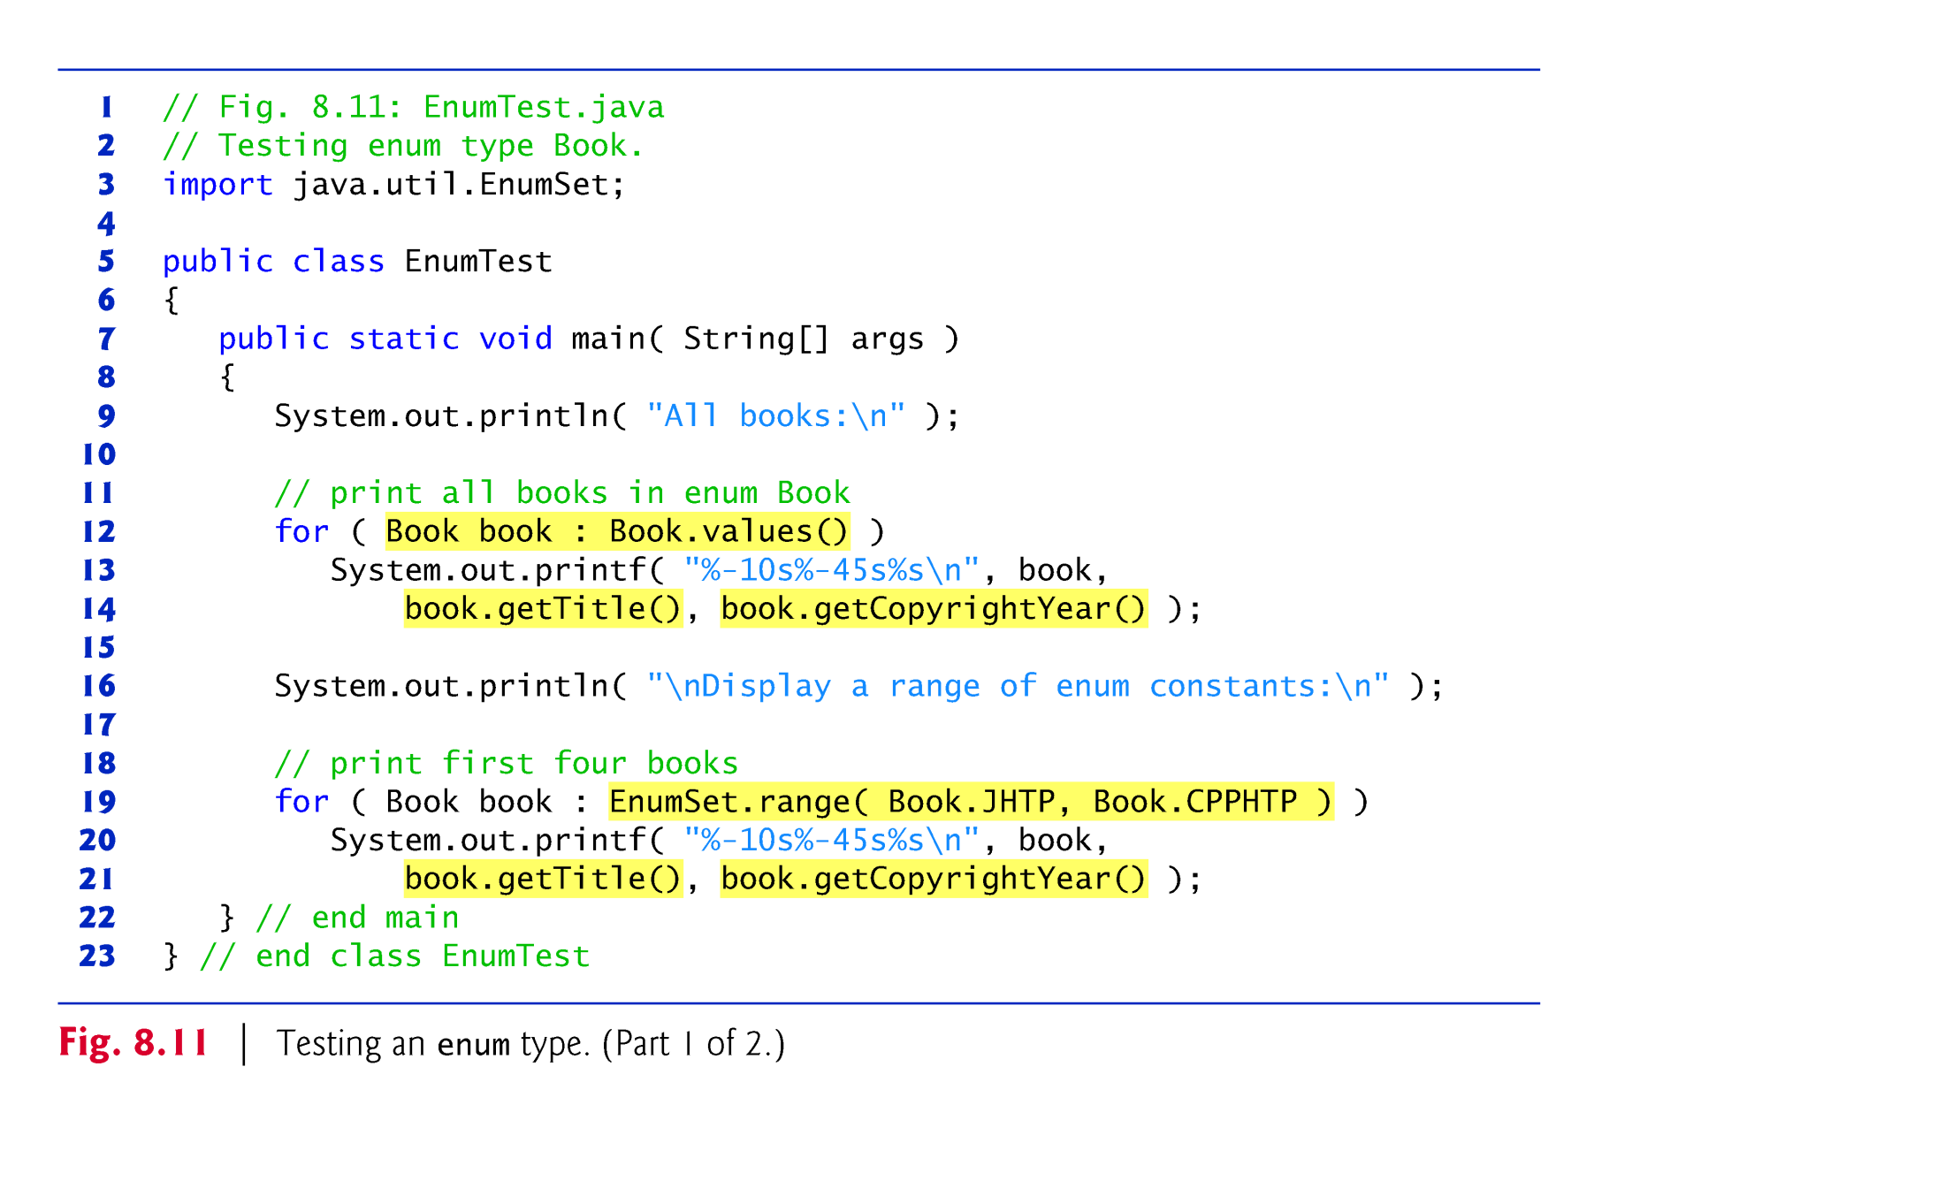
  Fig. 8.11: EnumTest.java

Slide 43
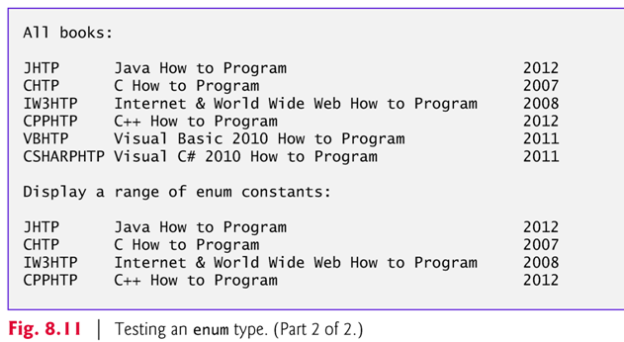
Exercise: Modify the program to display only books published after 2010.

Slide 44
8.11 static Class Members
In certain cases, only one copy of a particular variable should be shared by all objects of a class.
  A static field — called a class variable — is used in such cases.
A static variable represents classwide information — all objects of the class share the same piece of data.
  The declaration of a static variable begins with the keyword static.
Static variables have class scope.
  A class’s public static members can be accessed through a reference to any object of the class, or by qualifying the member name with the class name and a dot (.), as in Math.random().
  A class’s private static class members can be accessed by client codes only through methods of the class.

Slide 45
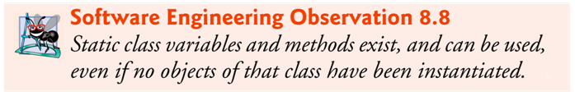
static class members are available as soon as the class is loaded into memory at execution time.
To access a public static member when no objects of the class exist (and even when they do), prefix the class name and a dot (.) to the static member, as in Math.PI.
To access a private static member when no objects of the class exist, provide a public static method and call it by qualifying its name with the class name and a dot.

Slide 46
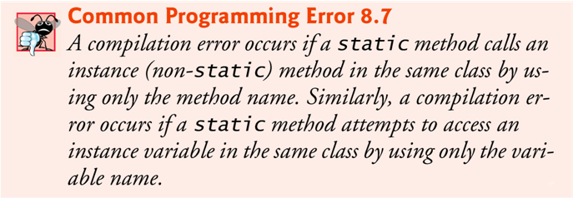
A static method cannot access non-static class members, because a static method can be called even when no objects of the class have been instantiated.
  For the same reason, the this reference cannot be used in a static method.
  The this reference must refer to a specific object of the class, and when a static method is called, there might not be any objects of its class in memory.

Slide 47
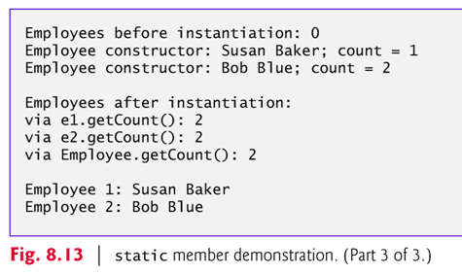
A sample application demonstrating static class variables:
  Fig. 8.12 (Employee.java) and 8.13

Slide 48
8.13 final Instance Variables
The principle of least privilege:
  Code should be granted only the amount of privilege and access that it needs to accomplish its designated task, but no more.
  Makes your programs more robust by preventing code from accidentally (or maliciously) modifying variable values and calling methods that should not be accessible.
Keyword final specifies that a variable is not modifiable (i.e., it’s a constant) and any attempt to modify it is an error.
    private final int INCREMENT;
  Declares a final (constant) instance variable INCREMENT of type int.

Slide 49
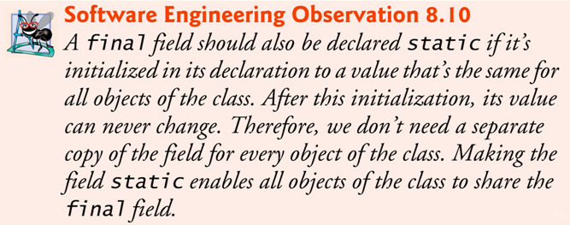
final variables can be initialized when they are declared or by each of the class’s constructors so that each object of the class has a different value.
If a class provides multiple constructors, every one would be required to initialize each final variable.
A final variable cannot be modified by assignment after it is initialized.
If a final variable is not initialized, a compilation error occurs.

Slide 50
8.14 Packages
Each class in the Java API belongs to a package that contains a group of related classes.
Packages are defined once, but can be imported into many programs.
Packages help programmers manage the complexity of application components.
Packages facilitate software reuse by enabling programs to import classes from other packages, rather than copying the classes into each program that uses them.
Packages provide a convention for unique class names, which helps prevent class-name conflicts. (It is ok to have classes with the same name, as long as they are in different packages.)

Slide 51
The steps for creating a reusable class:
  Declare a public class; otherwise, it can be used only by other classes in the same package.
  Choose a unique package name and add a package declaration to the source-code file for the reusable class declaration.
    In each Java source-code file there can be only one package declaration, and it must precede all other declarations and statements.
  Compile the class so that it’s placed in the appropriate package directory.
  Import the reusable class into a program and use the class.

Slide 52
Placing a package declaration at the beginning of a Java source file indicates that the class declared in the file is part of the specified package.
Only package declarations, import declarations and comments can appear outside the braces of a class declaration.
A Java source-code file must have the following order:
  a package declaration (if any),
  import declarations (if any), then
  class declarations.
Only one of the class declarations in a particular file can be public.
  Other classes in the file are non-public classes.
  They are placed in the package and can be used only by the other classes in the package.
  Non-public classes are in a package to support the reusable classes in that package.

Slide 53
A simple Java application that demonstrates how to use packages:
  http://sce.uhcl.edu/yang/teaching/JavaPackages.htm
Another example: Fig. 8.15
Note: The directory names in the package declaration specify the exact location of the classes in the package.
For example:
  The package declaration in Time1.java
      package com.deitel.jhtp.ch08;
  indicates that class Time1 should be placed in the directory
      com
      deitel
      jhtp
      ch08

Slide 54
javac command-line option -d causes the javac compiler to create appropriate directories based on the class’s package declaration.
  The option also specifies where the directories should be stored.
Example:
    javac -d . Time1.java
specifies that the first directory in our package name should be placed in the current directory (.).
The compiled classes are placed into the directory that is named last in the package statement.

Slide 55
The package name is part of the fully qualified class name.
  Class Time1’s name is actually com.deitel.jhtp.ch08.Time1
Can use the fully qualified name in programs, or import the class and use its simple name (the class name by itself).
If another package contains a class by the same name, the fully qualified class names can be used to distinguish between the classes in the program and prevent a name conflict (also called a name collision).

Slide 56
Specifying the Classpath During Compilation
  When compiling a class that uses classes from other packages, javac must locate the .class files for all other classes being used.
  The compiler uses a special object called a class loader to locate the classes it needs.
    The class loader begins by searching the standard Java classes that are bundled with the JDK.
    Then it searches for optional packages.
    If the class is not found in the standard Java classes or in the extension classes, the class loader searches the classpath, which contains a list of locations in which classes are stored.

Slide 57
The classpath consists of a list of directories or archive files, each separated by a directory separator
  Semicolon (;) on Windows or a colon (:) on UNIX/Linux/Mac OS X.
Archive files are individual files that contain directories of other files, typically in a compressed format.
  Archive files normally end with the .jar or .zip file-name extensions.
The directories and archive files specified in the classpath contain the classes you wish to make available to the Java compiler and the JVM.
The classpath can be modified by
  providing the -classpath option to the javac compiler
  setting the CLASSPATH environment variable.

Slide 58
By default, the classpath consists only of the current directory.
The classpath can be modified by
  providing the -classpath option to the javac compiler
  setting the CLASSPATH environment variable (not recommended).
Classpath
    download.oracle.com/javase/6/docs/technotes/tools/index.html#genera
  The section entitled “General Information” contains information on setting the classpath for UNIX/Linux and Windows.

Slide 59
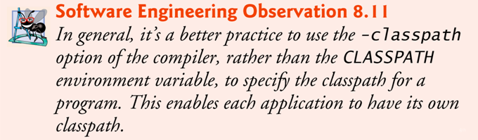
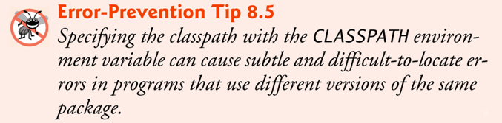

Slide 60
Specifying the Classpath
When Executing an Application
When you execute an application, the JVM must be able to locate the .class files of the classes used in that application.
Like the compiler, the java command uses a class loader that searches the standard classes and extension classes first, then searches the classpath (the current directory by default).
The classpath can be specified explicitly by using either of the techniques discussed for the compiler.
As with the compiler, it is better to specify an individual program’s classpath via command-line JVM options.
  If classes must be loaded from the current directory, be sure to include a dot (.) in the classpath to specify the current directory.

Slide 61
If no access modifier is specified for a method or variable when it’s declared in a class, the method or variable is considered as package-private (or package access).
In a program uses multiple classes from the same package, these classes can access each other’s package-access members directly through references to objects of the appropriate classes, or in the case of static members through the class name.
Package access is rarely used.
Example program: Fig. 8.17

Slide 62
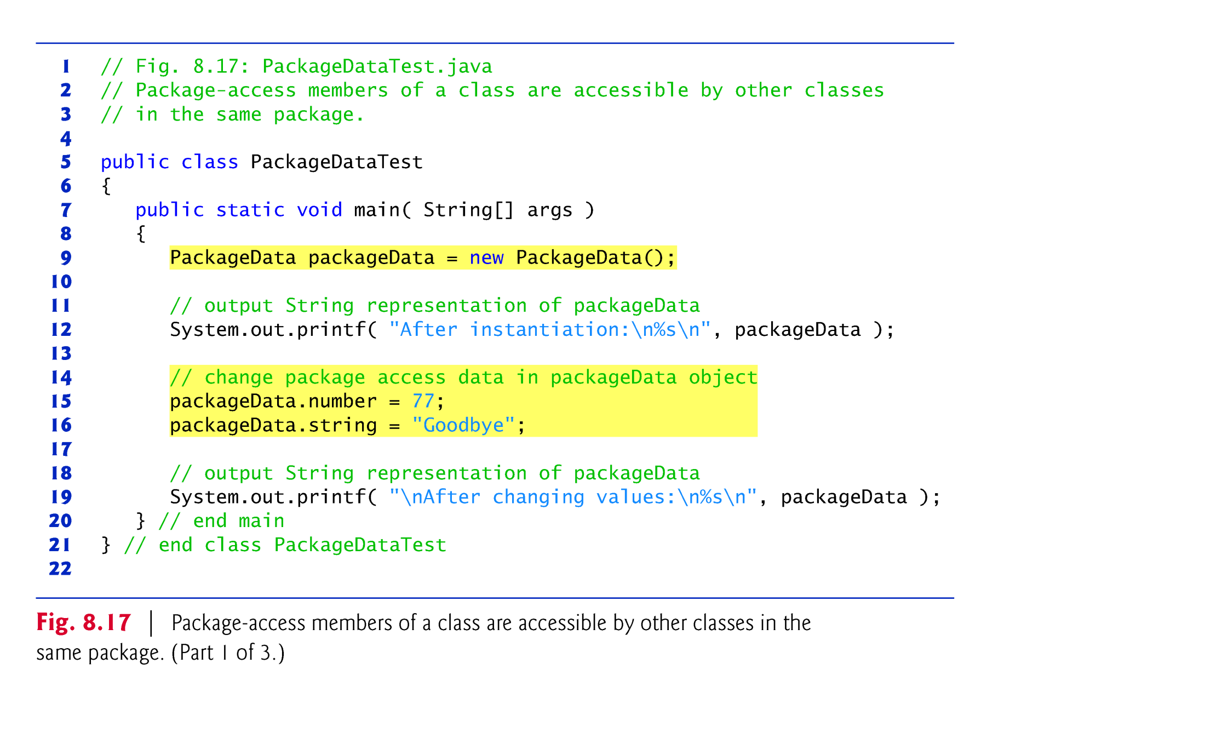

Slide 63
