Slide 1
Arrays
(part 2)
Based on slides from Deitel & Associates, Inc.
Revised by T. A. Yang

Slide 2
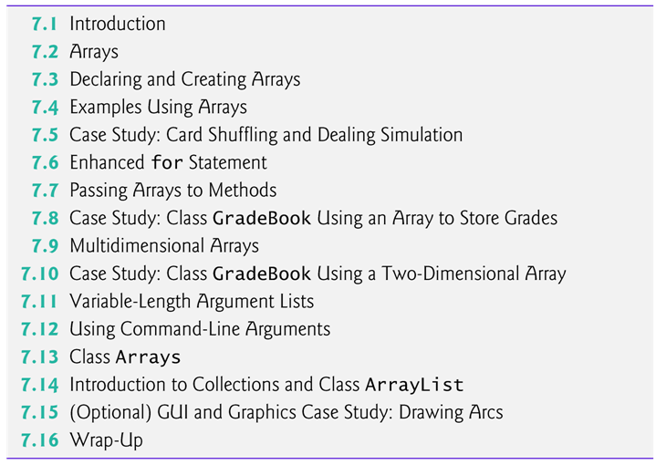

Slide 3
7.9 Multidimensional Arrays
Two-dimensional arrays are often used to represent tables of values consisting of information arranged in rows and columns.
Identify a particular table element with two indices.
  By convention, the first identifies the element’s row and the second its column.
Multidimensional arrays can have more than two dimensions.
Java does not support multidimensional arrays directly
  Allows you to specify one-dimensional arrays whose elements are also one-dimensional arrays, thus achieving the same effect.
In general, an array with m rows and n columns is called an m-by-n array.

Slide 4
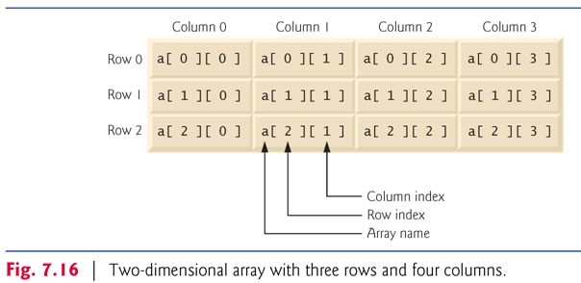

Slide 5
Multidimensional arrays can be initialized with array initializers in declarations.
A two-dimensional array b with two rows and two columns could be declared and initialized with nested array initializers as follows:
    int[][] b = { { 1, 2 }, { 3, 4 } };
  The initial values are grouped by row in braces.
  The number of nested array initializers (represented by sets of braces within the outer braces) determines the number of rows.
  The number of initializer values in the nested array initializer for a row determines the number of columns in that row.
  Rows can have different lengths.

Slide 6
The lengths of the rows in a two-dimensional array are not required to be the same:
    int[][] b = { { 1, 2 }, { 3, 4, 5 } };
  Each element of b is a reference to a one-dimensional array of int variables.
  The int array for row 0 is a one-dimensional array with two elements (1 and 2).
  The int array for row 1 is a one-dimensional array with three elements (3, 4 and 5).

Slide 7
A multidimensional array with the same number of columns in every row can be created with an array-creation expression.
    int[][] b = new int[ 3 ][ 4 ];
  3 rows and 4 columns.
The elements of a multidimensional array are initialized when the array object is created.
A multidimensional array in which each row has a different number of columns can be created as follows:
    int[][] b = new int[ 2 ][ ]; // create 2 rows
    b[ 0 ] = new int[ 5 ]; // create 5 columns for row 0
    b[ 1 ] = new int[ 3 ]; // create 3 columns for row 1
  Creates a two-dimensional array with two rows.
  Row 0 has five columns, and row 1 has three columns.

Slide 8
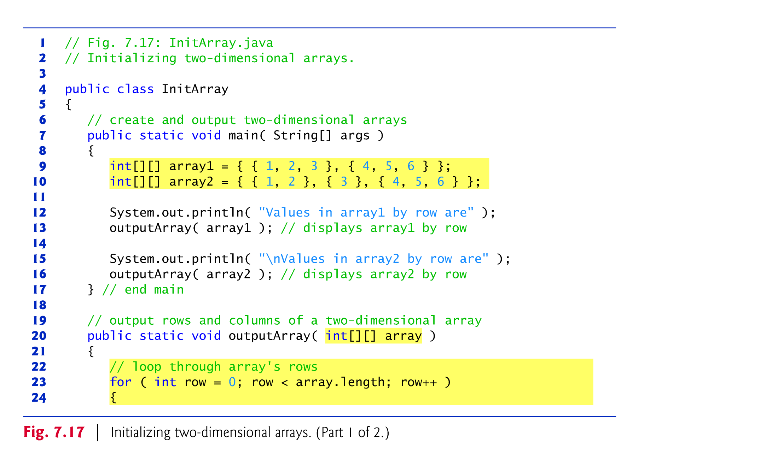
Figure 7.17 demonstrates initializing two-dimensional arrays with array initializers and using nested for loops to traverse the arrays.

Slide 9
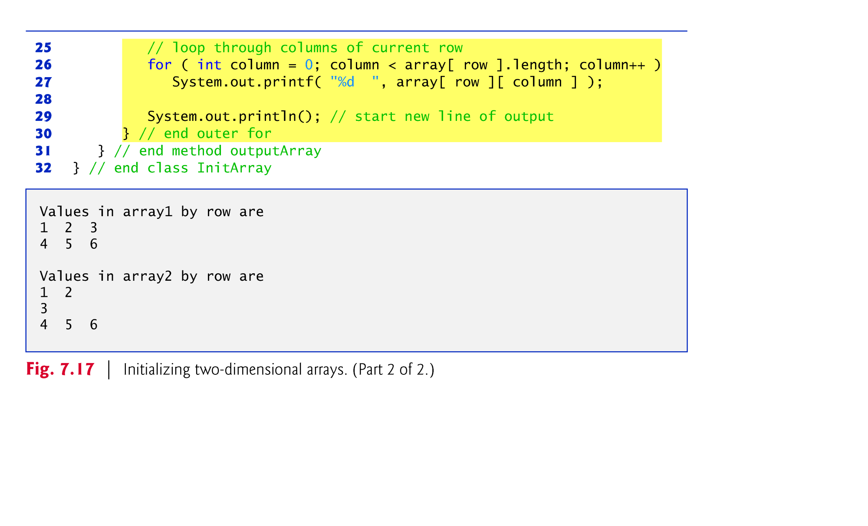

Slide 10
Exercise: Consider the two array declarations below. What are their respective trade-offs?
Approach 1:
    int[][] b = new int[ 2 ][ 5 ];
Approach 2:
    int[][] b = new int[ 2 ][ ]; // create 2 rows
    b[ 0 ] = new int[ 5 ]; // create 5 columns for row 0
    b[ 1 ] = new int[ 3 ]; // create 3 columns for row 1

Slide 11
7.11 Variable-Length Argument Lists
Variable-length argument lists
  Can be used to create methods that receive an unspecified number of arguments.
  Parameter type followed by an ellipsis (...) indicates that the method receives a variable number of arguments of that particular type.
  The ellipsis can occur only once at the end of a parameter list.
  The formal parameter is implicitly converted into an array, and can be used as such.

Slide 12
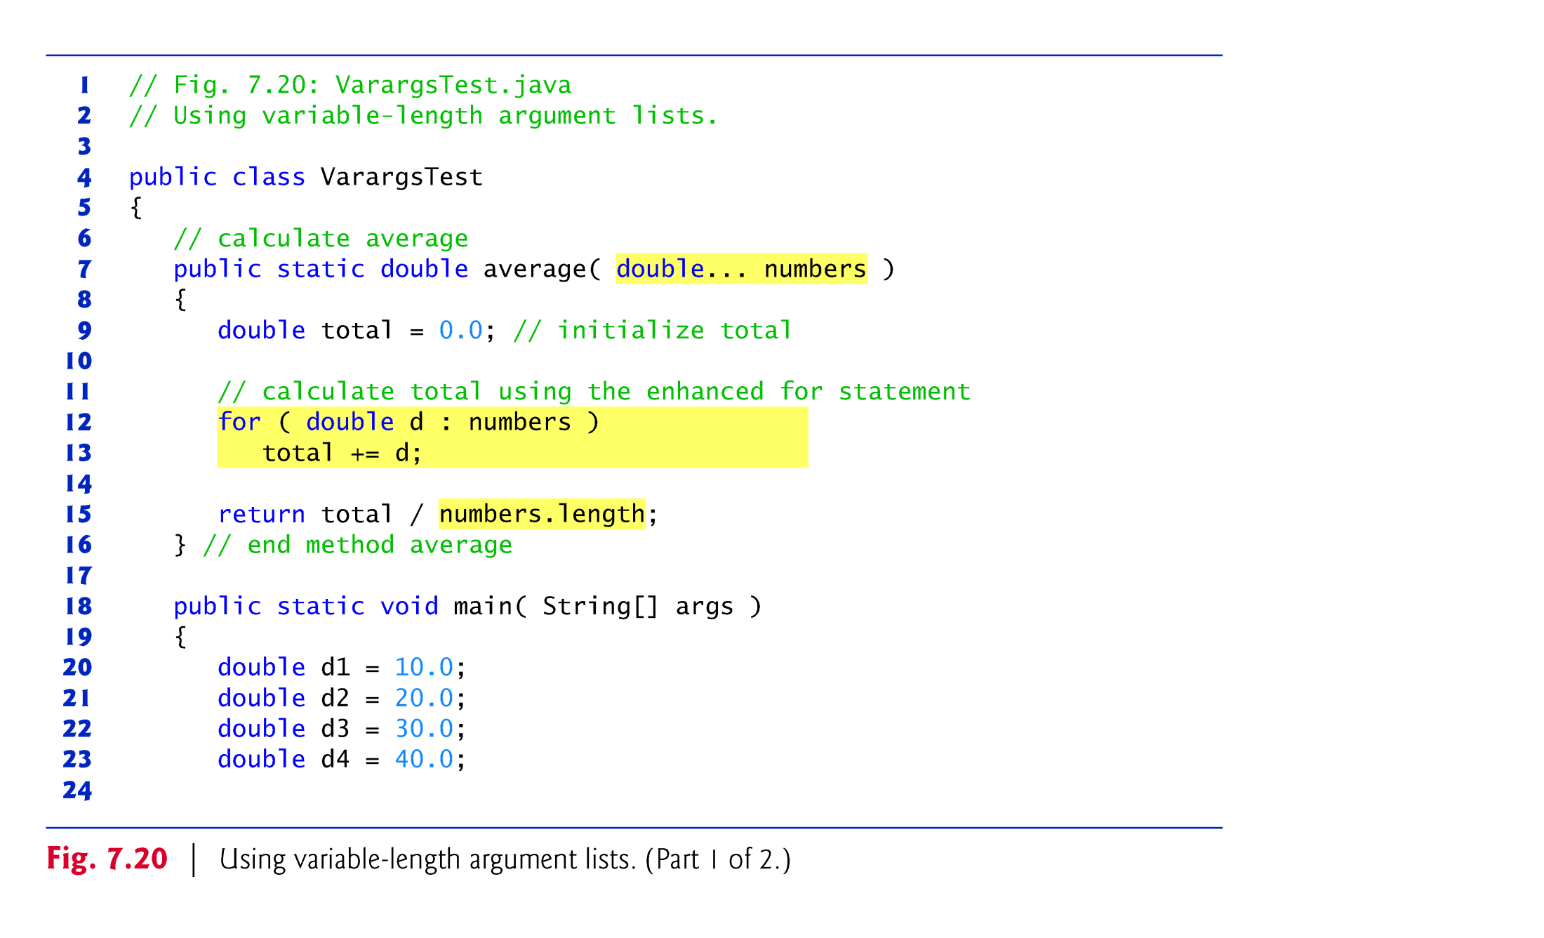

Slide 14
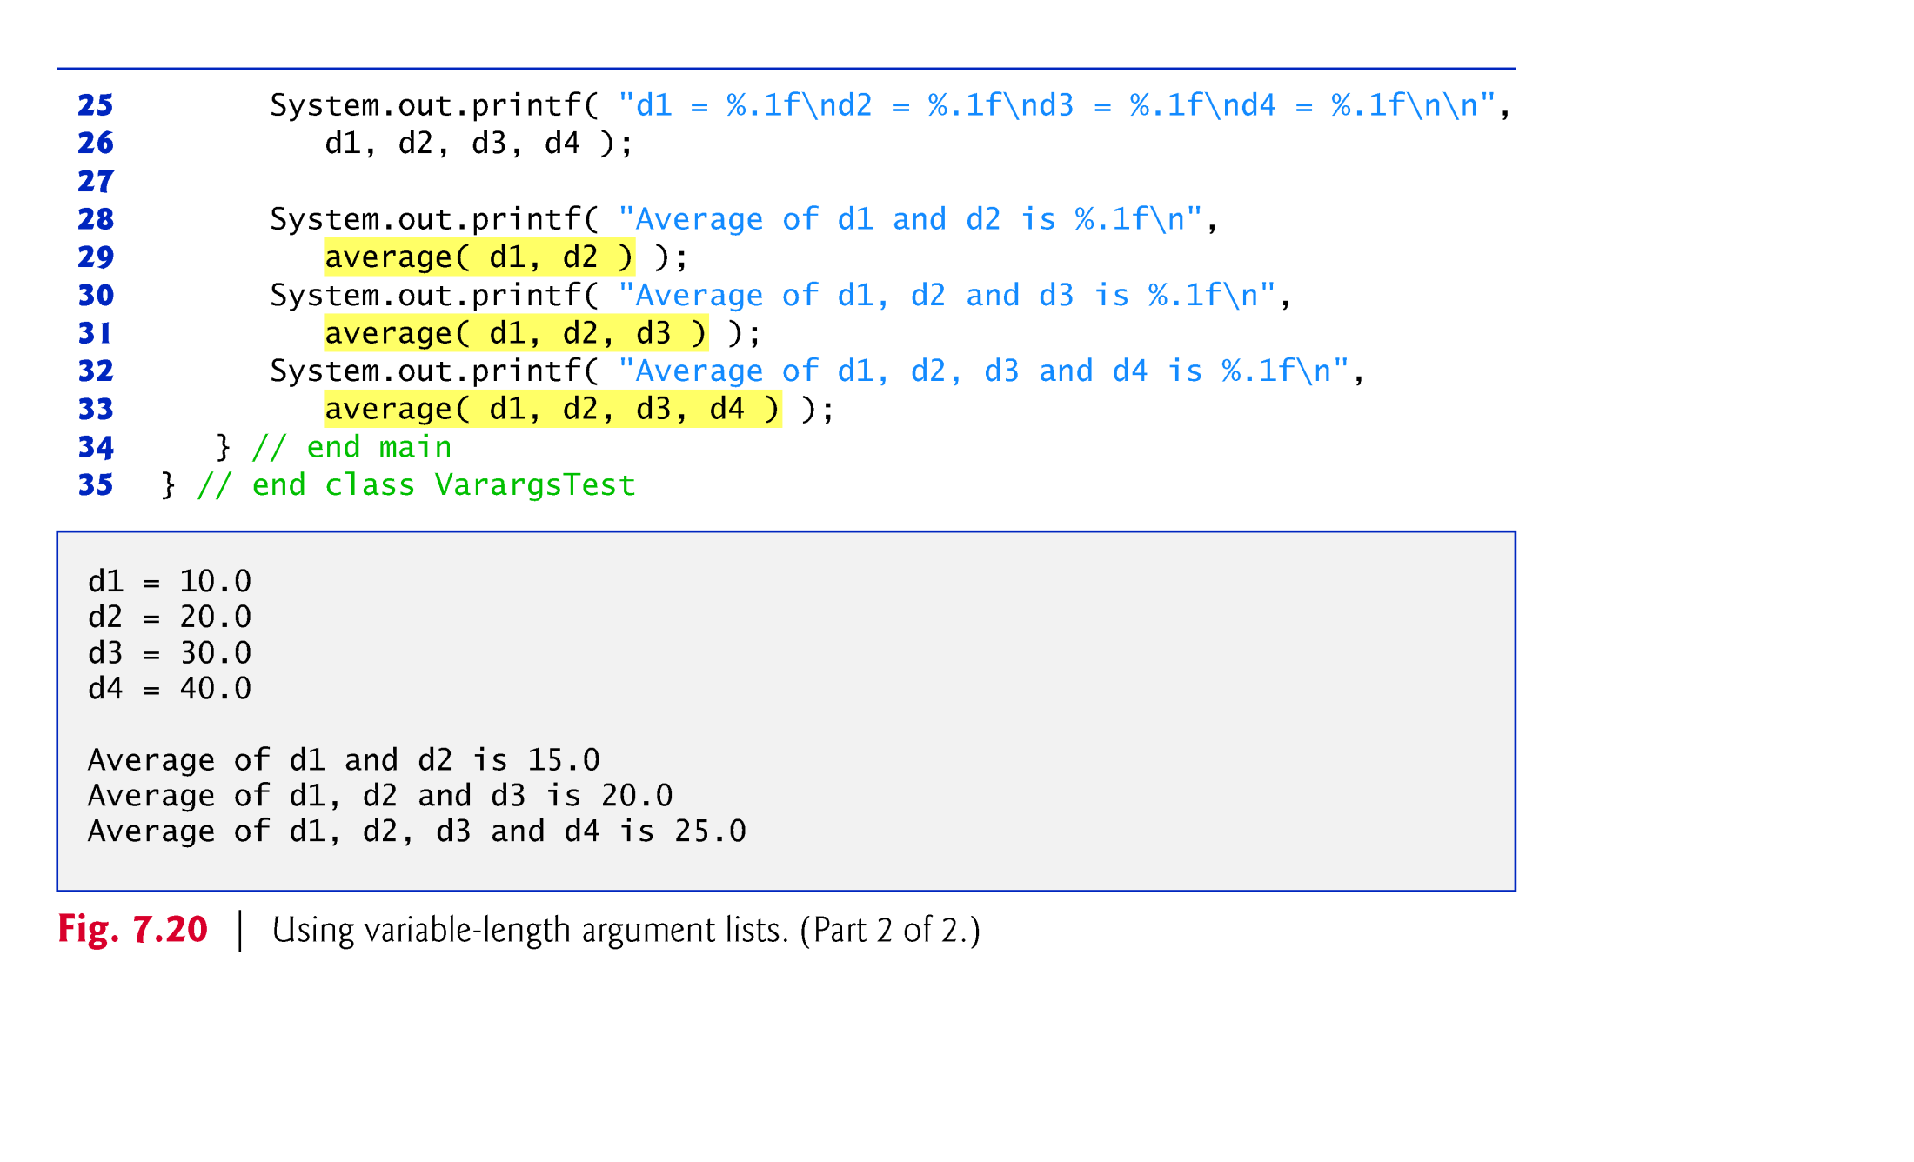

Slide 15
7.12 Using Command-Line Arguments
Command-line arguments
  Can pass arguments from the command line to an application.
  Arguments that appear after the class name in the java command are received by main in the String array args[].
  The number of command-line arguments is obtained by accessing the array’s length attribute.
  Command-line arguments are separated by white space, not commas.
  Fig. 7.21

Slide 16
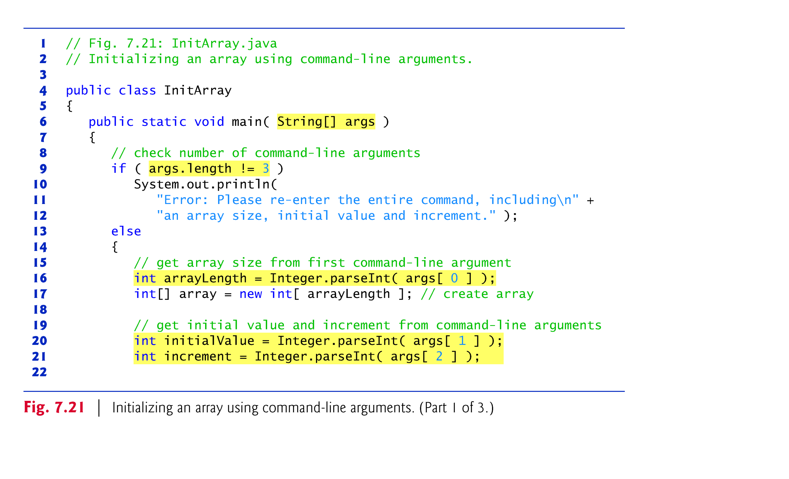

Slide 17
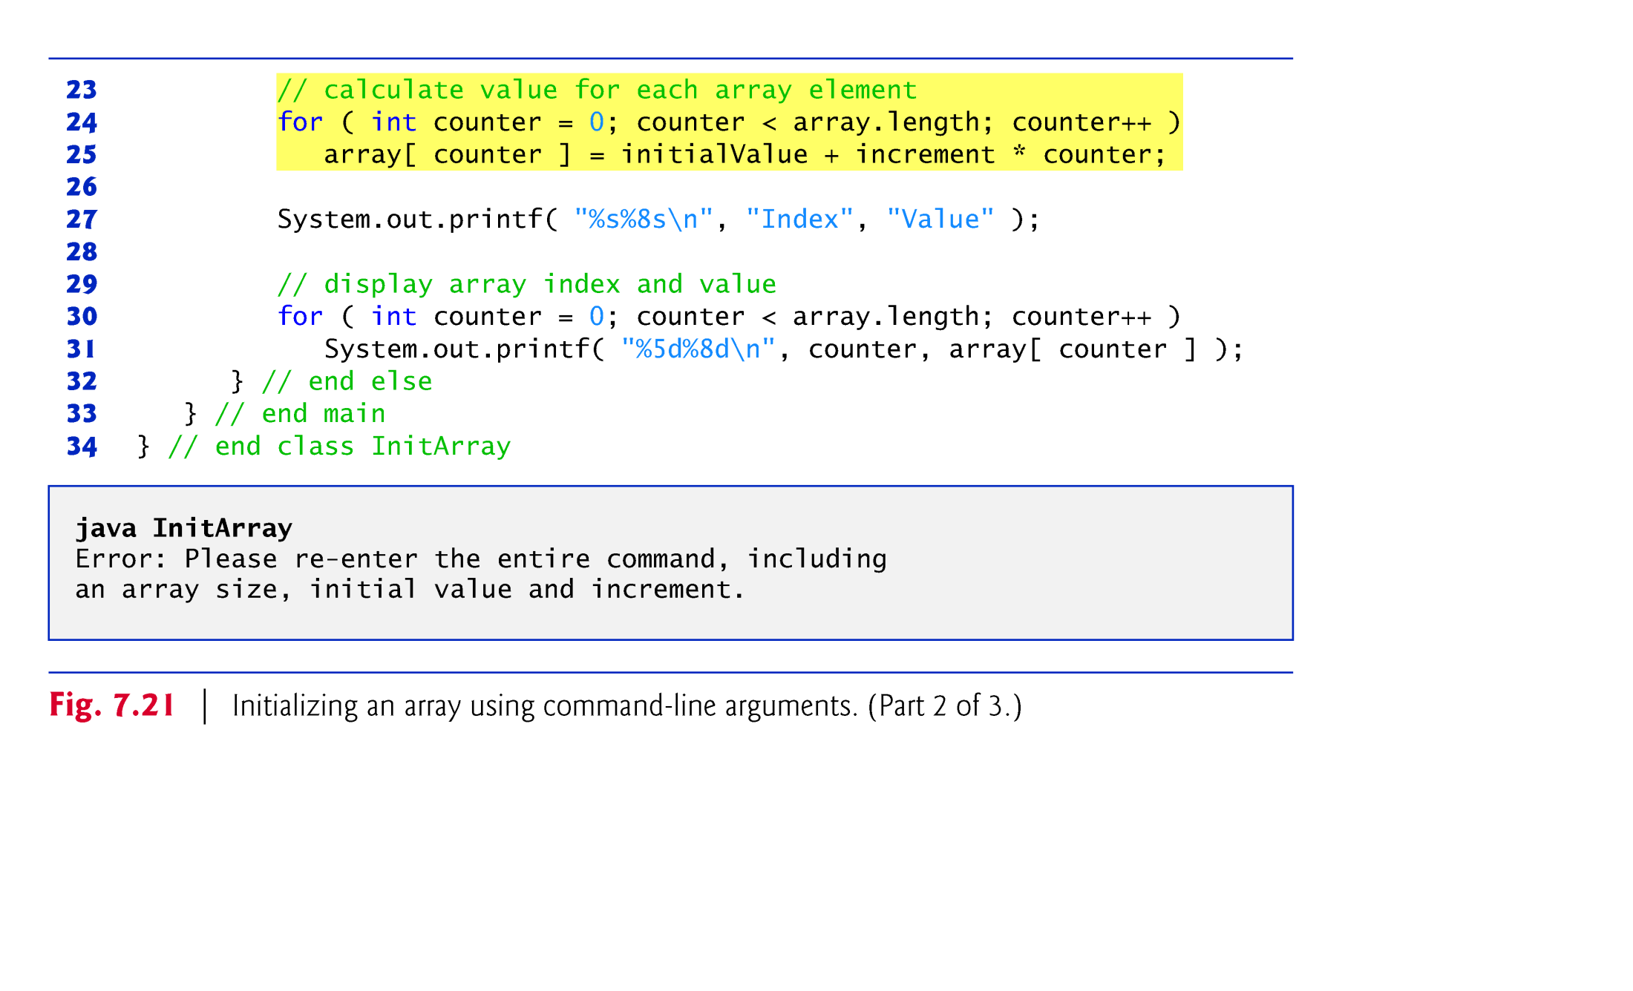

Slide 18
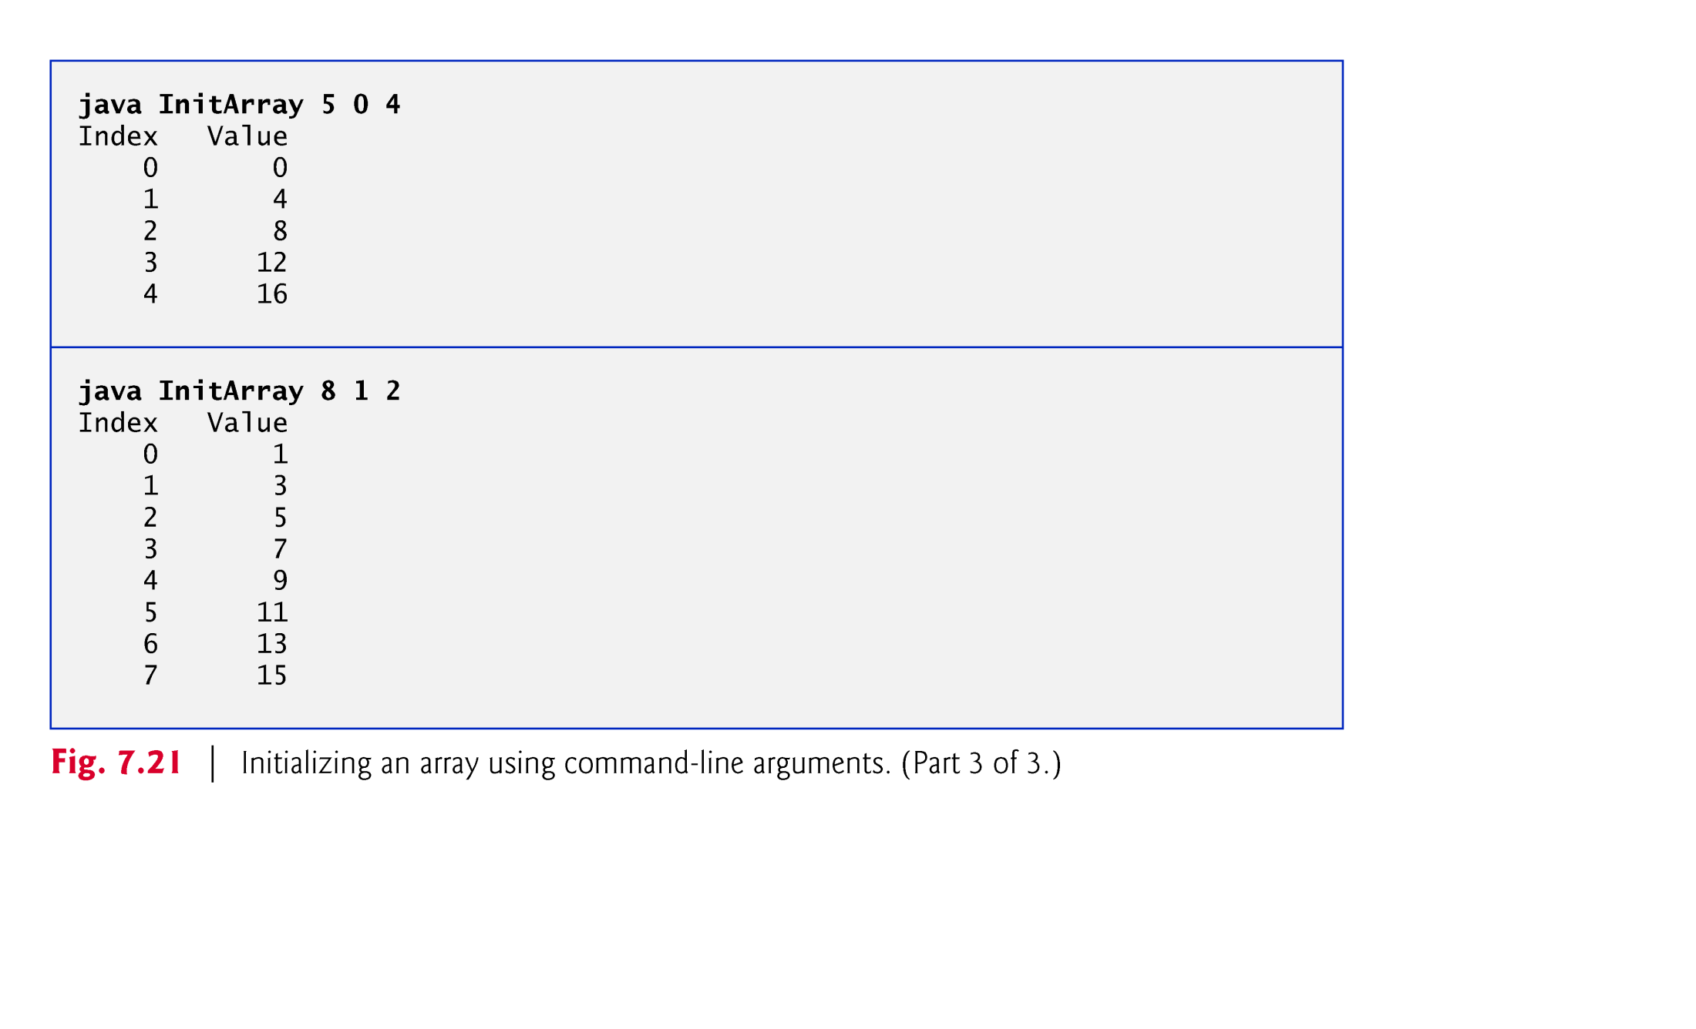

Slide 19
7.13 java.util.Arrays
Provides static methods for common array manipulations.
Example methods
  Sort() for sorting an array (ascending order by default)
  binarySearch() for searching a sorted array
  Equals() for comparing arrays
  Fill() for placing values into an array.
  copyOf() for copying part of an array into another array.
Methods are overloaded for primitive-type arrays and for arrays of objects.
System.arraycopy() method
  Copies contents of one array into another.
Example application: Fig. 7.22

Slide 20
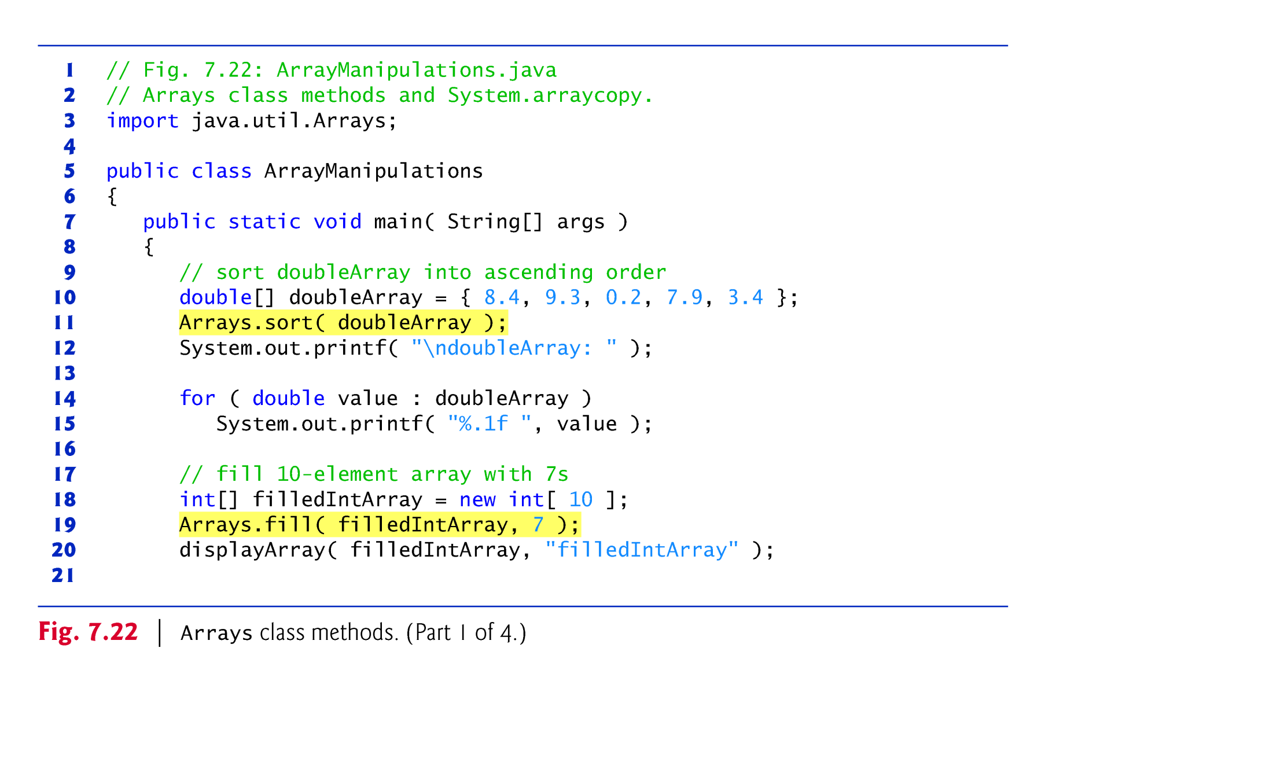

Slide 21
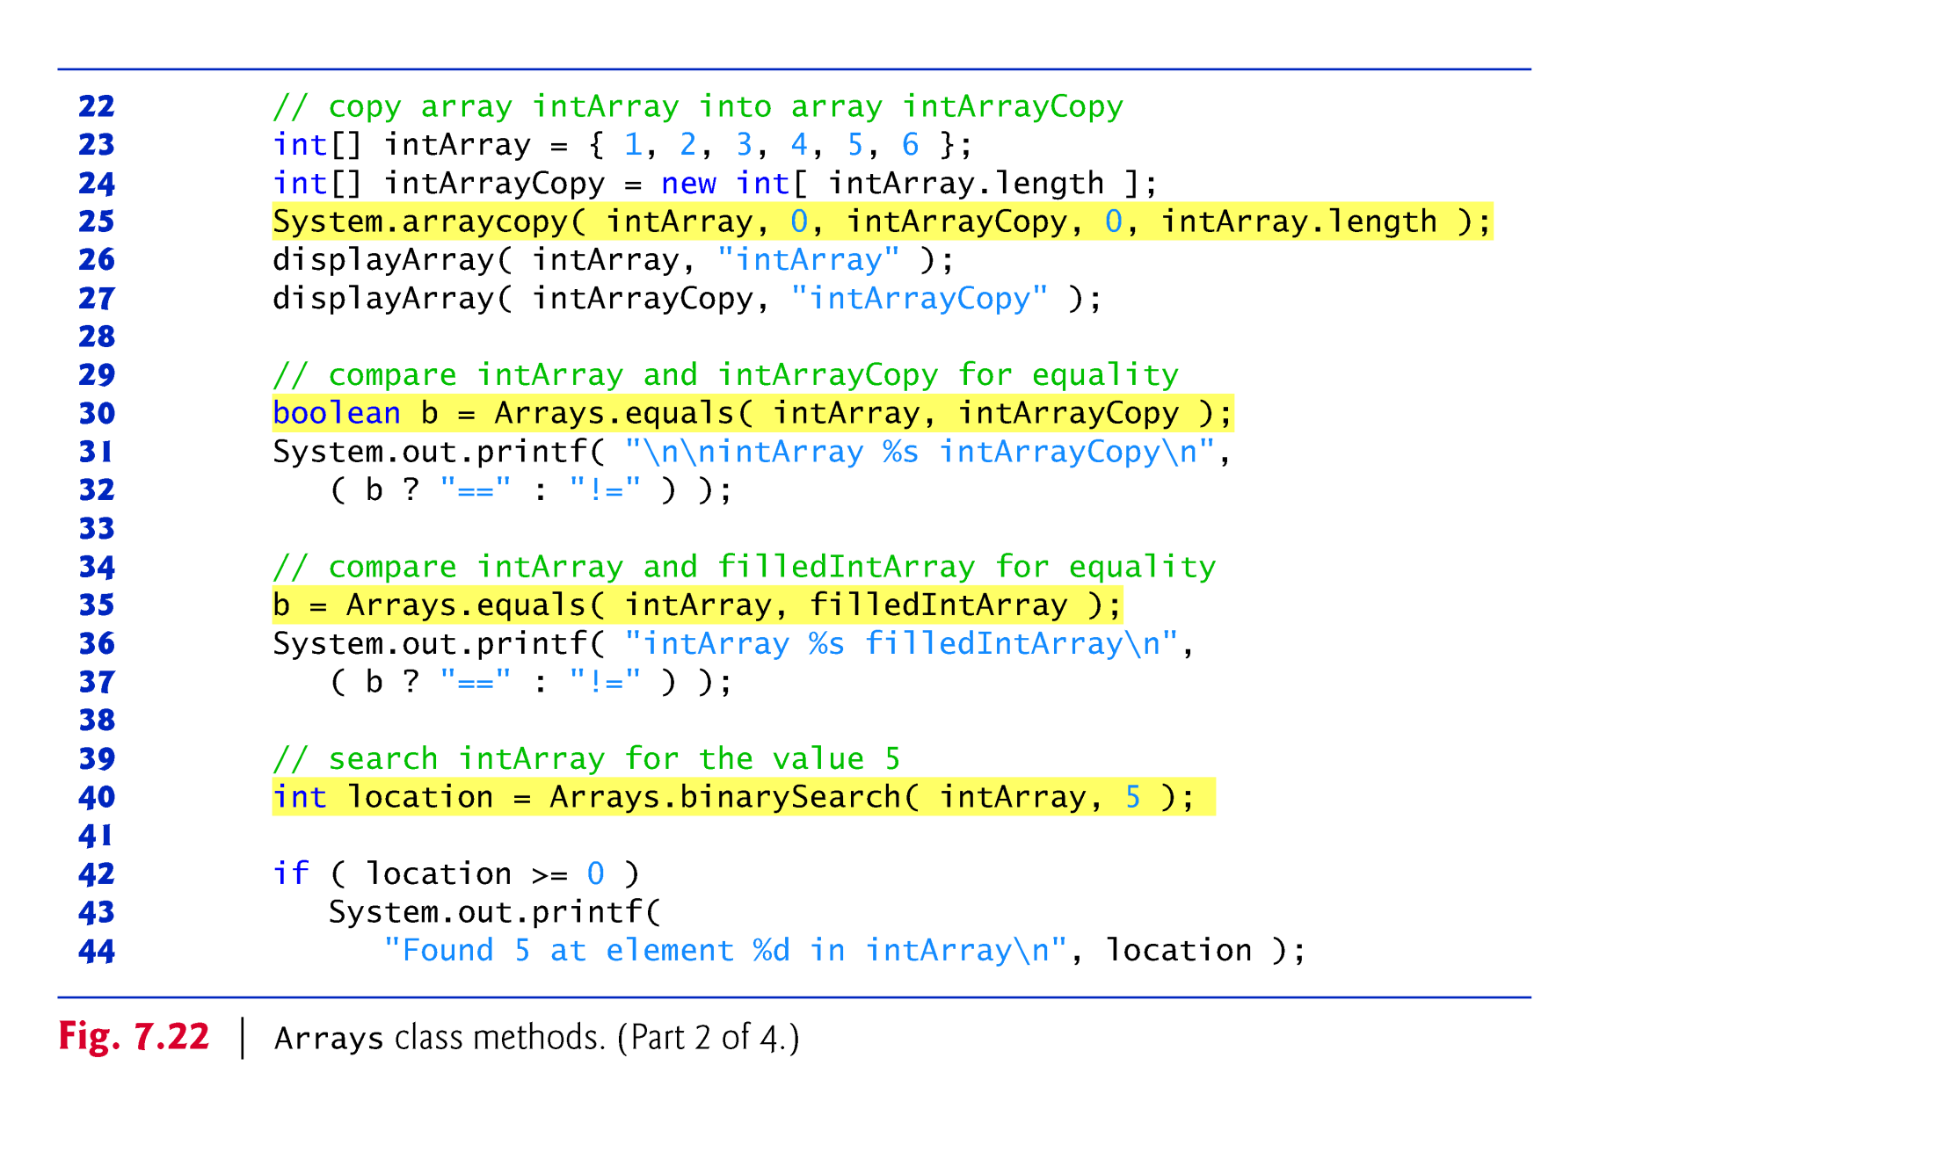

Slide 22
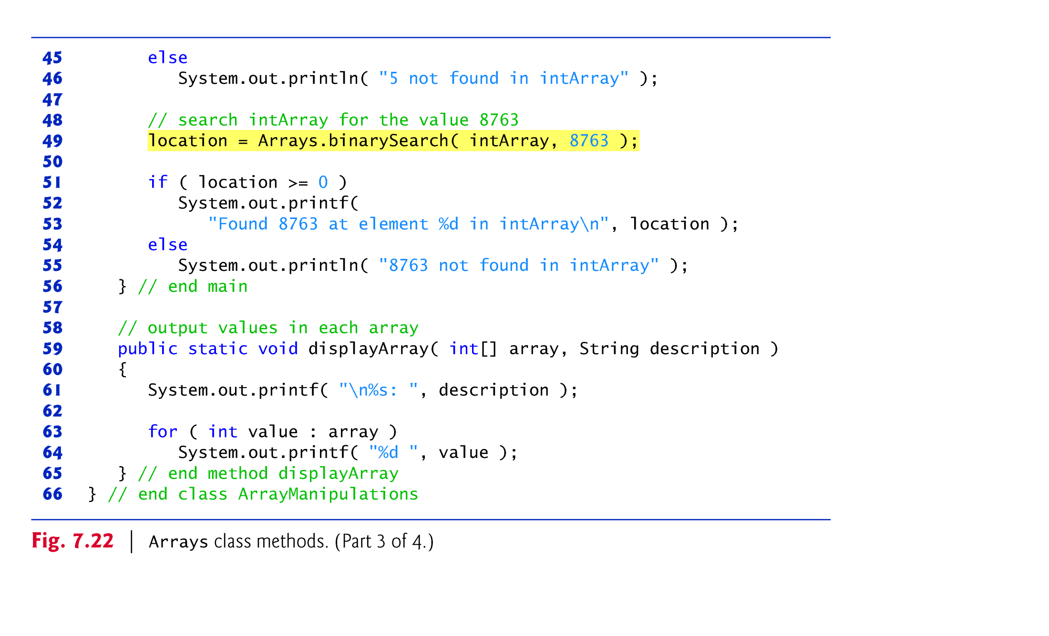

Slide 23
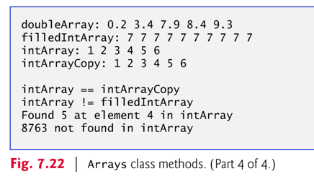

Slide 24
7.14 Collections and Class ArrayList
Java API provides several predefined data structures, called collections, used to store groups of related objects.
  Each provides efficient methods that organize, store and retrieve your data without requiring knowledge of how the data is being stored.
  Implementation details of each collection is hidden from the programmer, who focuses on the interface functions provided by that collection. → Reduce application-development time.
From http://download.oracle.com/javase/6/docs/api/java/util/Collection.html:
  A collection represents a group of objects, known as its elements.
  Some collections allow duplicate elements and others do not.
  Some are ordered and others unordered.
  Example collections: AbstractSet, ArrayList, LinkedList, PriorityQueue, Stack, …

Slide 25
Java.util.ArrayList
http://download.oracle.com/javase/6/docs/api/java/util/ArrayList.html
  Each ArrayList instance has a capacity.
  The capacity is the size of the array used to store the elements in the list.
  It is always at least as large as the list size.
  As elements are added to an ArrayList, its capacity grows automatically.
Example applications using ArrayList
  http://sce.uhcl.edu/yang/teaching/JavaProgrammingExamplesandRelatedTopics.htm#arraylist

Slide 26
import java.util.Collections;
import java.util.ArrayList;
public class ArrayListTest {
public static void main (String args[]) {
ArrayList animals = new ArrayList();
animals.add("snake");
animals.add("kangaroo");
animals.add("wombat");
animals.add("bird");
for (int i=0; i<animals.size(); i++) {
System.out.println("animal " + i + " : " + (String) animals.get(i));
}
Collections.sort(animals); //sort the ArrayList
for (int i=0; i<animals.size(); i++) {
System.out.println("animal " + i + " : " + (String) animals.get(i));
}
} //main()
} // ArrayListTest class

Slide 27
Generic classes
ArrayList<T> (package java.util)
  T is a placeholder for the type of element stored in the collection.
  This is similar to specifying the type when declaring an array, except that only nonprimitive types can be used with these collection classes.
Classes with this kind of placeholder that can be used with any type are called generic classes.

Slide 28
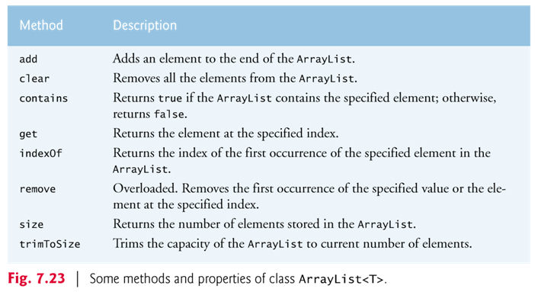

Slide 29
Figure 7.24 demonstrates some common ArrayList capabilities.
  Method add adds elements to the ArrayList.
    One-argument version appends its argument to the end of the ArrayList.
    Two-argument version inserts a new element at the specified position.
    Collection indices start at zero.
  Method size returns the number of elements in the ArrayList.
  Method get obtains the element at a specified index.
  Method remove deletes an element with a specific value.
    An overloaded version of the method removes the element at the specified index.
  Method contains determines if an item is in the ArrayList.

Slide 30
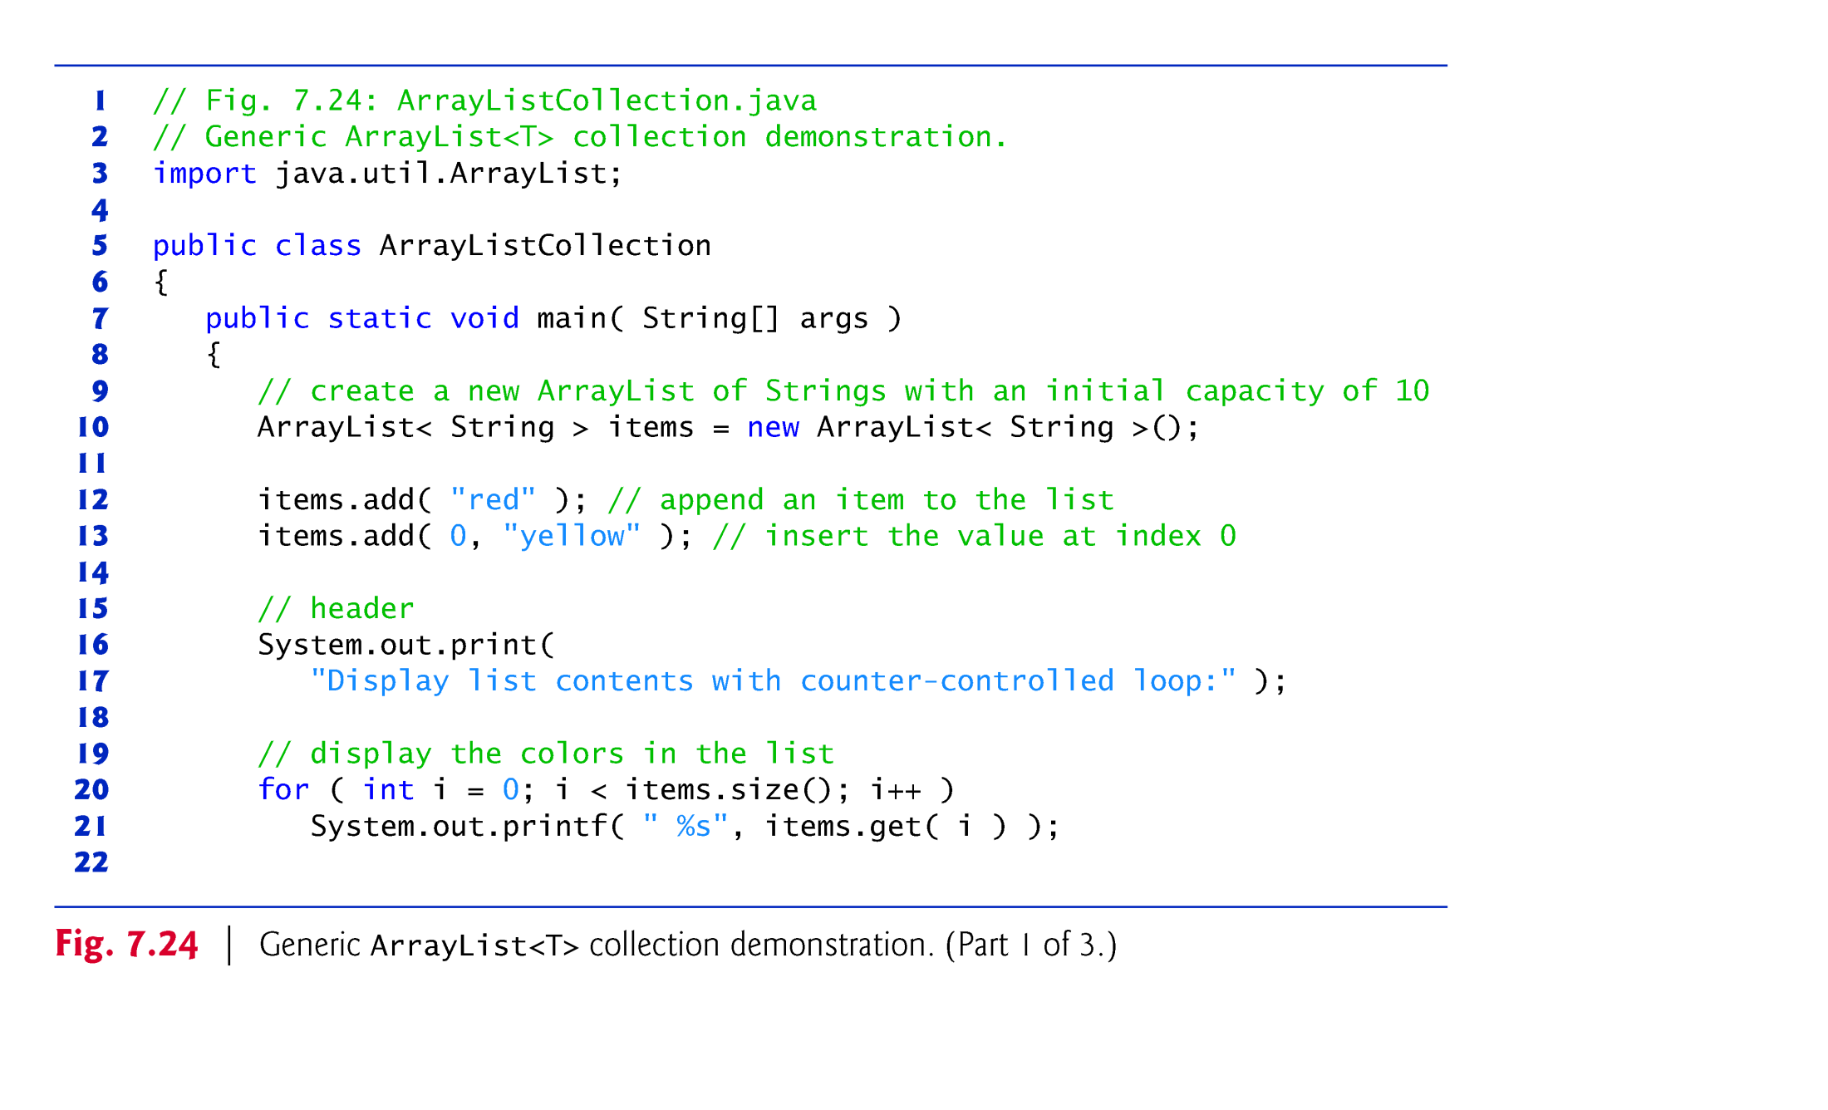

Slide 31
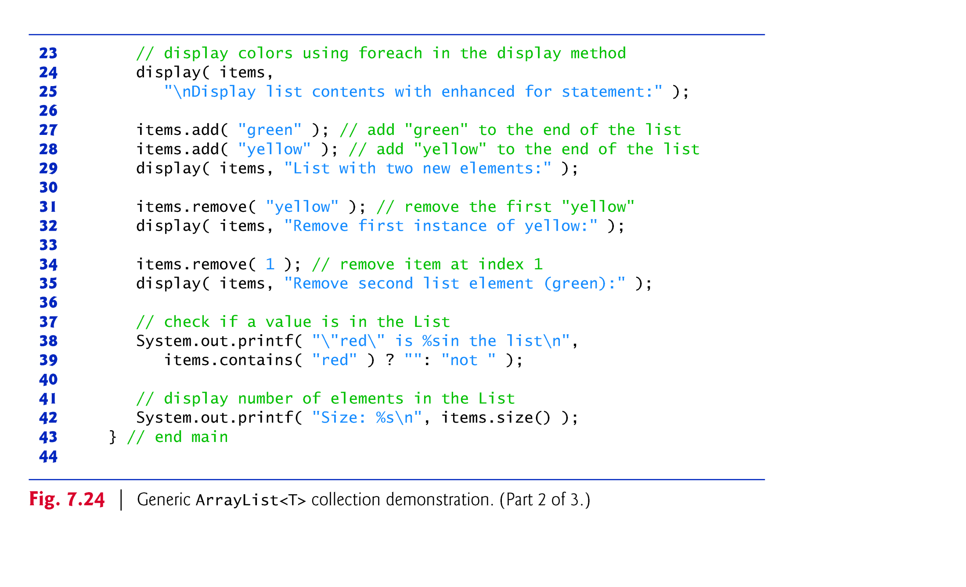

Slide 32
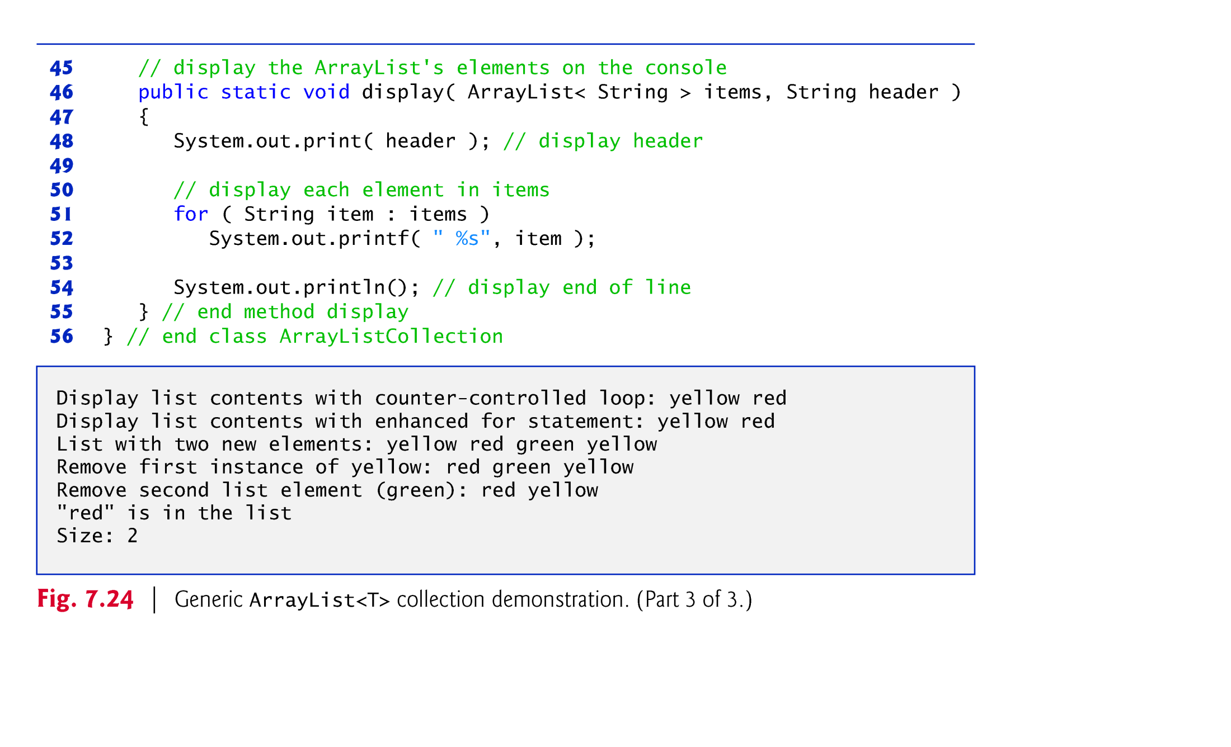

Slide 33
Exercise: Show the screen output of the following program.
  public class ArraysTest {
  public static void main(String args[]) {
  long longArray[] = new long[5];
  for (int i = 0; i < longArray.length; i++) {
  longArray[i] = i * i + 10;
  }//for
  for (int i = 0; i < longArray.length; i++) {
  System.out.printf("[%d]: %d\t", i, longArray[i]);
  }//for
  long tempArray[] = longArray;
  for (int i = 0; i < longArray.length; i++) {
  longArray[i] = tempArray[(i+1)% longArray.length];
  }//for
  System.out.println();
  for (int i = 0; i < longArray.length; i++) {
  System.out.printf("[%d]: %d\t", i, longArray[i]);
  }//for
  }//main
  }//class

Slide 34
