Slide 1
Arrays
Based on slides from Deitel & Associates, Inc.
Revised by T. A. Yang

Slide 2
Outline
Arrays
  One-dimensional arrays
  Multi-dimensional arrays
Arrays and Loops
Arrays as parameters to methods
The java.util.Arrays class
The java.util.ArrayList class
Examples & exercises

Slide 3
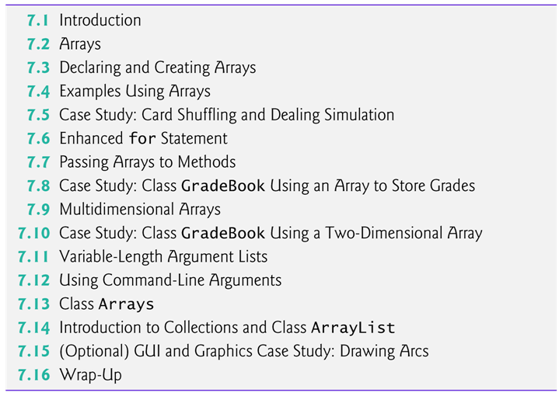

Slide 4
7.1 Introduction
Data structures
  Collections of related data items.
  Discussed in depth in Chapters 20–22.
  A separate course: csci 3333 Data Structures
Arrays
  Data structures consisting of related data items of the same type.
  Make it convenient to process related groups of values.
  Remain the same length once they are created.
  Arrays are objects so they are reference types.
  Elements can be either primitive or reference types.

Slide 5
The class java.util.Arrays:
  static methods for common array manipulations
The ArrayList collection
  Similar to arrays
  Dynamic resizing
    They automatically increase their size at execution time to accommodate additional elements.

Slide 6
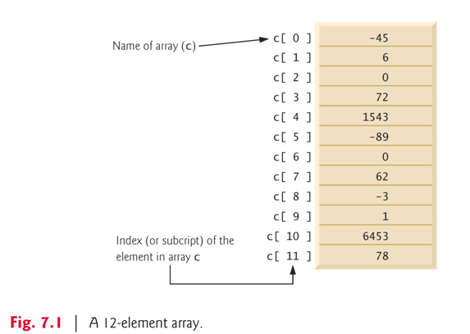
int [ ] c;
int c[ ];
int c[ ] = {-45, 6, 0, 72, 1543, -89, 0, 62, -3, 1, 6453, 78};

Slide 7
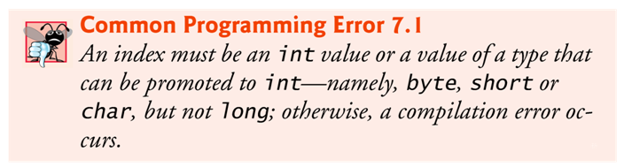
An index must be a nonnegative integer.
  Can use an expression as an index.
Every array object knows its own length and stores it in an instance variable called length.
  length cannot be changed because it’s a final variable.

Slide 8
7.3 Declaring and Creating Arrays
Array objects
  Created with keyword new.
  You specify the element type and the number of elements in an array-creation expression, which returns a reference that can be stored in an array variable.
Declaration and array-creation expression for an array of 12 int elements
    int[] c = new int[ 12 ];
Can be performed in two steps as follows:
    int[] c; // declare the array variable
    c = new int[ 12 ]; // creates the array

Slide 9
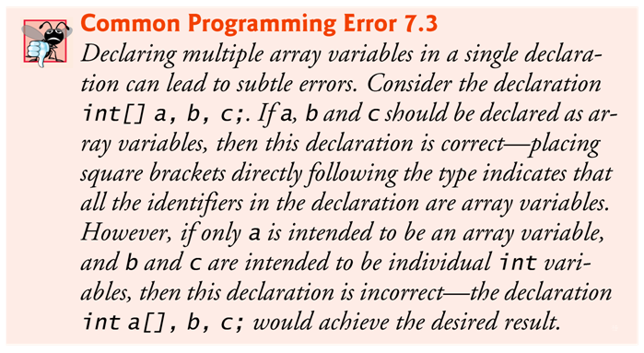
When an array is created, each element of the array receives a default value.
  Zero for the numeric primitive-type elements, false for boolean elements and null for references.

Slide 10
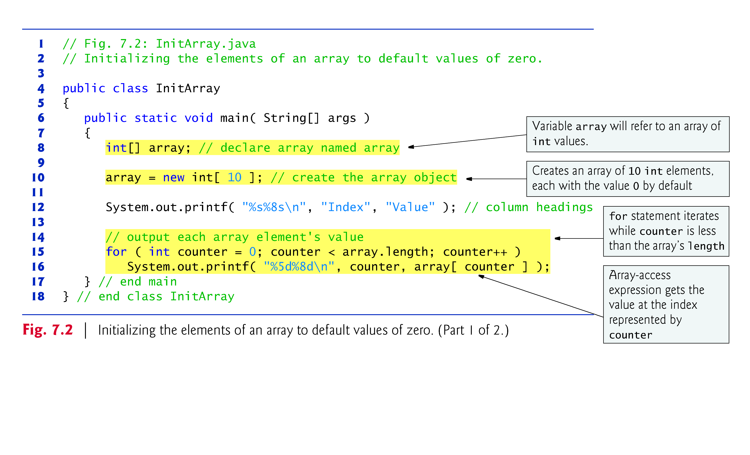
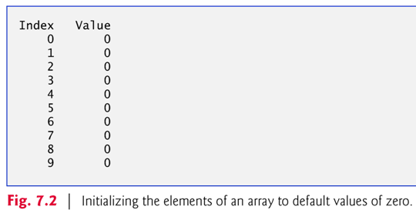

Slide 11
Array initializer
  A comma-separated list of expressions (called an initializer list) enclosed in braces.
  Used to create an array and initialize its elements.
  Array length is determined by the number of elements in the initializer list.
    int[] n = { 10, 20, 30, 40, 50 };
    Creates a five-element array with index values 0–4.
Compiler counts the number of initializers in the list to determine the size of the array
  It sets up the appropriate new operation “behind the scenes.”

Slide 12
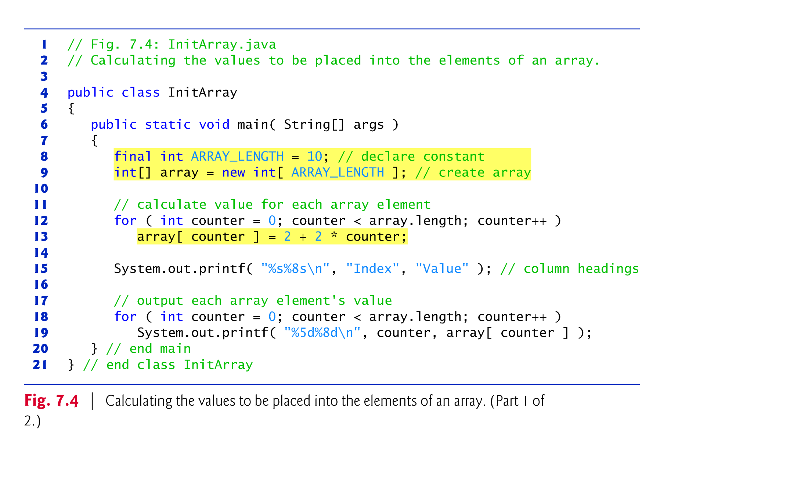
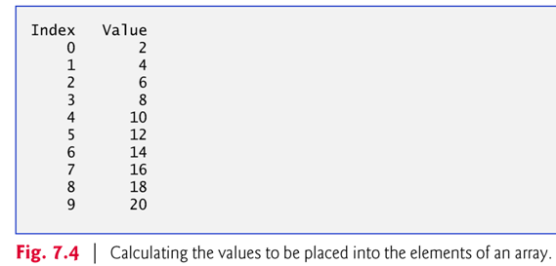

Slide 13
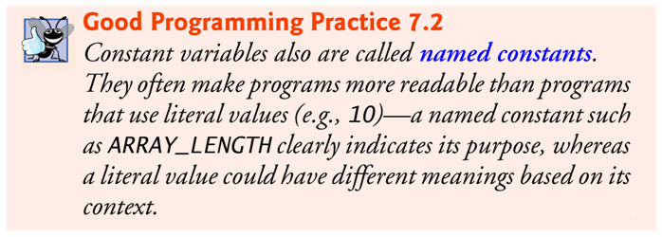
final variables must be initialized before they are used and cannot be modified thereafter.
An attempt to modify a final variable after it’s initialized causes a compilation error
    cannot assign a value to final variable
An attempt to access the value of a final variable before it’s initialized causes a compilation error

Slide 14
Fig. 7.6: BarChart.java
  Many programs present data to users in a graphical manner.
  Numeric values are often displayed as bars in a bar chart.
  A simple way to display numeric data is with a bar chart that shows each numeric value as a bar of asterisks (*).
  Format specifier %02d indicates that an int value should be formatted as a field of two digits.
    The 0 flag displays a leading 0 for values with fewer digits than the field width (2).

Slide 15
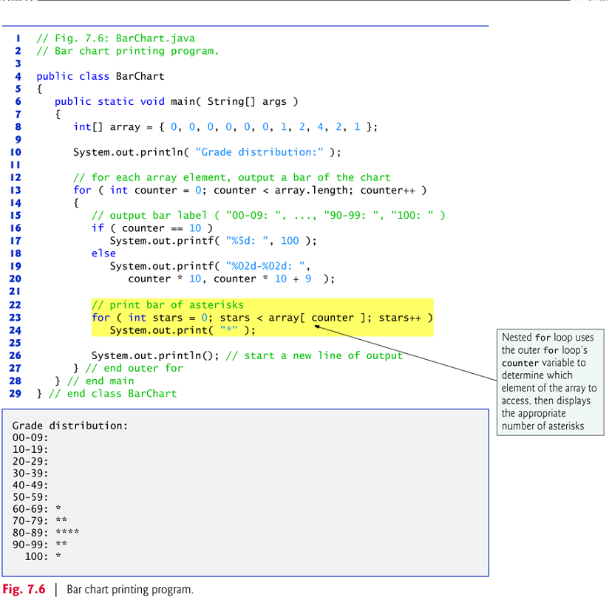

Slide 16
Sometimes, programs use counter variables to summarize data, such as the results of a survey.
Fig. 6.7 used separate counters in a die-rolling program to track the number of occurrences of each side of a six-sided die as the program rolled the die 6,000,000 times.
Fig. 7.7 shows an array version of this application.
  Line 14 of this program replaces lines 23–46 of Fig. 6.7.
Array frequency must be large enough to store six counters.
  We use a seven-element array in which we ignore frequency[0]
  More logical to have the face value 1 increment frequency[1] than frequency[0].

Slide 17
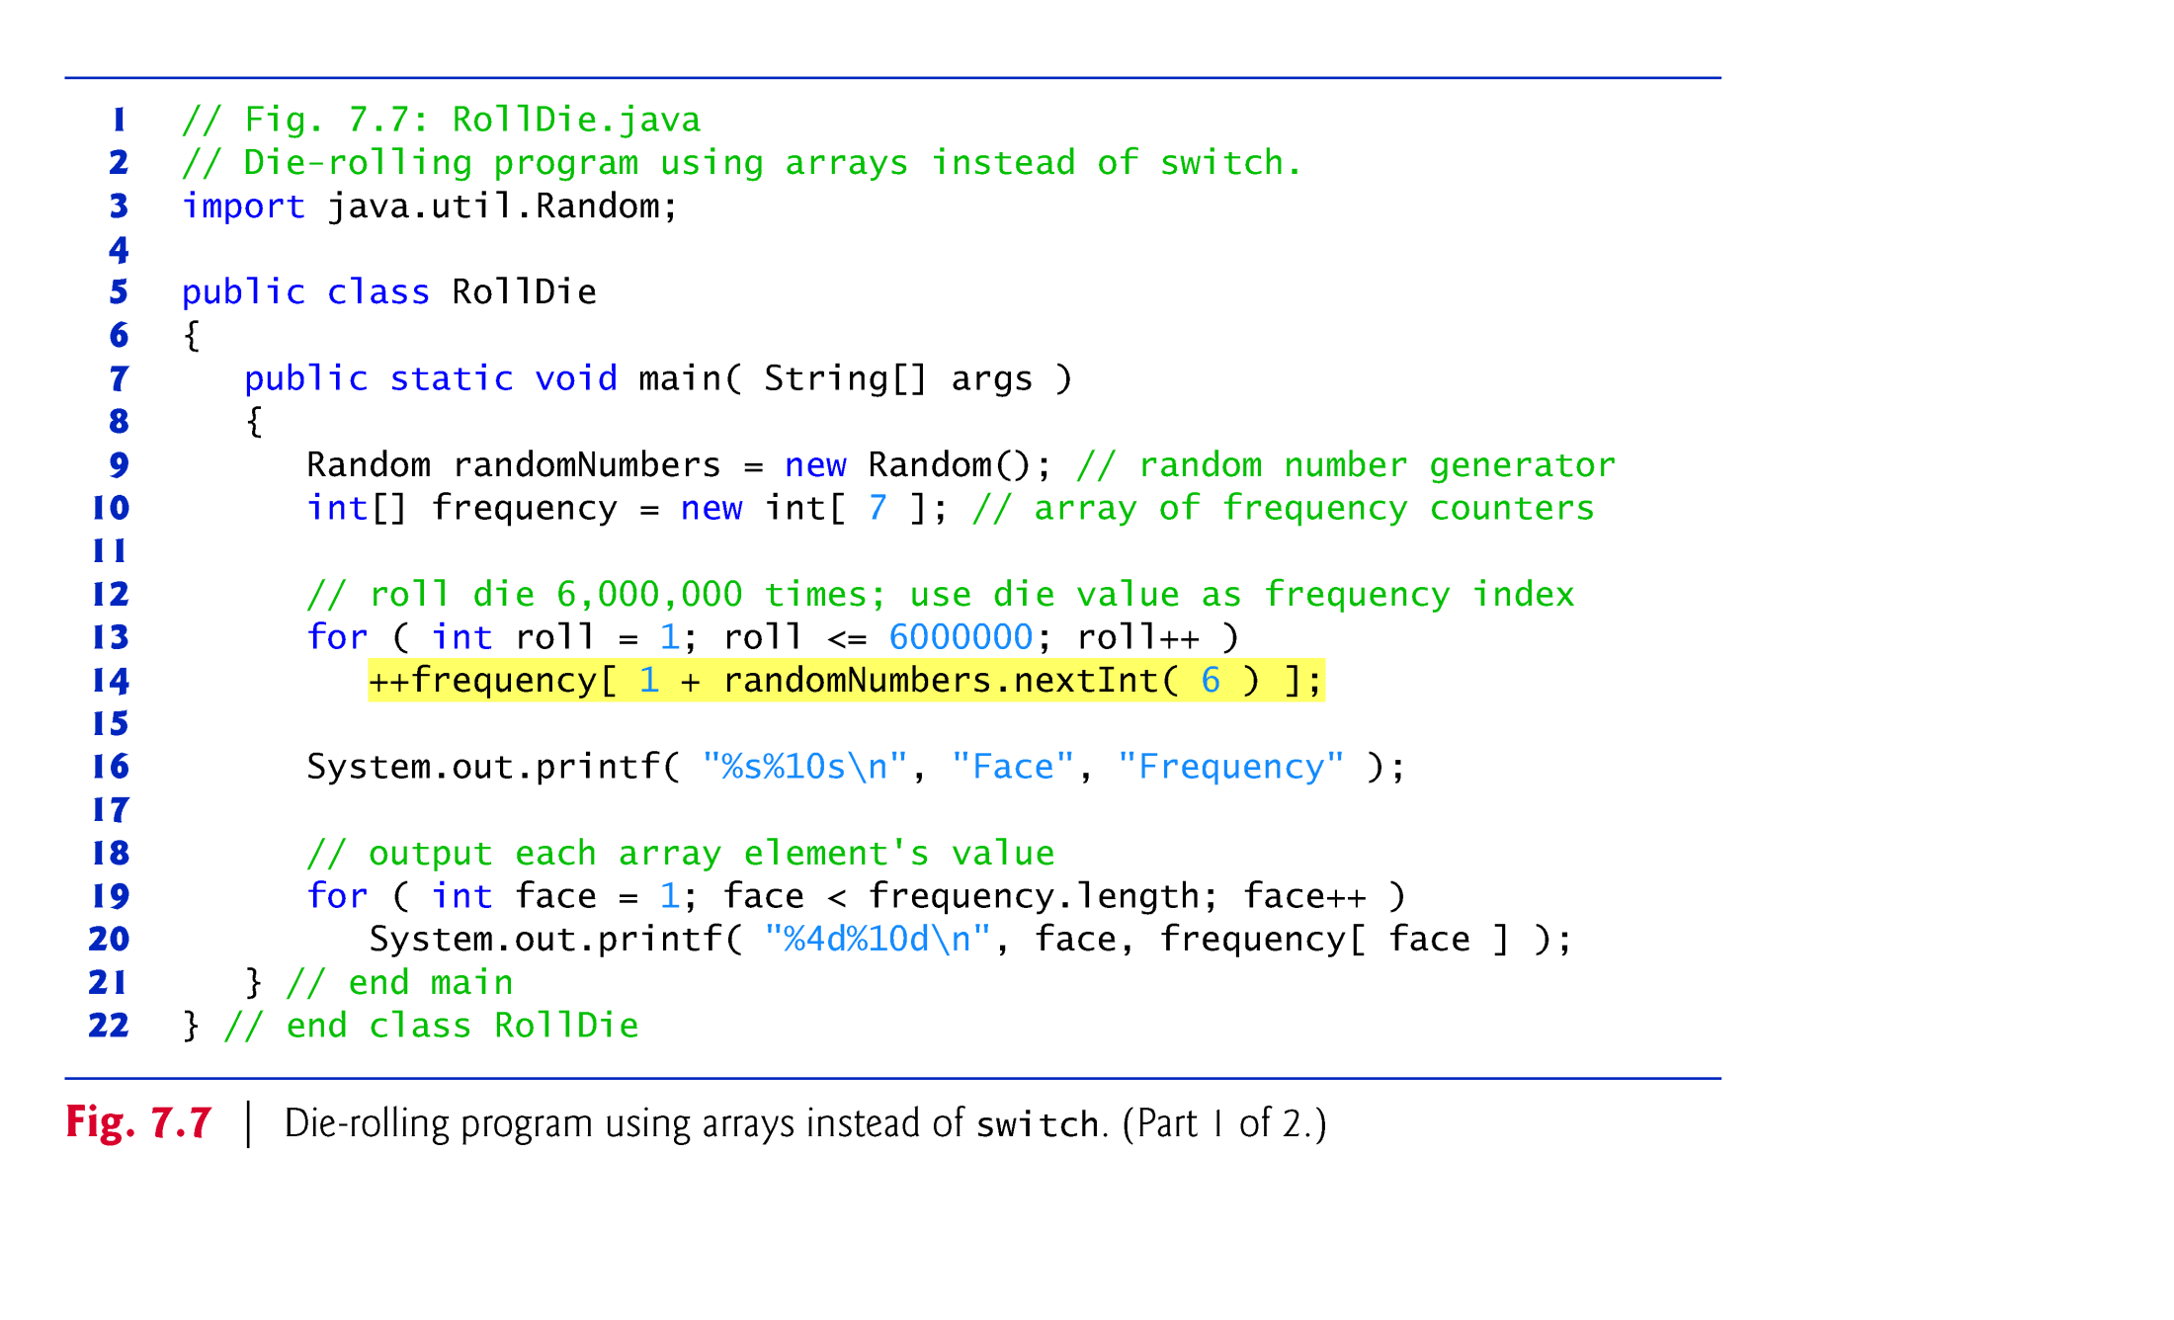
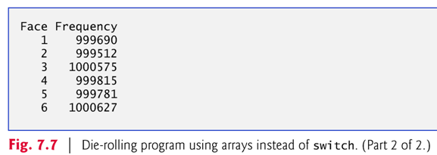

Slide 18
Bounds checking and exceptions
  JVM checks array indices to ensure that they are greater than or equal to 0 and less than the length of the array.
  If the program tries to reference an element that is outside the bounds of the array, Java generates an exception to indicate that an error occurred in the program at execution time.
  An exception indicates a problem that occurs while a program executes.
  The name “exception” suggests that the problem occurs infrequently — if the “rule” is that a statement normally executes correctly, then the problem represents the “exception to the rule.”
  Exception handling enables you to create fault-tolerant programs that can resolve (or handle) exceptions.

Slide 19
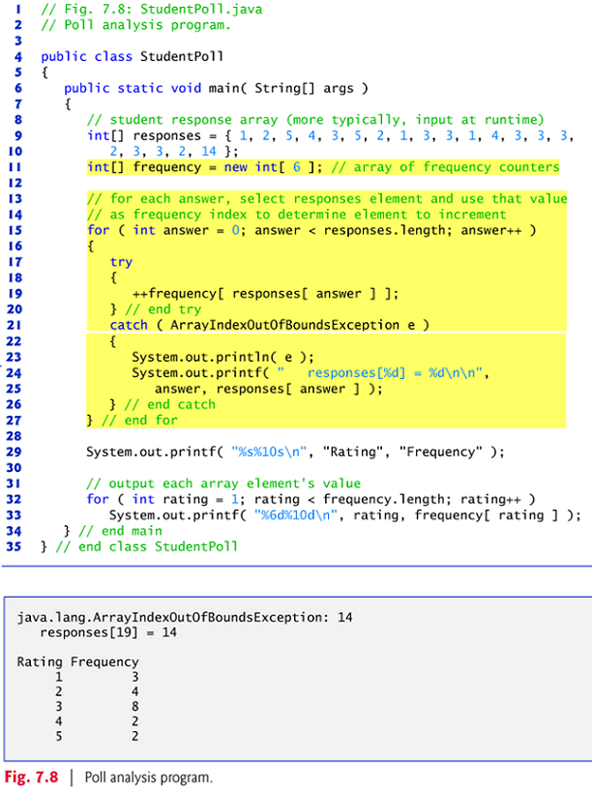
Exception handling
  To handle an exception, place any code that might throw an exception in a try statement.
  The try block contains the code that might throw an exception.
  The catch block contains the code that handles the exception if one occurs. You can have many catch blocks to handle different types of exceptions that might be thrown in the corresponding try block.

Slide 20
Executing the catch Block
  When the program encounters the value 14 in the responses array, it attempts to add 1 to frequency[14], which is outside the bounds of the array — the frequency array has only six elements.
  Because array bounds checking is performed at execution time, the JVM generates an exception — specifically line 19 throws an ArrayIndexOutOfBoundsException to notify the program of this problem.
  At this point the try block terminates and the catch block begins executing — if you declared any variables in the try block, they’re now out of scope.

Slide 21
The catch block declares a type and an exception parameter, and can handle exceptions of the specified type.
Inside the catch block, you can use the parameter’s identifier to interact with a caught exception object.
The exception object’s toString method returns the error message that is stored in the exception object.
The exception is considered handled when program control reaches the closing right brace of the catch block.
See http://download.oracle.com/javase/6/docs/api/java/lang/ArrayIndexOutOfBoundsException.html

Slide 22
7.6 Enhanced for Statement
Enhanced for statement
  Iterates through the elements of an array without using a counter.
  Avoids the possibility of “stepping outside” the array.
  Also works with the Java API’s prebuilt collections (see Section 7.14).
Syntax:
    for ( parameter : arrayName )
    statement
where parameter has a type and an identifier and arrayName is the array through which to iterate.
Parameter type must be consistent with the array’s element type.
The enhanced for statement simplifies the code for iterating through an array.

Slide 23
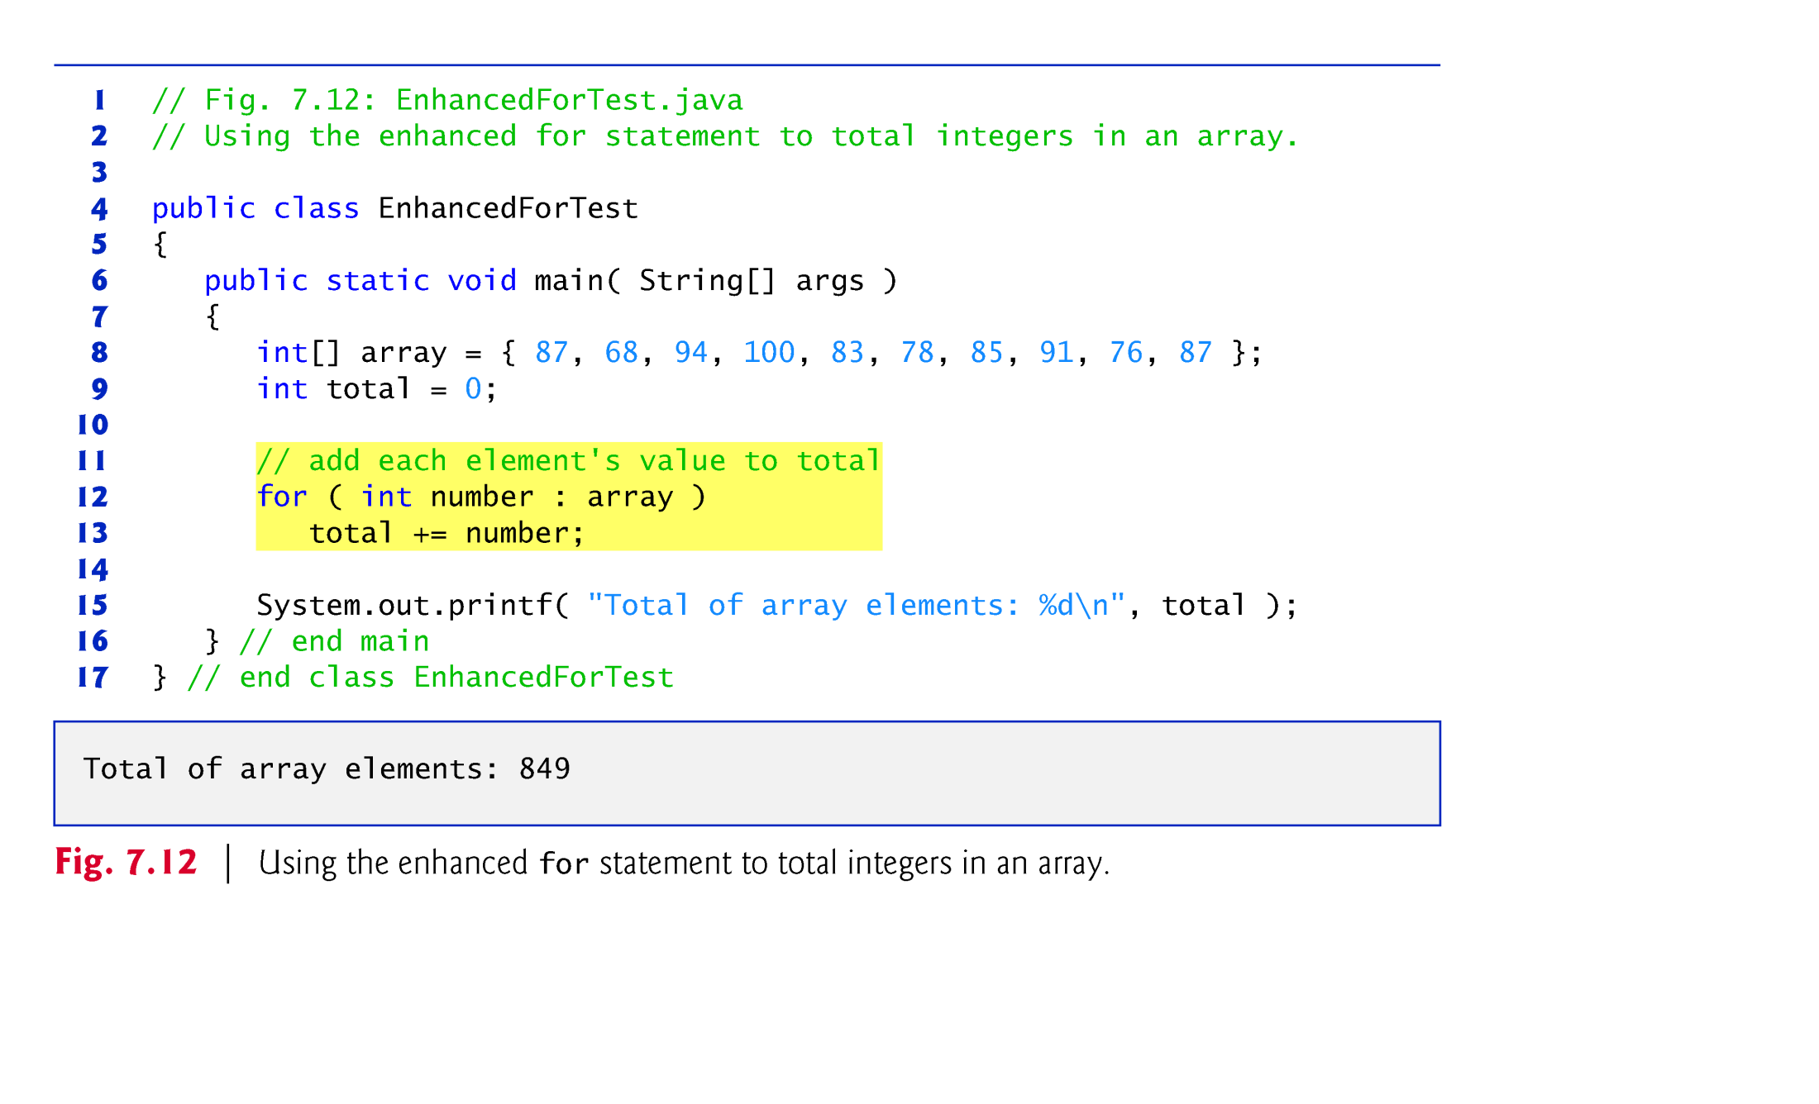

Slide 24
The enhanced for statement can be used only to obtain array elements
  It cannot be used to modify elements.
  To modify elements, use the traditional counter-controlled for statement.
Can be used in place of the counter-controlled for statement if you don’t need to access the index of the element.

Slide 25
7.7 Passing Arrays to Methods
To pass an array argument to a method, specify the name of the array without any brackets.
  Since every array object “knows” its own length, we need not pass the array length as an additional argument.
To receive an array, the method’s parameter list must specify an array parameter.
When an argument to a method is an entire array or an individual array element of a reference type, the called method receives a copy of that reference.
When an argument to a method is an individual array element of a primitive type, the called method receives a copy of the element’s value.
  Such primitive values are called scalars or scalar quantities.

Slide 26
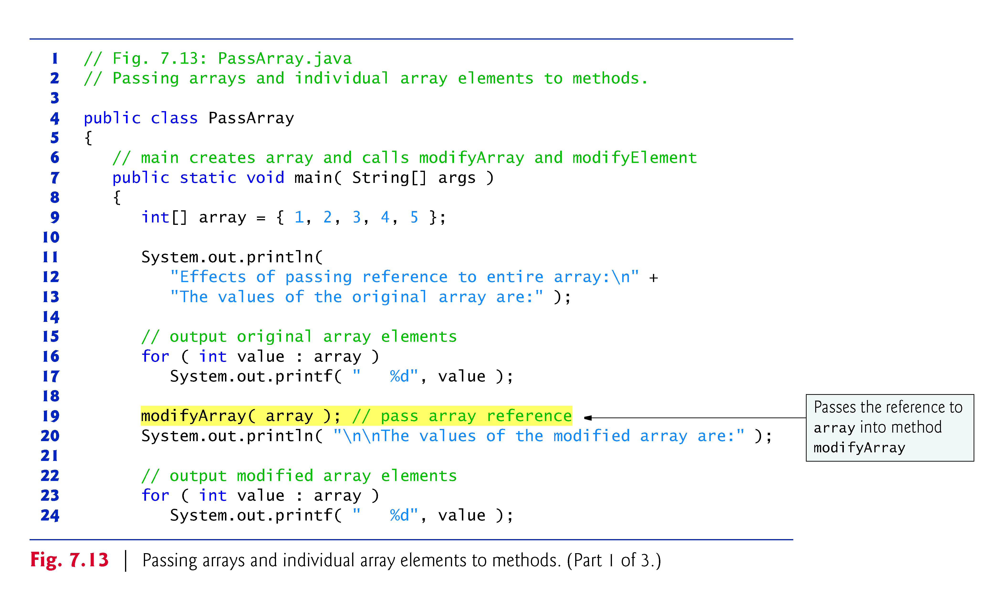

Slide 27
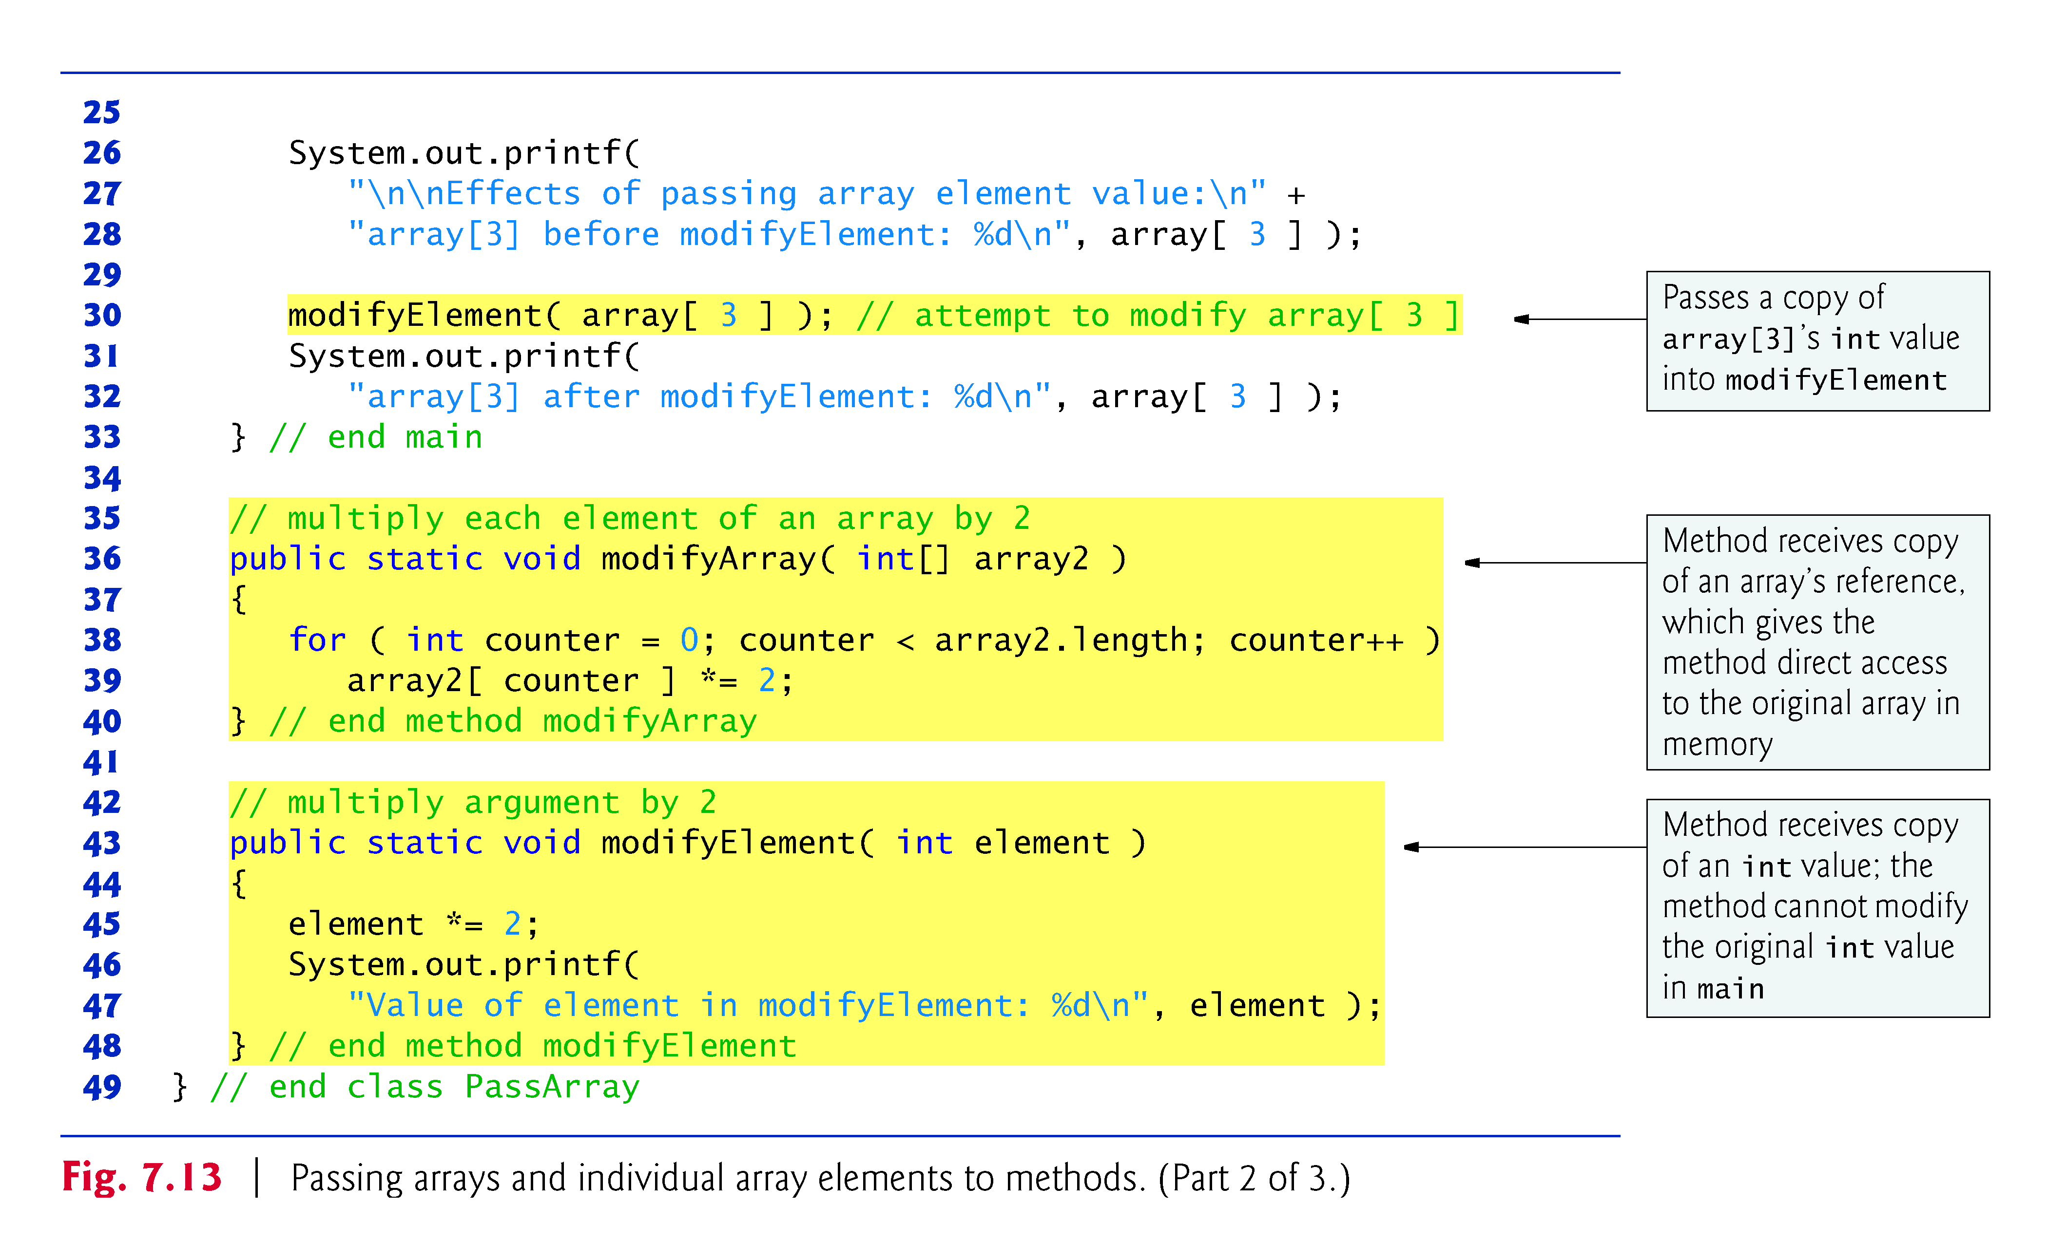

Slide 28
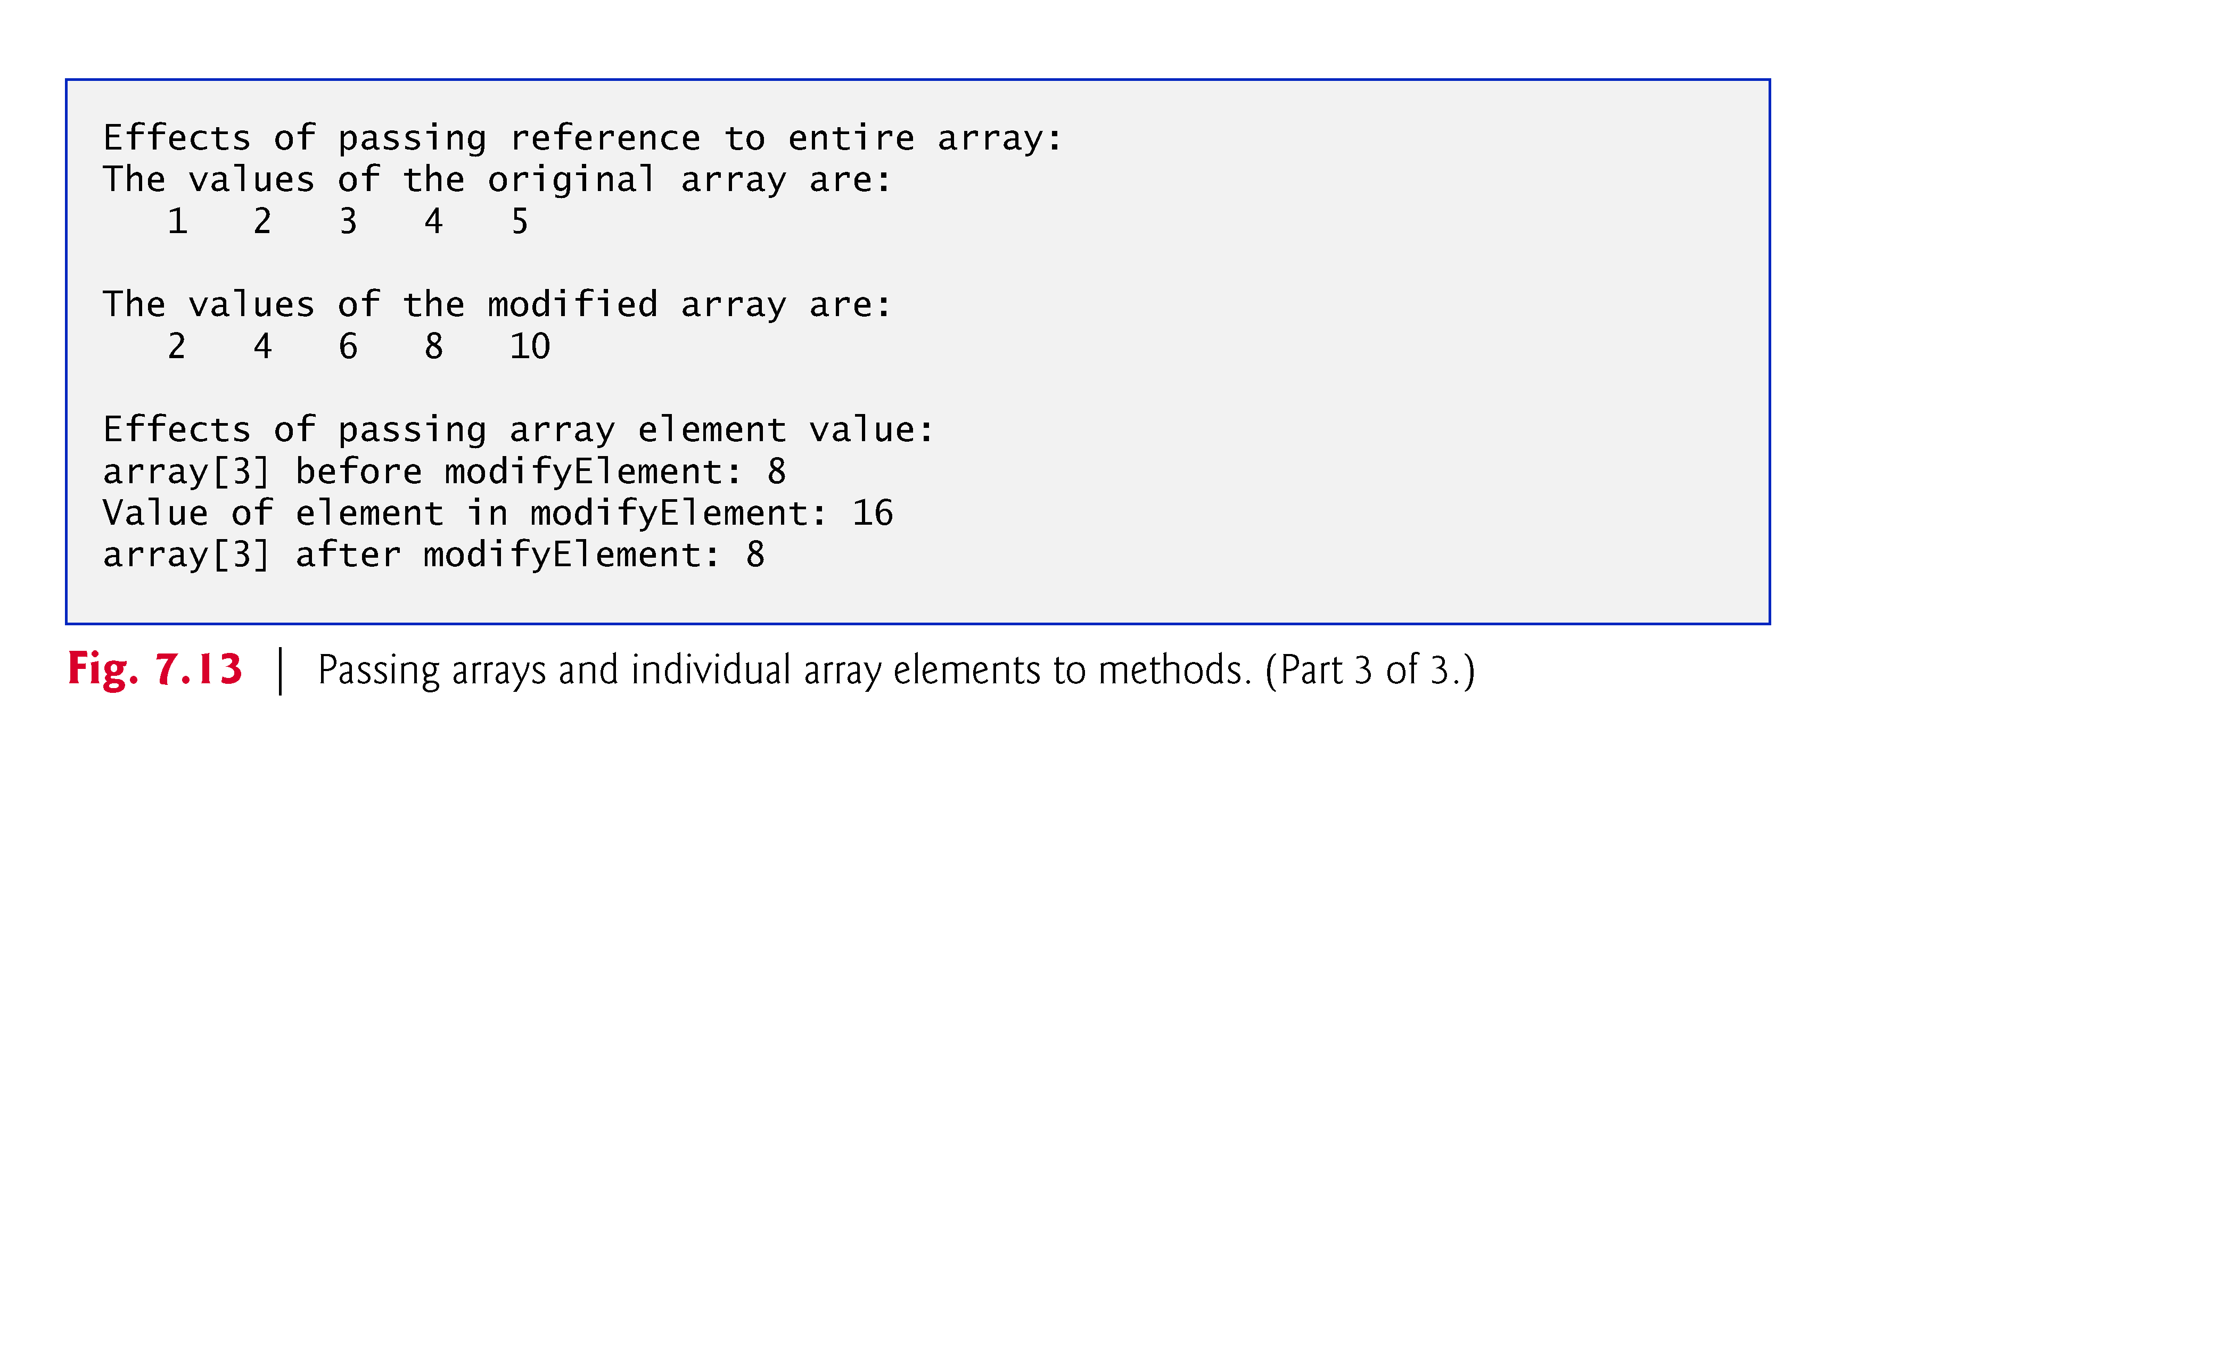

Slide 29
Pass-by-value (also called call-by-value)
  A copy of the argument’s value is passed to the called method.
  The called method works exclusively with the copy.
  Changes to the called method’s copy do not affect the original variable’s value in the caller.
Pass-by-reference (also called call-by-reference)
  The called method can access the argument’s value in the caller directly and modify that data, if necessary.
  Improves performance by eliminating the need to copy possibly large amounts of data.

Slide 30
All arguments in Java are passed by value.
A method call can pass two types of values to a method
  Copies of primitive values
    Example: (Line 30) modifyElement (array[3]);
  Copies of references to objects
    Example: (Line 19) modifyArray (array);
If a method modifies a reference-type parameter so that it refers to another object, only the parameter refers to the new object
  The reference stored in the caller’s variable still refers to the original object.
  Q: How would this be verified?
  Exercise: Modify the program in Fig. 7-13 to verify the above statement.
Although an object’s reference is passed by value, a method can still interact with the referenced object by calling its public methods using the copy of the object’s reference.
  The parameter in the called method and the argument in the calling method refer to the same object in memory.

Slide 31
Exercises:
  int [ ] c1;
  int c2[ ];
  int c3[ ] = {-45, 6, 0, 72, 1543, -89, 0, 62, -3, 1, 6453, 78};
// Exercise 1: display each of the elements in c3;
displayArray (c3);
// Exercise 2: make c2 the same as c3
c2 = c3;
displayArray(c2);
// Exercise 3: copy elements in c3 to c1; keep them as separate arrays
c1 = Arrays.copyOf (c3, c3.length);
displayArray(c1);

Slide 32
Exercises:
// Exercise 4: add the values in c2 into c1
// Exercise 5: add the values in c1 to get the sum
// Exercise 5: add the values in c1 and c2 and save the sum into the corresponding elements in c3

