Slide 1
Polymorphism
Based on slides from Deitel & Associates, Inc.
Revised by T. A. Yang

Slide 2
Outline
Introduction
Inheritance and polymorphism
Implementing polymorphism in Java:
  Operator /method Overloading
  Method Overriding
  Abstract and Concrete Classes
  Interfaces

Slide 3
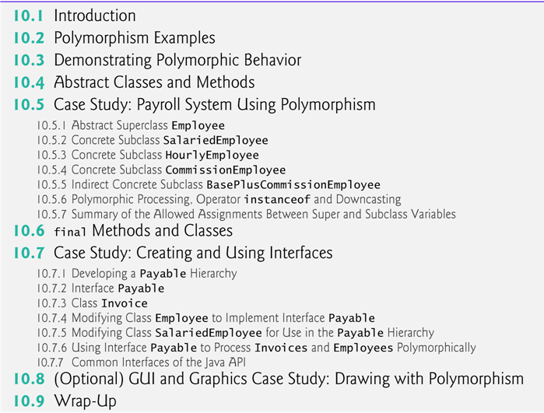

Slide 4
Polymorphism
Meaning of polymorphism
  “the quality or state of existing in or assuming different forms” (http://www.merriam-webster.com/dictionary/polymorphism)
  “a principle in biology in which an organism or species can have many different forms or stages” (http://download.oracle.com/javase/tutorial/java/IandI/polymorphism.html)

Slide 5
Polymorphism in Java
“The capability of an action or method to do different things based on the object that it is acting upon” (http://www.xyzws.com/Javafaq/what-is-runtime-polymorphism-in-java/16)
    Polymorphism allows you define one interface and have multiple implementations.
“Polymorphism enables you to write programs that process objects that share the same superclass as if they’re all objects of that superclass.” (Deitel & Deitel)
“The ability of a reference variable to change behavior according to what object instance it is holding.” (http://www.javapassion.com/javase/javapolymorphism.pdf)

Slide 6
Examples of polymorphism in Java
Operator Overloading
  An operator, like ‘+’, can handle different types of operands (e.g., int, float, String).
Method Overloading
  Methods with the same name (but different signatures) are defined within a class. e.g., System.out.print( ) is overloaded in PrintStream.
Method Overriding
  A method defined in a superclass is re-defined/specialized in a subclass by a method with the same signature.
Abstract and Concrete Classes
  The virtual/abstract methods defined in an abstract class are implemented in its subclasses.
Interfaces
  A Java interface defines a set of methods but does not implement them.
  A class that implements the interface agrees to implement all of the methods defined in that interface, thereby agreeing to certain behavior. (http://www.iam.ubc.ca/guides/javatut99/java/more/interfaceDef.html)

Slide 7
Method Overriding
  A method defined in a superclass is re-defined or specialized in a subclass by a method with the same signature.
  A reference of a subclass may be assigned to a variable of the superclass. (This is allowed because each subclass object is an object of its superclass.)
  A method defined in the superclass is overridden in the subclass.
  ...
  SuperClass obj1 = new SuperClass();
  SuperClass obj2 = new SubClass();
  ...
  obj1.someMethod(); // SuperClass version is called
  obj2.someMethod(); // SubClass version is called
  ....
  (source: http://geekexplains.blogspot.com/2008/06/dynamic-binding-vs-static-binding-in.html)

Slide 8
An example program: InheritanceAndPolymorphism
// a simple application that illustrates the basic idea of polymorphism
package Animals; public class Animal { public void whoAmI() { System.out.println("I am a generic Animal."); } } | //Driver program import Animals.*; class PolymorphismDemo { public static void main(String[] args) { Animal ref1 = new Animal(); | Animal ref2 = new Dog(); Animal ref3 = new Cat(); Animal ref4 = new Bird(); ref1.whoAmI(); ref2.whoAmI(); ref3.whoAmI(); ref4.whoAmI(); } }
package Animals; public class Dog extends Animal { @Override public void whoAmI() { System.out.println("I am a Dog."); } } | package Animals; public class Cat extends Animal { @Override public void whoAmI() { System.out.println("I am a Cat."); } } | package Animals; public class Bird extends Animal { @Override public void whoAmI() { System.out.println("I am a Bird."); } }

Slide 9
Why polymorphism?
Extensibility: With polymorphism, we can design and implement systems that are easily extensible.
  New classes can be added with little or no modification to the general portions of the program, as long as the new classes are part of the inheritance hierarchy that the program processes generically.
  The only parts of a program that must be altered to accommodate new classes are those that require direct knowledge of the new classes that we add to the hierarchy.
Easy maintenance of changes: When new classes are added, existing client codes do not need to be changed.

Slide 10
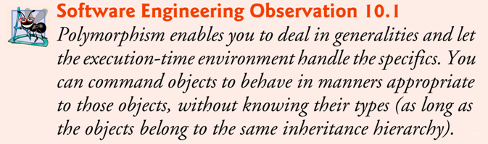
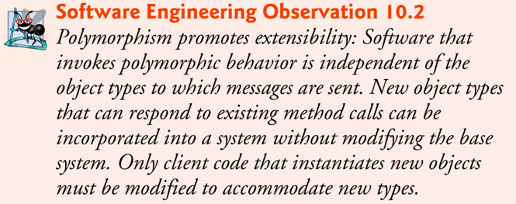

Slide 11
Dynamic binding
When a superclass variable contains a reference to a subclass object, and that reference is used to call a method, the subclass version of the method is called.
  The Java compiler allows this “crossover” because an object of a subclass is an object of its superclass (but not vice versa).
When the compiler encounters a method call made through a variable, the compiler determines if the method can be called by checking the variable’s class type.
  If that class contains the proper method declaration (or inherits one), the call is compiled.
At execution time, the type of the object to which the variable refers determines the actual method to use.
  This process is called dynamic binding.

Slide 12
Dynamic (or Run-time) binding
versus Static (or compilation-time) binding
“In programming languages, name binding is the association of objects (data and/or code) with identifiers.” (http://en.wikipedia.org/wiki/Name_binding)
Invoking a method on a subclass object via a superclass reference invokes the subclass functionality at run time. → dynamic binding
The type of the referenced object, not the type of the variable, determines which method is called.
c.f., Static methods and instance variables are bound at compilation time. → static binding

Slide 13
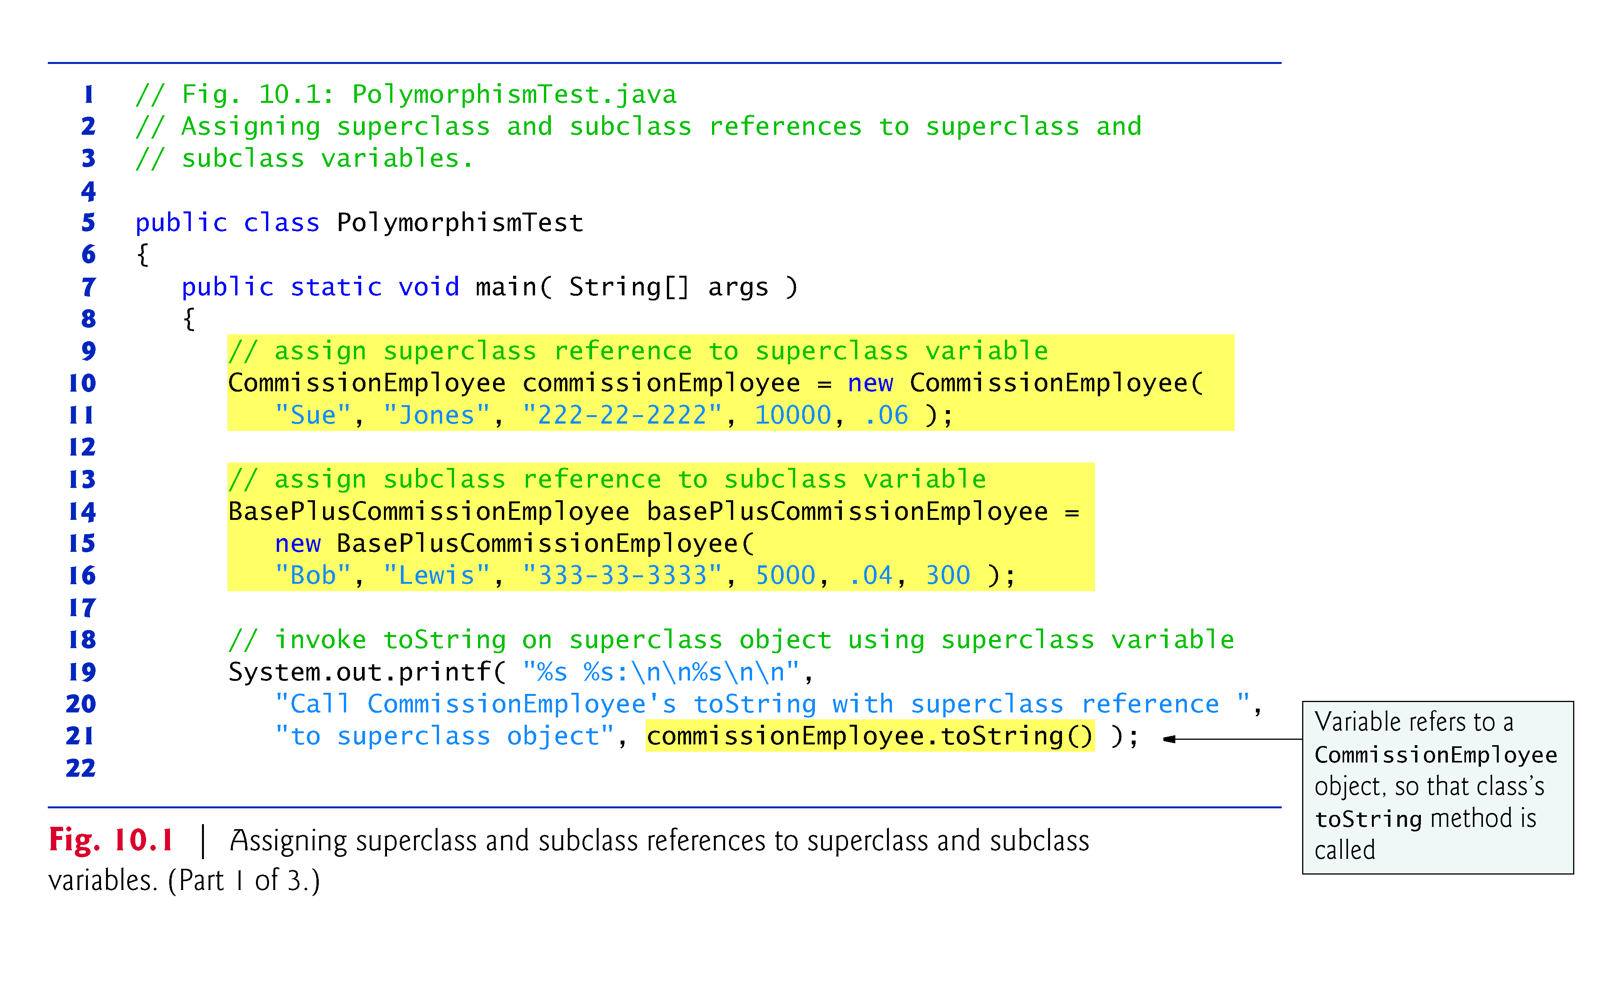
Fig. 10.1: Another example of method overriding

Slide 14
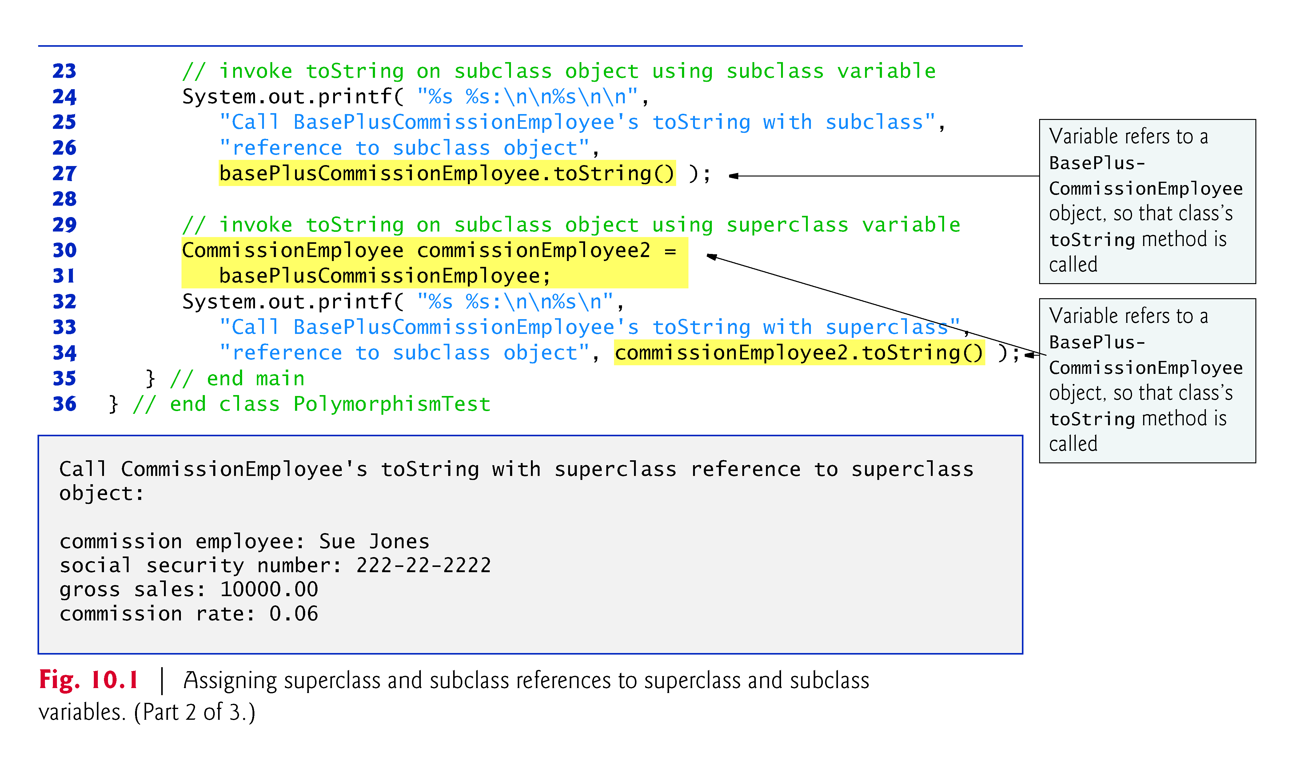

Slide 15
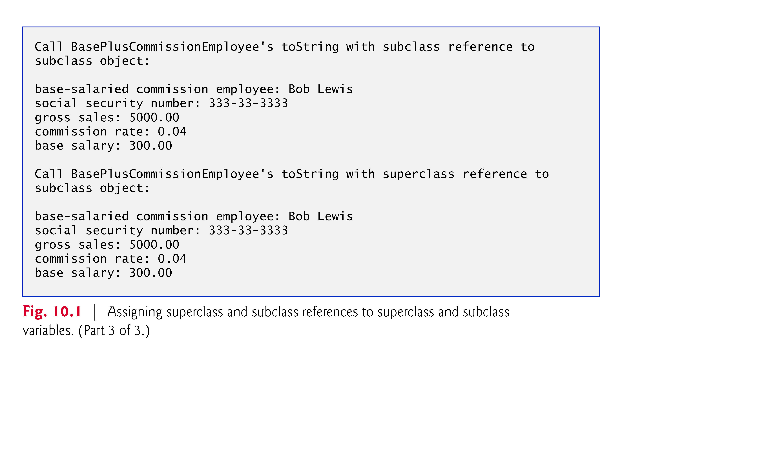

Slide 16
10.4 Abstract Classes and Methods
Abstract classes
  Sometimes it’s useful to declare classes for which you never intend to create objects.
  Used only as superclasses in inheritance hierarchies, so they are sometimes called abstract superclasses.
  Cannot be used to instantiate objects — abstract classes are incomplete.
  Subclasses must declare the “missing pieces” to become “concrete” classes, from which you can instantiate objects; otherwise, these subclasses, too, will be abstract.
An abstract class provides a superclass from which other classes can inherit and thus share a common design.

Slide 17
An example program: AbstractClassDemo
// a simple application that illustrates the basic idea of abstract classes.
public abstract class Animal { public abstract void talk(); // An abstract method declaration. // It is implemented in the subclasses. } | public class ClientClass { public static void main(String[] args) { // Animal ani = new Animal(); // compilation error! // Abstract classes cannot be instantiated. Animal dog = new Dog(); Animal cat = new Cat(); dog.talk(); cat.talk(); } }
public class Cat extends Animal { public void talk() { System.out.println("Meow."); } } | public class Dog extends Animal { public void talk() { System.out.println("Woof!"); } }

Slide 18
You make a class abstract by declaring it with keyword abstract.
An abstract class normally contains one or more abstract methods.
  An abstract method is one with keyword abstract in its declaration, as in
    public abstract void draw(); // an abstract method
Abstract methods do not provide implementations.
A class that contains abstract methods must be an abstract class even if that class contains some concrete (nonabstract) methods.
Each concrete subclass of an abstract superclass also must provide concrete implementations of each of the superclass’s abstract methods.
Constructors and static methods cannot be declared abstract. Why?

Slide 19
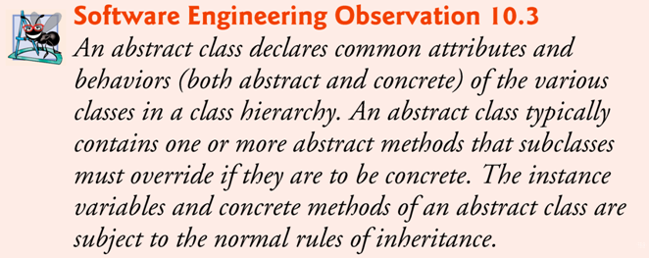
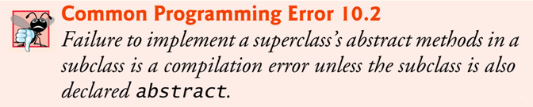

Slide 20
When to use an abstract class?
  Programmers often write client code that uses only abstract superclass types to reduce client code’s dependencies on a range of subclass types.
    You can write a method with a parameter of an abstract superclass type.
    When called, such a method can receive an object of any concrete class that directly or indirectly extends the superclass specified as the parameter’s type.
Q: How would you verify the above statement?
  Modify AbstractClassDemo to add a method that takes a superclass as a parameter.
  Test that method with objects of various concrete subclasses.
→ See AbstractClassDemo2.

Slide 21
Another sample application: AbstractClassDemo2
Every object in Java knows its own class and can access this information through the getClass() method, which all classes inherit from class Object.
  The getClass() method returns an object of type Class (from package java.lang), which contains information about the object’s type, including its class name.
  The result of the getClass() call is used to invoke getName() to get the object’s class name.

Slide 22
A Sample Application of Polymorphism:
layered software systems
Polymorphism is particularly effective for implementing so-called layered software systems.
Example: Operating systems and device drivers.
  Commands to read or write data from and to devices may have a certain uniformity.
  Device drivers control all communication between the operating system and the devices.
  A write message sent to a device-driver object is interpreted in the context of that driver and how it manipulates devices of a specific type.
  The write call itself really is no different from the write to any other device in the system — place some number of bytes from memory onto that device.

Slide 23
An object-oriented operating system might use an abstract superclass to provide an “interface” appropriate for all device drivers.
  Subclasses are formed that all behave similarly.
  The device-driver methods are declared as abstract methods in the abstract superclass.
  The implementations of these abstract methods are provided in the subclasses that correspond to the specific types of device drivers.
New devices are always being developed.
  When you buy a new device, it comes with a device driver provided by the device vendor and is immediately operational after you connect it and install the driver.
This is another elegant example of how polymorphism makes systems extensible.

Slide 24
10.5 Payroll System Using Polymorphism
A company pays its employees on a weekly basis. The employees are of four types:
  Salaried employees are paid a fixed weekly salary regardless of the number of hours worked,
  hourly employees are paid by the hour and receive overtime pay (i.e., 1.5 times their hourly salary rate) for all hours worked in excess of 40 hours,
  commission employees are paid a percentage of their sales, and
  base-salaried commission employees receive a base salary plus a percentage of their sales.
The company wants to write a Java application that performs its payroll calculations polymorphically.

Slide 25
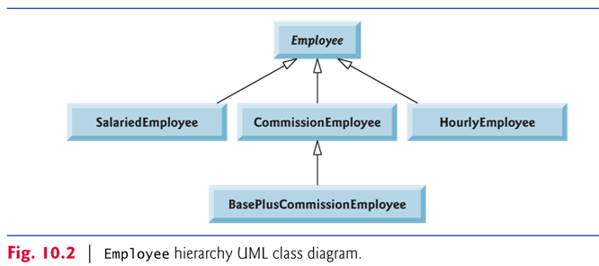
abstract class Employee represents the general concept of an employee.
Subclasses: SalariedEmployee, CommissionEmployee , HourlyEmployee and BasePlusCommissionEmployee
Fig. 10.2 shows the inheritance hierarchy for our polymorphic employee-payroll application.
Abstract class names are italicized in the UML.

Slide 26
10.5.7 Allowed Assignments Between Superclass and Subclass Variables
There are four ways to assign superclass and subclass references to variables of superclass and subclass types.
  Assigning a superclass reference to a superclass variable is straightforward.
  Assigning a subclass reference to a subclass variable is straightforward.
  Assigning a subclass reference to a superclass variable is safe, because the subclass object is an object of its superclass.
    The superclass variable can be used to refer only to superclass members.
    If this code refers to subclass-only members through the superclass variable, the compiler reports errors.

Slide 27
  Attempting to assign a superclass reference to a subclass variable is a compilation error.
    To avoid this error, the superclass reference must be cast to a subclass type explicitly. (the so-called downcasting)
    At execution time, if the object to which the reference refers is not a subclass object, an exception will occur.
    Use the instanceof operator to ensure that such a cast is performed only if the object is indeed a subclass object.
    Warning: Unless really necessary (as in this case of determining whether to perform downcasting), avoid the use of the instanceof operator. Definitely do not use instanceof to substitute method overriding by subclasses.
    (See http://www.javapractices.com/topic/TopicAction.do?Id=31 for discussion.)

Slide 28
10.6 final Methods and Classes
A final method in a superclass cannot be overridden in a subclass.
  Methods that are declared private are implicitly final, because it’s not possible to override them in a subclass.
  Methods that are declared static are implicitly final.
  A final method’s declaration can never change, so all subclasses use the same method implementation, and calls to final methods are resolved at compile time—this is known as static binding.

Slide 29
A final class cannot be a superclass (i.e., a class cannot extend a final class).
  All methods in a final class are implicitly final.
Class String is an example of a final class.
  If you were allowed to create a subclass of String, objects of that subclass could be used wherever Strings are expected.
  Since class String cannot be extended, programs that use Strings can rely on the functionality of String objects as specified in the Java API.
Making the class final if you do not like that class to be further extended.
Making the class final also prevents programmers from creating subclasses that might bypass security restrictions.

Slide 30
10.7 Creating and Using Interfaces
Interfaces offer a capability allowing unrelated classes to implement a set of common methods.
Interfaces define and standardize the ways in which things such as people and systems can interact with one another.
  Example: The controls on a radio serve as an interface between radio users and a radio’s internal components.
  Can perform only a limited set of operations (e.g., change the station, adjust the volume, choose between AM and FM)
  Different radios may implement the controls in different ways (e.g., using push buttons, dials, voice commands).
  The interface specifies what operations a radio must permit users to perform but does not specify how the operations are performed.

Slide 31
Java Interface
An interface describes a set of methods that can be called on an object, but does not provide concrete implementations for all the methods.
You use the implement keyword to declare that a class implements (i.e., provides concrete implementations for the methods of) one or more interfaces.
Each interface method in an interface must be declared in all the classes that explicitly implement that interface.

Slide 32
Once a class implements an interface, all objects of that class have an is-a relationship with the interface type, and all objects of the class are guaranteed to provide the functionality described by that interface.
  This is true of all subclasses of that class as well.
  Sounds familiar?
  Q: Isn’t this the superclass/subclass relationship? What’s the difference?
Interfaces are particularly useful for assigning common functionality to possibly unrelated classes (i.e., classes that do not have the superclass/subclass relationship).
  Allows objects of unrelated classes to be processed polymorphically — objects of classes that implement the same interface can respond to all of the interface method calls.

Slide 33
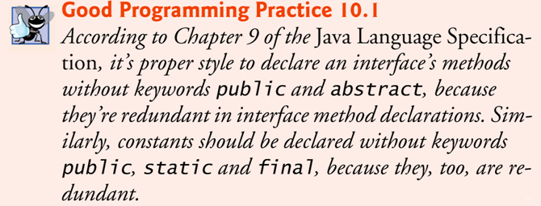
An interface declaration begins with the keyword interface and contains only constants and abstract methods.
  All interface members must be public.
  Interfaces may not specify any implementation details, such as concrete method declarations and instance variables.
  All methods declared in an interface are implicitly public abstract methods.
  All fields are implicitly public, static and final.

Slide 34
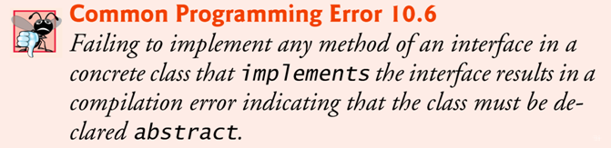
To use an interface, a concrete class must specify that it implements the interface and must declare each method in the interface with specified signature.
  Add the implements keyword and the name of the interface to the end of your class declaration’s first line.
A class that does not implement all the methods of the interface is an abstract class and must be declared abstract.
Implementing an interface is like signing a contract with the compiler that states, “I will declare all the methods specified by the interface or I will declare my class abstract.”

Slide 35
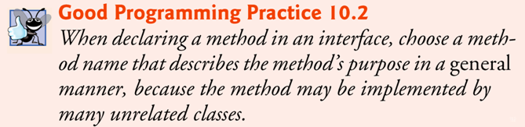
A public interface must be declared in a file with the same name as the interface and the .java file-name extension.

Slide 36
Example program with interface
http://sce.uhcl.edu/yang/teaching/InterfaceDemo/InterfaceDemo.htm
Exercise: Run this application using NetBeans.
Q: If you want to make the interfaces (Fruit and Vegetable) reusable by other projects in NetBeans, what needs to be done?
Exercise: Create another application with a fruit (say, Orange) and a vegetable (say, Spinach) and test the interfaces.

Slide 37
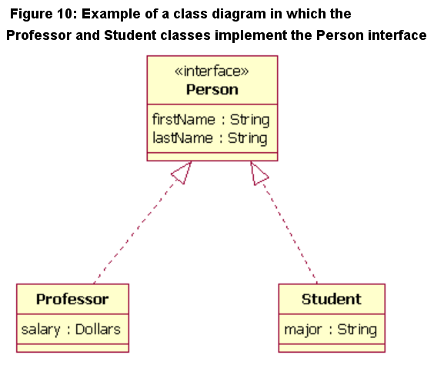
UML diagram for Interface
In UML 2, an interface is considered to be a specialization of a class modeling element. Therefore, an interface is drawn just like a class, but the top compartment of the rectangle also has the text "«interface»", as shown in Figure 10. (source: http://www.ibm.com/developerworks/rational/library/content/RationalEdge/sep04/bell/)
Warning! This is an incorrect example of interface. Why?

Slide 38
Interfaces vs abstract classes
Exercise:
  Redraw the interface diagram in the previous slide as an UML diagram with inheritance, by replacing the interface with an abstract class.

Slide 39
Interfaces vs Abstract Classes
Source: http://download.oracle.com/javase/tutorial/java/IandI/abstract.html
Unlike interfaces, abstract classes can contain fields that are not static and final, and they can contain implemented methods.
Such abstract classes are similar to interfaces, except that they provide a partial implementation, leaving it to subclasses to complete the implementation.
Multiple interfaces can be implemented by classes anywhere in the class hierarchy, whether or not they are related to one another in any way.
By comparison, abstract classes are most commonly subclassed to share pieces of implementation. A single abstract class is subclassed by similar classes that have a lot in common (the implemented parts of the abstract class), but also have some differences (the abstract methods).

Slide 40
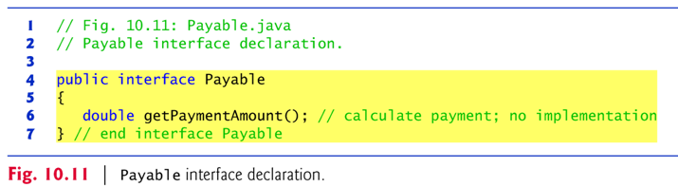
10.7.1 Developing a Payable Hierarchy
The example application in 10.7 builds an application that can determine payments for employees and invoices alike.
  Classes Invoice and Employee both represent things for which the company must be able to calculate a payment amount.
  Both classes implement the Payable interface, so a program can invoke method getPaymentAmount() on Invoice objects and Employee objects alike.
  Enables the polymorphic processing of Invoices and Employees.
  Note that Invoices and Employees are different type of objects, and do not belong to the same inheritance hierarchy.

Slide 41
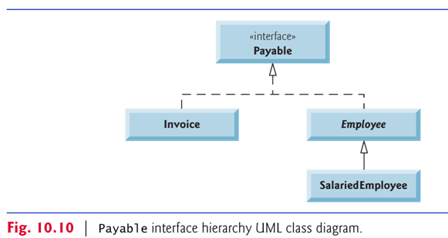
Interface Hierarchy

Slide 42
No Multiple Inheritance in Java!
Java does not allow subclasses to inherit from more than one superclass, but it allows a class to inherit from one superclass and implement as many interfaces as it needs.
To implement more than one interface, use a comma-separated list of interface names after keyword implements in the class declaration, as in:
    public class ClassName extends SuperclassName
    implements FirstInterface, SecondInterface, …

Slide 43
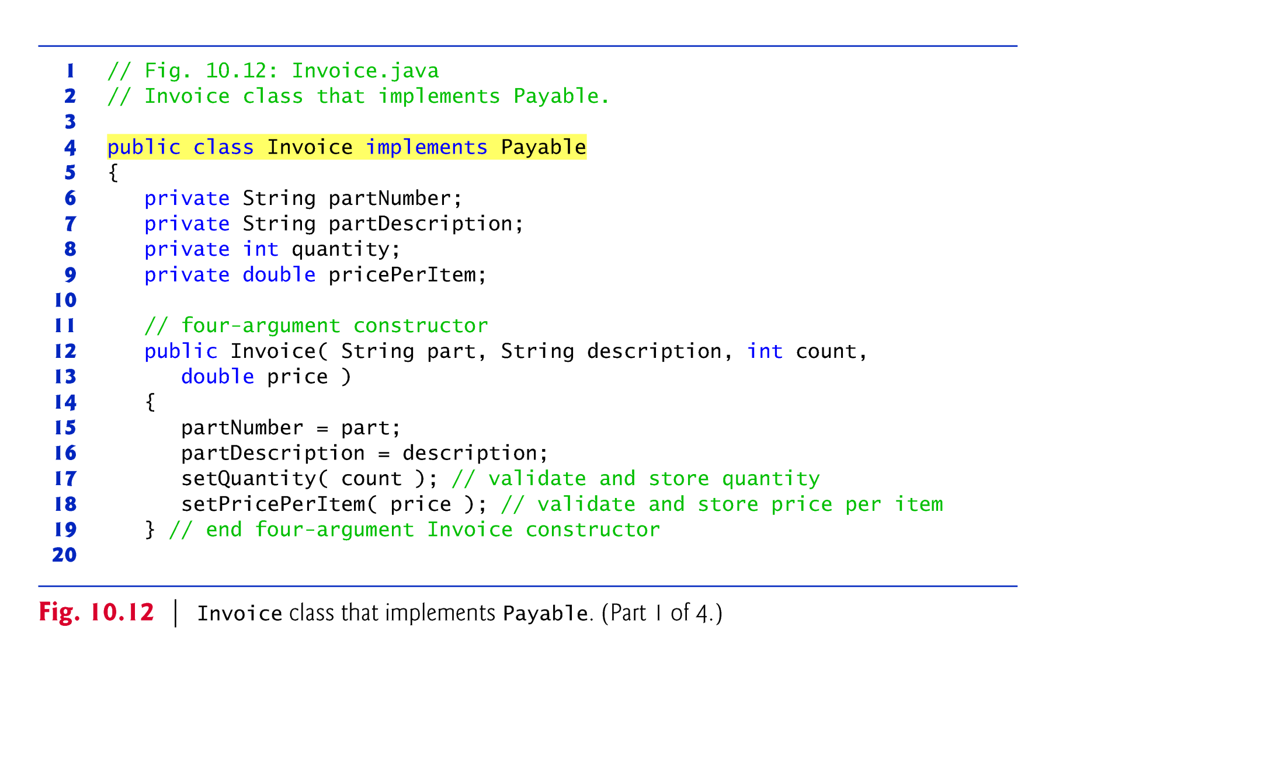

Slide 44
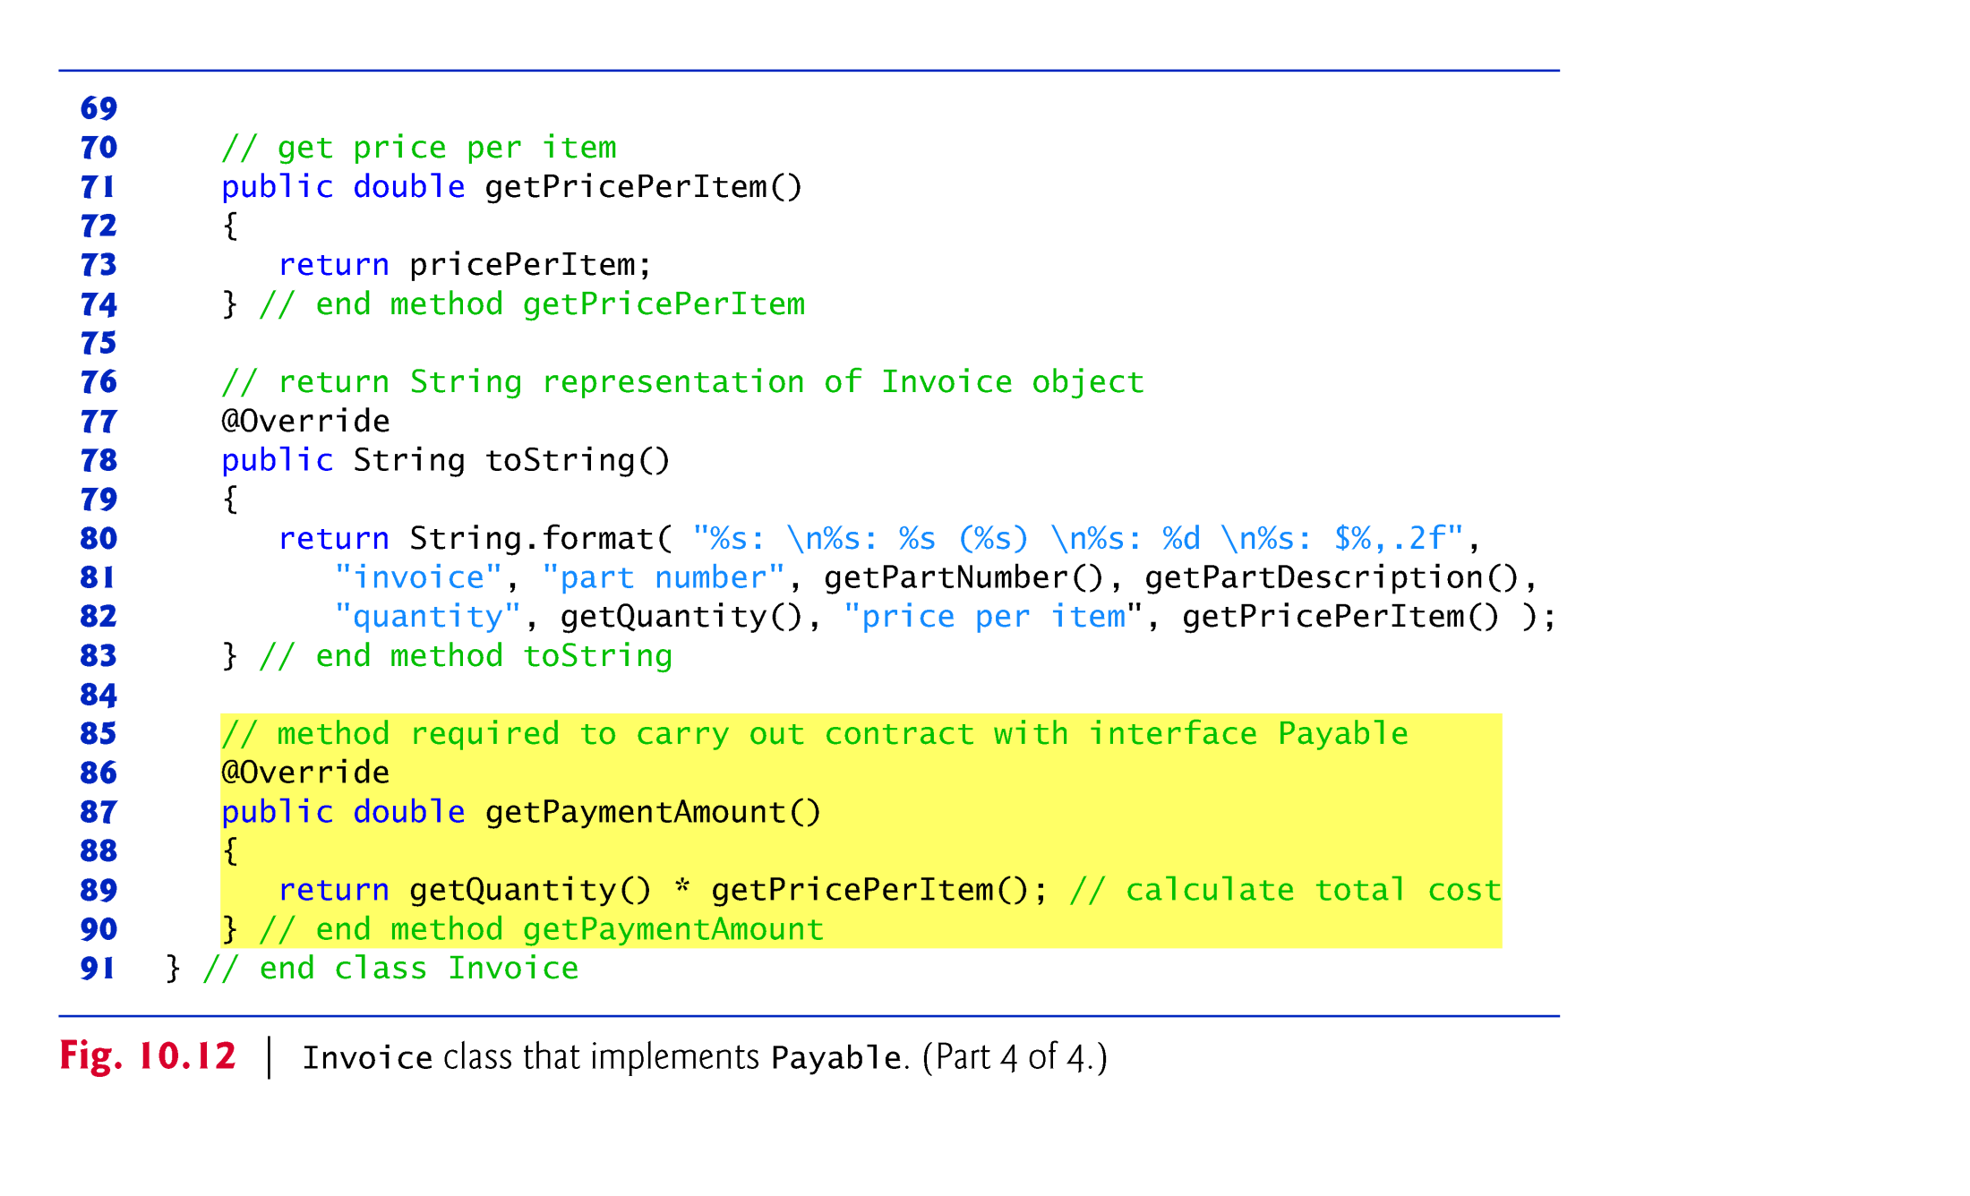

Slide 45
When a class implements an interface, it makes a contract with the compiler.
  The class will implement each of the methods in the interface or that the class will be declared abstract.
  If the latter, we do not need to declare the interface methods as abstract in the abstract class—they are already implicitly declared as such in the interface.
  Any concrete subclass of the abstract class must implement the interface methods to fulfill the contract.
  If the subclass does not do so, it too must be declared abstract.
Each direct Employee subclass inherits the superclass’s contract to implement method getPaymentAmount and thus must implement this method to become a concrete class for which objects can be instantiated.

Slide 46
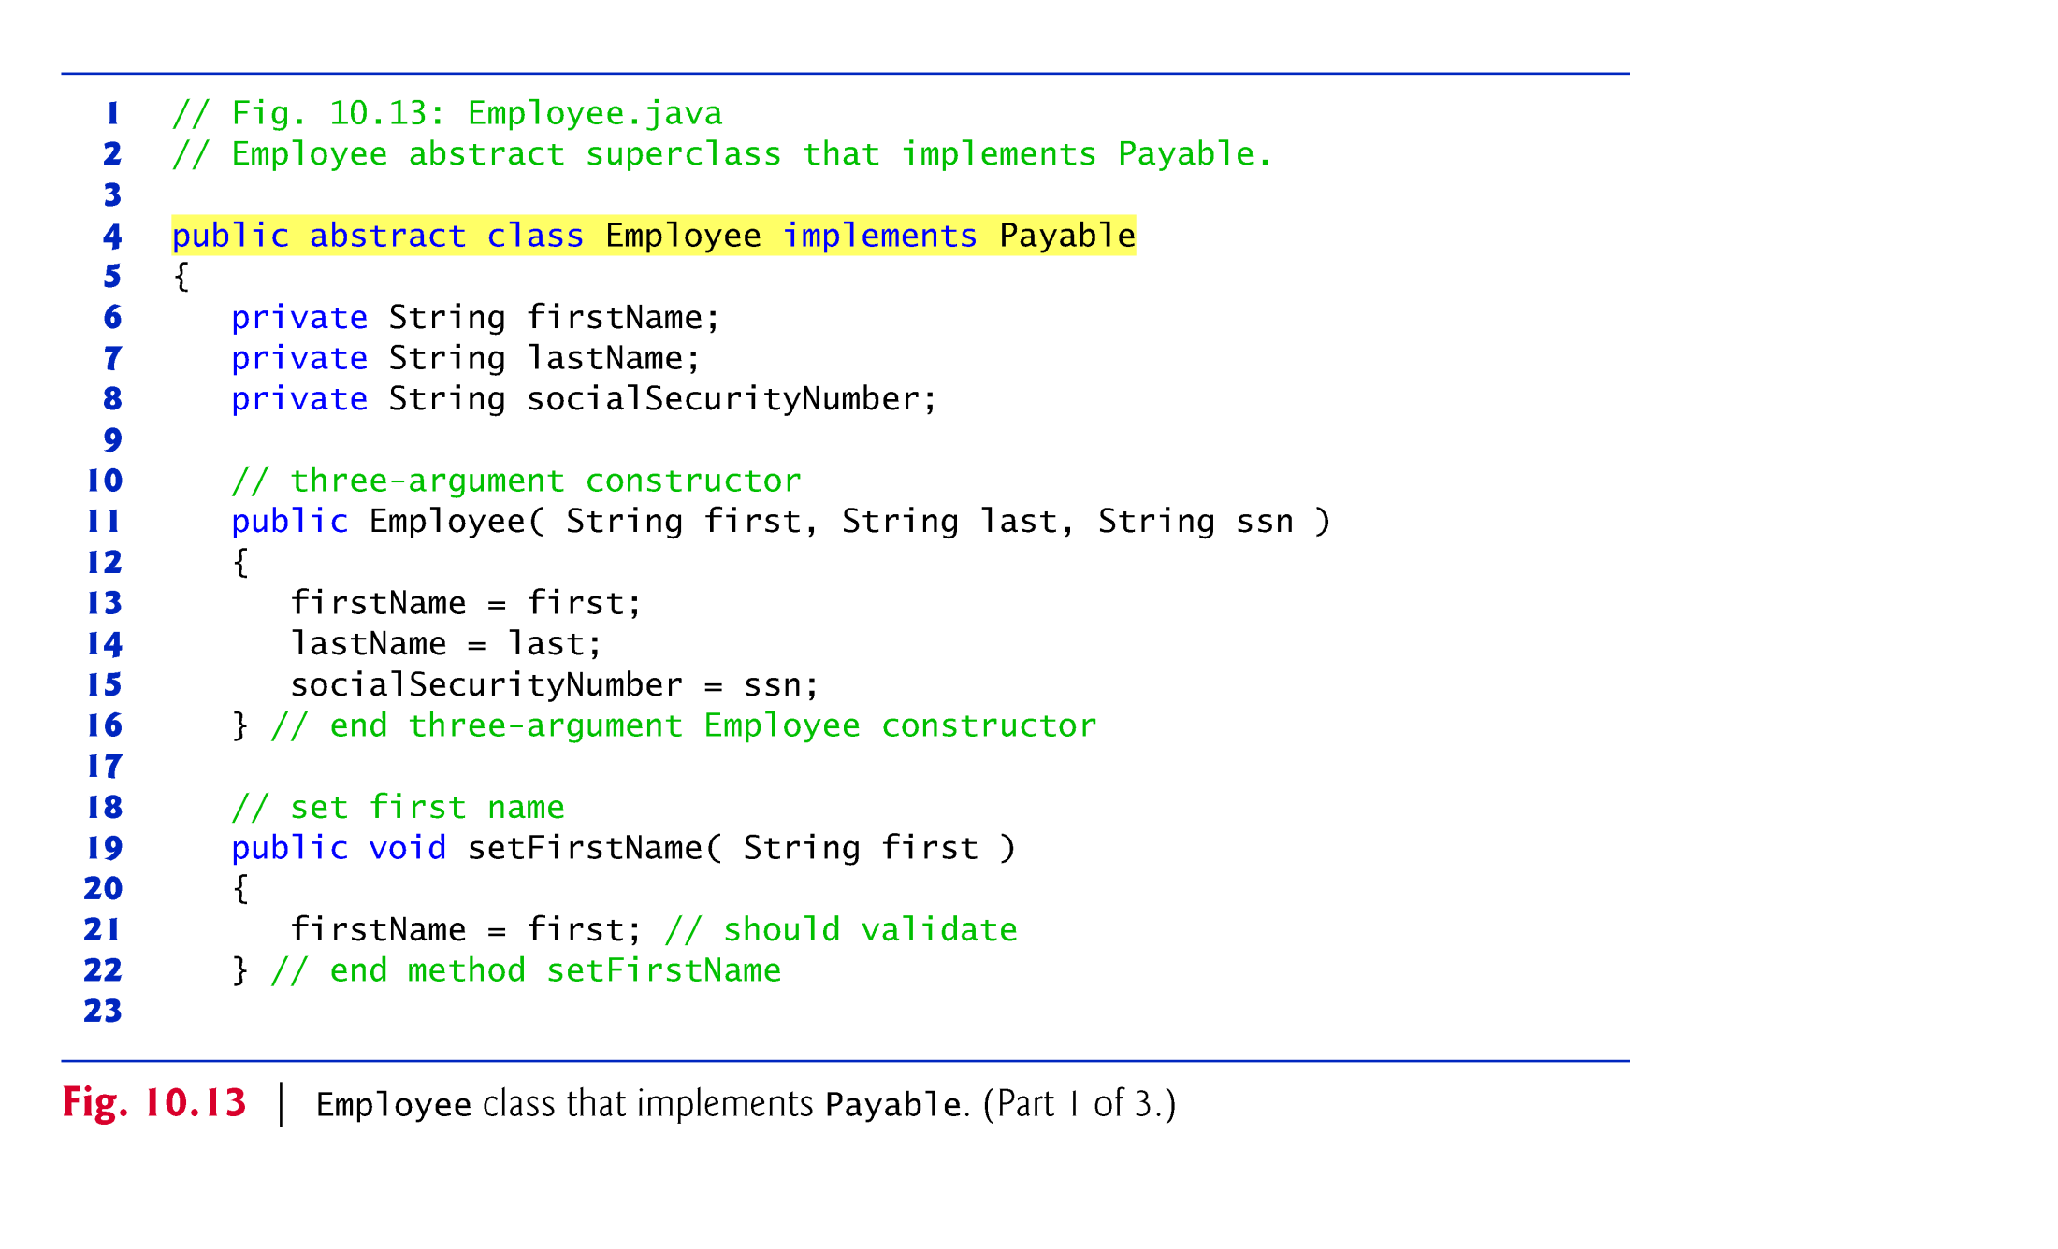

Slide 47
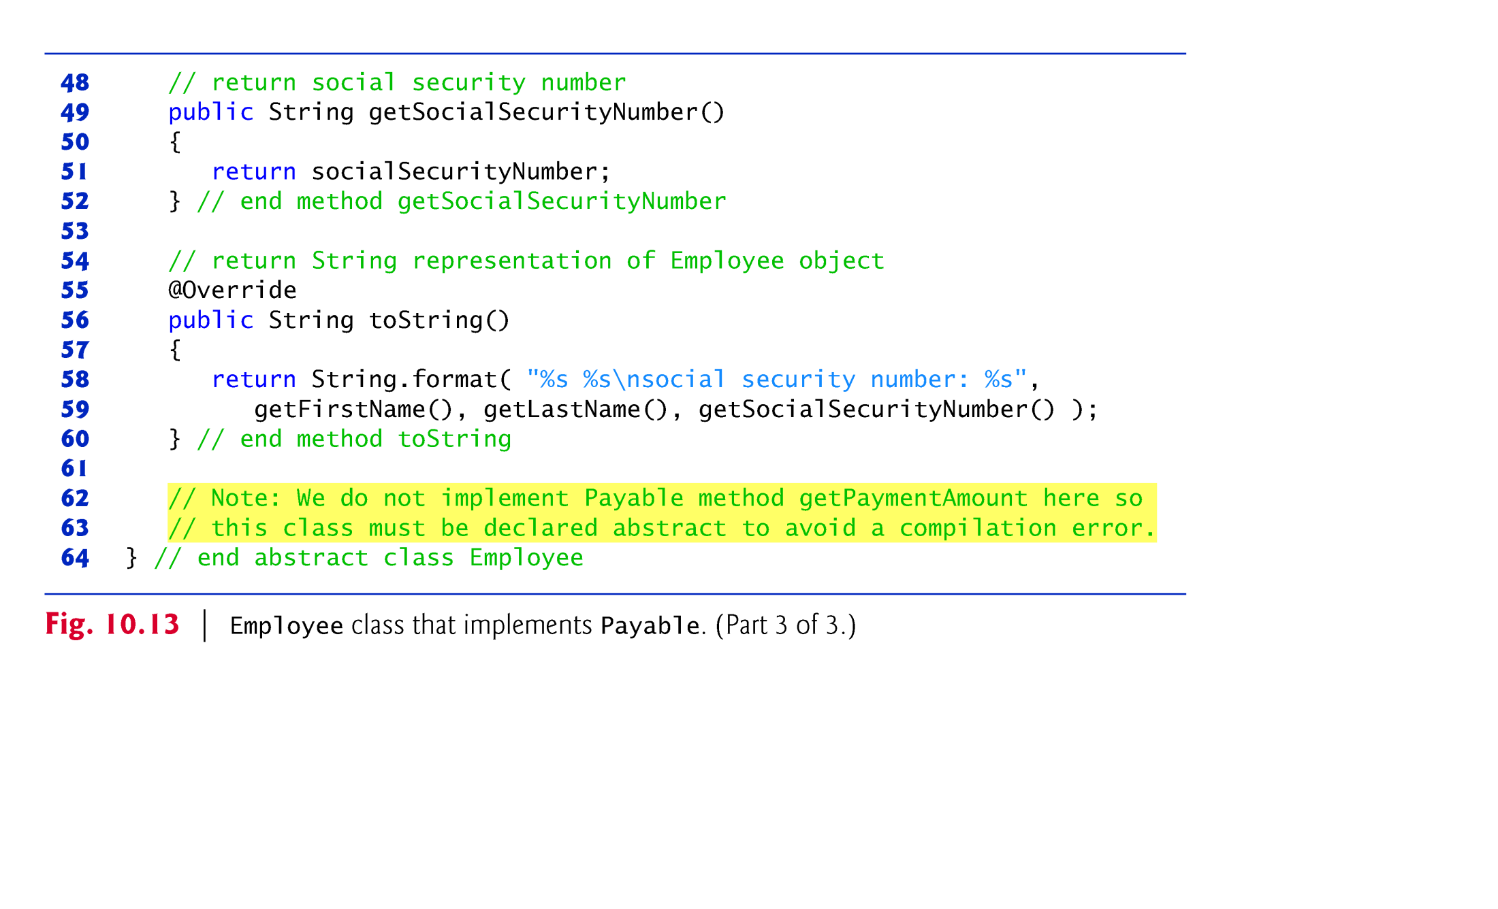

Slide 48
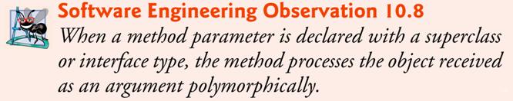
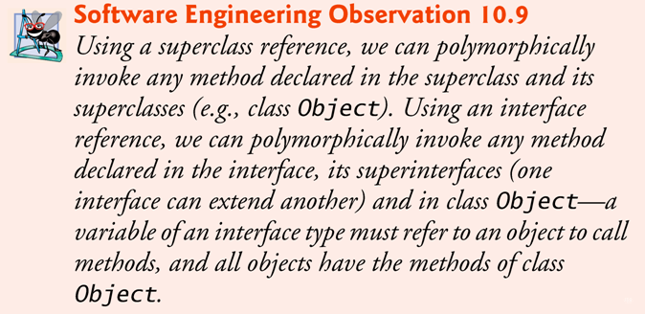

Slide 49
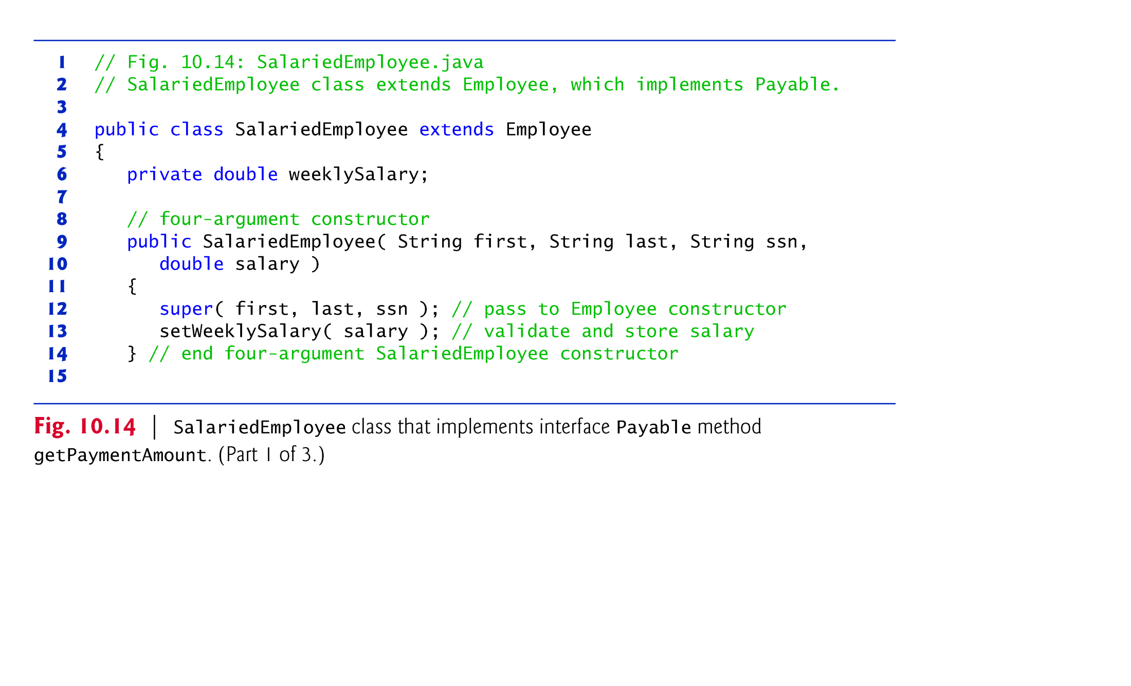

Slide 50
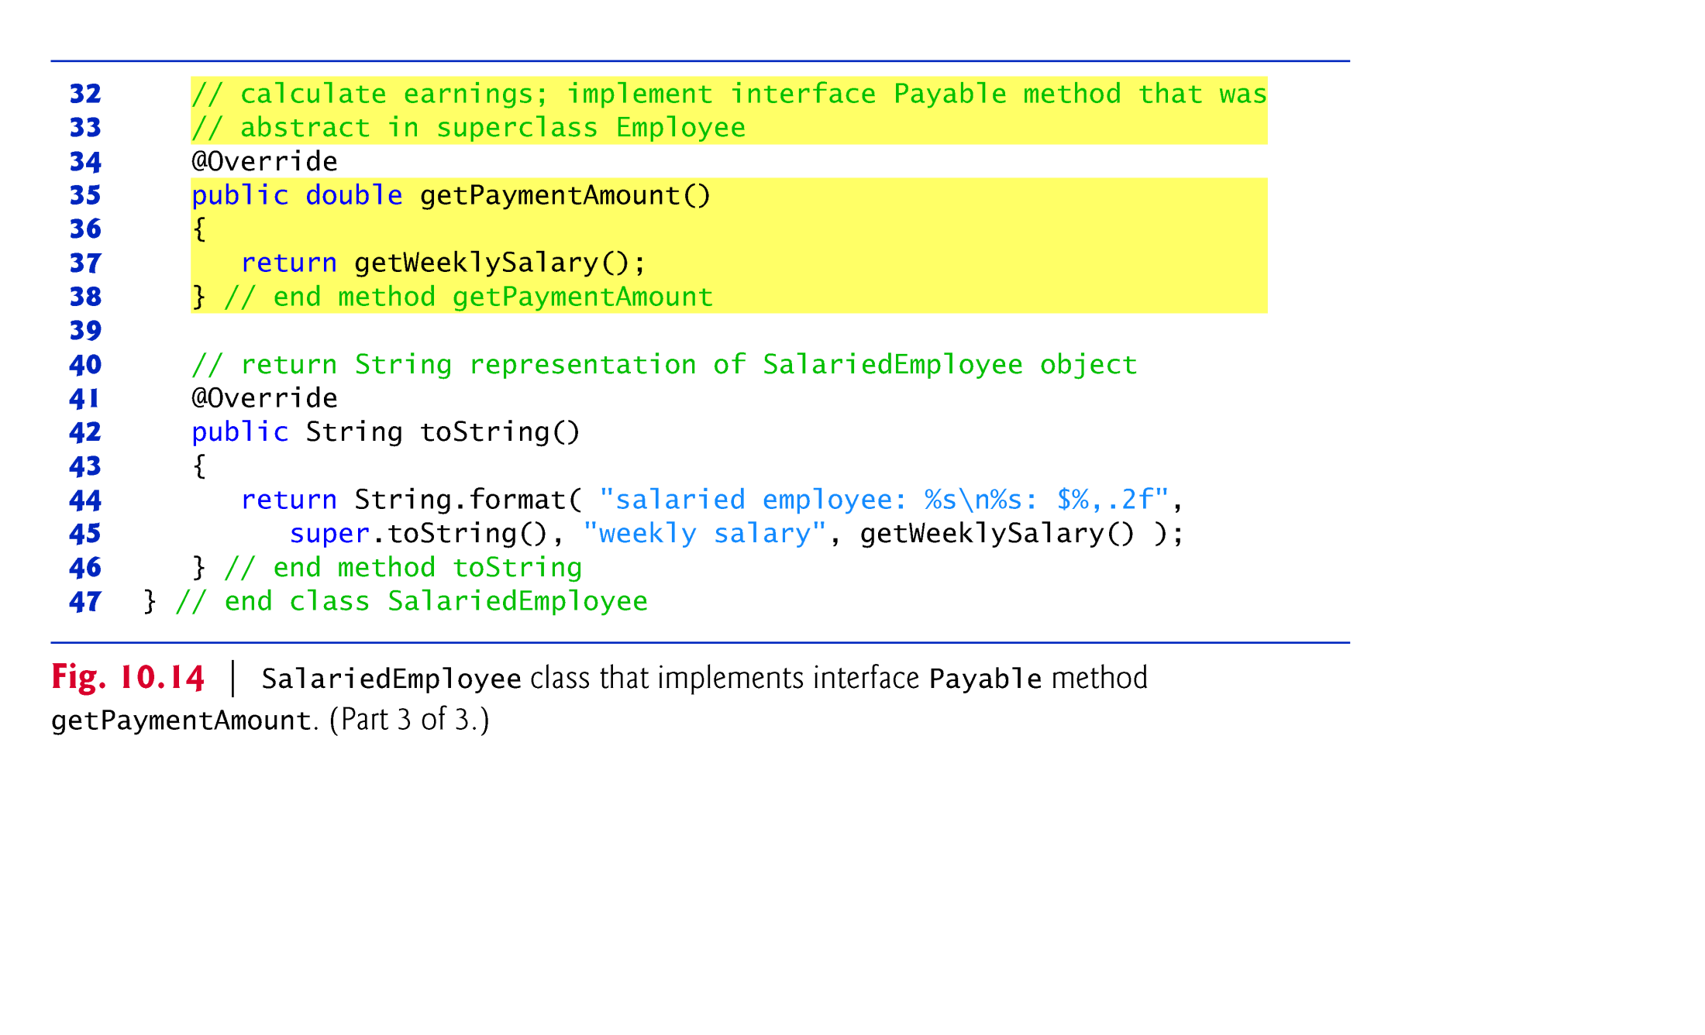

Slide 51
Objects of any subclasses of a class that implements an interface can also be thought of as objects of the interface type.
Thus, just as we can assign the reference of a SalariedEmployee object to a superclass Employee variable, we can assign the reference of a SalariedEmployee object to an interface Payable variable.
Invoice implements Payable, so an Invoice object also is a Payable object, and we can assign the reference of an Invoice object to a Payable variable.

Slide 52
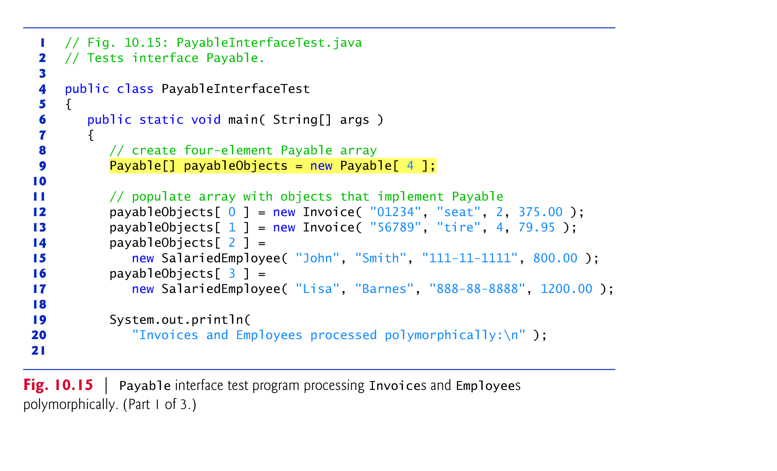

Slide 53
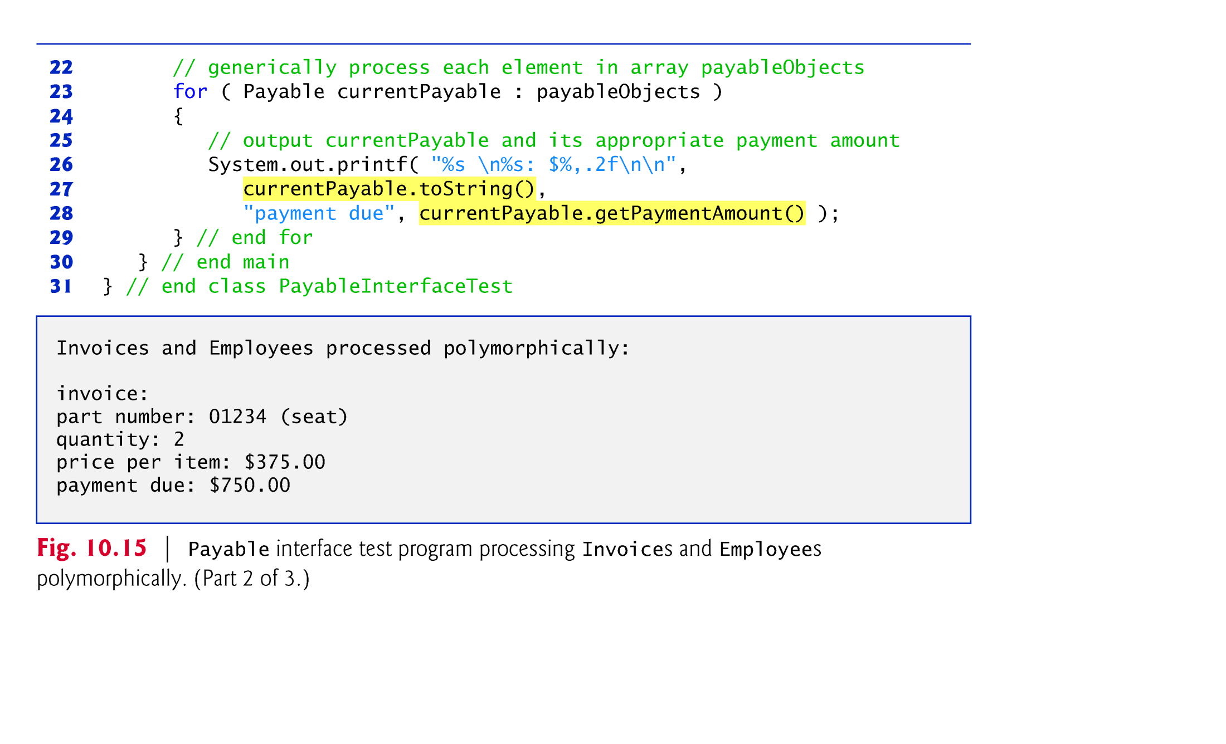

Slide 54
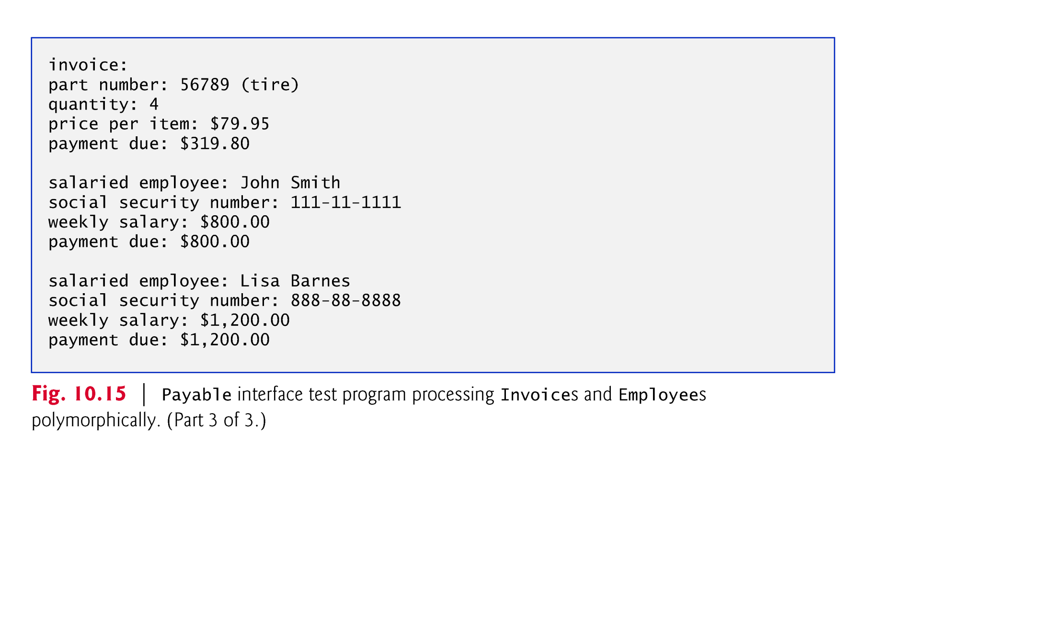

Slide 55
10.7.7 Common Interfaces of the Java API
The Java API’s interfaces enable you to use your own classes within the frameworks provided by Java, such as comparing objects of your own types and creating tasks that can execute concurrently with other tasks in the same program.
Figure 10.16 presents a brief overview of a few of the more popular interfaces of the Java API.

Slide 56
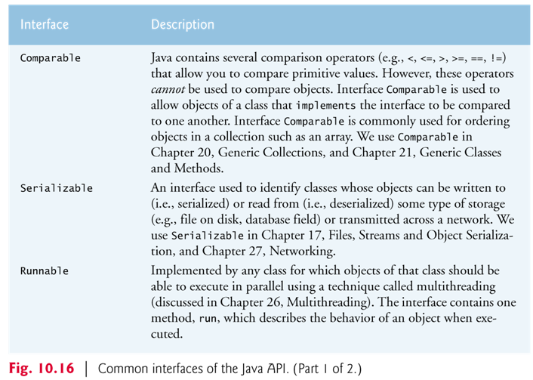

Slide 57
